Slide 1


Color blindness
By: Edwin

Slide 2


What is color blindness?
Colour blindness got it's name because people who are colour-blind cannot see certain colours. So they are Blind To Some Colours. Colour-blindness is the inability to distinguish the differences between certain colours. This condition results from an absence of colour-sensitive pigment in the cone cells of the retina, the nerve layer at the back of the eye.

Slide 3
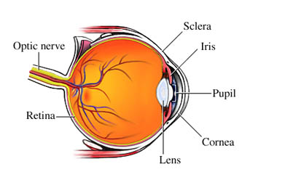

Slide 4

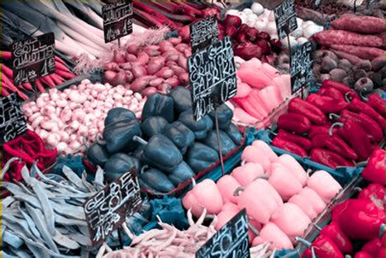

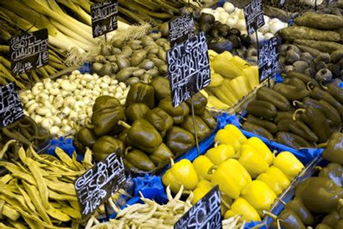

Normal vision
3. Tritanopia
4. Monochromacy
There are four types of color blindness, they are:
DEUTERANOPIA
PROTANOPIA
TRITANOPIA
mONOCHROMACY
Deuteranopia
2. Protanopia

Slide 5
Which Chromosomes Does
The Abnormality's Occur To?
Type | Chromosome
Deuteranopia | X Chromosome
Protanopia | X Chromosome
Tritanopia | Chromosome 7
Rod Monochromacy | Chromosome 2/8

Slide 6

Problems they might face….
People with color blindness face many challenges like: choosing and preparing food, gardening, sport, driving a car and selecting clothing etc..
When cooking colour blind people won’t know if they have cooked a piece of meat rare or well and are unlikely to be able to tell the difference between green and ripe tomatoes or between ketchup and chocolate sauce.

Slide 7
Problems they might face….
If your cooking and they don’t get any help mentally they will be very frustrated.
It could affect educationIn primary school, a child will often find themselves coloring in, painting or otherwise involved in various forms of art.
In Secondary school, teens may find themselves in science attempting to identify a chemical reaction or determine a scientific litmus test outcome.
When they get older it also means that they'll be excluded from undertaking certain jobs such as a pilot, train driver or electrician because of their inability to distinguish certain colours.

Slide 8

Why does color blindness occur?
The vast majority of people with a colour vision deficiency have inherited their condition from their mother, who is normally a ‘carrier’ but not colour blind herself. Some people also acquire the condition as a result of long-standing diseases such as diabetes, multiple sclerosis, some liver diseases and almost all eye diseases or they acquire the condition over time due to the aging process, medication etc.

Slide 9

How many are affected
by this condition?
Approximately 1 in 12 men are affected (8%) and 1 in 200 women in the world are affected

Slide 10
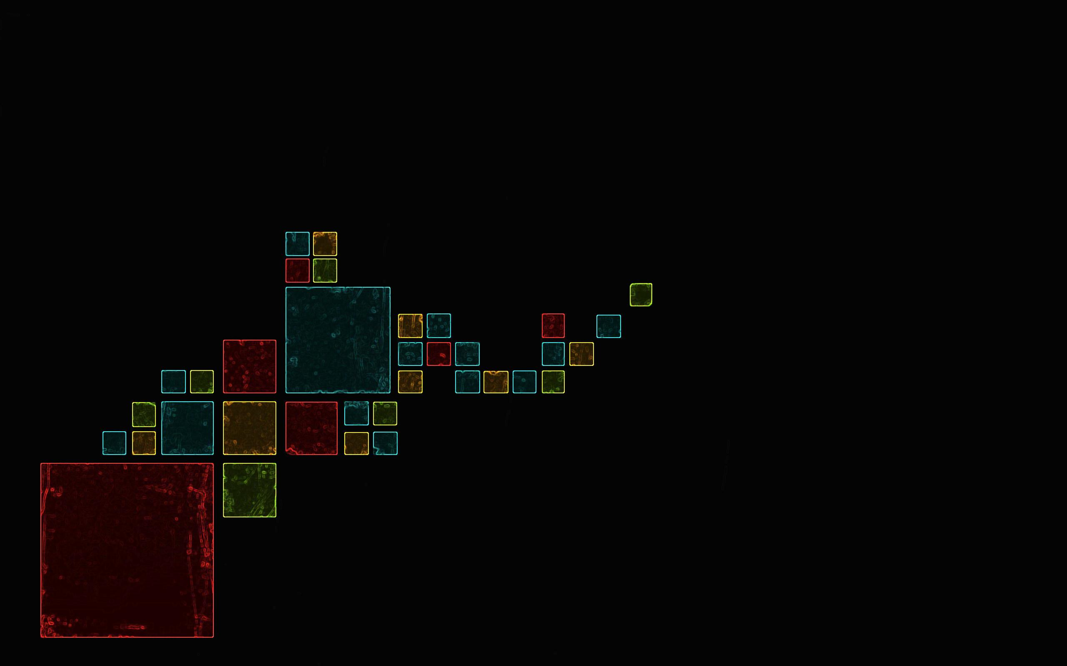

Is there any way to treat color blindness?
There is no cure for inherited colour blindness. Most people with colour blindness just learn to tell the difference between colours.

Slide 11
Can this condition be diagnosed before birth or after birth?
Colour blindness isn't correctable, since it's caused by an inherited defect of the light sensitive pigment in special cells – called cone cells in the retina at the back of the eye.

Slide 12
Bibliography
http://pediatrics.med.nyu.edu/conditions-we-treat/conditions/color-blindness
http://www.colourblindawareness.org/colour-blindness/living-with-colour-vision-deficiency/
http://www.colourblindawareness.org/
http://kidshealth.org/kid/talk/qa/color_blind.html
http://www.colour-blindness.com/solutions/living-with-colour-blindness/
http://www.color-blindness.com/color-arrangement-test
http://www.netdoctor.co.uk/ate/eyes/203419.html

Slide 13



