Slide 1
WOMEN DURING WW2

Slide 2
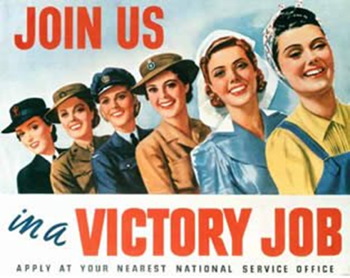
Maurice Bramley, ‘Join us in a victory job’, 1943. Colour photolithograph

Slide 3
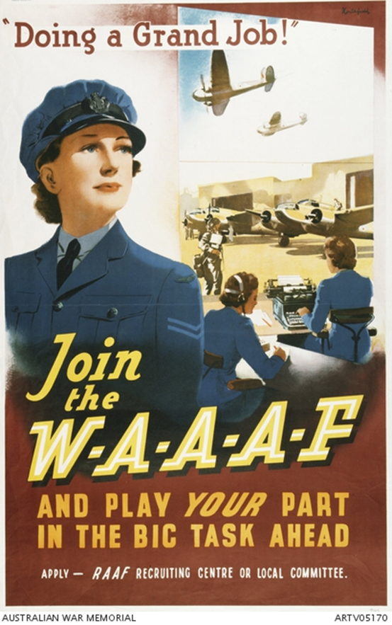
James Northfield, ‘Doing a great job!” Join the WAAAF’, 1942. Offset lithograph on paper.

Slide 4
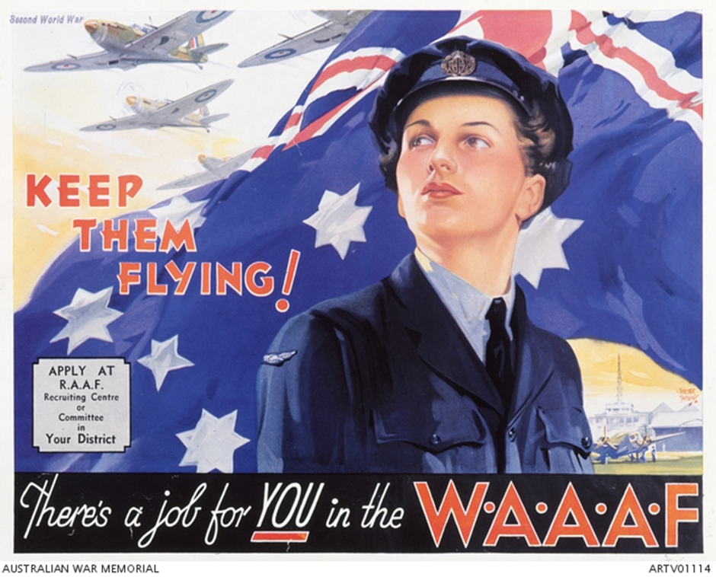
Walter Lacy Jardine ‘Keep them flying’, 1942. Offset lithograph on paper

Slide 5
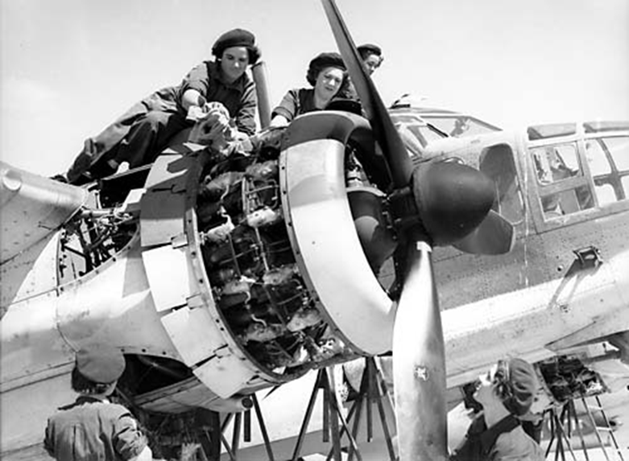
Members of the Women’s Auxilliary Air Force (RAAF) aircraft. March 1943

Slide 6
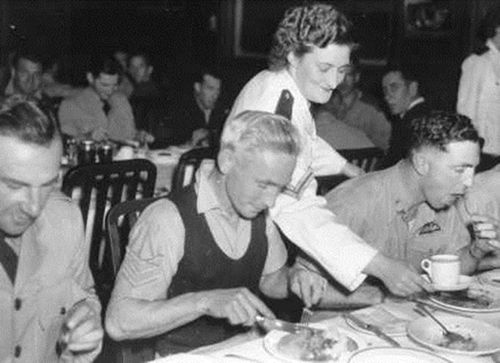
‘Male mess Orderlies are now a thing of the past on most Australian Air Force Stations where the introduction of WAAAF staffs has released more and more men for active work in the operational areas.’

Slide 7
‘Some reasons why I joined the WAAAF’
• Being patriotic and wanting to serve my country.
• I was young and healthy with an unbending sense of 'my country needs me'.
• I'm not sure but perhaps it was my dad's 1st AIF background, seeing friends and families affected in various ways, the lure of enlisting campaigns or the air of mystery and appeal as women began appearing in uniform in our town.
• First and foremost I wished to serve my country.
• Seeing my four brothers in uniform made me very determined to want to do my bit too.
• I joined up because I loved marching, music, excitement, pageantry and the colour blue! I also joined because I loved and still love England.
• I joined the WAAAF because I was born Patricia instead of Peter.
• I knew that somehow I must be part of the challenge to the German fallacy that 'might is right'.
• Many, like myself, found 'joining up' an escape from an intolerably dead-end employment situation, as well as a patriotic response.
• Apart from financial reasons, I was better off financially.
• Walking along St George's Terrace, Perth, with a crowd of girls one evening in 1942, I pointed to an Air Force House and said, 'I think I'll join'. One of the girls said, 'Well, go and do it', and pushed me in the door.
• I joined up from a war-embattled home to help protect 40 Marine Parade, Maroubra.
(Based on Clare Stevenson and Honor Darling (eds), The WAAAF Book, Hale and Iremonger, Sydney, 1984 pp 80 - 87)

Slide 8
An explanation of some reasons why they didn’t join:
Low rate of pay: The low rate of pay is a very strong indeed, and unanswerable, argument for many girls, especially for those who contribute to the upkeep of their parents’ home.
Fear of unemployment after the war: There is fear that if they give up their present position to enter the Auxiliary Air Force, they run a big risk, not only of losing status in their work, but even of being unable to obtain work at all after the war. This is of special importance to young women who occupy responsible positions in the commercial world.
Unsatisfactory propaganda and recruiting methods.
The basis of the appeal which urges women to release Air Force men for the front by taking their base jobs as clerks, cooks and so on is not effective. Possibly many women do not want to be merely substitutes for men; if they can do certain duties as efficiently as men, they want to be regarded as fellow members of the Air Force—not as substitutes.
Social and personal objections: A number are deterred by a fear, or impression of snobbishness. Many girls are genuinely attached to their homes, and the desire that they should not leave them for comparative hardships, possible unpleasantness and risks of membership of a ‘fighting’ service, is mutual between them and their parents.
It’s not ‘our’ war: Indifference and selfishness must be included in the personal reasons which in some cases prevent enrolment.

Slide 9
Moral aspersions
‘There is no doubt that stories about the moral conduct of WAAAFs have put many girls off joining up, and have caused parents to dissuade their daughters, and Air Force men to dissuade their girlfriends and sisters, from seeking to enroll.’
Source 7 Excerpt from a 1942 report about why_women were not joining the WAAAF
(Professor_A._P._Elkin, University of Sydney Archives Document, AWM PR 84/291)

Slide 10
Source 8 Extract from the memoir of Judy Stone, a WAAAF servicewoman
“I came from a home where my mother did practically everything for me. I went into Bankstown camp and was among the first of the WAAAF in New South Wales. Now just imagine coming from a home where you never cleaned anything. Your main job was to mend your stockings, and to and out that you had to clean everything you used, including the toilets and the showers … everything. Believe me, that was a culture shock! And to think you had to share a bedroom—it was only a hut—with all those women and you’d never even undressed in front of others before. It was so entirely different. It didn’t take us long, though—it was a case of survival of the fittest and you had to be _ t so we survived.
Very early in the piece there were some servicemen who rather resented us being there but I think in the main most of the men accepted us. They couldn’t have handled it without us or a lot of the men wouldn’t have been sent overseas. So we were very necessary.
It had a tremendous influence on my life and I think anybody who was involved, anybody who felt they were doing a worthwhile job, would feel as I do—that it was a terrible time, it was a horrific time, but you wouldn’t have missed it for anything because it gave us a different outlook on life, it made us more understanding of a lot of things and it made brothers and sisters of a lot of people who would never have known each other otherwise.”

Slide 11
QUESTIONS:

Slide 12
Analyse Sources 1–3, and then complete the following table:
 | SOURCE 1 | SOURCE 2 | SOURCE 3
What is being promised? | Victory
What sorts of jobs are being advertised? | Air-force, army, nurse, farmer, cook
Who is the target audience for these advertisements? | Young women
What words, images or ideas are used to ‘sell’ the promise of the advertisements?
How successful do you think the advertisement would have been? Why?

Slide 13
Analyse Source 4 and 5, then answer the following questions:
A. What is shown in these photographs?
B. Compare the jobs being done in these photographs to the range of jobs discussed in Sources 1-3. What are the similarities and differences?
Who might have taken these photographs, and for what purpose?
Are these evidence for examining women’s role in the WAAAF than Sources 1-3? Explain your answer.

Slide 14
Analyse Sources 6 and 7, then complete the following table.
 | SOURCE 6 | SOURCE 7
List of reasons for or against joining the WAAAF
How the source supports or challenges the image of the WAAAF presented in Sources 1-3

Slide 15
Read Source 8.
According to the author, what were the benefits of the WAAAF to herself and to her country?

