Slide 1
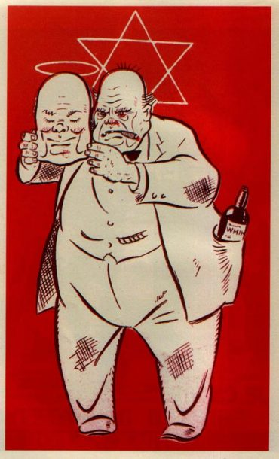
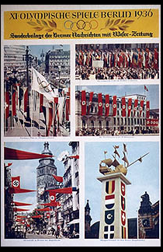
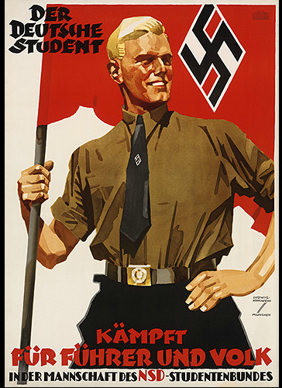
Nazi propaganda
By- Pooja
This poster from 1936 emphasizes the role of students for the "Führer and People." Nazi propagandists were especially concerned to reach and persuade German youth, the future leaders of the nation, to support the goals and policies of the Nazi Party.
Churchill is drunk. And he’s a Jew. This is show that the Jews have a mask on their face and they are never real to others.

Slide 2
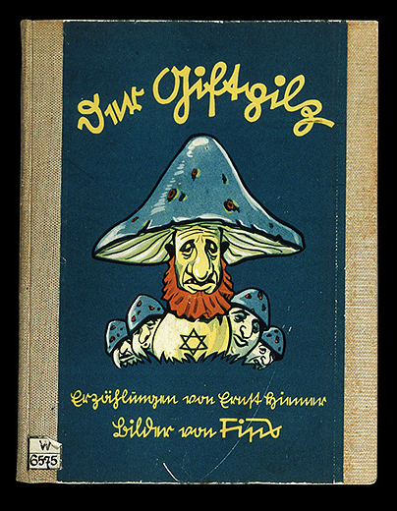
Who is in it and who created it?
Der Giftpilz is a children's book published by Julius Streicher in 1938. The title is German for "the toadstool" or "the poisonous mushroom". The book was intended as anti-Semitic propaganda. The text is by Ernst Hiemer, with illustrations by the illustrator Philipp Rupprecht.
What is it?
It’s a Nazi propaganda, it is the book cover used at schools to teach children.
When was it created?
It was created in 1938.
Where was it created ?
It was created in Berlin, Germany.
Why- purpose?
In this book there is an entire chapter containing numerous false quotations from the Talmud. The book claims that the Talmud forbids Jews to do manual labour, and that Jews are only permitted to engage in trade, and that non-Jews are meant to be slaves. The chapter further states that Talmudic law allows Jews to cheat non-Jews, and asks Jews to enslave the non-Jewish population. It was sometimes used in schools.
How was it used?
It was sometimes used in schools, newspapers to prove Jews as cruel and non-faithful.
THE POISONOUS MUSHROOM !!!

