Slide 1
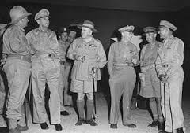
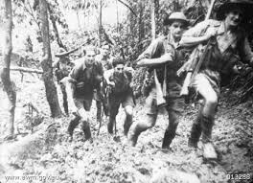
MAROUBRA FORCE
By: Pooja Sivakumar

Slide 2
What is the Maroubra force?
Maroubra Force was the name given to the Australian infantry force that defended Port Moresby, Papua New Guinea from the Japanese.
Was also involved in the Kokoda Track Campaign of the Pacific War, World War II.

Slide 3
What was their role?
A force of Australians known as Maroubra Force arrived at Buna on July 21st, 1942, as the first Japanese force of 1500 men landed at Gona.
Their role was to defend port Moresby and Papua new Guinea from the Japanese .

Slide 4
Reports
Maroubra Force was the name given to the Australian infantry force that defended Port Moresby, Papua New Guinea from the Japanese.
It was formed on 21 June 1942
On 24 June, Major General Morris was ordered by Australian High Command to send the 39th Battalion, called the Maroubra Force, in to Port Moresby to hold the town of Kokoda, just over half way between Port Moresby and Gona.

Slide 5
Reports
Opposing the Japanese was "Maroubra Force", comprising the 300-strong Papuan Infantry Battalion and an Australian military unit.
The Maroubra Force suffered many casualties and when the Japanese attacked, commander Brigadier Potts had only 1000 men against 6000 Japanese.
The Japanese had artillery guns while the Australians scrambled with few supplies using helmets and cans to create defensive positions.

Slide 6



