Slide 1
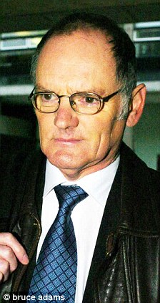
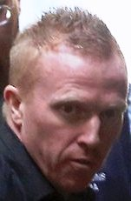
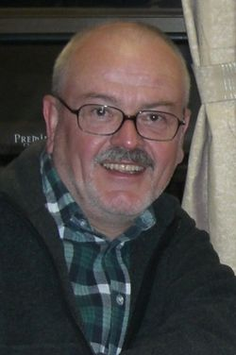

Serial killers
Encyclopedia
By- Pooja

Slide 2
Table of contents
Jack the ripper
Death of Jill Meagher
The lady in the lake case
The west gate bridge murder case
The Frankston serial killer
Robert Black
Westgate bridge murder
Glossary

Slide 3
Jack the ripper!
Name: Jack the ripper
Crime; Murder
Victims:
43 year old alcoholic women.
47 year old Annie Chapman.
45 year-old Swedish immigrant Lily
46 year-old Catherine Eddowes
Mary Kelly
Location: London
Similarities:All died in London, killed a similar way , all in 40s except one, all women, all prostitutes
Differences: Mary was way different to the others; She was much younger, Chose to be a prostitute, Was not killed in a public place
Criminal theories; Since Jack the ripper was anonymous, no one knew his childhood or parents or background but criminologists believe Jack the rippers criminal theory was to do with Social learning Theory.

Slide 4
Death of Jill Meagher
Perpetrators name; Adrian Bayley
Age; 41 years old.
Crime: Rape, Murder
Previous crimes- At 19 he raped two teenagers and attempted to rape another. He served time behind bars, but faked his way through a sex offender program to get early release. In 2000 he raped five prostitutes over a six-month period. In 2012 while on parole, he assaulted a man in Geelong.
What are the facts of the case?
How did the crime take place?
Ms Meagher was snatched off Brunswick's Sydney Road after a night out with friends
What time- 12:19 pm
Where did it take place- In Brunswick Sydney road.
What effects did this case have on the victim’s family and society:- This case got questions in people’s minds about if the law was strict enough and if the society was safe that something like this could be so easy to get out of.

Slide 5
The lady in the lake case!
Perpetrators name; Gordon Park
Age; 66 years old
Crime: murder of his first wife Carol Ann Park
Punishment: jailed for life
Name and number of victims; Carol Ann Park
Type of perpetrator serial killer, as he killed a lot of people including his first wife.
What are the facts of the case?- The Lady in the Lake trial was a 2005 murder case in which Gordon Park (25 January 1944 – 25 January 2010) a retired teacher from Lecce, near Barrow-in-Furness,Cumbria, was jailed for life for the murder of his first wife, Carol Ann Park, in 1976.
How did the crime take place?- he smashed Carol by her face to a flat faced object of some sort, then he bound her with a rope, and put difficult knots, weighed down with rocks and thrown overboard from a boat on Coniston water. The body landed on an underwater ledge where it was later found by the amateur drivers.
What time?- went missing 1976, body found- 1997
Where did it take place- Carol Park went missing on 17 July 1976, and was never seen alive again by her family. In 1997,Her body was discovered at the bottom of Coniston Water.
Case analysis- Gordon park had murdered his first wife Carol Ann Park, he was then jailed for life, in 1976. this case was then called “The Lady In The Lake trial” because Gordon’s wife was found on land from the Coniston water.

Slide 6
Robert Black
Perpetrators name; Robert Black
Age; 67 (died)
Crime: -rape, sexual assault, kidnapping and murder
Punishment: Life imprisonment
Name and number of victims; 4+ Caroline Hogg , Sarah Harper, Teresa Thorn hill
Type of perpetrator – Rapist, Sexual assault, And murderer.
Choose a theory of crime and describe it ; Black is a diagnosed psychopath, meaning a person suffering from chronic mental disorder with abnormal or violent social behaviour. Which is similar to the theory known as strain theory.
How did the crime take place? Robert black was known to have a similar way of dealing with all his victims, his victims were mostly known to be children (girls). He’d kidnap them first and also mentioned that he sexually assaulted them or rape them then killed them.
What time- 26 march 1986, 1981 to 1986
Where did it take place- United Kingdom
what effects did this case have on the victim’s family and society? The effects this had on the victim’s family was terrible especially the thought that the children had barely begun their life and it was already ended. And society was feeling unsafe that something like that can happened more than one time. Especially that the police didn’t find enough evidence to capture the culprit and arrest them before he could move on to the next victim.
Case analysis- Robert Black is a serial killer which primarily attacks the girls. Girls are the victims of the serial killer Black. Robert Black kidnapped and murder four girls between the ages of 5 years.

Slide 7
The west gate bridge murder case
Perpetrators name- Arthur Freeman
Age- 37 years old
Crime: guilty of murdering his four-year-old daughter by throwing her off the city's Westgate Bridge.
Punishment: sentenced to life imprisonment
Name and number of victims- daughter Dancey Freeman
Type of perpetrator- murder, he threw his daughter off the bridge and killed her.
How did the crime take place- Dancey was thrown off the bridge by her dad Arthur Freeman, she died after a few hours after the throw.
What time?- January 29th 2009
Where did it take place?- The west gate bridge, Melbourne
Case analysis - He has been recorded for murdering only his 4 year old daughter Dancey Freeman just to show the anger and revenge he had on his ex-wife. He had to spend 32 years of non-parole period.

Slide 8
The Frankston serial killer
Perpetrators name- Paul Charles Denyer
Age; 42 year old
Crime: murder
Punishment: sentenced to life prison
Name and number of victims; 3 victims, Elizabeth Stevens, 18/ Debbie Fream, 22/ Natalie Russell 17
Type of perpetrator – serial killer, because he killed 3 victims in very similar ways and reasons.
What are the facts of the case?
How did the crime take place?- Paul always stalked and murdered the three women in and around the Melbourne suburb of Frankston during 7 week period.
What time?- June to July 1993
Where did it take place?- Melbourne, Australia
Case analysis- Paul Charles Denyer was transsexual, he hated women in general. He also killed the three victims because he hated them. They were all young women, he had to spend his life in prison from December 20th 1993.

Slide 9
Glossary
Criminal theory- Criminology is the scientific study of the nature, extent, causes, control, and prevention of criminal behaviour.
Perpetrator- someone who perpetrates wrongdoing
Non-parole period- Parole is the provisional release of a prisoner who agrees to certain conditions prior to the completion of the maximum sentence period. Originating from the French parole, the term became associated during the Middle Ages with the release of prisoners who gave their word.
Chronic mental disorder- A mental disorder, also called a mental illness or psychiatric disorder, is a mental or behavioural pattern or anomaly that causes either suffering or an impaired ability to function in ordinary life (disability), and which is not developmentally or socially normative.

