Slide 1

A place where one has born and grew up. Where people live together as a family. Home is a place where you have all the things for survival. Home is where people care and share their happiness and sorrows with each other .
Home

Slide 2
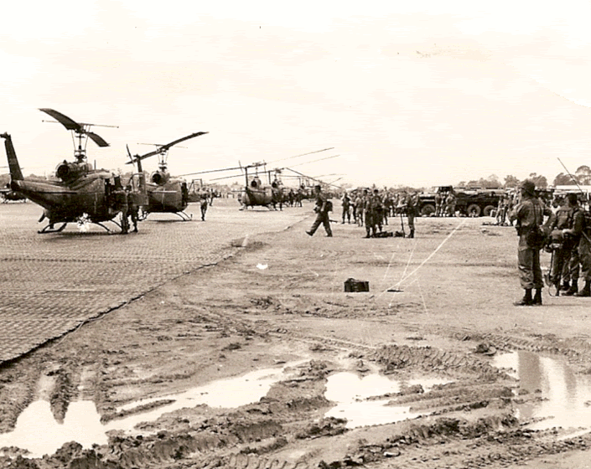
At a warzone, its a place where a war would be held or would have occurred earlier. Place where a war would have been created, its always not safe to live in a warzone
Warzone

Slide 3
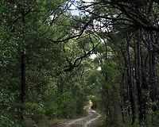
Its a dense woody plant smaller than a tree. Its a wild uncultivated part of the country.
Bush

Slide 4
What characters need to do to survive in that setting?
At home :
Food, water and shelter are important. No much work is needed to be done because everything will be already organised.
At Warzone :
Weapons will be needed to kill people who attack you. You will have to have good stealing skills because you have to steal food, water. You will have to be able to fight for each other.
At The Bush :
You will need to hunt for animals have a camping sight at the bush to sleep out. You will need to hunt for water and food.

Slide 5
What you need to make you survive ?
Home :
At home you would need people who protect and help you to get through the hard times in life. Food, water and shelter is also important to survive. You will also need guidance of your parents.
Warzone :
Guns, weapons, armour, shield to survive in a warzone. Mainly you will need food water and shelter to survive. Family and friends support is also needed.
The Bush :
food water and shelter are always important. Guidance of elders or maybe friends. You will need knives weapons and hunting skills.

