Slide 1
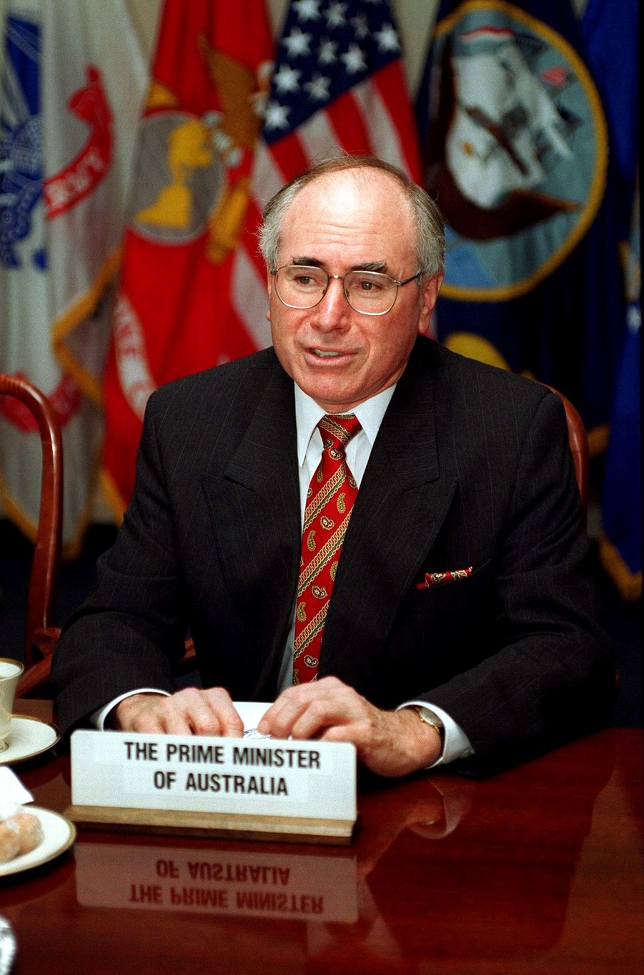
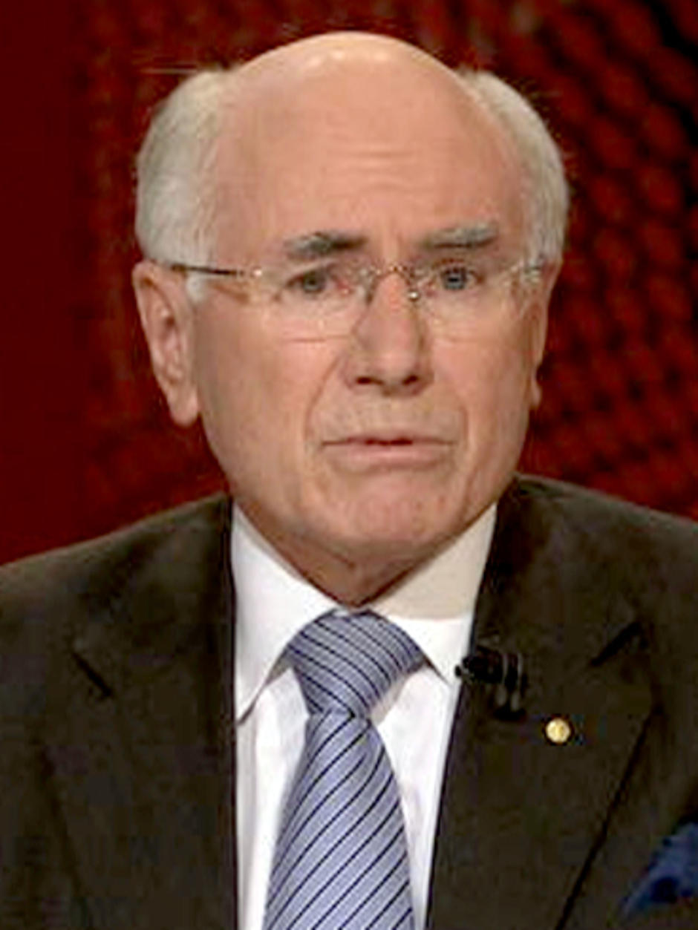
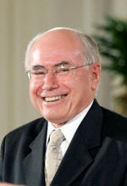
Our Australian Prime Minister
John Howard
By – Vishnu Sivakumar

Slide 2
Information About John Howard
He John Howard was born in Earlwood, a Sydney suburb, on 26 July 1939. He grew up in this south-western industrial suburb, attending the local government primary school and later the Canterbury Boys' High School. His father, a garage owner, influenced his political and industrial views, affect on him the importance of small business as an employment provider. After studying law at Sydney University, John Howard graduated in 1961 and then practised as a solicitor for the next twelve years. A committed Liberal Party member, he was soon deeply involved in its organisation: he joined the party's New South Wales State Executive in 1963. He served as State Vice-President of the party 1972 to 1974. Later in Australia he was elected as the 25 Prime Minister on 11th March 1996 to 3rd December 2007 representing the Liberal Party.

Slide 3
Some of the developments he made to our country
Strong profitable growth, low inflation and interest rates, lowest unemployment in 30 years, creation of around two million new jobs, and wage increases.
Introduced gun control with a federally-funded buy-back scheme in 1996.
Goods and Services consumption tax (GST) July 2000. GST revenue of around $40 billion per annum granted to the States and Territories.
Reform of industrial relations system. Replacement of award contend with direct employer- employee enterprise agreements. Introduction of Work Choices 2006.
Gradual social control of Telstra, with billion dollar proceeds going to environmental funding.
Introduced principle of mutual obligation to social policy.
Committed Australian troops to international coalitions led by the United States in Afghanistan and Iraq as part of the 'War on Terror'. Took a leading role in United Nations peace enforcement in East Timor which enabled the independent parlimantary state of East Timor to be entitle in 2002.
Adopted an 'Asia-plus' diplomacy, focusing on relations with Australia's Asian neighbours while maintaining and developing traditional links with Britain and other Commonwealth nations and the United States.
Record health funding of $47.6 billion in 2006-07
Program to extend broadband internet and mobile phone connections to region

Slide 4
answer this if you can
What did John Howard’s father own?
During what year did he announce the gun control?
How many dollars proceeded going to the environmental fund?
Did he introduce principle of mutual obligation to social policy?
How much of GST revenue per annum granted to the States and Territories?
How many jobs did he create?
What are the number of changes he made to our country?
When did John Howard graduate?

Slide 5
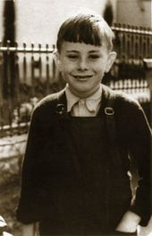
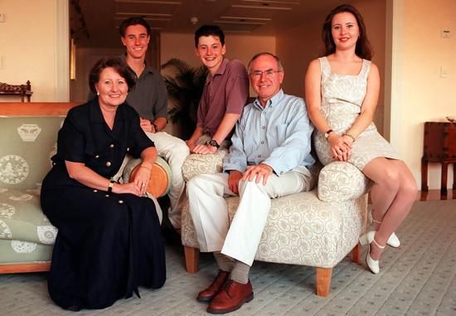
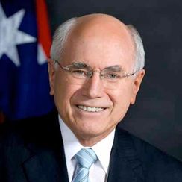
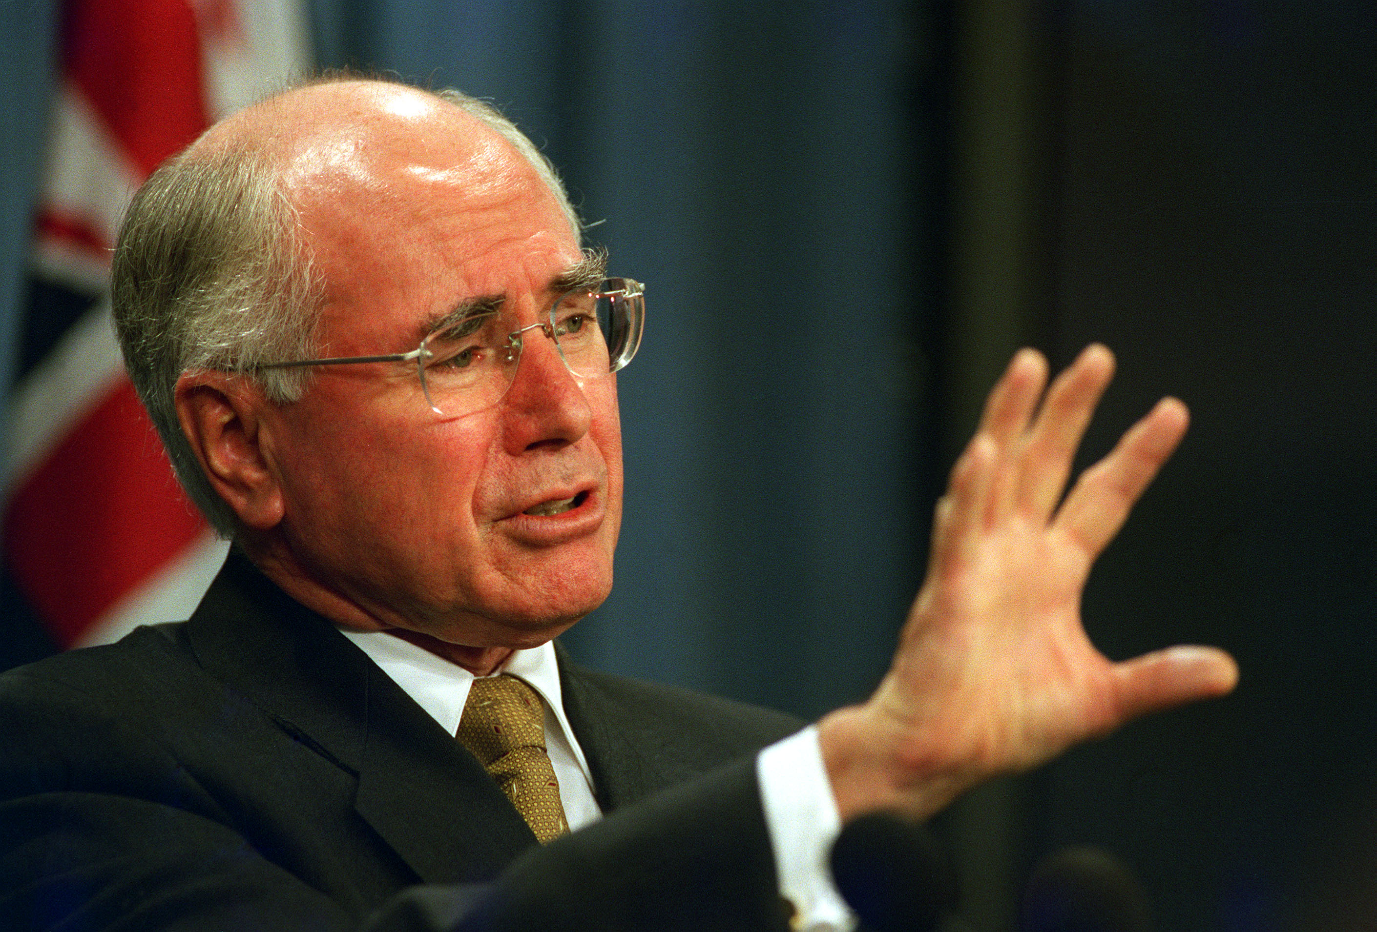
Some pictures
When John Howard was small.
A picture with his family.
Picture of him self.
While he was arguing in the court.

Slide 6
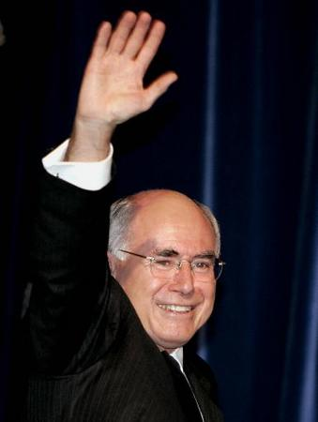
THANKS FOR WATCHING AND LISTENING
I HOPE YOU HAVE LEARNT SOMETHING
ABOUT OUR AUSTRALIAN PRIME MINISTER

