Slide 1
Tour Around Egypt
By- Vishnu Sivakumar

Slide 2
Pyramid of Giza
I would be visiting the great pyramid of Giza since it is one of the world known sites. The pyramid built by ancient Egyptians for the pharaoh Khufu, originally known as Khnum-Khufu. The pyramid is also the oldest and largest of the three other pyramids in the Giza Necropolis which also makes it the most famous of the three various pyramids. It is a great mystery of how these pyramids were built. The pyramid has an height of 139 metres and it was opened at 2540BC. This pyramid withholds the burial of the fourth dynasty Egyptian pharaoh Khufu and it has many chambers for many reasons. Each block has an amazing average weight of 2.5 to 15 tons each and it is estimated that there are approximately 2.3 million stone blocks in total to construct the gigantic pyramid. Within the pyramid there are 3 chambers the first underground carved into a bedrock, the second above ground which was called the queen’s chamber by early explorer and the third is the king’s chamber which also holds a red granite almost in the centre of the pyramid. So this would be a great place to visit.

Slide 3
The Great Sphinx of Giza
Second I would visit the great Sphinx of Giza, commonly referred as the Sphinx, is a limestone structure which poses a recelining or couchant sphinx that stands on the Giza Plateau on the west bank of Nile. The structure has a height of 20 metres at it’s highest point. The Sphinx is a legendary creature with the body of a lion and a human head. The Great Sphinx also holds the record for the oldest known monumental structure. Not only this but also for the largest monolith statue in the world. The humongous statue is commonly believed to have been built by the ancient Egyptians during the reign of the pharaoh Khafra. But however some of the facts have still not been discovered such as why and when it was built. But I just believe that the Great Sphinx is a great monument in Egypt which therefore makes it the a wonderful place to visit.

Slide 4
Luxor Temple
As a finish of to my adventure around Egypt I would visit the Luxor temple. This was and is one of the most important places for the Egyptians since it is a place to preach their gods and also it is the place where the citizens show of their culture and tradition. As you may know learning about cultures other than your one is immensely important. These days culture is becoming one of the barriers to communication as in any association people in the same culture tend to form groups and talk better with people in their culture. So the only key to at least speak to people who are ‘culture freaks’ are learning about their culture. But however some people are not like that, they are happy to talk to everyone and keep learning forever in their life. The Egyptian tradition is one of the most unique traditions in the world. What make them unique is their dressing sense and their native beliefs. This brings us to the end of the journey making it a fabulous finish to our tour around Egypt.

Slide 5
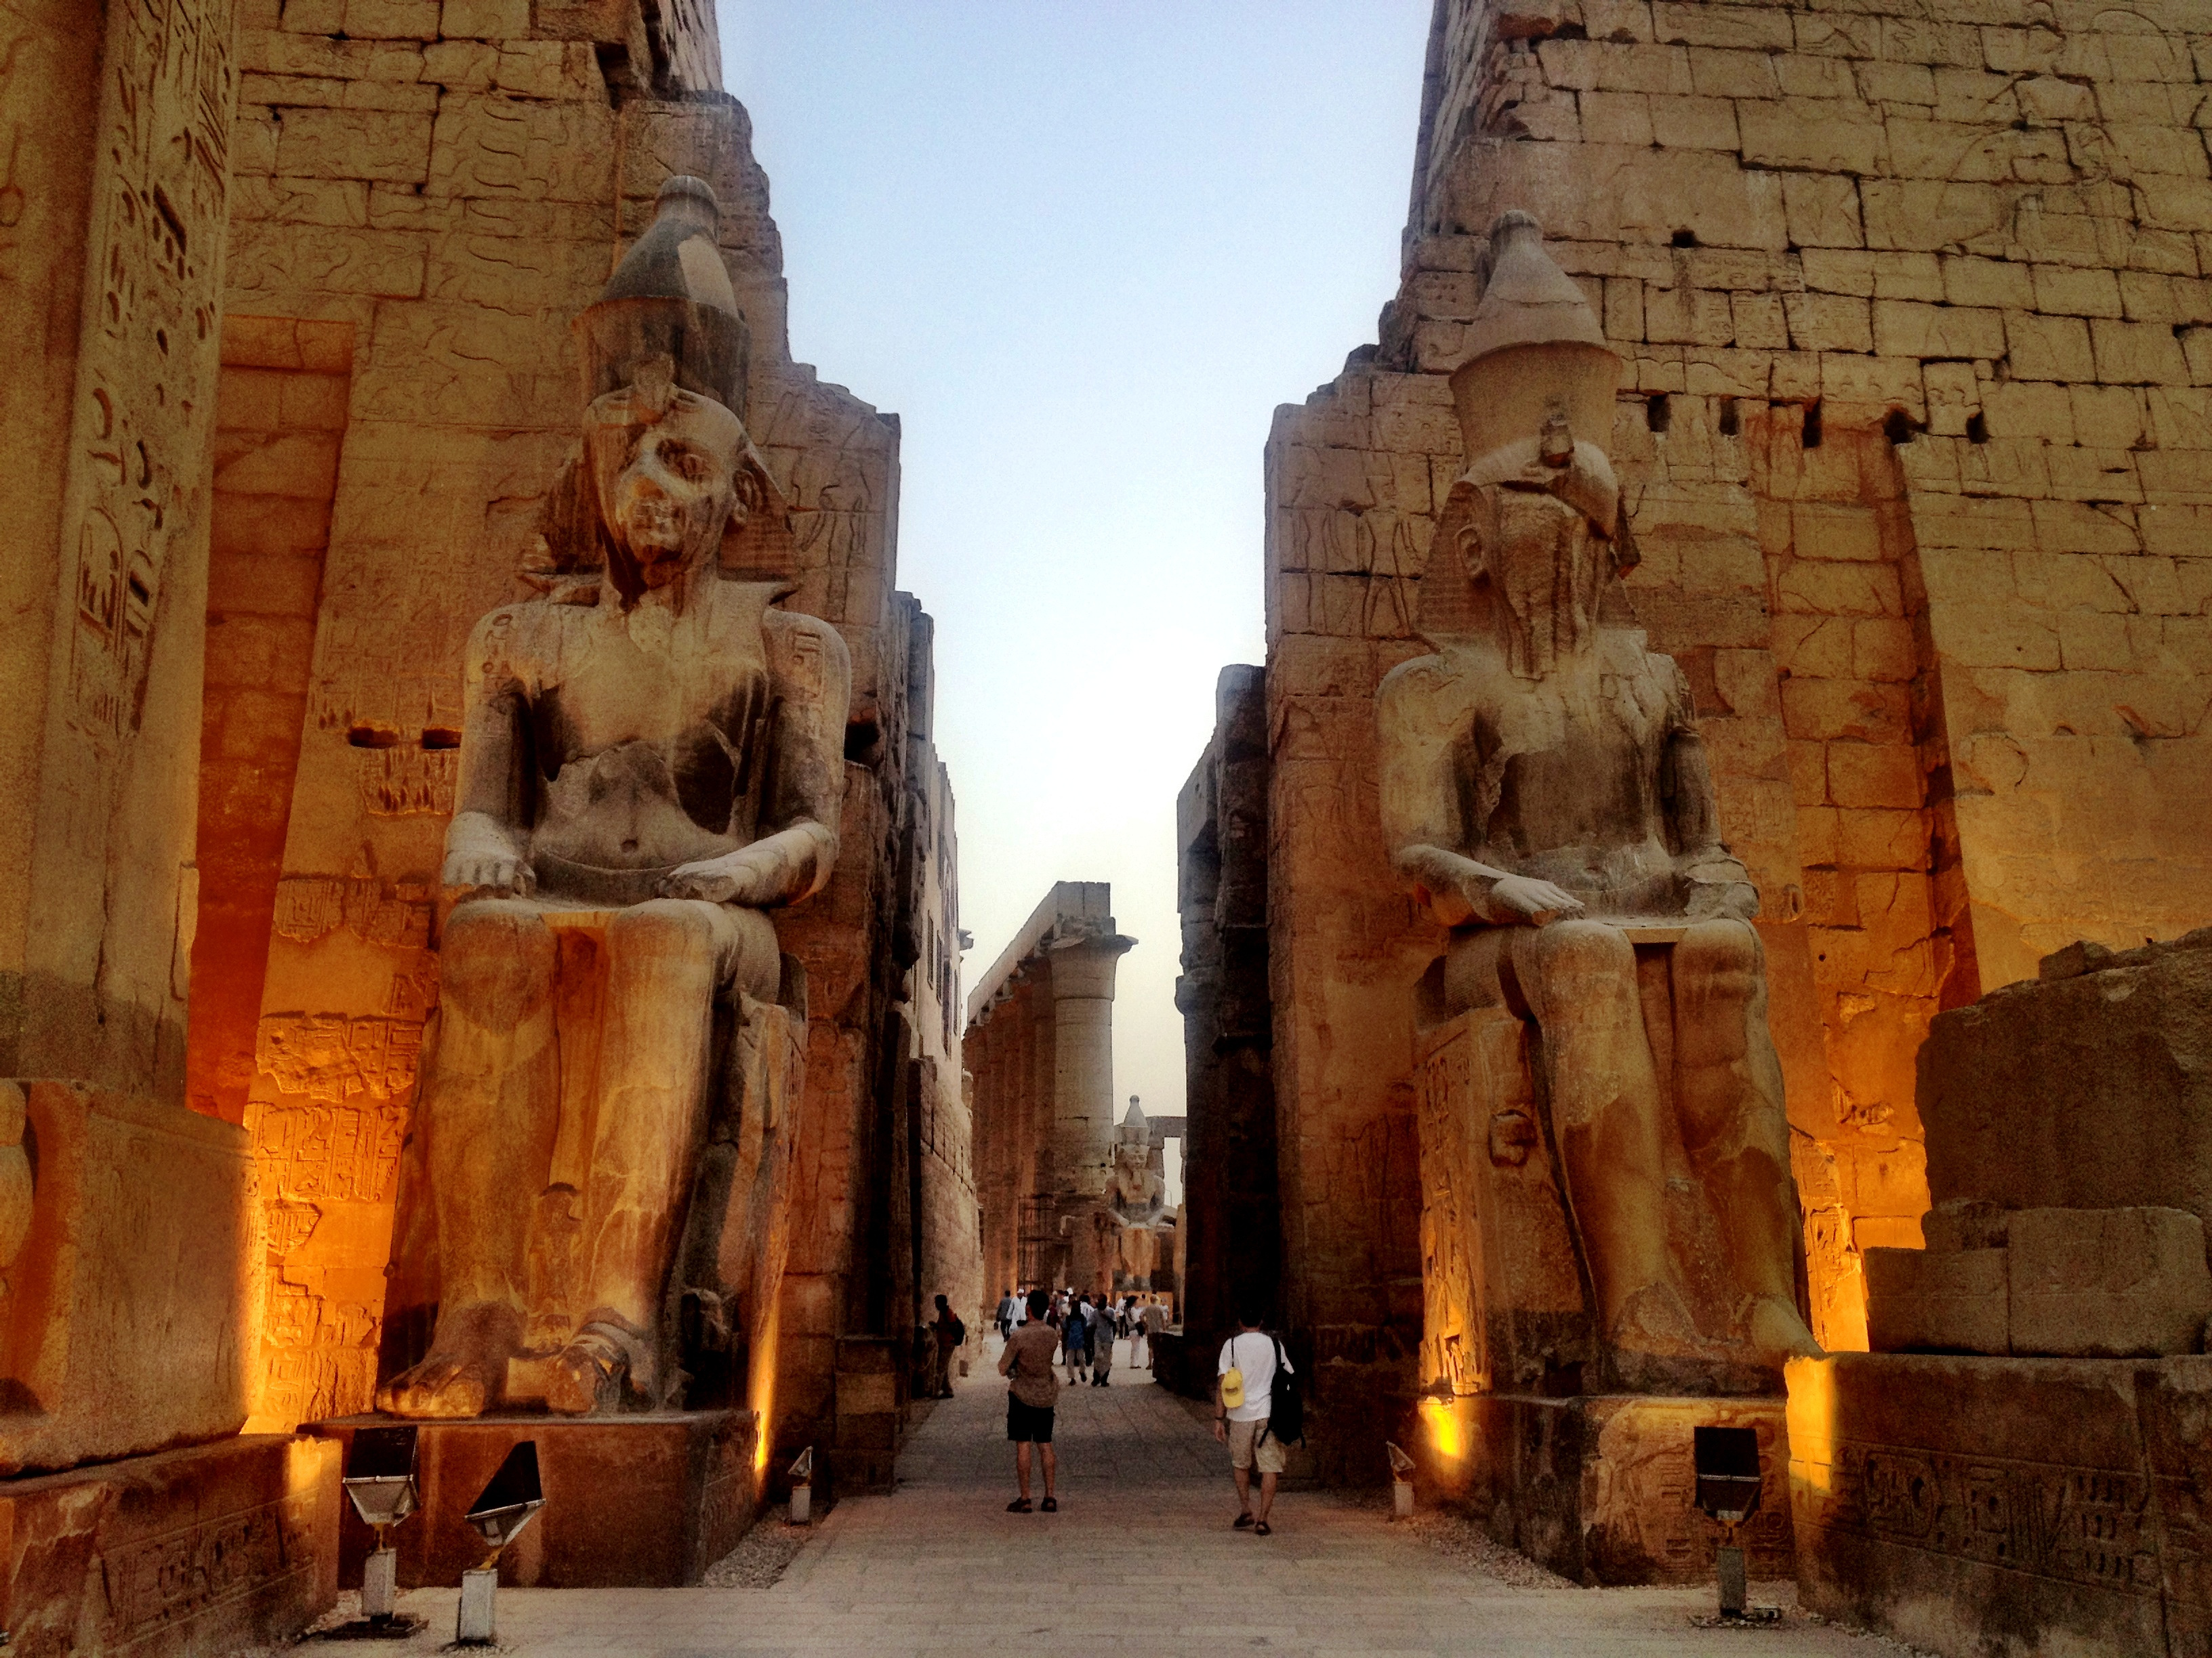
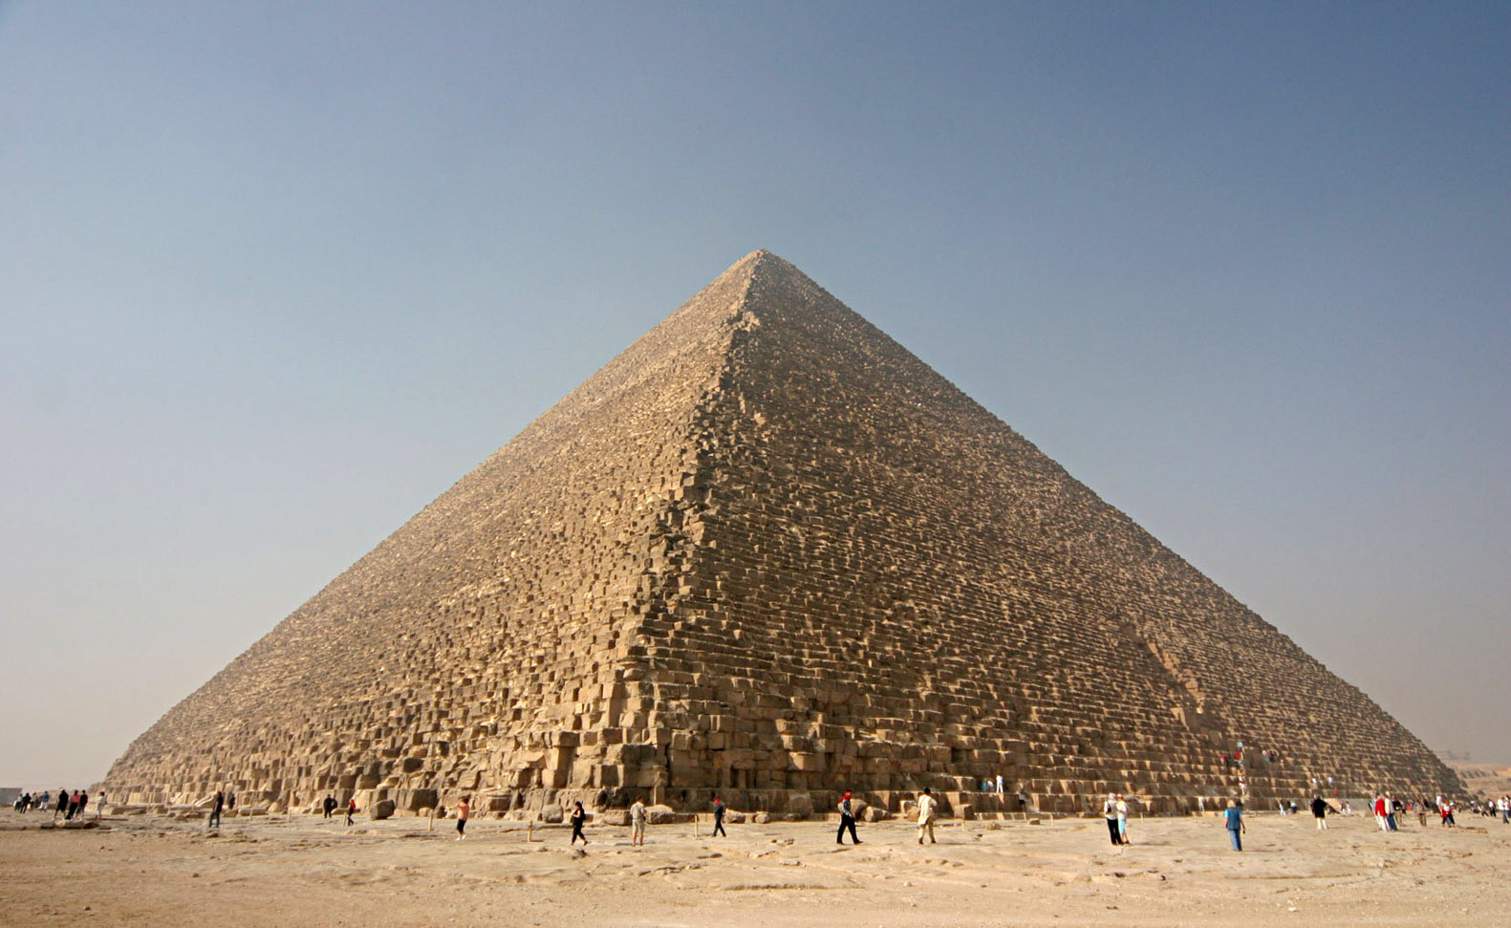
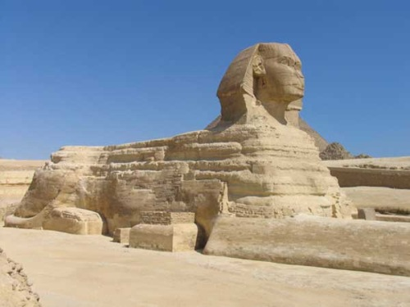
Timeline
Luxor Temple
(1400 BCE)
Luxor Temple
(1400 BCE)
The Great Pyramid of Giza
(2540 BC)
The Great Sphinx of Giza
(2558 – 2532 BC)

Slide 6
Thanks For Watching

