Slide 1
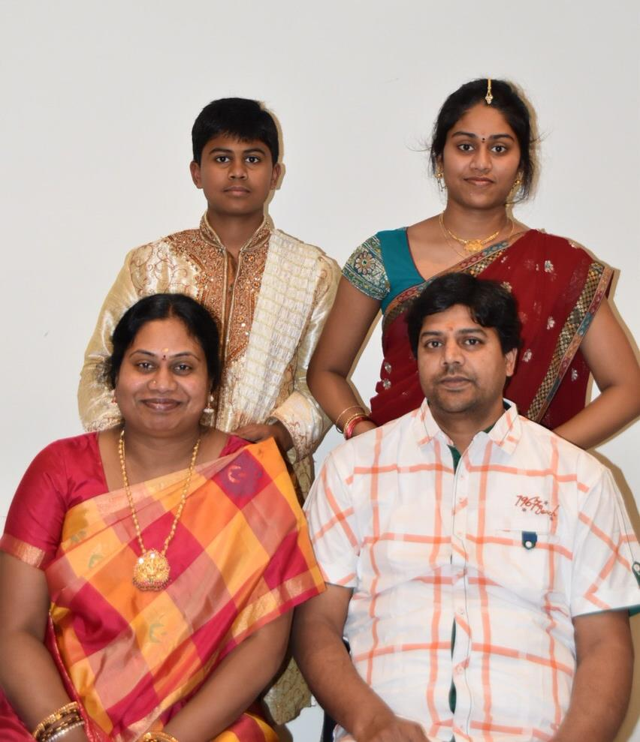
My Family Tree
Me
Born - India
Govinda Reddy
Born - India
Chennabai
Born - India
Bharathi
Born - India
Narayanan
Born - India
Velu
Born – India
Vani
Born - India
Boominathan
Born – India
Rani
Born - India
Prakash
Born - India
Durrai
Born - India
Vasantha
Born - India
Gagalaksmi
Born - India
Muthu
Born - India
Sivakumar
Born - India
By – Vishnu Sivakumar

