Slide 1




Monash Healthcare Innovation Summer Scholarships 2022/2023
Prototype Map & Intellectual Property / Patent Search
Andrew Xu

Slide 2
HISS 2022/2023
Why
Prototype mapping – help us better understand what you’re planning on doing, allows us to better support you.
Patent search – establishes whether you have freedom to operate. I.e. Intellectual property infringement limits what designs / workflows you can & cannot do, it’s important to know now.

Slide 3
HISS 2022/2023
Prototype roadmap
A basic visual representation of what and when you’re planning to make during a project.
It lays out the project in a digestible timeline format that keeps all project stakeholders on the same page.
Ideally should have three main elements:
Milestones – big, key objectives that needs to be met.
Deliverables – smaller/lesser tasks which contributes to milestones.
Timeline – indication of how long each deliverable takes & deadlines for milestones.

Slide 4
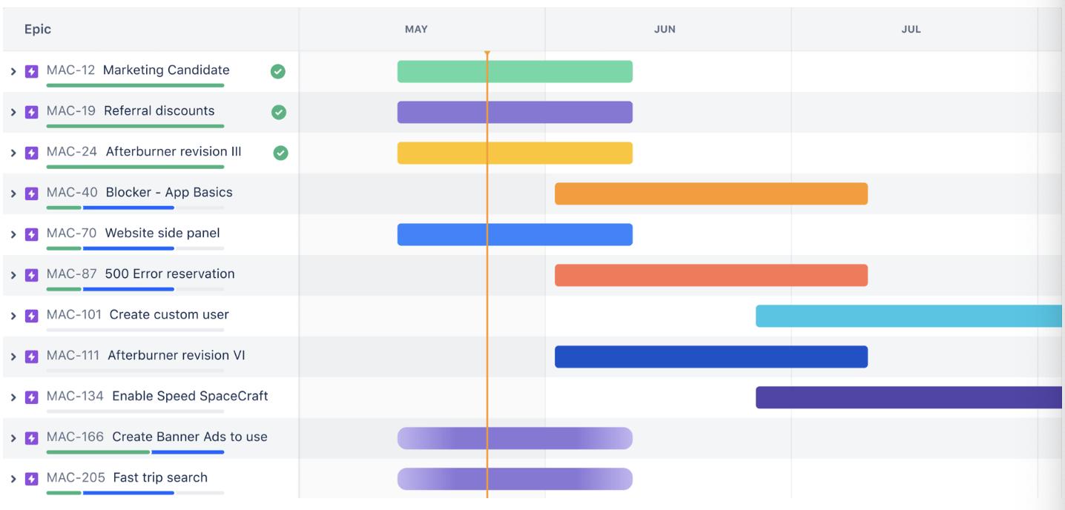
HISS 2022/2023
Prototype roadmap – Gantt Chart
Shows the deliverables on the Y axis, and time on the X axis.

Slide 5
HISS 2022/2023
Prototype roadmap – Gantt Chart
For the sake of HISS, we’re asking you to create a Gantt Chart for:
Weeks 9-12 (i.e. including this week).
One of the milestones needs to be either a Proof of Concept or Minimal Viable Product.
Don’t need to include HISS deliverables, but rather we’re asking you to decompose your main milestones into its own sets of deliverables.
Please make sure that your deliverables / milestones are achievable. We will somewhat hold you accountable based on the timeline you give us.

Slide 6
HISS 2022/2023
Prototype roadmap – General tips
Work backwards from an end goal.
Know you limits / don’t over-promise.
For teams of >1, delegate tasks. I.e. don’t all work on the same deliverable at the same time, work in parallel and hold review sessions to go over each other’s work.
Miro (Gnatt chart template)
Jira / Atlassian (Gnatt charting)
Notion (Task planning, team organisation, documentation)

Slide 7
HISS 2022/2023
Patent search
Workshop by Jason next Tuesday.
Not expected to come out with a comprehensive list of patents relating to your proposed solution.
Rather teaches you how to search for a patent, and what elements to look out for / consider.
Easy for hardware, difficult for software.
Software – not allowed to patent “algorithms” or “code”, but allowed to patent the “workflow” of the algorithms/code.
Not too familiar with the field – ask Jason if you have any questions.

Slide 8
HISS 2022/2023
Questions?

