Slide 1




Monash Healthcare Innovation Summer Scholarships 2022/2023
Business Models & Market Analysis
Andrew Xu

Slide 2
HISS 2022/2023
Why
(your goal should not be “getting rich”)
To make something costs money.
Where do you get this money?
How do you make sure the way you implement the solution is sustainable in the long run in terms of financials?
In healthcare, the end-user most often isn’t the payer.

Slide 3
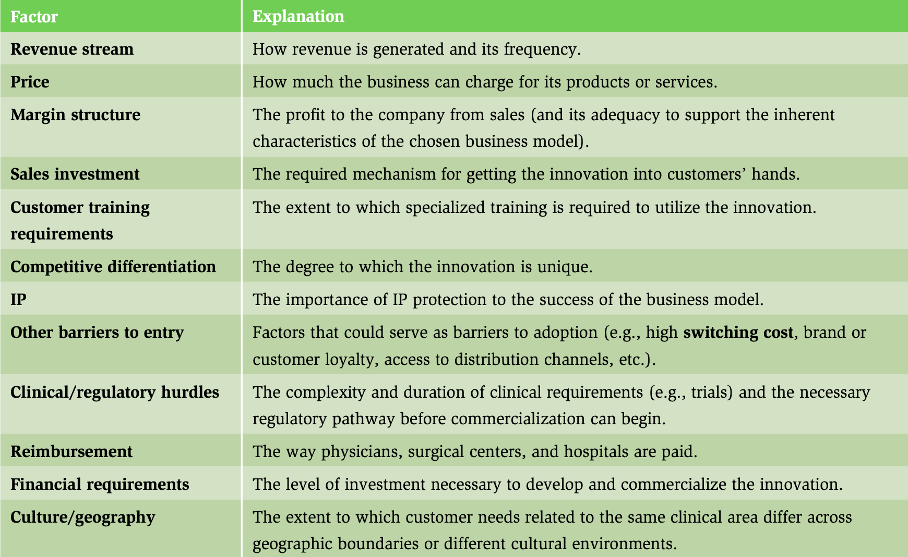
HISS 2022/2023
Business model

Slide 4
HISS 2022/2023
Business model - cost
Consider:
How much would it cost to prototype?
How much would it cost to make a unit of the product?
How much would it cost to maintain a unit of the product?
What are the other anticipated costs associated with the product? Consider regulatory, patenting, clinical trials, labour costs, etc

Slide 5
HISS 2022/2023
Business model - revenue
Consider:
Who pays for it?
How will you make money?
What type of model are you proposing?
What is your proposed price? What are the current prices of competitors?
What is the sales/market penetration strateg y?
What is the exit strategy?
Who are the potential acquirers?
What is the investor ROI?
What is the most significant risks and what is the de-risking strategy?

Slide 6
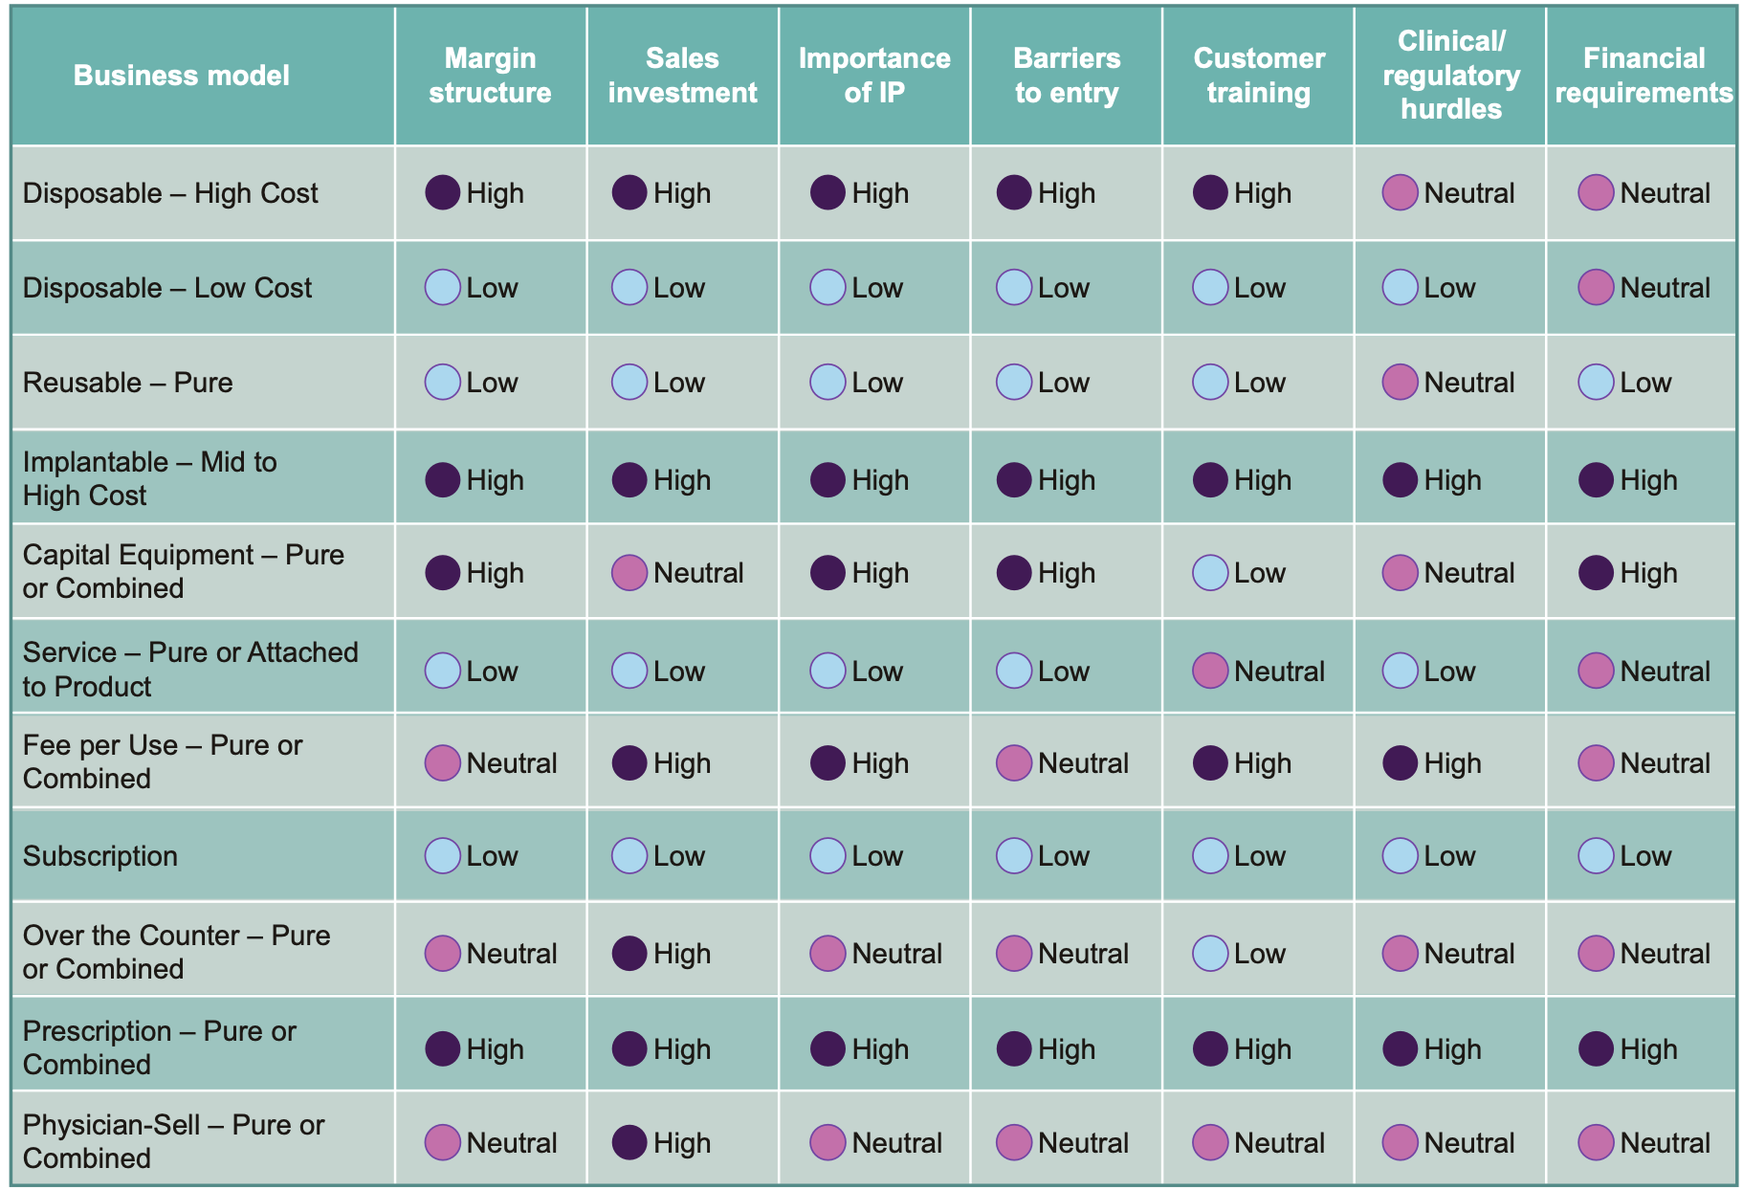
HISS 2022/2023
Business model

Slide 7
HISS 2022/2023
Market analysis
Consider:
What is the TAM (Total Addressable Market)?
What is the SAM (Serviceable Available Market)?
What is the SOM (Serviceable Obtainable Market)?
Who are your competitors within the market?
What are the segmentations within the market? Which one(s) are you targeting?
Can the market be expanded?
What are the major market forces?

Slide 8
HISS 2022/2023
Reimbursement
Consider:
What is the reimbursement strategy? MBS? PBS? Philanthropy?
What is the health economic profile compared to the SOP (standard operating procedure)?
Does it fit within the hospital’s KPIs?
If it’s related to Medicare coding, consider:
Can you use an existing Medicare code? Do you need a new code?
Can the code be claimed for your intended clinical context? Has there been precedence of this being done before?
What are the other, comparable codes?

