Slide 1




Monash Healthcare Innovation Summer Scholarship
2022/2023
Business model & market analysis
Andrew Xu

Slide 2
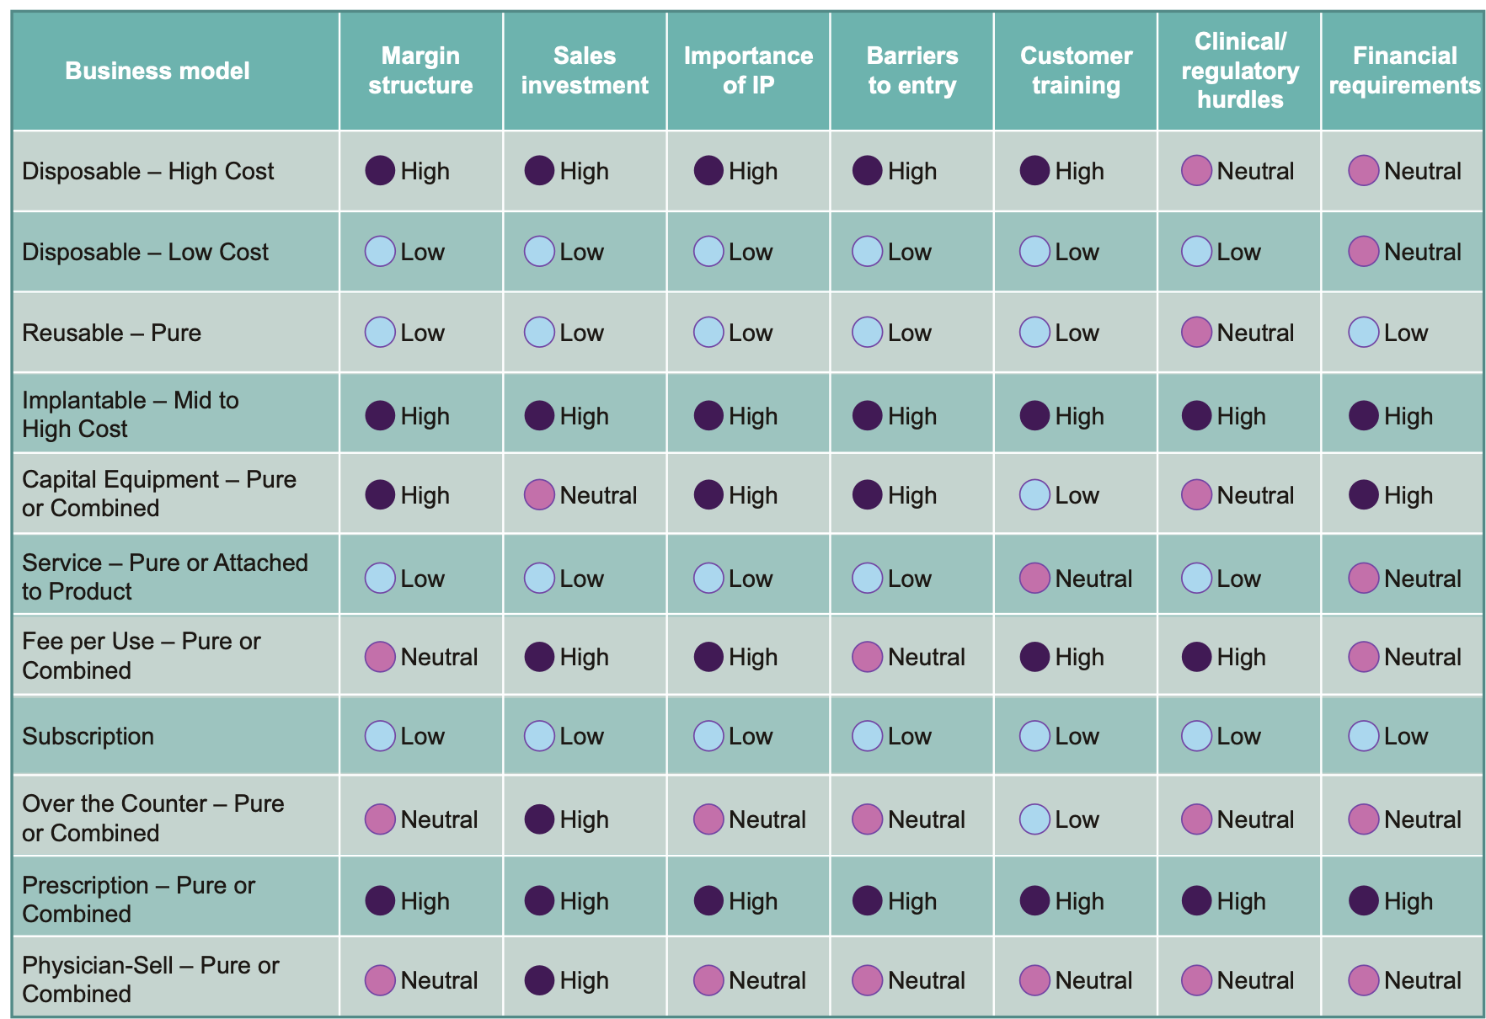
Types of business models
HISS 2022/2023

Slide 3
Business model - cost
HISS 2022/2023
Consider:
How much would it cost to prototype?
How much would it cost to make a unit of the product?
How much would it cost to maintain a unit of the product?
What are the other anticipated costs associated with the product? Consider regulatory, patenting, clinical trials, labour costs, etc

Slide 4
Business model - revenue/reimbursement
HISS 2022/2023
Consider:
Who pays for it?
How will you make money?
What is the sales/market penetration strategy?
What is your proposed price? What are the current prices of competitors?
What is the reimbursement strategy? MBS? PBS? Philanthropy?
What is the health economic profile compared to the SOP (standard operating procedure)?
Does it fit within the hospital’s KPIs?
Can you use an existing Medicare code? Do you need a new code?
Can the code be claimed for your intended clinical context? Has there been precedence of this being done before?
What are the other, comparable codes?

Slide 5
Business model - risk management
HISS 2022/2023
Consider:
What is the exit strategy?
Who are the potential acquirers?
Does it fit within the hospital’s KPIs?
What is the investor ROI?
What are the most significant risks and what is your de-risking strategy?

Slide 6
Market analysis
HISS 2022/2023
Consider:
What is the TAM (Total Addressable Market)?
What is the SAM (Serviceable Available Market)?
What is the SOM (Serviceable Obtainable Market)?
Who are your competitors within the market?
What are the segmentations within the market? Which one(s) are you targeting?
Can the market be expanded?
What are the major market forces?

Slide 7
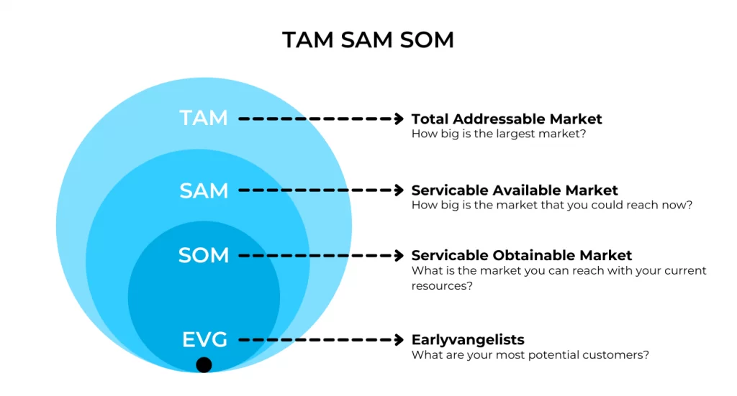
Market analysis
HISS 2022/2023

Slide 8
Advice for deliverables
HISS 2022/2023
Read the textbook on the relevant section of business model
Make sure to prioritise questions highlighted in bold - these need to be answered and included in the project report
  Others should be considered & included when appropriate
TAM/SAM/SOM is difficult to calculate, but represents a really important set of numbers - spend some time to think about them.

Slide 9
HISS 2022/2023
Questions?

