Slide 1




Project [NAME]
Week 5 Deliverable Summary
[template, delete]
ENTER OWN IMAGE HERE (e.g. scholar and clinician photo)
Monash Healthcare Innovation Summer Scholarship
2022/2023
Scholars:
Clinicians:

Slide 2
Project [NAME] - Week 5 Deliverables
HISS 2022/2023
Mission Statement:
[ENTER HERE]
[template, delete]
FEEL FREE TO CHANGE ANY FORMATS
just make sure key information is included
Needs Statement:
[ENTER HERE]

Slide 3
Project [NAME] - Week 5 Deliverables
Current gold standard
HISS 2022/2023
Transplant patients are supplied with immunosuppressants immediately after transplantation, with a rough estimate of the dosage decided by the doctor. The dosage is modified based on clinical judgement and measuring immunosuppressive drug levels.

Slide 4
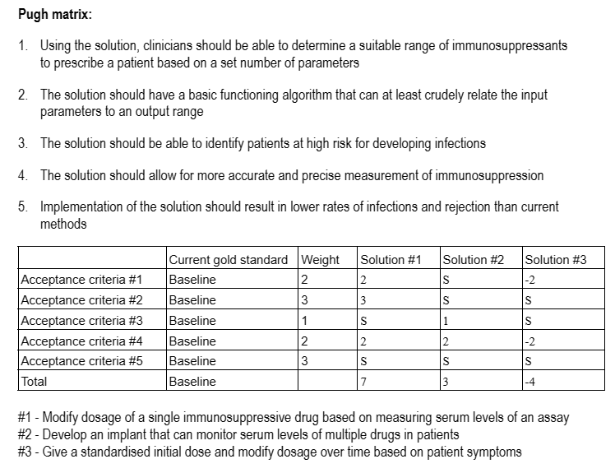
Project [NAME] - Week 5 Deliverables
Pugh Matrix
HISS 2022/2023

Slide 5
Project [NAME] - Week 5 Deliverables
Final verdict
HISS 2022/2023
The most feasible solution seems to be solution #1 - where the dosage of an immunosuppressive drug is modified based on serum levels of an assay. Current immunosuppression dosing procedures are crude and inaccurate. However, a novel blood immune function assay known as the Quantiferon®-Monitor (QFM) has been developed to measure the immunosuppression state of individual patients. A tool can be developed that considers the QFM serum levels of patients and calculates a personalised dosage range, allowing for a personalised administration schedule.

Slide 6
Project [NAME] - Week 4 Deliverables
Project Reflection
HISS 2022/2023
End of week reflections/highlights/learning points:
[Enter here any additional points from the week that are valuable to share]
…
Final Questions:
[Enter here any particular blockers or questions you have for next week/want assistance with from an organiser, clinician, expert in the field]
…
[template, delete]
FEEL FREE TO CHANGE ANY FORMATS
just make sure key information is included

