Slide 1




Monash Healthcare Innovation Summer Scholarships 2022/2023
Yvonne Strover

Slide 2
HISS 2022/2023
Deliverable for Week 5
Narrowing idea selection to top 3
You will be walked through a methodology of narrowing down your ideas
You may have an idea of what the best idea might be, but it fails for certain key parameters
You’ll be asked to give a weighting to key parameters and critically analyse which potential ideas best fulfill the criteria - and more importantly, fulfill the most critical criteria
Due by: 5pm on Wednesday with a presentation to team on Wednesday at 9am
Notes:
Basically what is in the textbooks. Students who did well are the ones who followed the textbook well. There are other programs who utilise this book like melb uni and stanford. There will be a lot of individual work so use the book when you get stuck.

Slide 3
https://www.youtube.com/watch?v=S3FUYDaQyuc&ab_channel=StanfordBiodesign

Slide 4

HISS 2022/2023
Report Structure
Please do not alter the format much or at all
Due end of week 7 (pitch week) - 12/1/23
Template is uploaded to week 5 folder
report showcases your work/research to date
report is an expansion of your pitch
Notes:
When you talk to CC or stakeholders throughout the program, you mission will change and its depending on these conversations and the insights you gain that you can define what you are trying to achieve.

Slide 5
HISS 2022/2023
Report Structure
Please do not alter the format much or at all
Due end of week 7 (pitch week) - 12/1/23
Template will be uploaded to week 5 folder
report showcases your work/research to date
report is an expansion of your pitch
appraise your project and be honest about whether or not it should continue and why
Notes:
When you talk to CC or stakeholders throughout the program, you mission will change and its depending on these conversations and the insights you gain that you can define what you are trying to achieve.

Slide 6
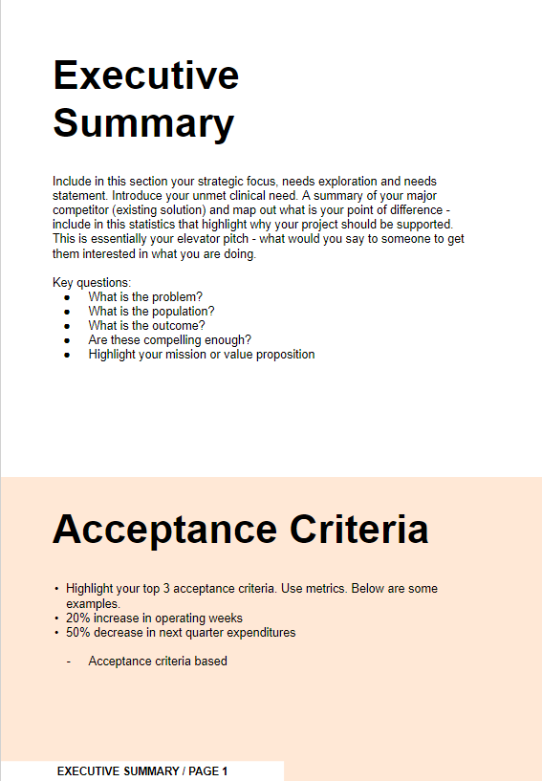
HISS 2022/2023
Report Structure
P1 - Executive Summary
your elevator pitch - if someone reads only some of the report its this part - make it count and make it concise
it will utilise your mission statement, needs and acceptance criteria
these are essential short summaries of your project - refine them continuously
Notes:
When you talk to CC or stakeholders throughout the program, you mission will change and its depending on these conversations and the insights you gain that you can define what you are trying to achieve.

Slide 7
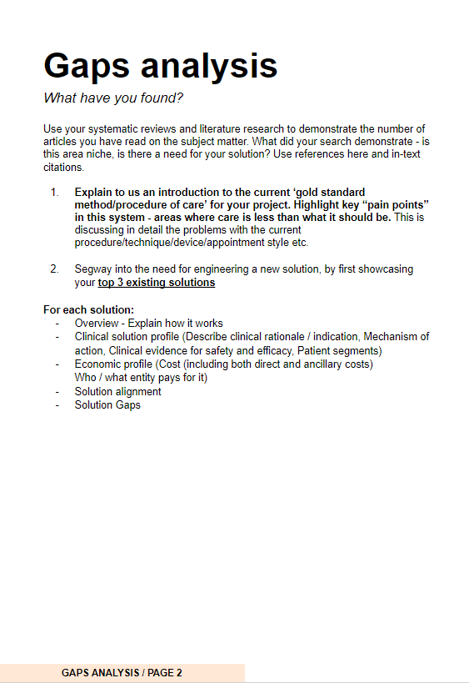
HISS 2022/2023
Report Structure
P2+ - Gaps Analysis
Notes:
When you talk to CC or stakeholders throughout the program, you mission will change and its depending on these conversations and the insights you gain that you can define what you are trying to achieve.

Slide 8
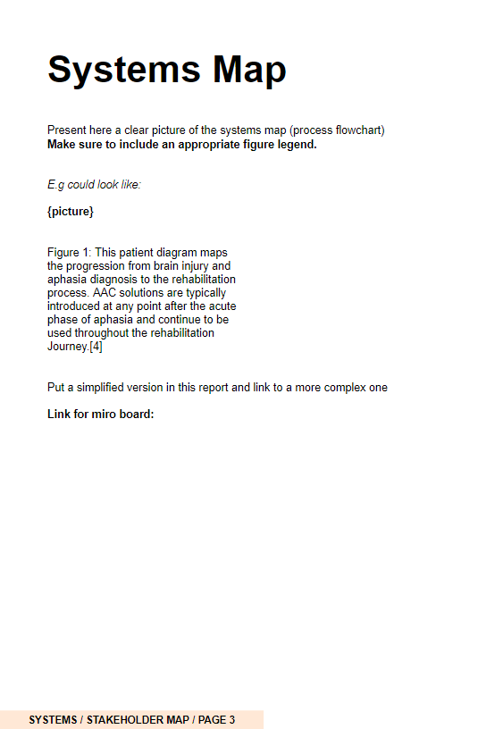
HISS 2022/2023
Report Structure
P3 - Systems Map
updated from your deliverable based on your feedback and new information

Slide 9
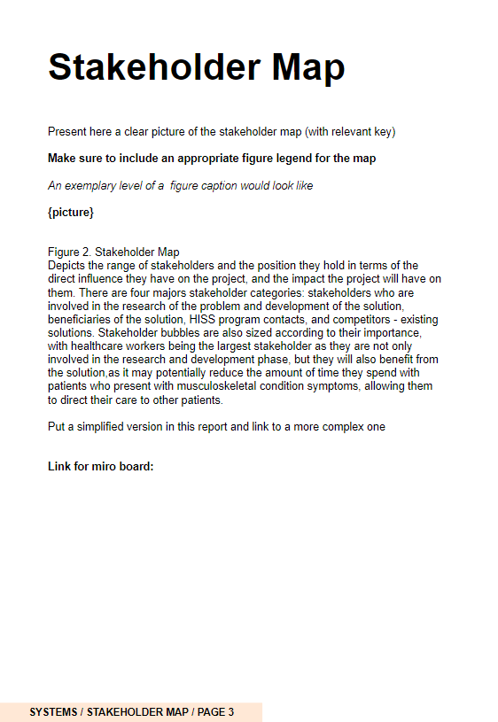
HISS 2022/2023
Report Structure
P4 - Stakeholder Map
updated from your deliverable based on your feedback and new information

Slide 10

HISS 2022/2023
Report Structure
P5+ - Outcomes of Qualitative and Quantitative Research
summary of main findings of your literature review
summary of main findings of your observations and conversations
looking for numbers, data, diagrams, etc.

Slide 11
HISS 2022/2023
Report Structure
P6 - Top 3

Slide 12
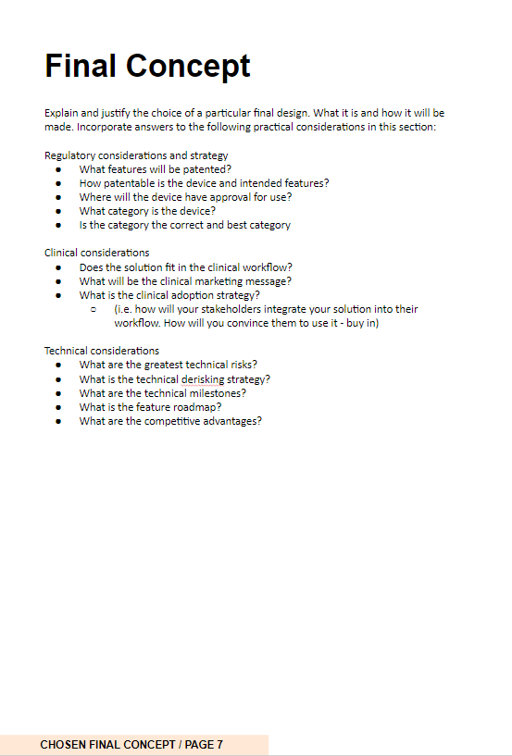
HISS 2022/2023
Report Structure
P7 - Final Concept
key questions to ask about the nature of your final concept clinically, technically and from a regulatory perspective
(business side is dealt with more in depth in following sections)
consider all the questions, answer what you can

Slide 13
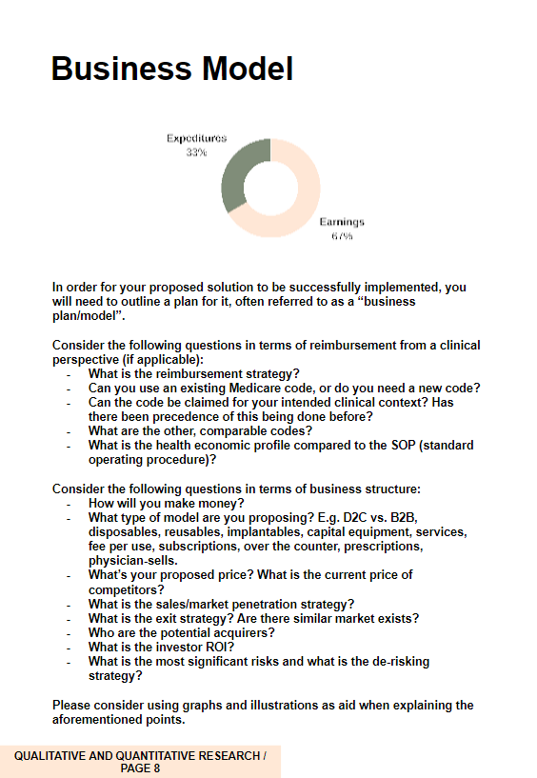
HISS 2022/2023
Report Structure
P8 - Business Model*
What will be your business model?
Do not invent a new one!
Likely best to copy what already works and is used in similar solutions.
Big list of key questions - show that you have considered them all and answer what you can
*taught after break

Slide 14
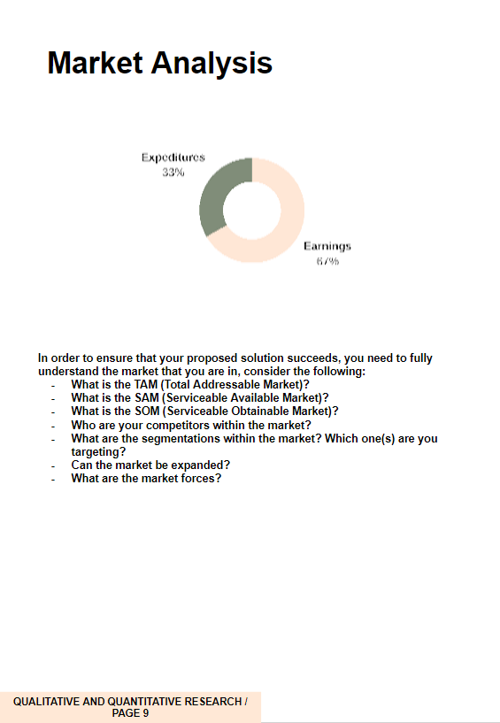
HISS 2022/2023
Report Structure
P9 - Market Analysis*
What industry are you in?
What market are you looking at? What are the forces? (power of buyer, supplier, substitutes, etc)
Who are you competing with?
How do you enter it?
*taught after break

Slide 15
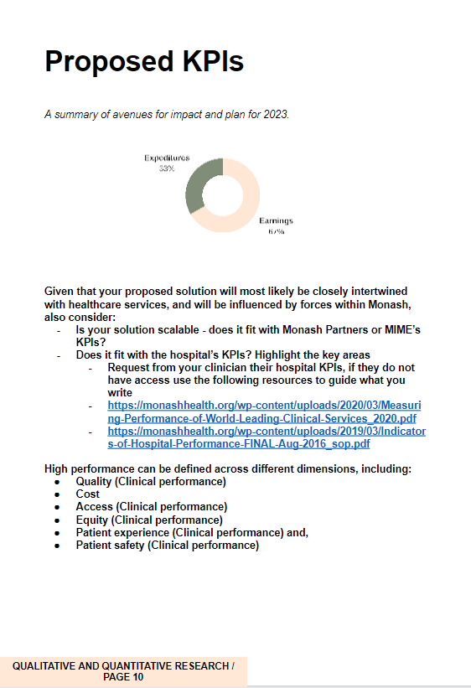
HISS 2022/2023
Report Structure
P10 - Proposed KPIs*
ask for your clinician to send their hospital/institution’s KPIs
if they cannot find or share this, use the resources to propose KPIs that fit the needs of the system generally
want measurable and quantifiable KPIs that fit the needs of your stakeholders
*MIME KPI’s are being chased up
*taught after break

Slide 16
HISS 2022/2023
Report Structure
P11 - Ask and Next Steps
Team photos and credits
who is your team and why/whether are they appropriate for this project
what resources and people do you need going forward?

Slide 17
HISS 2022/2023
Report Structure
P12 - Timeline
Develop a timeline for the rest of the program
Add key milestones from development, to creation of an MVP, preliminary testing and anything else

Slide 18
HISS 2022/2023
Report Structure
P13 - References
Vancouver style
expected to have proper citations for your research
Formal report - use formal language
Notes:
When you talk to CC or stakeholders throughout the program, you mission will change and its depending on these conversations and the insights you gain that you can define what you are trying to achieve.

Slide 19
HISS 2022/2023
Report Structure
P13 - References
Vancouver style
expected to have proper citations for your research
Formal report - use formal language
Report is a major outcome of the program, shared with professional stakeholders (clinicians, MIME)

Slide 20
HISS 2022/2023
Report Structure
P13 - References
Vancouver style
expected to have proper citations for your research
Formal report - use formal language
Report is a major outcome of the program, shared with professional stakeholders (clinicians, MIME)
Useful resource summarising your work and details whether or not your project is viable
Notes:
When you talk to CC or stakeholders throughout the program, you mission will change and its depending on these conversations and the insights you gain that you can define what you are trying to achieve.

Slide 21
HISS 2022/2023
ABSORB THAT FOR NOW
FOCUS ON THE NEXT DELIVERABLE, TAKE A BREAK FOR HOLIDAYS AND REVISIT FRESH
MUCH OF THE REPORT IS REFINING AND REFACTORING EVERYTHING YOU HAVE ALREADY DONE
Notes:
When you talk to CC or stakeholders throughout the program, you mission will change and its depending on these conversations and the insights you gain that you can define what you are trying to achieve.

