Slide 1




Monash Healthcare Innovation Summer Scholarships 2021/2022
Stakeholder Mapping, Systems Mapping, Ideation
Andrew Xu

Slide 2
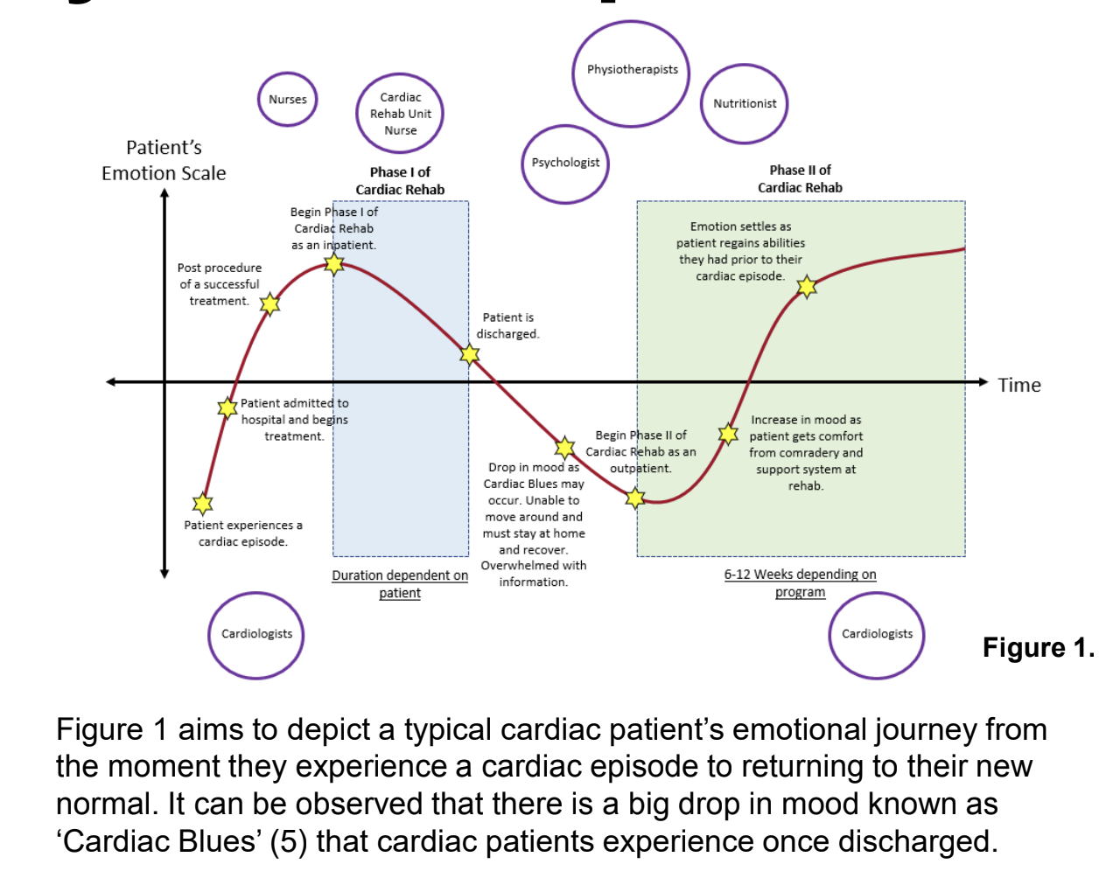
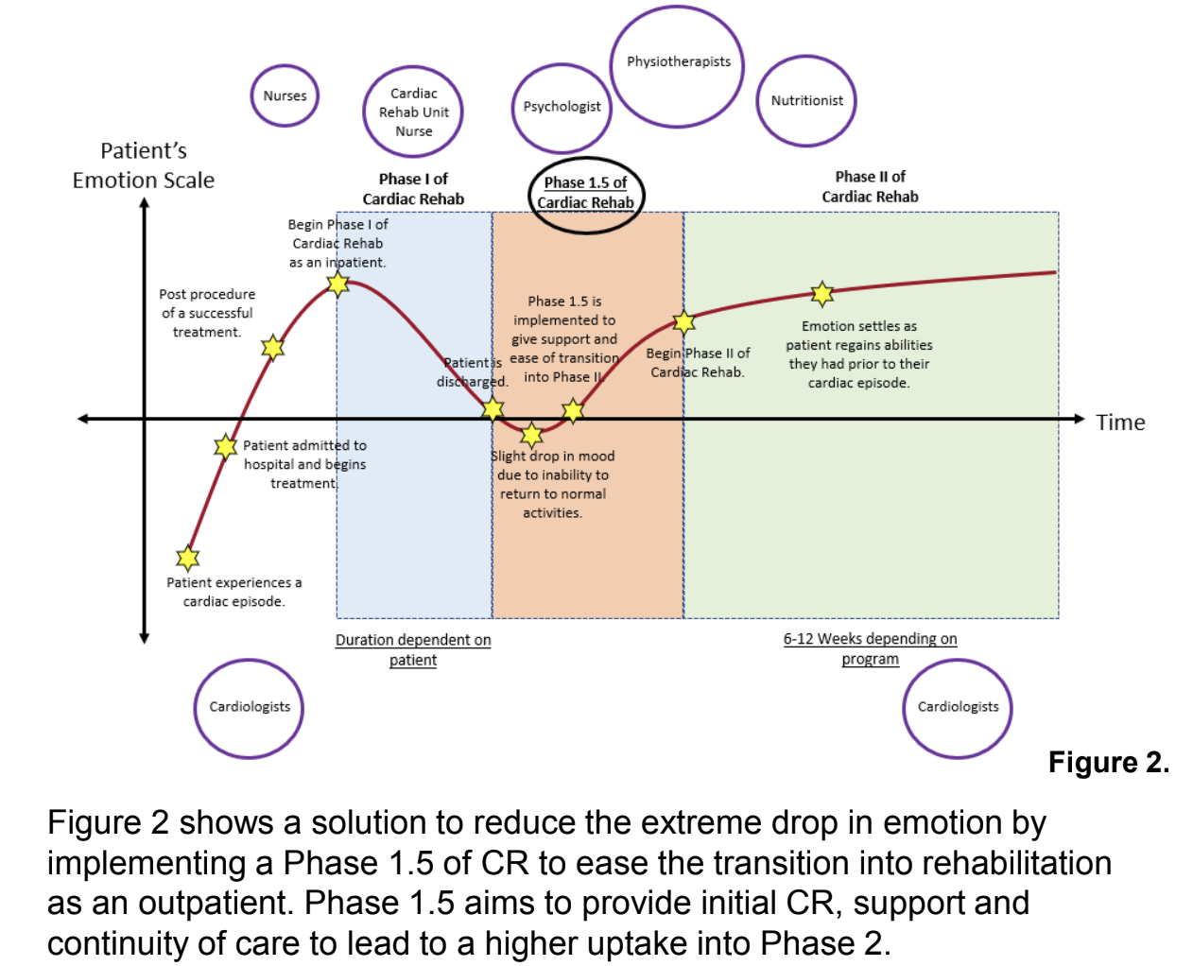
HISS 2022/2023
Systems mapping

Slide 3
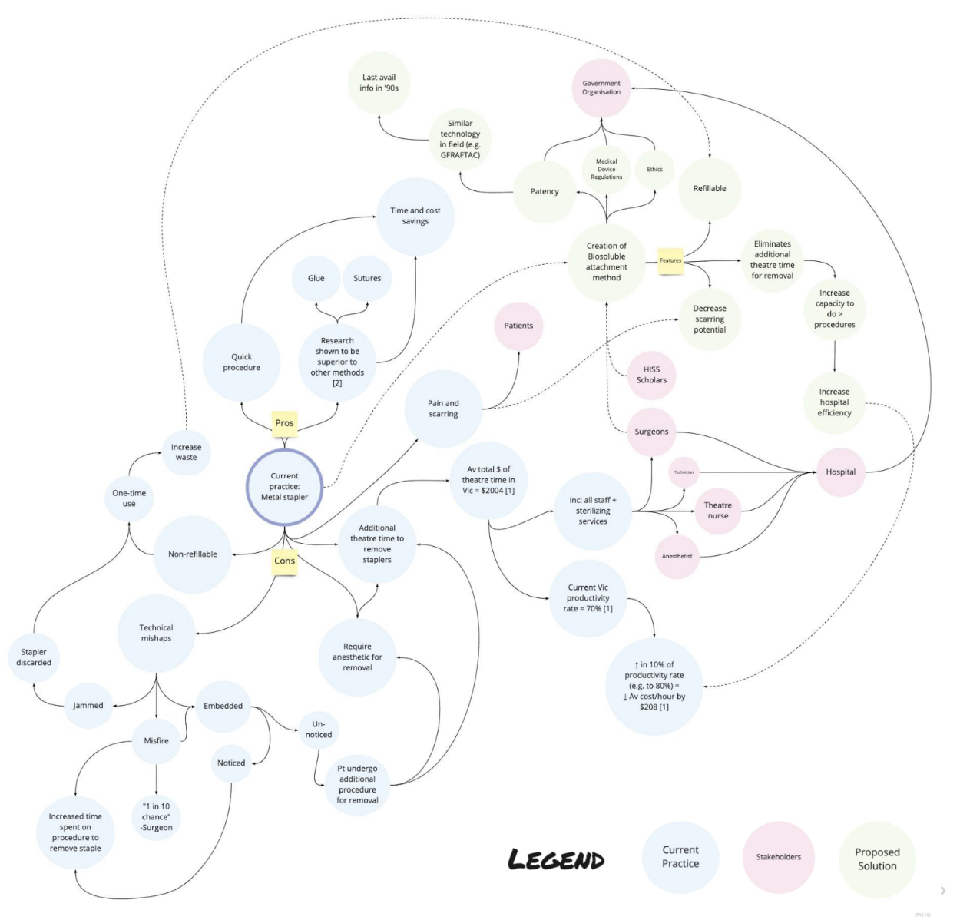
HISS 2022/2023
Systems mapping

Slide 4
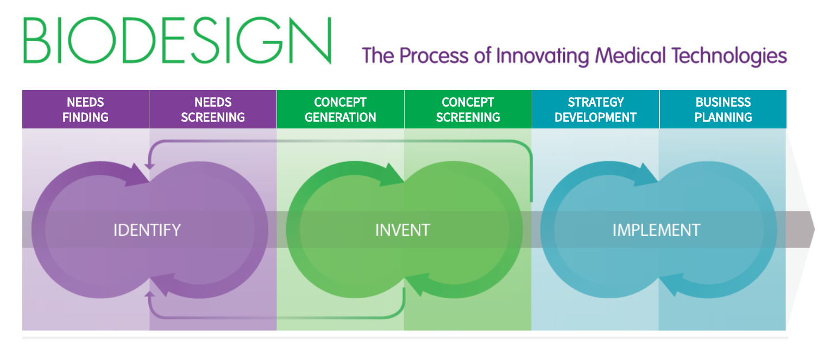
HISS 2022/2023
Ideation

Slide 5
HISS 2022/2023
Program Outline
The INVENT phase focuses on devising innovative solutions to the defined need, taking advantage of creative ideation techniques, prototyping and testing methods, and a filtering process that is based on objective risk criteria

Slide 6
HISS 2022/2023
Ideation
Ideation refers to the process of creating new concepts or ideas and is used when new solutions are required to address well-defined needs.
Write one sentence pitch on what your problem is –
Generating “how might we” questions
Consider a hypothetical need statement related to your problem eg atrial fibrillation: a way to identify the onset and duration of atrial fibrillation in patients with recurrent AF in order to improve efficiency of physician visits
HMW make a tiny recorder that a patient will not even notice?
HMW record a heart rhythm a home without touching a patient?

Slide 7
HISS 2022/2023
Ideation
Take 5 minutes to come up with your own HMW statement.

