Slide 1
Intellectual Property

Slide 2

Notes:
https://www.monash.edu/industry/commercialisation/faqs#:~:text=What%20is%20the%20role%20of,to%20license%20the%20IP%20to.

Slide 3
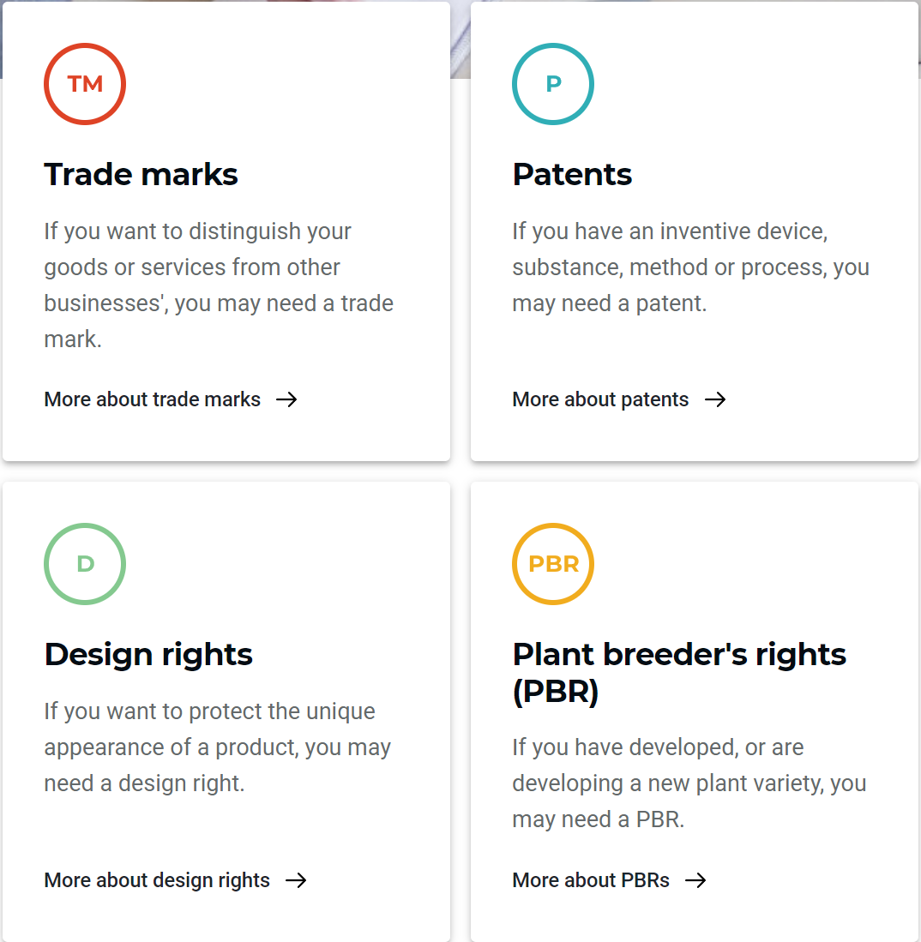
https://youtu.be/PlUNQ3_-RmI
Notes:
https://youtu.be/PlUNQ3_-RmI

Slide 4
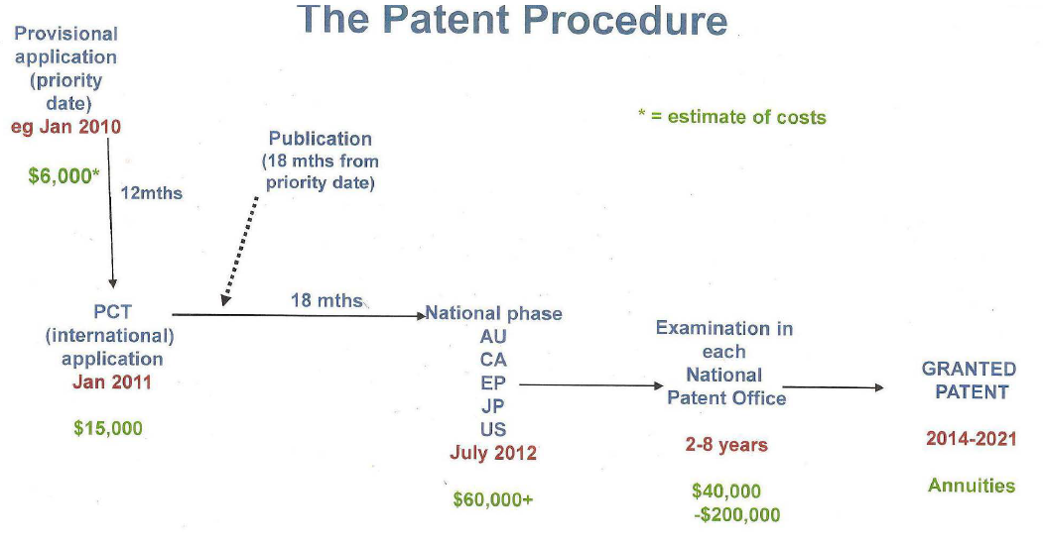
student-ip-rights-a-summary, Appendix C

Slide 5
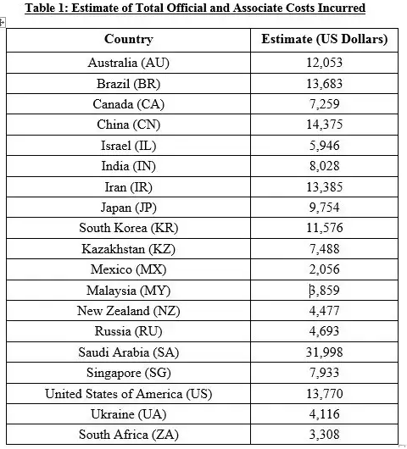
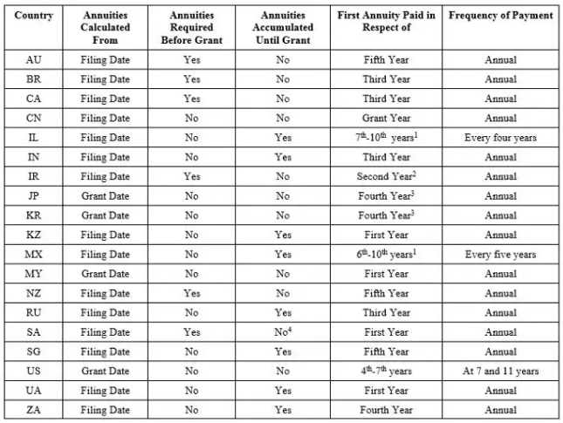
Annuities in Different Regions
https://medium.com/quantify-ip/decoding-the-patent-annuity-maze-6d31e9f93d0f#:~:text=Patent%20annuities%20(also%20known%20as%20maintenance%20or%20renewal%20fees)%20are,a%20granted%20patent%20in%20force.

Slide 6
STUDENT INTELLECTUAL PROPERTY (IP) OWNERSHIP AND RELATED RIGHTS
Under the Monash University (Vice-Chancellor) Regulations, a student owns the IP created by them during their research while enrolled as a student at Monash, except:
  Where that IP is created in association with a staff member (e.g. in the role of the student’s supervisor), the work of the staff member is owned by Monash.
  Where the IP was generated as part of a collaborative research activity must be assigned to the University.
student-ip-rights-a-summary

Slide 7
Student generated IP that is a Collaborative Research Activity
A research project undertaken by more than one person
A research project that is subject to an agreement with a third party under which the University has obligations relating to intellectual property
A research project based on a concept or proposal developed by a member of staff, affiliate or third party or collaboratively by the student and a member of staff, affiliate or third party other than one which the student has independently developed and the research for which the student will independently undertake
A research project undertaken using University resources, other than standard resources or resources procured by the University commonly provided to students or collaboration provided by the student’s supervisor in the form of standard supervisory advice and guidance at the level that would be expected.
student-ip-rights-a-summary, Appendix B

Slide 8
Student Deed of Assignment
When enrolling at the University you would have signed a deed of assignment
For HISS we have another for you to sign

Slide 9
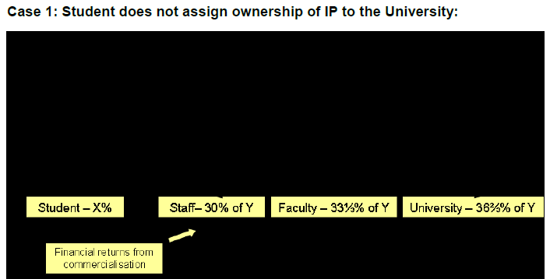
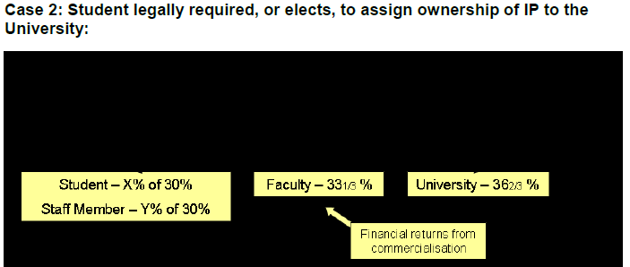
student-ip-rights-a-summary, Appendix D

