Slide 1
Stakeholder Mapping / Engagement :
A Crash Course

Slide 2
WE HAVE 2 MINUTES TO...
Meet Me
Darren Rajit
Recovering Engineer & Service Designer
What I do
Researching ways to make better, evidence based decisions for our health systems
Also
Interested in global health, technology and policy
Contact
darren.rajit@gmail.com

Slide 3
WE HAVE 1 MINUTE TO PREVIEW...
What we’ll learn today
Mindsets
Skills
A mindset is an attitude that influences how you approach anything that comes our way. Hard to pin down, but will probably be the most useful thing you will learn today
Skills develop over time, and so today will be an opportunity to develop a few design skills that will serve you well across the rest of the program, and hopefully in your careers.
Methods
We’ll be going through some specific design methods. Specifically we’ll do some stakeholder analysis, stakeholder mapping and if time allows, draft a plan for continued stakeholder engagement

Slide 4
WE HAVE 1 MINUTES TO PREVIEW...
How you you’ll learn today
Learn from others
We’ll go through the room and get folks to talk through their thought process and projects. I’ll deliver some notes as well, but we will keep lecturing to a minimum and focus on getting an output we can move forward with after today’s session.
Work with your partner
You would have been assigned a partner at the beginning of the program, so we’ll use this opportunity to get to know each other better, discover a hidden need and develop or design an idea to address it.
We’ll use a Zoom breakout room for this.
Work on your own
There will be segments where you’ll be working on your own and thinking about either your project, or whatever you want to bring to today’s session.

Slide 5
WE HAVE 5 MINUTES TO...
Learn
From
Others
What does the word ‘stakeholder’ mean to you?
How do you think stakeholders are relevant to what you’re going to be doing over the next few months?

Slide 6
WE HAVE 5 MINUTES TO...
Learn
From
Others
What does the word ‘stakeholder’ mean to you?
How do you think stakeholders are relevant to what you’re going to be doing over the next few months?
Stakeholders are whoever will be affected by our project, or whoever will influence its direction and / or outcome.
Knowing who our stakeholders are, managing their expectations, and bringing them into our design process will be crucial to ensuring that we are designing for the right problem, for the right people.

Slide 7
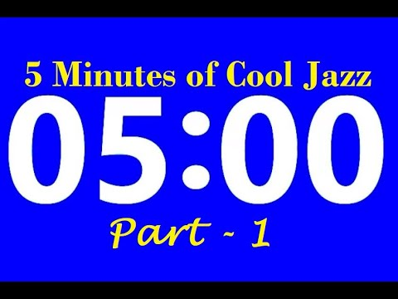
WE HAVE 5 MINUTES TO...
Work on
Your own
Let’s get down to stakeholder analysis.
List all the potential stakeholders that could possibly be relevant to your project.
No need to overthink, just focus on doing a brain dump, and quantity (be specific)
Work individually for now.
Stakeholder definition:
whoever will be affected by our project, or
whoever will influence its direction and / or outcome.
Whoever has a concrete interest in the project
Can be individuals, partner organisations, other teams etc.
Prompt:
Think about the lifecycle of your project, from napkin sketch, up to the point it is fully realised.
Notes:
Day in a life - journey mappy activity

Slide 8
WE HAVE 5 MINUTES TO...
Learn
From
Others
What themes or types of stakeholders do you see emerging out of your list?

Slide 9
WE HAVE 5 MINUTES TO...
Learn
From
Others
What themes or types of stakeholders do you see emerging out of your list?
There are *TONS* of ways we can look at our stakeholders, and likely this will depend on your project. (eg: beneficiaries vs funders vs customers, users, developers, etc.)
For the purposes of this session, we will focus on 1 lens:
Their position on a impact-influence matrix.

Slide 10
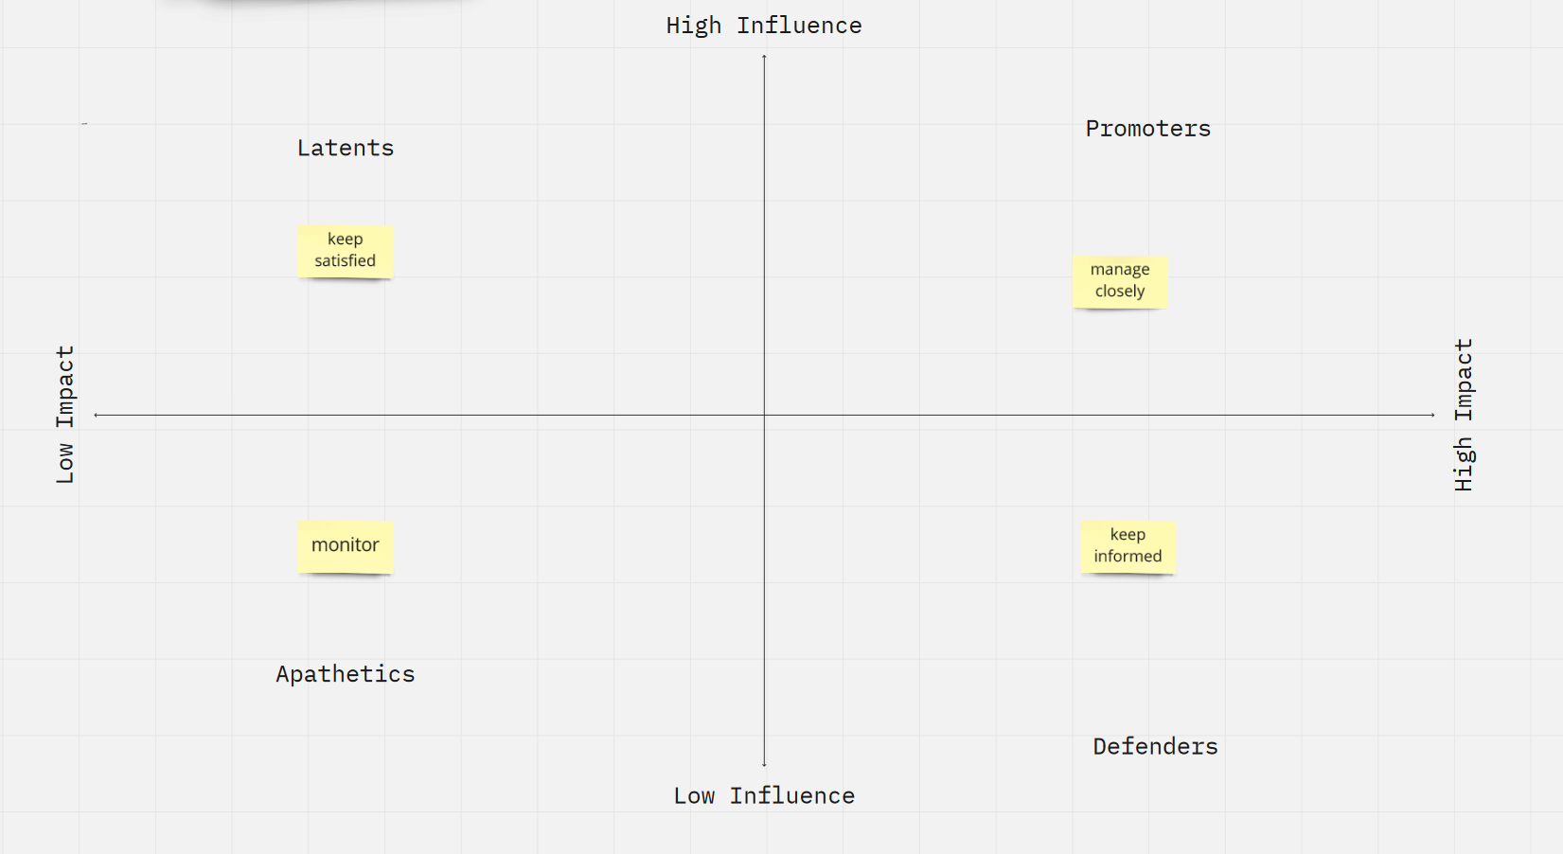
https://miro.com/app/board/uXjVOdbwTnk=/?invite_link_id=295753060380
Here we organise our stakeholders according to the level of impact the project will have on them, and their level of influence over the project.
We do this to help us prioritise our stakeholder engagement strategy.

Slide 11
WE HAVE 5 MINUTES TO...
Let’s get some stakeholder mapping done:
Place your stakeholders on the matrix according to the level of impact the project will have on them, and their level of influence over the project.
Commit to a quadrant on the matrix when assigning a stakeholder.
Link to miro template: https://miro.com/app/board/uXjVOdbwTnk=/?invite_link_id=295753060380
Notes:
Day in a life - journey mappy activity

Slide 12

WE HAVE 5 MINUTES TO…
Work on your own
Let’s get some stakeholder mapping done:
By far the most important thing about a stakeholder map is the value exchange between our stakeholders.
Sketch out the relationships between your stakeholders with *directional arrows*
This can include things like funding, social relationships, reporting lines etc.
Notes:
Day in a life - journey mappy activity

Slide 13
WE HAVE 3 MINUTES TO…
Learn from Others
Reflect on how that activity make you feel.
How did you feel about the process?
What do you think of what you came up with?
Notes:
Day in a life - journey mappy activity

Slide 14
WE HAVE 3 MINUTES TO…
Learn from Others
Being uncomfortable
You may feel that you do not have enough information about your stakeholders to:
determine their relationships in the system and
Determine how they may be relevant to your project.
That is natural! Stakeholder mapping is the first step in mapping out your problem so that you can prioritise who to talk to first to get a handle of the landscape.
Stakeholder maps are conversation tools in of themselves
It is unwise to make assumptions about our stakeholders and the problem we’re trying to solve. Stakeholder maps are a good way to lay out the existing assumptions that we are making about our problem. We can then present these to our stakeholders and use the map as a tool to guide a potential conversation or interview.
We can then iterate on our maps as an ongoing reference for ourselves as we navigate through our project.
Notes:
Day in a life - journey mappy activity

Slide 15


WE HAVE 10 MINUTES TO...
Work with your partner
Let’s iterate on our stakeholder map:
Take turns going through your stakeholder maps with your partner.
Take note of any differences in opinion that may crop up with your partner.
Consolidate a final stakeholder map that you both agree on.
Iterate further on your stakeholder map if there is new information you would like to add.
Notes:
Day in a life - journey mappy activity

Slide 16
WE HAVE 3 MINUTES TO…
Learn from Others
Reflect on how that activity make you feel.
How did you feel about the process?
What do you think of the end product you came up with?
How do you plan to use this map in your project?
Notes:
Day in a life - journey mappy activity

Slide 17
WE HAVE 3 MINUTES TO…
Learn from Others
Strengths of stakeholder maps when used right
Stakeholder mapping helps to build consensus within a project team on who the key stakeholders are in a project, and the extent of their relationships.
Hopefully, you have consensus at least within your duos. Stakeholder mapping in of itself can be a stakeholder engagement strategy.
Risks when stakeholder mapping
Stakeholder mapping is *NOT* a solo activity. It needs to involve the relevant stakeholder for it to achieve its purpose. Without all stakeholders brought to the table, the map will never be complete or comprehensive.
Stakeholders will always make assumptions about other stakeholders. The role of you (as designers) is understanding where all of these stakeholders are coming from, and arriving to some approximation of the truth.
Notes:
Day in a life - journey mappy activity

Slide 18
WE HAVE 10 MINUTES TO...
Work with your partner
Let’s focus on what is to come, defining a stakeholder engagement strategy:
Focusing on the top right quadrant of the stakeholder map, plan:
How you will engage with the stakeholders in this quadrant
How often you will engage
What will you engage these stakeholders for
IF top right is looking sparse, focus on bottom right as well.
Notes:
Day in a life - journey mappy activity

