Slide 1




Monash Healthcare Innovation Summer Scholarship
2022/2023
Existing solutions, alignment, and gaps
Andrew Xu

Slide 2
Why?
HISS 2022/2023

Slide 3
Why?
HISS 2022/2023
Don’t re-invent the wheel - saves money, time, and effort
Establish current best line of care (baseline)
Identify areas of improvement

Slide 4
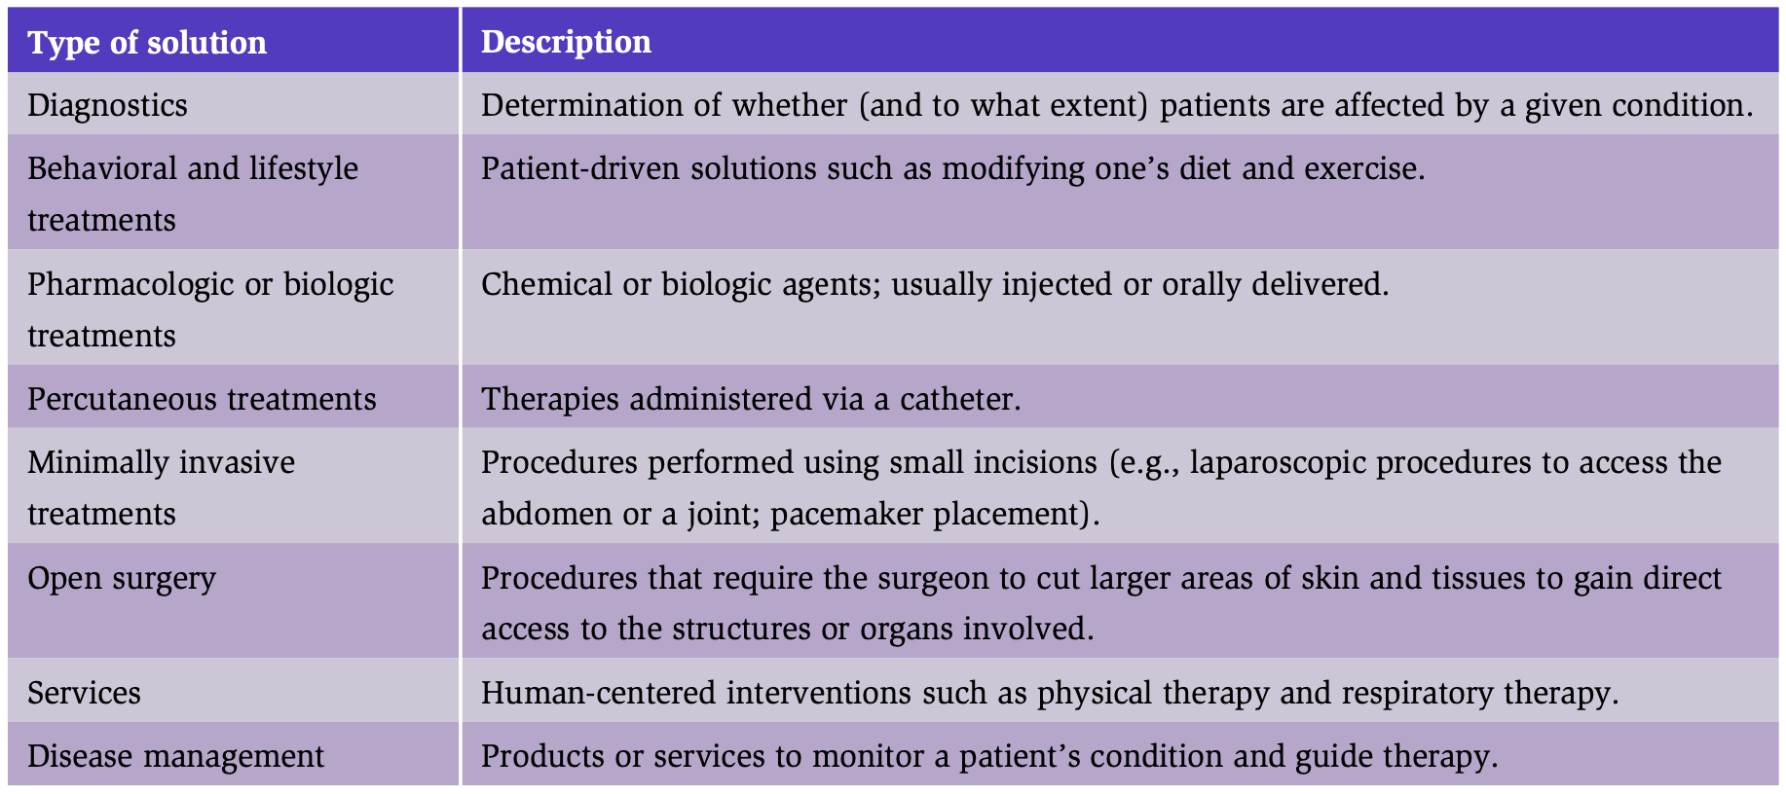
Main types of solutions to consider
HISS 2022/2023

Slide 5
Approach to existing solution analysis
HISS 2022/2023
Overview of solution
Clinical solution profile
Economic solution profile
Utilisation solution profile
Emerging solution profile
Summary of solution landscape
Solution alignment
Gaps in solution

Slide 6
Overview of solution
HISS 2022/2023
High-level description
Who uses it
How it’s used
Skill required by the user
Useful for refining needs statement / acceptance criteria

Slide 7
Clinical solution profile
HISS 2022/2023
Describe clinical rationale / indication
Mechanism of action
Clinical evidence for safety and efficacy
Patient segments
Useful for gaps analysis

Slide 8
Economic solution profile
HISS 2022/2023
Cost (including both direct and ancillary costs)
Who / what entity pays for it
Useful for market analysis

Slide 9
Utilisation solution profile
HISS 2022/2023
Describe exactly how it’s used in clinical practice (step-by-step), by whom, and where
Useful for market analysis

Slide 10
Emerging solution profile
HISS 2022/2023
If it’s a relatively novel technology, look at how it’s going to impact the solution landscape
Useful for needs statement / acceptance criteria

Slide 11
Summary of solution landscape
HISS 2022/2023
Develop a cohesive assessment of potential opportunities within the current and emerging solution environment, focusing on the gap between these alternatives and the defined needs criteria
Useful for pitch

Slide 12
Solution alignment
HISS 2022/2023
Compare the solution to each dot-point of the acceptance criteria, describe whether it addresses it.

Slide 13
Solution gaps
HISS 2022/2023
Compare the solution to each dot-point of the acceptance criteria, describe whether it doesn’t address it.

Slide 14
HISS 2022/2023
Questions?

