Slide 1




Monash Healthcare Innovation Summer Scholarship
2022/2023
Week 3 Deliverables Intro
Tanushree Sharma
Yvonne Strover

Slide 2
Outline
HISS 2022/2023
Existing Solutions - How : Why/What
Solution Alignment
Gaps in solution
Failed solutions
Stakeholder Mapping
State of the Art Summary
Notes:
Program deliverables can look different for each project. Depends on the type of project and what the end goal is. This is what HCD is.

Slide 3
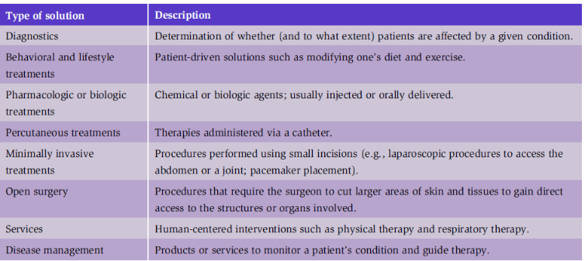
HISS 2021/2022
1.5.A Existing Solutions - How : Why/What
Your projects will differ in this area. All different types of solutions should be considered including the types below if applicable.
*treating the problem through one or more small puncture sites through the skin
Pages in ebook 133-134
Notes:
pg 133-134
table 2.2.1

Slide 4
HISS 2021/2022
1.5.B Solution Alignment
Think about patient motivation, capability and interest.
Do the solutions you found align with all of these ideas?
What are the problems with each?
Notes:
user interviews become important here. if you dont have any, thats okay. try to infer or speak to clinical perspective

Slide 5
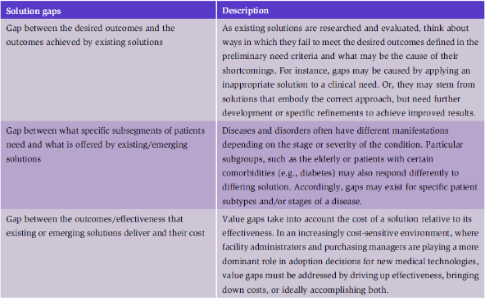
HISS 2021/2022
1.5.C Gaps in solutions
The desired outcome of this analysis is to find a gap (or gaps) in the landscape of existing solutions that represents an opportunity to address the stated need.
Notes:
pg 135
table 2.2.2

Slide 6
HISS 2021/2022
1.5.D Failed solutions
The solutions you have found and the gaps are there for a reason.
There would have been solutions that were tried and failed to get to that stage.
There should be literature on tried and failed attempts or on areas that have been explored that aren’t feasible.
Notes:
pg 148

Slide 7
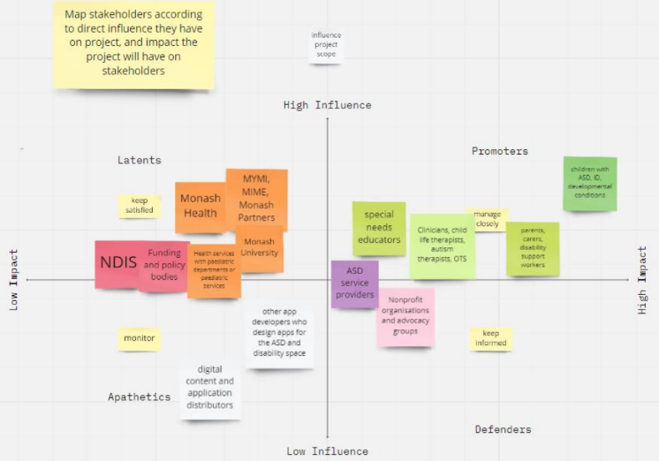
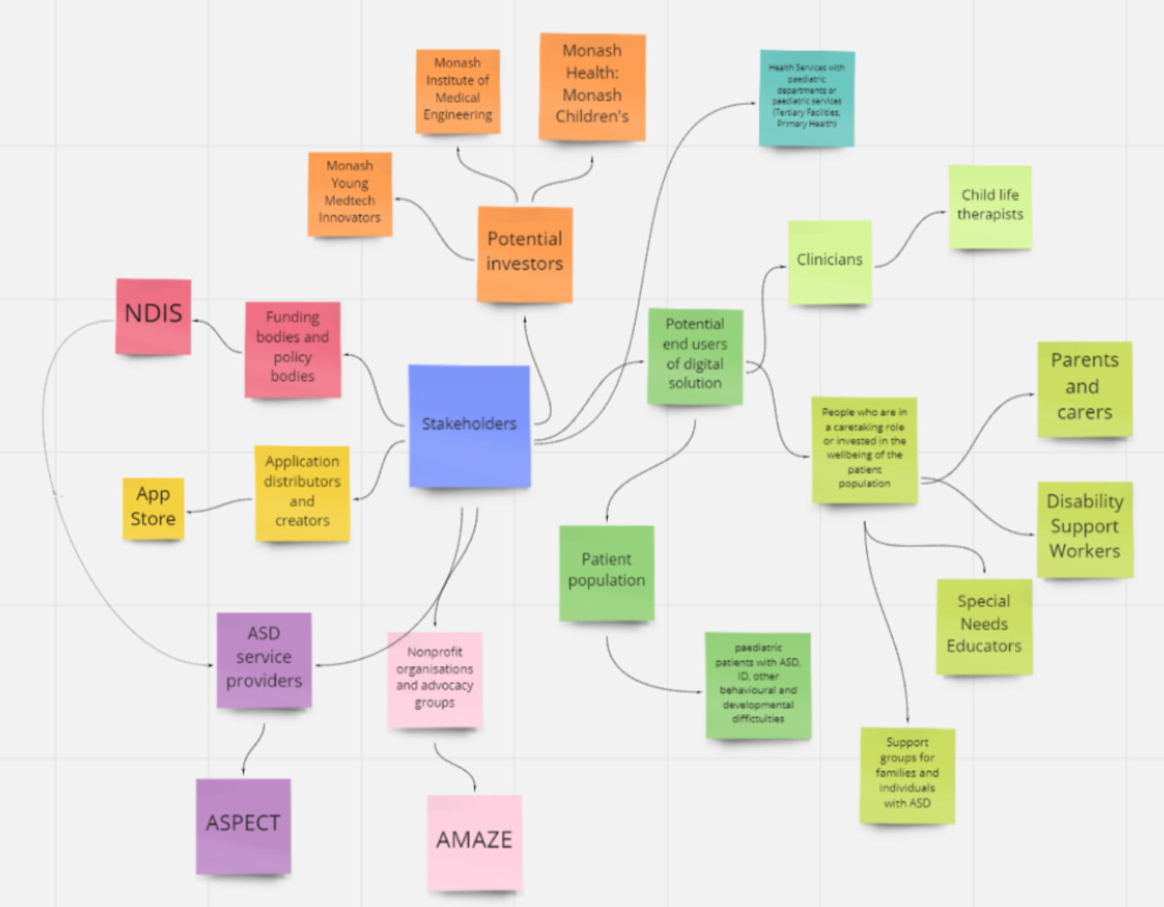
HISS 2021/2022
Stakeholder Mapping* due in week 4

Slide 8
HISS 2021/2022
State of the Art Summary
WHAT
A summary of the technologies used in the current solutions that represent the "state of the art"
i.e. what is currently considered best practice? the gold standard?
WHY
It is important to understand what is believed to be the most current view of the State of the Art in the field
HOW
Based on a review of the "best" or most accepted existing solutions, the underlying technologies and principles on which they are based is described as a reference
Notes:
pg 148

Slide 9
HISS 2021/2022
Deliverables
Existing Solutions: For each solution found, analyse the parts. Submit in table form with name of solution and sentence/small paragraph for each subpoint analysing the solution
State of the Art Summary: a short paragraph detailing what the current most used practice is for your problem and why
Due by: 5pm on Thursday with a presentation to team on Friday at 9am
Notes:
DSF: pg 114-124
ES: 134-148
don’t divide into each topic for existing solution. just analyse each area for each solution.

Slide 10
HISS 2022/2023
Thank you and good luck!

