Slide 1




Monash Healthcare Innovation Summer Scholarship
2022/2023
Disease State Fundamentals
Andrew Xu

Slide 2
HISS 2022/2023
Why?
Better understanding of disease = better solutions
Not understanding disease fundamentals limits ability to come up with solutions
Helps with understanding who the key stakeholders are

Slide 3
Why?
HISS 2022/2023
Better understanding of disease = better solutions
Not understanding disease fundamentals limits ability to come up with solutions
Helps with understanding who the key stakeholders are

Slide 4
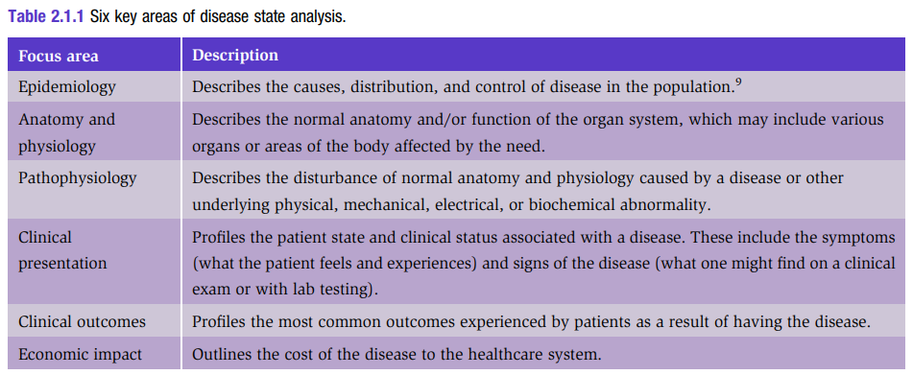
Key areas to cover
HISS 2022/2023

Slide 5
Recommendations
HISS 2022/2023
Find the specific subcategories of the overall disease you’re looking at that’s relevant to the problem you’re trying to solve.
The problem you’re trying to address does not necessarily affect everyone with the disease.

Slide 6
Resources
HISS 2022/2023
AMBOSS (5 day free trial)
UpToDate (should be free)
Calgary guide (free)

Slide 7
HISS 2022/2023
Questions?

Slide 8
Ethics - quick summary
HISS 2022/2023
Realistically - don’t have time to submit an application for ethics research
But double check with your clinician to see if they have ethics approval
Workarounds:
Call it a “conversation” rather than “interview”
Ask your clinician to conduct interviews on behalf of you
Explicitly state that the information won’t be used for academic purposes (e.g. publishing papers, etc)

