Slide 1




Project [NAME]
Week 12 Deliverable Summary
[template, delete]
ENTER OWN IMAGE HERE (e.g. scholar and clinician photo)
Monash Healthcare Innovation Summer Scholarship
2022/2023
Scholars:
Clinicians:

Slide 2
Project Impetus - Week 12 Deliverables
HISS 2022/2023
Mission Statement:
We are making a software application to solve the problem of inaccurate medication dosages in transplant patients to lower infection rates after the transplant procedure

Slide 3
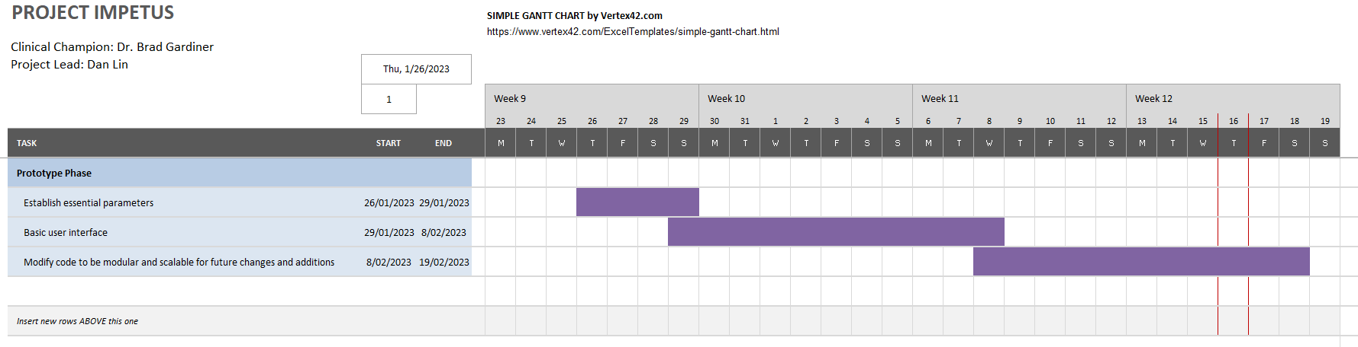
Project Impetus - Week 12 Deliverables
Gantt Chart
HISS 2022/2023

Slide 4
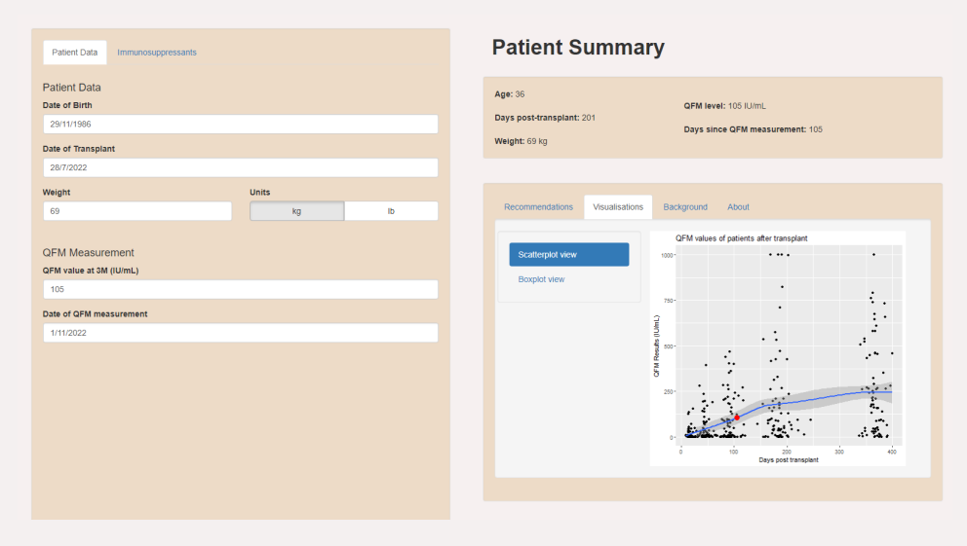
Project Impetus - Week 12 Deliverables
Prototyping progress
HISS 2022/2023

Slide 5
Project [NAME] - Week 12 Deliverables
Project Reflection
HISS 2022/2023
End of week reflections/highlights/learning points:
[Enter here any additional points from the week that are valuable to share]
…
Final Questions:
[Enter here any particular blockers or questions you have for next week/want assistance with from an organiser, clinician, expert in the field]
…
[template, delete]
FEEL FREE TO CHANGE ANY FORMATS
just make sure key information is included

