Slide 1




Connecting research, grants and funding streams in the MedTech ecosystem
Monash Healthcare Innovation Summer Scholarship
2022/2023
Julie Dao

Slide 2
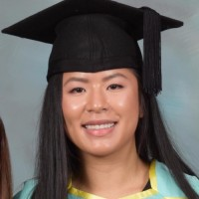
Who am I?
HISS 2022/2023
Julie Dao (PhD Candidate)
BSc (Hons)
Vascular Pathophysiology and Therapeutics Group
Victorian Heart Hospital / MonashHealth / Monash Biomedicine Discovery Institute
Faculty of Medicine Nursing and Health Sciences
Immediate Past President of Monash Young MedTech Innovators
Head of Monash Heart Hackathon team
MedTech Actuator Menzies Scholar
Head of Innovation at Medical Pantry
Founded some projects and had some projects die too

Slide 3
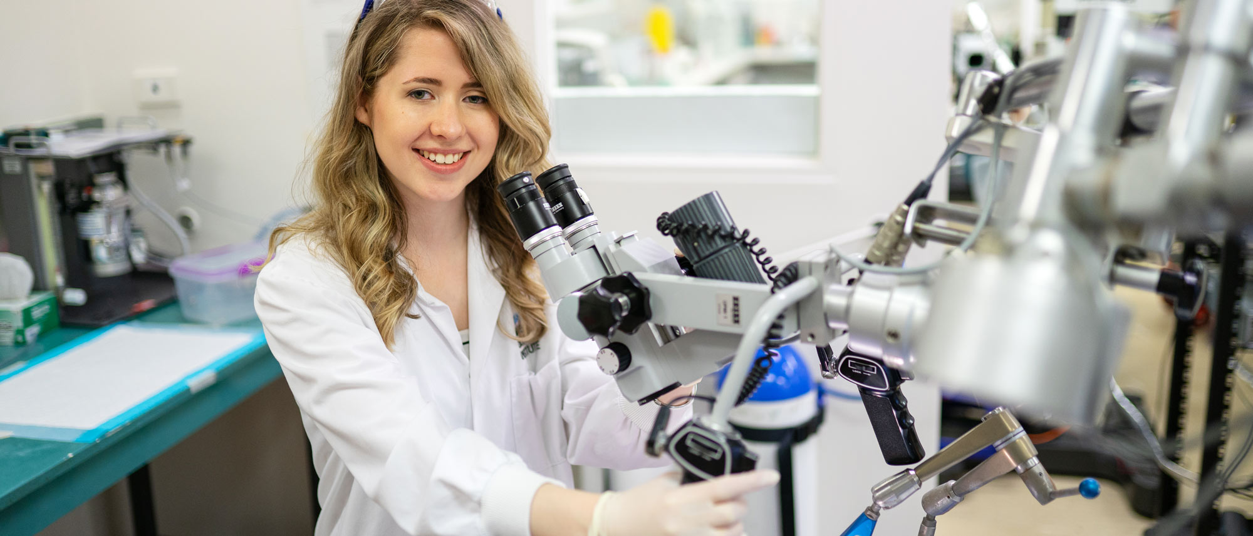


Crux of today’s presentation
Research, grants and funding are important in getting a project started and off the ground
HISS 2022/2023
Research
Grants/Funding
Project

Slide 4


Crux of today’s presentation
Research, grants and funding are important in getting a project started and off the ground
HISS 2022/2023

Slide 5
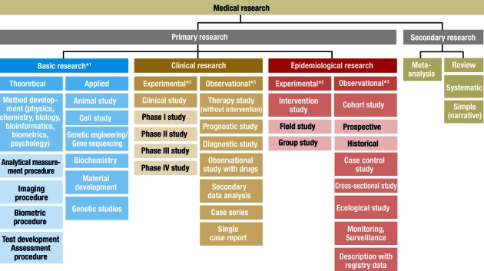
What is Research?
HISS 2022/2023
Research is a logical and systematic search for new and useful information on a particular topic
Research is important both in scientific and non-scientific fields
Aims to solve new problems and phenomena that occur in everyday life
Researchers undertake work to find causes, solutions, explanations and applications

Slide 6
What is Research?
HISS 2022/2023
Basic medical research (experimental research) includes animal experiments, cell studies, biochemical, genetic and physiological investigations, and studies on the properties of drugs and or materials
Clinical studies include both intervention (or experimental) studies and non-interventional studies

Slide 7

Why is it Important?
HISS 2022/2023

Slide 8
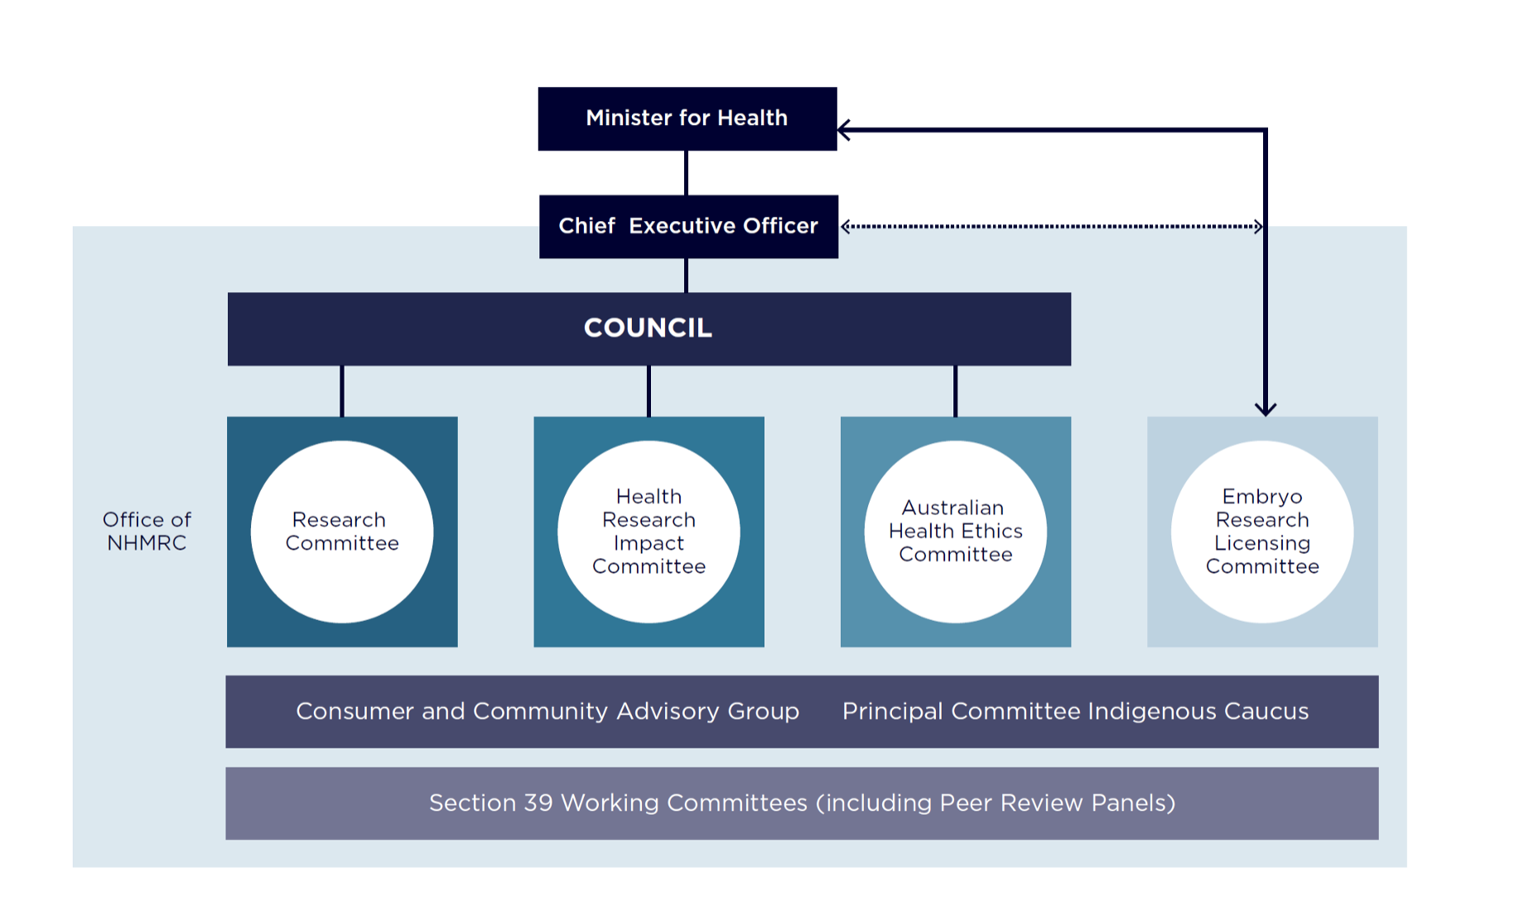
Why is it Important?
HISS 2022/2023
National Health and Medical Research Council is the main statutory authority of the Australian Government responsible for medical research
The NHMRC pursues activities designed to:
  Raise the standard of individual and public health throughout Australia
  Foster the development of consistent health standards between the various states and Territories
  Foster medical research and training and public health research and training throughout Australia
  Foster consideration of ethical issues relating to health

Slide 9
Types
HISS 2022/2023
NHMRC invests in health and medical research through its grant program.
NHMRC does not direct funding to any specific disease or health issue.
Research topics are investigator driven and funding decisions are the outcome of a competitive process that relies on the collective judgement of independent peer reviewers, guided by NHMRC's Principles of peer review.
NHMRC's grant program consists of four funding streams:
Investigator Grants, which provide the highest-performing researchers at all career stages with funding for their salary (if required) and a significant research support package.
Synergy Grants, which provide funding for outstanding multi-disciplinary research teams to work together to answer complex questions.
Ideas Grants, which support researchers at all career stages to pursue innovative and creative research projects.
Strategic and Leveraging Grants, which support research that addresses identified national needs. These grant schemes include:
  Targeted and Urgent Calls for Research
  Clinical Trials and Cohort Studies
  Centres of Research Excellence
  Development Grants
  international collaborative schemes
  Partnerships for Better Health (Partnership Centres and Partnership Projects).

Slide 10
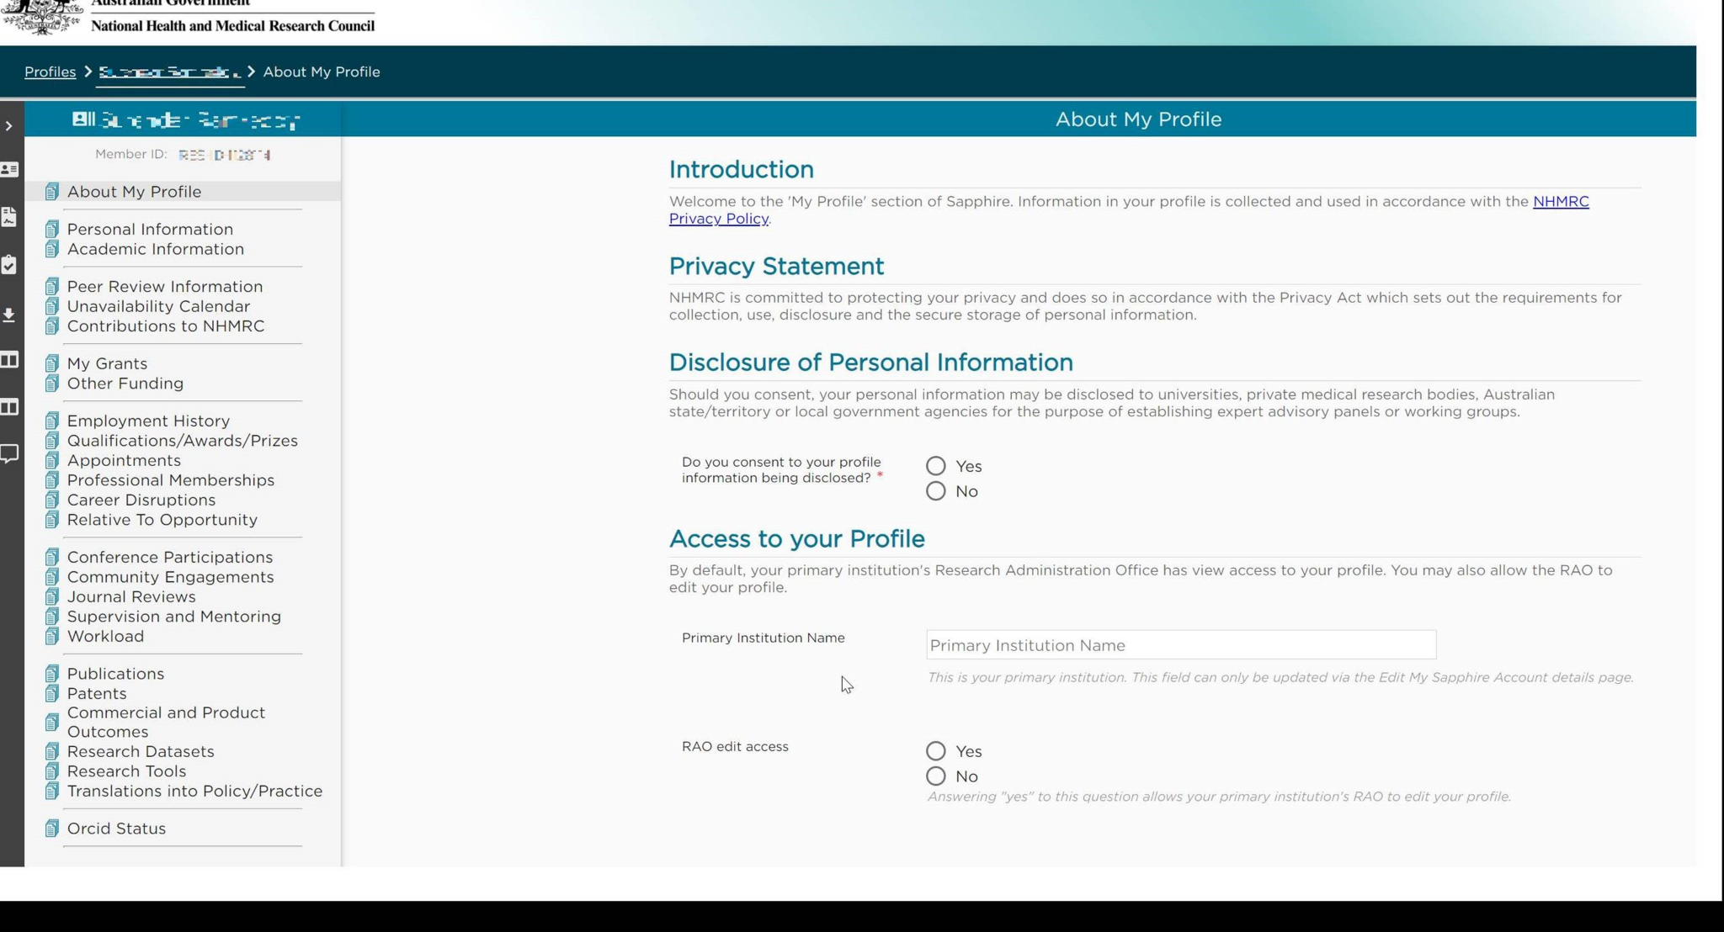
Sapphire
HISS 2022/2023

Slide 11
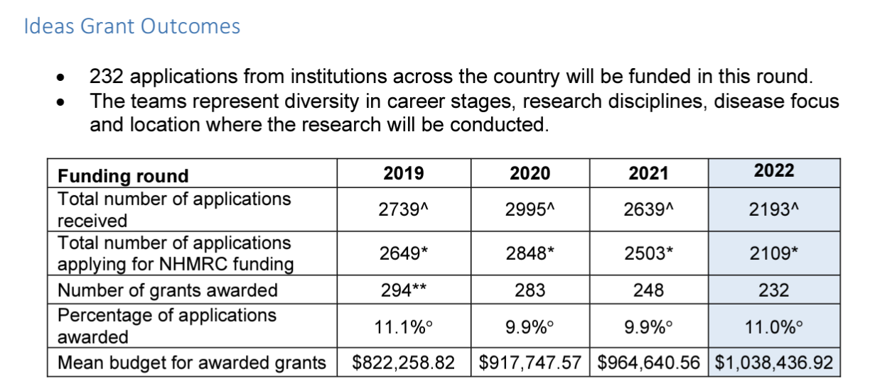
Focusing in on Ideas Grants
HISS 2022/2023

Slide 12
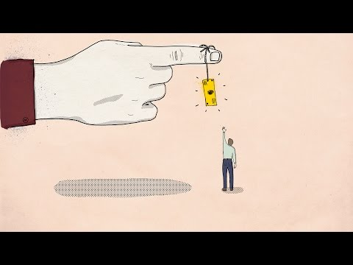
A quick-snap shot of funding
HISS 2022/2023

Slide 13
Focusing in on Ideas Grants
HISS 2022/2023
chrome-extension://efaidnbmnnnibpcajpcglclefindmkaj/https://www.nhmrc.gov.au/sites/default/files/documents/attachments/grant%20documents/2020_ideas_grants_recommended_for_funding_commencing_2021.pdf

Slide 14

MedTech Actuator?
HISS 2022/2023
MedTech Actuator is Australia’s premier medical technology commercialisation initiative
MedTech startups accelerate from Seed stage to Series A in 15 months?

Slide 15
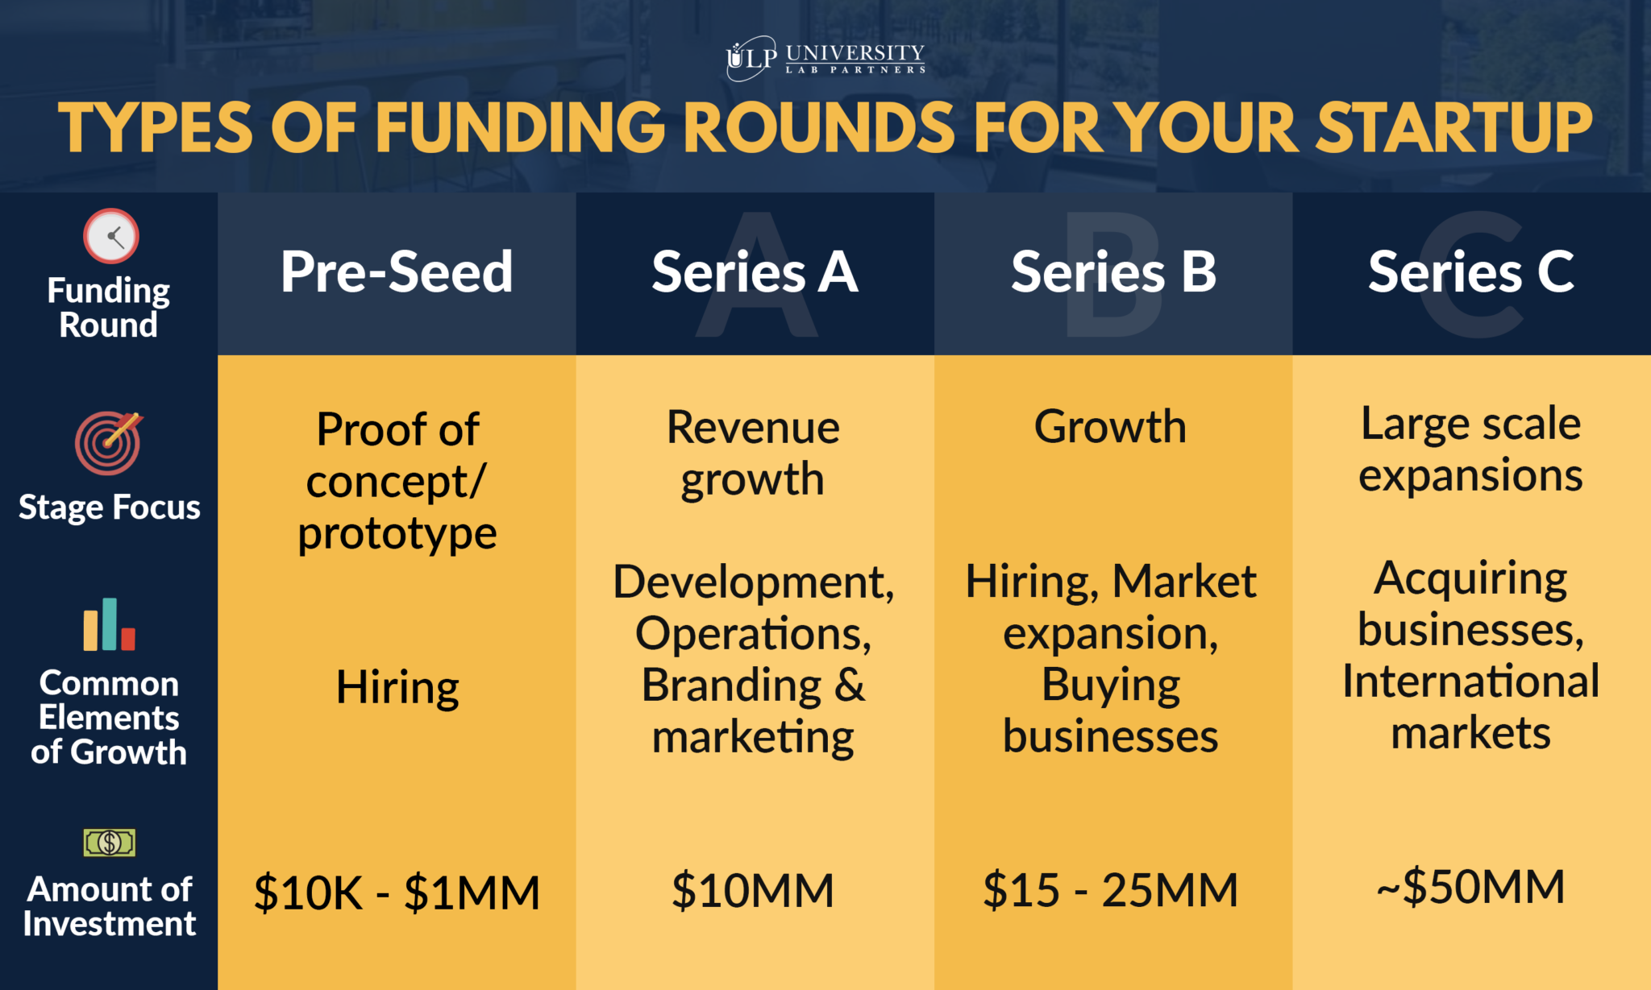
MedTech Actuator?
HISS 2022/2023
MedTech Actuator is Australia’s premier medical technology commercialisation initiative
MedTech Acccelerator: MedTech startups accelerate from Seed stage to Series A in 15 months?

Slide 16

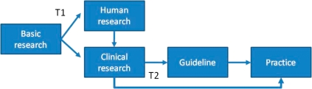
How long does research take to become translated?
HISS 2022/2023

Slide 17

Startmate?
HISS 2022/2023
Fund for startups more broadly and is not specific to medical technology (variety of interests)
Startmate have had founders with little more than an idea go on to raise a seed round, teams that have raised a Series A round mid-program and follow up with a Series B round 12 months later

Slide 18
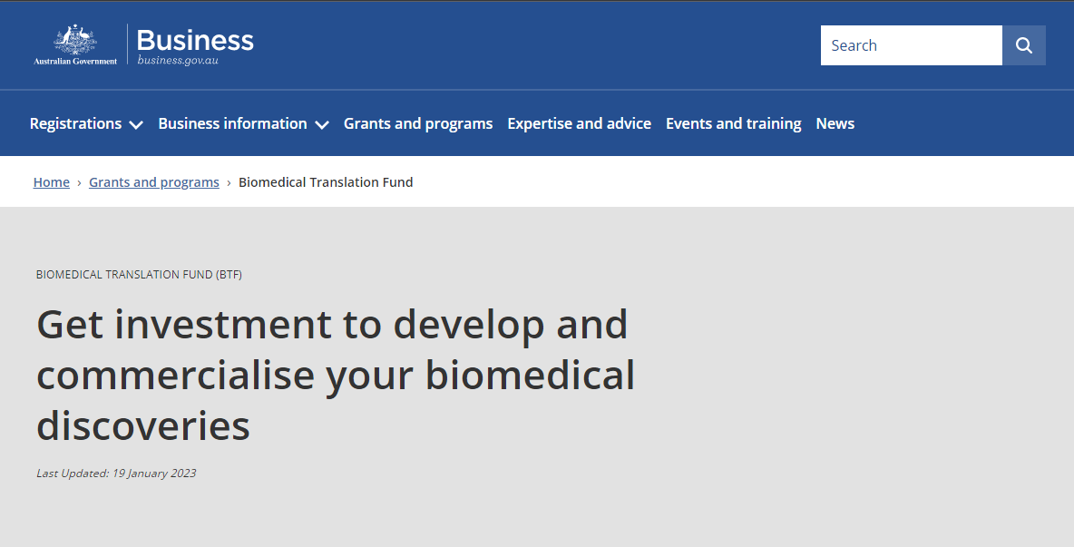
Biomedical Translation Fund
HISS 2022/2023
The Biomedical Translation Fund (BTF) provides companies with venture capital through licensed private sector fund managers
The BTF Program policy objectives are to:
Invest in promising biomedical discoveries and assist in their commercialisation
Encourage the development of companies commercialising biomedical discoveries by addressing capital and management constraints

Slide 19

Take away message
HISS 2022/2023

Slide 20
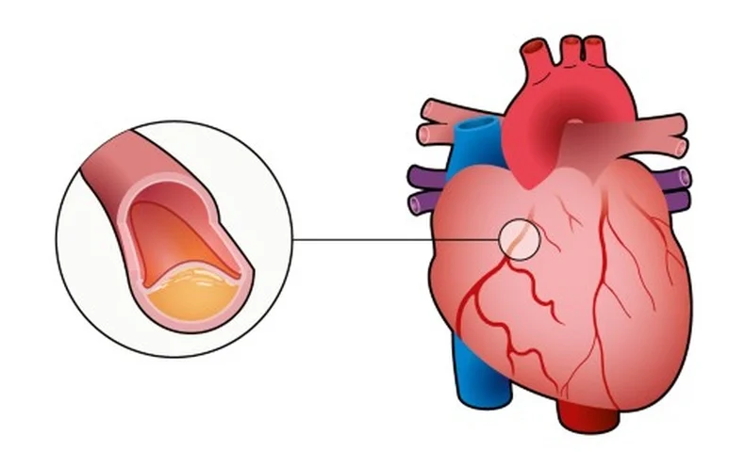

How I Want you to Start Thinking
HISS 2022/2023
Problem you are passionate about solving?
What are the different ways we can tackle this problem?
Medication changes, lifestyle changes etc.
Support of the heart through mechanical means?
Who is doing this work?

Slide 21
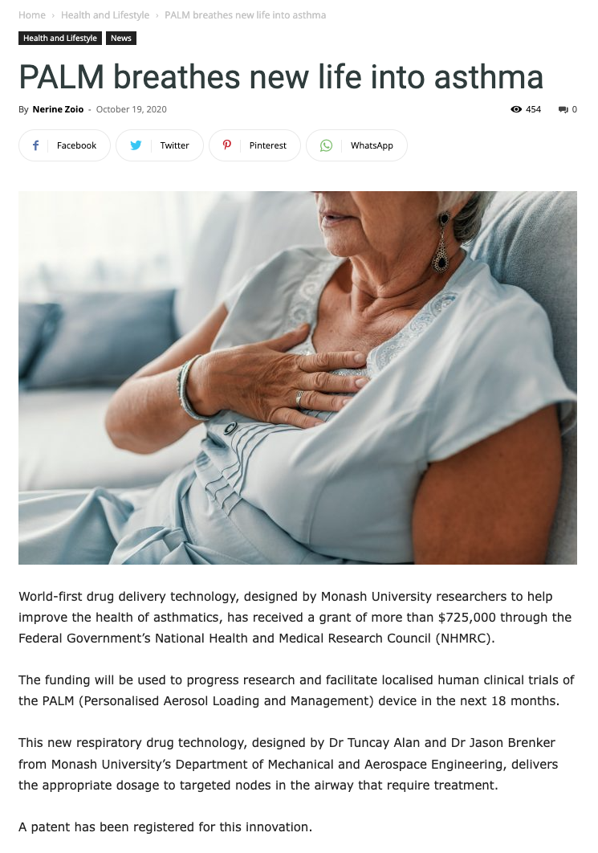
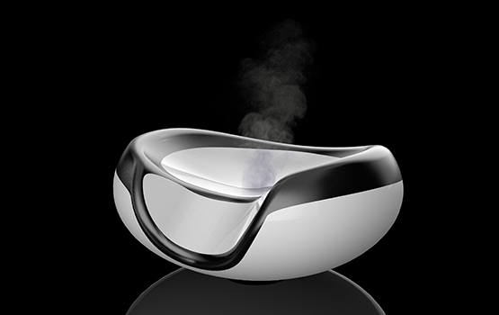
Crux of today’s presentation
Research, grants and funding are important in getting a project started and off the ground
HISS 2022/2023
Research
Grants/Funding
Project

Slide 22
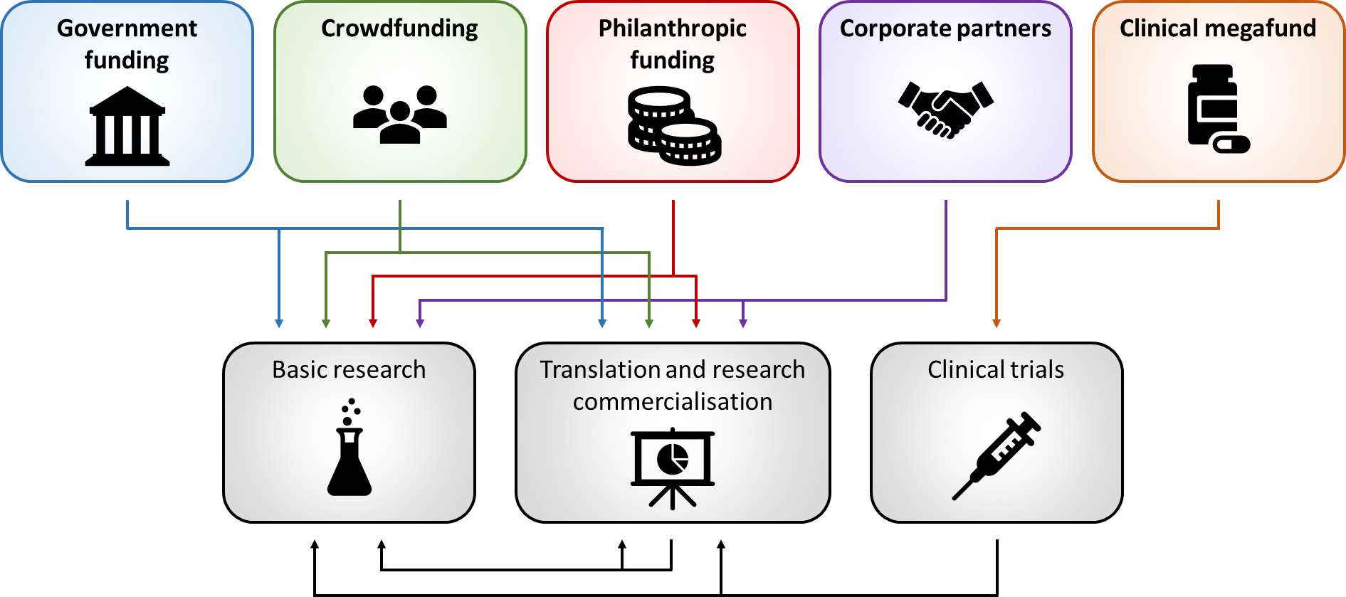
Only the tip of the iceberg
HISS 2022/2023

