Slide 1




Monash Healthcare Innovation Summer Scholarships 2022/2023
Welcome to Program
Julie Dao
Jason Brenker
Tanushree Sharma
Andrew Xu

Slide 2
Acknowledgement of Country
HISS 2022/2023
We wish to acknowledge the Traditional Owners of the land whose Monash University campuses share, the Wurundjeri People of the Kulin Nation and pay respects to Elders past and present

Slide 3
Outline
HISS 2022/2023
  Purpose
  Team
  Program Outcome
  Program Deliverables
Notes:
Program deliverables can look different for each project. Depends on the type of project and what the end goal is. This is what HCD is.

Slide 4
Purpose
HISS 2022/2023
Connecting students from across faculties and disciplines to evaluate concepts for new technologies and create proof-of-concepts for real world problems.
Demonstrating to Monash the untapped student innovation ecosystem (all aspects of society are involved in the creation of a healthier and kinder Australia).
We want to create a proactive arena for students, where they are considered equal, and can be active in decision making when addressing important clinical problems.
We want to reduce deaths and increase overall health-outcomes.

Slide 5
Organising Team
HISS 2022/2023
Julie Dao: kim.dao@monash.edu, 0433838221
Jason Brenker: jason.brenker@monash.edu, 0399050420
Dinasha Wimalasiri: dwim0001@student.monash.edu, 0433456588
Tanushree Sharma: tsha0024@student.monash.edu, 0458867931
Andrew Xu: dex1@student.unimelb.edu.au, 0426837667
Yvonne Strover: ystr0001@student.monash.edu. 0432790541
Notes:
Powerpoint is shared with you guys on the drive.

Slide 6
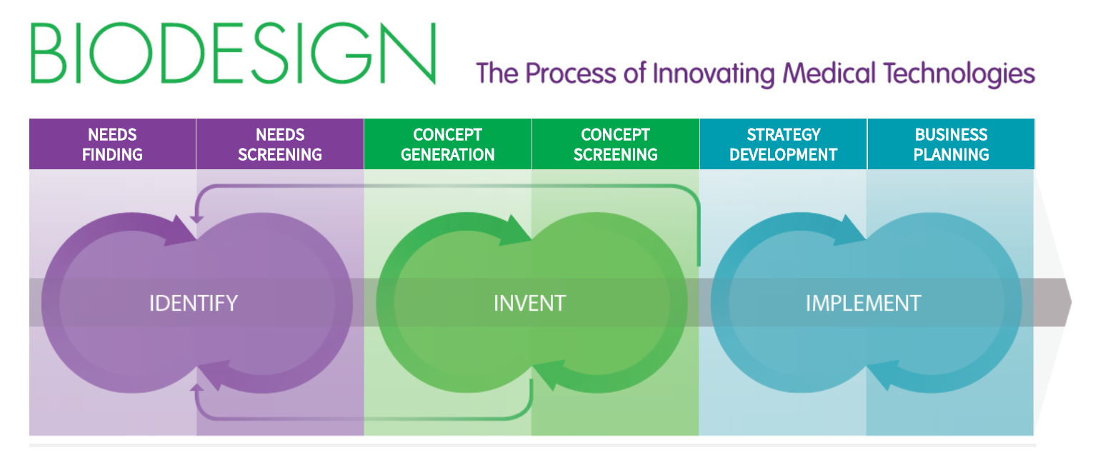
Program Outline
HISS 2022/2023
The 12-week scholarship program is divided up into three distinct phases to help guide you as scholars through the process of validating and creating innovative tech-agnostic solutions to address a clinical need
Notes:
Open biodesign textbook. Read through pages …

Slide 7
Program Outline
HISS 2022/2023
The IDENTIFY phase focuses on understanding a promising unmet clinical need presented to you by your clinical champion, and screening the characteristics and context that the problem exists in
Week 1 to Week 3

Slide 8

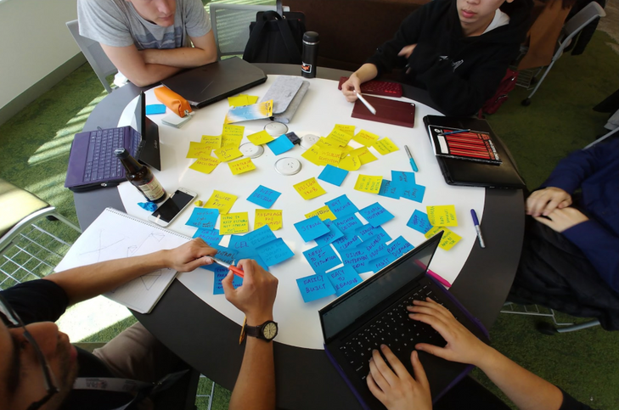
Program Outline
HISS 2022/2023
SPRINT 1 - Student Led Problem Discovery
3-weeks researching, evaluating unmet clinical need
Students will pitch their projects / clinical need in to MYMI, MIME and Monash Partners
Key Deliverables
  Executive summary
  Pitch
Notes:
Program is divided into Sprints. You will unpack the problem with your clinicians. The goal is to understand your problem so you can pitch it to people to support you. The executive summary is something that is valuable and you will show this to others. It will be used in the future. Executive summary should be done to a high quality. Ask for feedback from CC or us all the time if you are unsure. Every Friday will be a presentation of your deliverable and you will get feedback from everyone.

Slide 9
Program Outline
HISS 2022/2023
The INVENT phase focuses on devising innovative solutions to the defined need, taking advantage of creative ideation techniques, prototyping and testing methods, and a filtering process that is based on objective risk criteria
Week 4 to Week 9
Notes:
This is where the deliverables will change depending on the project. Some will be a lit review with info or solutions and creating prototypes.

Slide 10
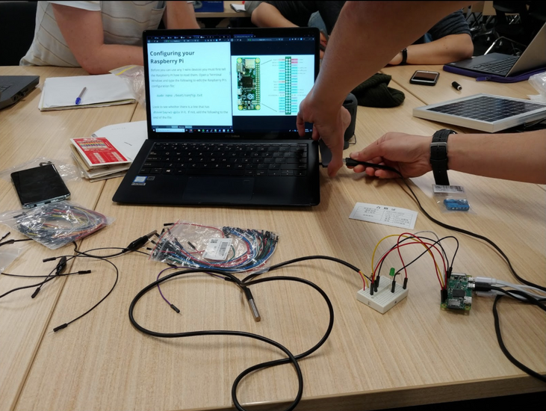
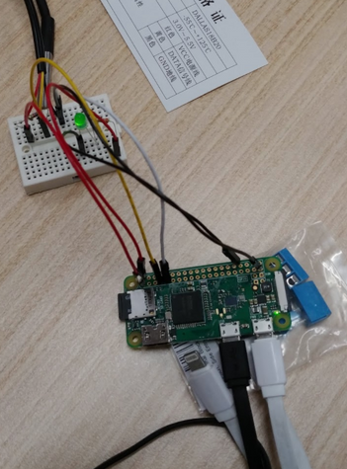
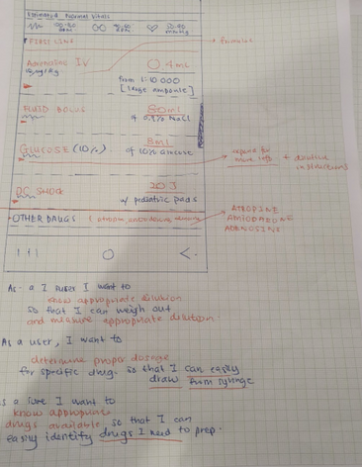
Program Outline
HISS 2022/2023
SPRINT 2 - Concept ideation, and prototyping
Student teams will work with clinicians and identified stakeholders to rapidly prototype and iterate on concepts and solutions addressing clinical need.
Proposed solutions shall aim to be technology agnostic and problems focused.
It is expected that prototypes will mainly be low to medium fidelity. (eg: Wireframes, alpha versions, minimum viable products etc.)
Notes:
Everyone’s sprint is different. Although initial approach was to create a technological solution, my directions hanged because of what I found out about my problem and how many layers and people were involved.
MVP will be different depending on CC and project.

Slide 11
Program Outline
HISS 2022/2023
The IMPLEMENT phase focuses on creating a plan for developing the concept into a real product that is safe and effective for patients and attractive to stakeholders and end-users.
Week 10 to Week 12
Notes:
Putting solution into practice. How do the end users feel about what you made? User interviews come into play and the importance of it is stated. You should be speaking to at least 25 people throughout the program. In the implement phase you should have these deep conversations and build a rapport with them. These are the people who will use it or be involved.

Slide 12
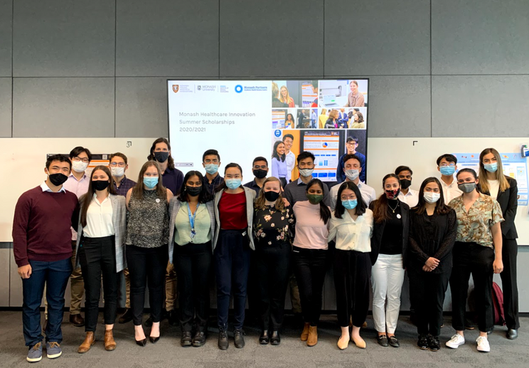
Program Outline
HISS 2022/2023
SPRINT 3 - Concept selection, iteration and delivery
At the end of program, student-clinician teams will pitch their project / prototype to Monash Partners, MIME and MYMI in a public HISS Showcase
Projects will apply for ongoing funding and support for 2023 and beyond for real world implementation.
Notes:
End of the program. You’ve had feedback on your solution through user interviews and your CC but how do you present it to the greater public. You were really focused on the area you were working in but how does this relate to everyone. How can you pitch your problem and solution to people who don’t have any expertise in this area and get them all invested. You will have major stakeholders at the final showcase for you to pitch to who could invest in your idea. You need to pitch it in a way that they will remember your problem and then realise how important it is to solve.

Slide 13

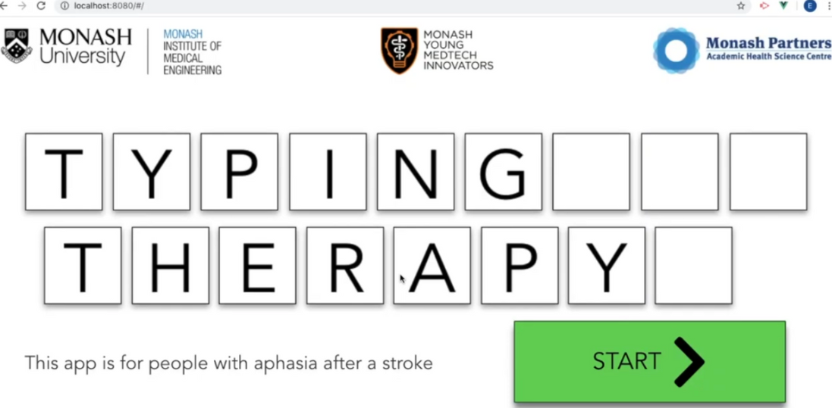
Program Outline
HISS 2022/2023
Post-program - HISS Phase II Funding and Support
Projects with clear need for further development may be incubated under the MYMI Projects Branch
Notes:
You could be incubated under MYMI Projects and apply for HISS Phase 2 funding.
TuCann have more then 500k for their project and have patented it.
This is a great success story but it takes about 10-15 years to really get a medtech product to market.
Project QWERTY aimed to help people with aphasia after a stroke to regain mobility in typing and help find jobs. Has then gone to an aphasia group to utilise.

Slide 14



Outcomes from HISS
Project Cyclops
HISS 2022/2023
1 underpinned $2.5 million MRFF grant as a proof of concept
3 projects in development -> 2 investigating commercial viability and in alpha stages
Project PPH - now personalgdm.com (have a look)
Project Lexicon
Notes:
Medical Research Future Fund: from government to transform health and medical research and innovation to improve lives and help sustainability. Basically the government has 20 billion dollars to give to great projects that help people.
Project Cyclops was a project that aimed to make eye testing digital. Used existing tech but repurposed it to get a solution for the problem. Used matlab in new way. Basically really successful projects don’t reinvent the wheel but they use existing code and repurposed it and innovated it to suit their problem. It’s not about creating something new but using new ways to create something.
PersonalGDM - Saad made this during HISS. Made by student from tech background and research background working together. So this is an example of what you all could make. Was part of the application for a 2.5 million mrff grant. CC used a new way to calculate adverse risks in pregnancies. It can be used to calculate the probability that an individual woman affected by gestational diabetes will experience an adverse pregnancy outcome. Student made a paper based solution digital so more people can access it. They didn’t make the formula but made it more accessible to people.
Project Lexicon - help with clinical decision making. Entered a couple of accelerator programs and funding. Currently in discussions with people in Singapore to create a bigger reach for the app. Found a new way to categorize data to make it easier to search medical information.

Slide 15
Expectations
  Be committed to understanding and validating the problem
  Be flexible
  Think outside the box - reach out to people (talk to potential customers and stakeholders!!)
    LinkedIn
    Facebook groups
    Cast out a web and see what you get back in return
  Use the BioDesign text-book as your guide!
    useful chapters referenced in Deliverable Powerpoints!
HISS 2022/2023

Slide 16
HISS 2021/2022
Activity Break
Notes:
speed dating.
name
studying
fave colour
interesting fact
why you are interested in medtech

Slide 17
Expectations
HISS 2022/2023
80% attendance expected for compulsory events
MaDe Labs 1 and 2 everyday (exceptions communicated in advance)
If you cannot make it, let us know.
Deliverables are due 5pm on Thursday (more info later)
Upload to Google Drive folder for relevant week
Every Friday Deliverable Presentation (more info later)
If unable to submit, let us know.

Slide 18
Housekeeping
HISS 2022/2023
All comms on Slack. Any emergency, please call us.
  Channels self explanatory
  Out-of-office when visiting sites
Everyday will have at least one Coordinator working so they will be your go to contact for that day.
Have a 48 hr response turnaround.
We will attempt to record masterclasses - attendance is expected
Notes:
48hr response turn around?

Slide 19
General Weekly Structure
HISS 2022/2023
Stand Ups
  Wednesday
  Friday
Lunch 1pm to 2pm (may be shifted to accommodate masterclasses)
Masterclasses throughout the week
Allocated Deliverable Time
Visitations to see your clinicians
After Week 2, Skillshare presentations will start (10-15 minutes presentation,
5 minutes questions) Based on a topic which you are particularly interested in and want to share.
Notes:
site visitations,

Slide 20



Why Standup?
HISS 2022/2023
Identify
Problems
Keep
Updated
Keep
Motivated
Notes:
Identify problems quickly
Keep the team updated on your progress
Keep each team member motivated as they see their teammates dominating.

Slide 21



Standup
HISS 2022/2023
What did I work on
this week?
What will I work on
next week?
What are my
blockers?
Notes:
State your project name and how you come up with it
Mission statement
Needs statement
What you need to finish next week
Problems encountered
Something surprising you learnt

Slide 22

Standup
HISS 2022/2023
- State your project name and how you came up with it
- Mission statement
- Needs statement
- What you need to finish next week
- Problems encountered
- Something surprising you learnt
Notes:
State your project name and how you come up with it
Mission statement
Needs statement
What you need to finish next week
Problems encountered
Something surprising you learnt

Slide 23
HISS 2022/2023
Any questions?

