Slide 1




Monash Healthcare Innovation Summer Scholarship
2022/2023
Acceptance Criteria and Intro to Standups
Tanushree Sharma

Slide 2
Outline
HISS 2022/2023
  Purpose of Acceptance criteria
  General Structure
  Examples
  Stand-up Structure
Notes:
Program deliverables can look different for each project. Depends on the type of project and what the end goal is. This is what HCD is.

Slide 3
HISS 2022/2023
Define Strength & Weaknesses
After meeting with your clinicians, you should be able to get a sense of their strengths and weaknesses in their understanding of the space
Define own strengths:
acknowledgement of own skill set.
Define own weaknesses:
what you need to learn in order to understand one aspect of your project more.
For example
- how many types of strokes are there?
- what are their side effects
- existing rehabilitation practices
Notes:
Never innovate by yourself. Identify your own weaknesses and strengths. Later on when you get paired up, being aware of your skills can help defining what your role will be. Be really honest with yourself. If there is something you want to learn, this is where u can start. When speaking with clinician be honest about capabilities and set outcomes you can meet.

Slide 4
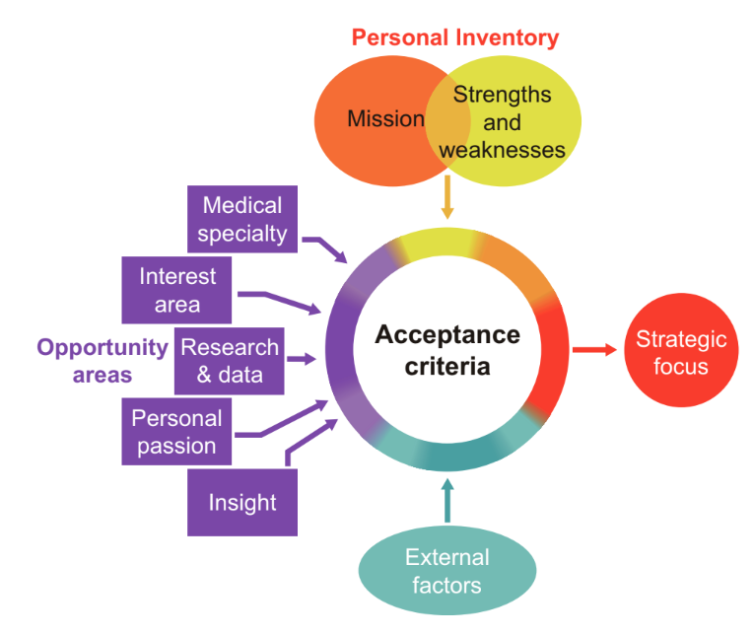
What do we have to consider ?
HISS 2022/2023
  Familiarise yourself with Medical Specialty (getting used to key terminology)
  Taking into account external factors
in context of the social, economic and sometimes environmental factors
  Research and databases available
coming from summary of literature reviews
Notes:
patients, physicians, facilities, and payers
alike are looking more critically at the affordability of
healthcare and the economic value associated with new
innovations.

Slide 5
Purpose
‘acceptance criteria are conditions
that must be met to make an innovation project attractive
to the innovator’
HISS 2022/2023

Slide 6
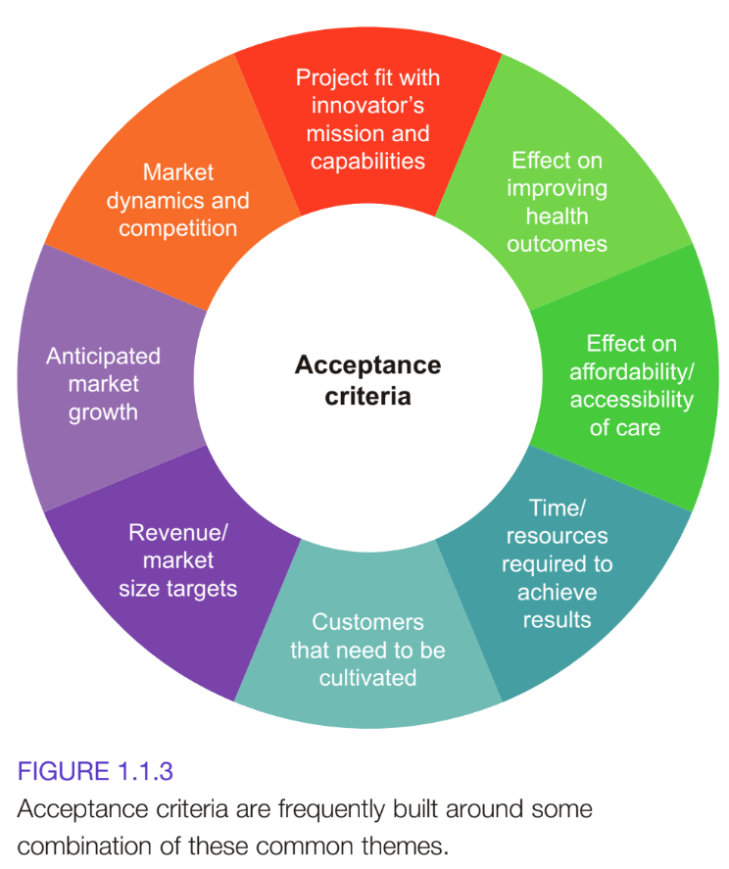
HISS 2022/2023
Develop Acceptance Criteria
Notes:
Acceptance criteria combines all the facets of the problems. It needs to account for all these things. A true acceptance criteria statement ensures all these are met and ticked off. Does your solution save time for clinicians when finding medical information? Is your solution affordable? You criteria should meet the needs of all these things.

Slide 7
HISS 2022/2023
Develop Acceptance Criteria
This example has a mission to improve important outcomes for patients on a major scale, the acceptance criteria might require a project that defines acceptance criteria around the magnitude of the impact its solution can have on people’s lives
Eg.
Has a total potential market of $1 billion or more
Will be cost-neutral or cost-reducing (so it gets adopted)
Will be attractive to investors (so it gets adequate financial support)
Results in an innovation that has a significant impact on patient’s quality of life (as opposed to an innovation that makes a device cheaper, faster or easier to use)
All acceptance criteria should be cheaper, faster or easier to use *starting point*
Notes:
Think broadly. I understand the problem but how do i make people want this solution.
Cheaper, faster easier
If your product doesn’t meet these requirements then it wont work. Why would you work on that

Slide 8
HISS 2022/2023
Example from text-book
Suppose that a large corporation has a mission to develop a product that expands its portfolio into a new clinical area that drives increased growth
within the company.
Factors company has to think about before defining the acceptance criteria
The availability of resources (staff- skill set, funding needed, time)
BUT HOW CURRENT sales force is deployed
(i.e. which types of doctors it already calls on) = strength / weakness
Important to develop acceptance criteria as it enables co-operation to make the decision to engage in the project.
Notes:
Think broadly. I understand the problem but how do i make people want this solution.
Cheaper, faster easier
If your product doesn’t meet these requirements then it wont work. Why would you work on that

Slide 9
HISS 2022/2023
Acceptance criteria could look like
Eg.
The clinical practice area is new to the company and is growing at a minimum of 10 percent per year and/ or can generate a minimum of $100 million in revenue per year.
Technologies in this space have a relatively well- understood regulatory pathway and clear clinical trial requirements so they can be brought to market within two to three years.
The company’s established sales force already calls on these same customers, so the commercial fit is good.

Slide 10
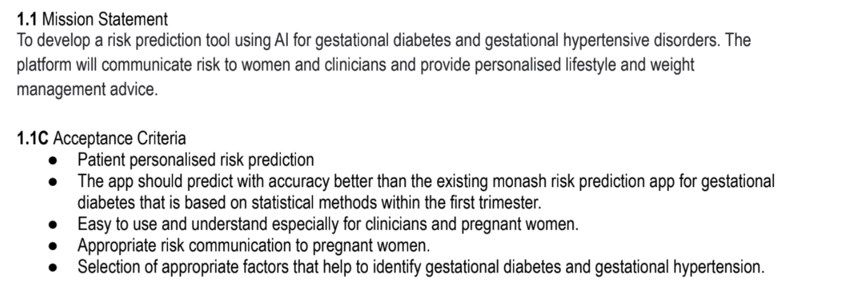
HISS 2022/2023
Student’s deliverable example 1

Slide 11
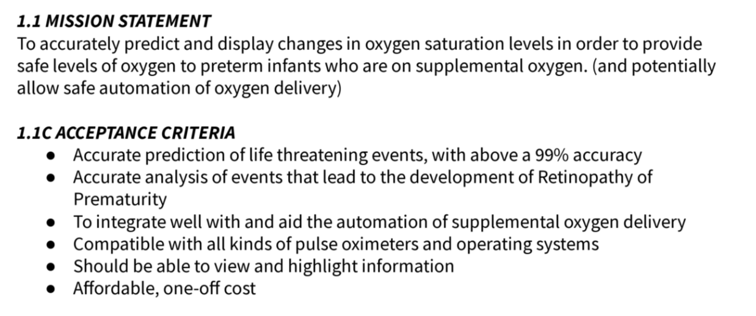
HISS 2022/2023
Student’s deliverable example 2

Slide 12



Why Standup?
HISS 2022/2023
Identify
Problems
Keep
Updated
Keep
Motivated
Notes:
Identify problems quickly
Keep the team updated on your progress
Keep each team member motivated as they see their teammates dominating.

Slide 13



Standup
HISS 2022/2023
What did I work on
this week?
What will I work on
next week?
What are my
blockers?
Something surprising that you learnt
Notes:
State your project name and how you come up with it
Mission statement
Needs statement
What you need to finish next week
Problems encountered
Something surprising you learnt

Slide 14

Standup
HISS 2022/2023
- State your project name and how you came up with it
- Mission statement
- Needs statement
- What you need to finish next week
- Problems encountered
- Something surprising you learnt
Notes:
State your project name and how you come up with it
Mission statement
Needs statement
What you need to finish next week
Problems encountered
Something surprising you learnt

Slide 15
HISS 2022/2023
Thank you and good luck!

