Slide 1




Monash Healthcare Innovation Summer Scholarship
2022/2023
Needs statement & PPO
Andrew Xu

Slide 2
HISS 2022/2023
What’s the point?
Fully understand the problem before solving it
Problem comes from unmet needs
It’s hard to figure out what the needs are
First 3 weeks - explore the needs surrounding the topic

Slide 3
What’s needs exploration?
HISS 2022/2023
1.2 Needs Exploration
1.2.A Understand external factors - e.g. environment, policies,
implementation, stakeholders
1.2.B Assess how external factors influence goals - can add risk
1.3 Needs Statement Development
1.3.A Develop a statement of what you want to achieve - be specific in
needs being met but not in implementation
1.3.B Identify problem, population, outcome "A way to address (problem)
in (population) that (outcome)"

Slide 4
PPO
HISS 2022/2023
Defined as three main areas:
Problem - a basic issue that’s limiting a quality and/or affordability or care somewhere in healthcare delivery
Always ask yourself “why” when determining the core problem
Population - patients, family members, doctors, nurses, allied health, hospitals, etc
Usually the people affected are wider than you think
Outcome - what is the positive change/improvement that the population would experience if the problem was solved?
Needs to be measurable

Slide 5
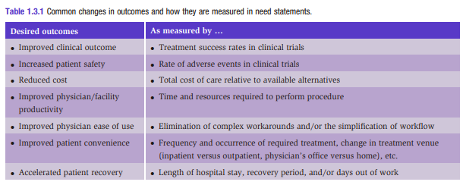
Outcome measurement examples
HISS 2022/2023

Slide 6
HISS 2022/2023
We don’t consider solutions at this stage

Slide 7
How do we answer these questions?
HISS 2022/2023
Background research - literature reviews, articles/papers
Clinical champions - experts in their field, but highly biased towards their solutions
Needs a certain level of expectation management - a useful skill to learn
Stakeholder interviews - talk to the people affected by the problem / involved in solving the problem
Easiest way to get these contacts is via your clinical champion’s
connections
Observations - see the problem in real life with your own eyes

Slide 8
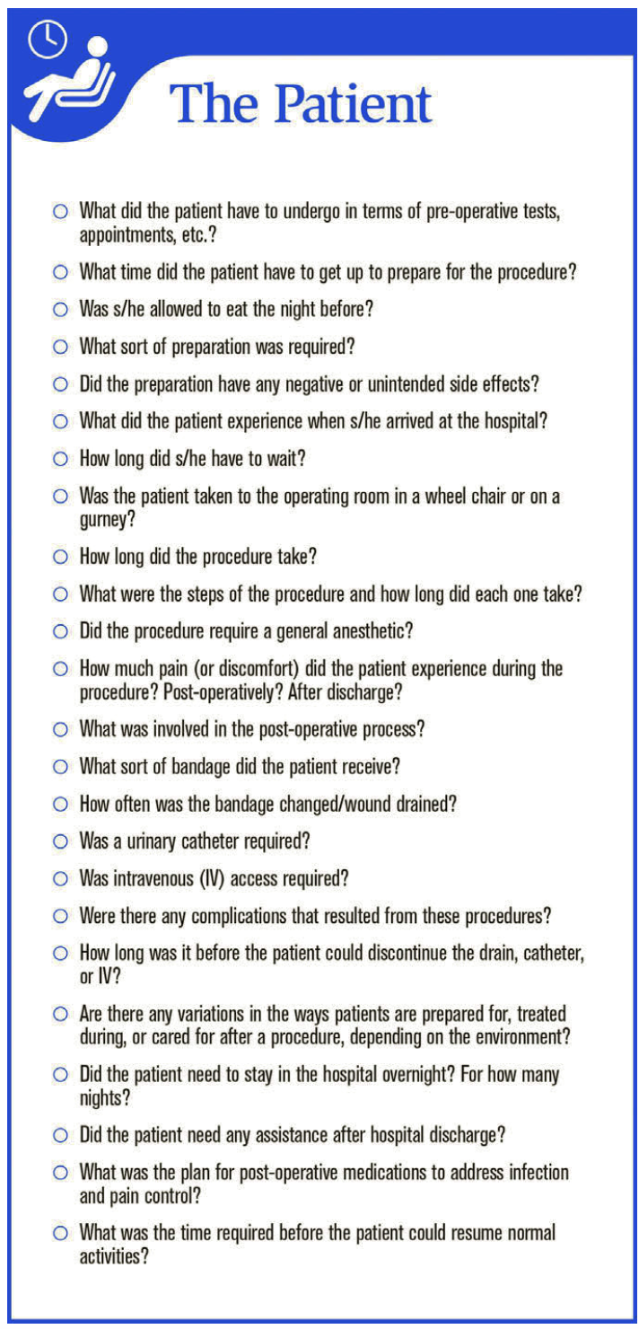
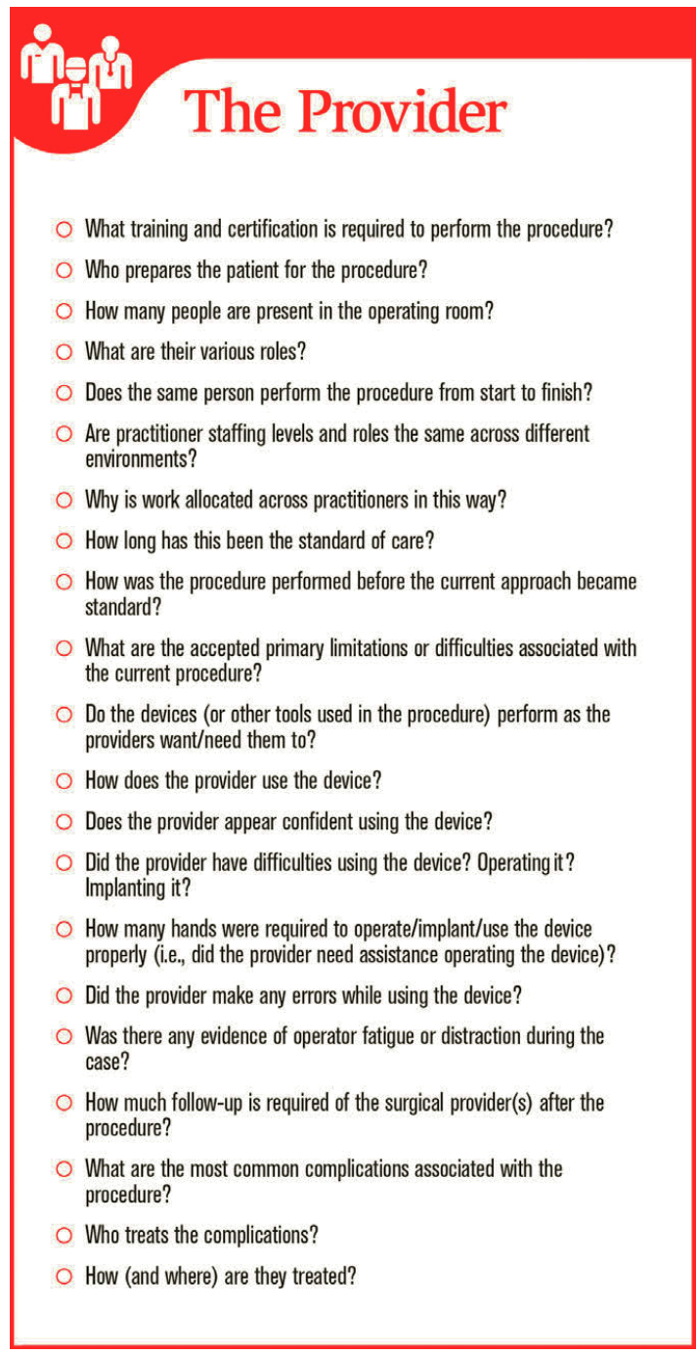
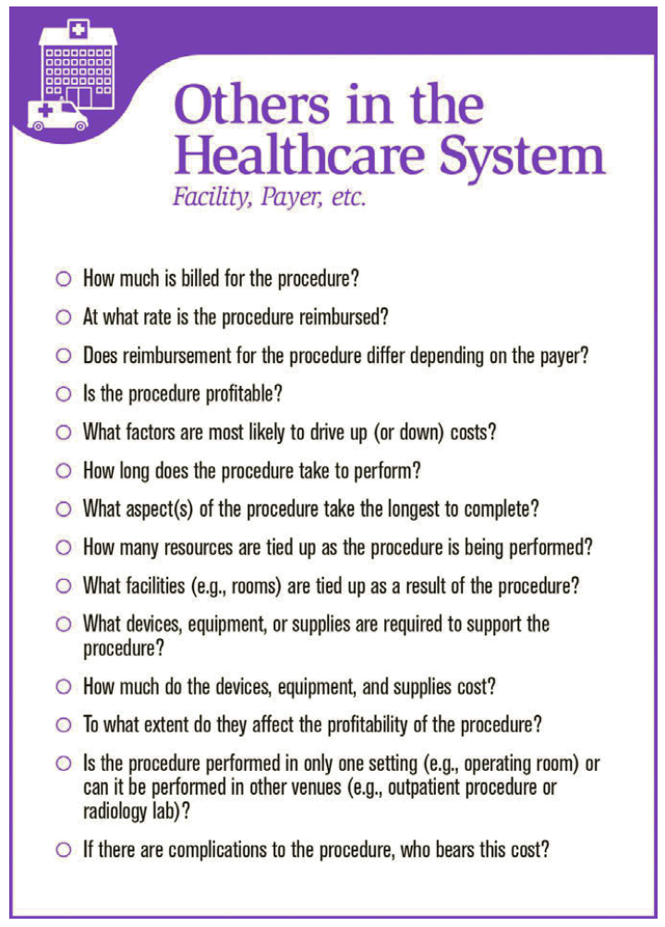
Checklist
HISS 2022/2023

Slide 9
Deliverable for needs statement
HISS 2022/2023
Outlines the problem, population, and outcome WITHOUT restricting yourself to a specific solution
“A way to (address problem) in (population) so that (desired outcome)”

Slide 10
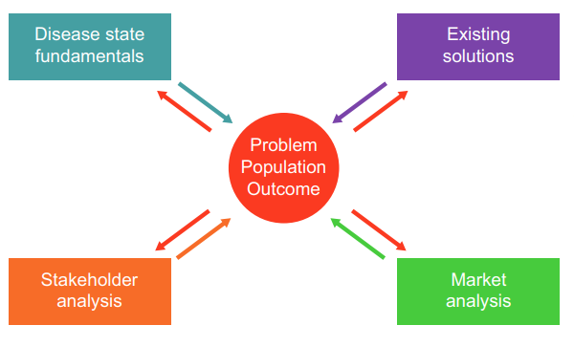
Importance of needs statement
HISS 2022/2023

Slide 11
HISS 2022/2023
Questions?

