Slide 1




Monash Healthcare Innovation Summer Scholarships 2022/2023
Searching the Literature
Julie Dao

Slide 2
HISS 2022/2023
Purpose
All research, whatever the discipline, needs to be situated in relation to what has already been done in the field.
Reviewing the literature helps you:
find out what is already known about a topic in order to locate gaps and justify the research being undertaken
locate the work of important theorists whose ideas will inform the research
identify useful methodologies, methods and documentary sources

Slide 3
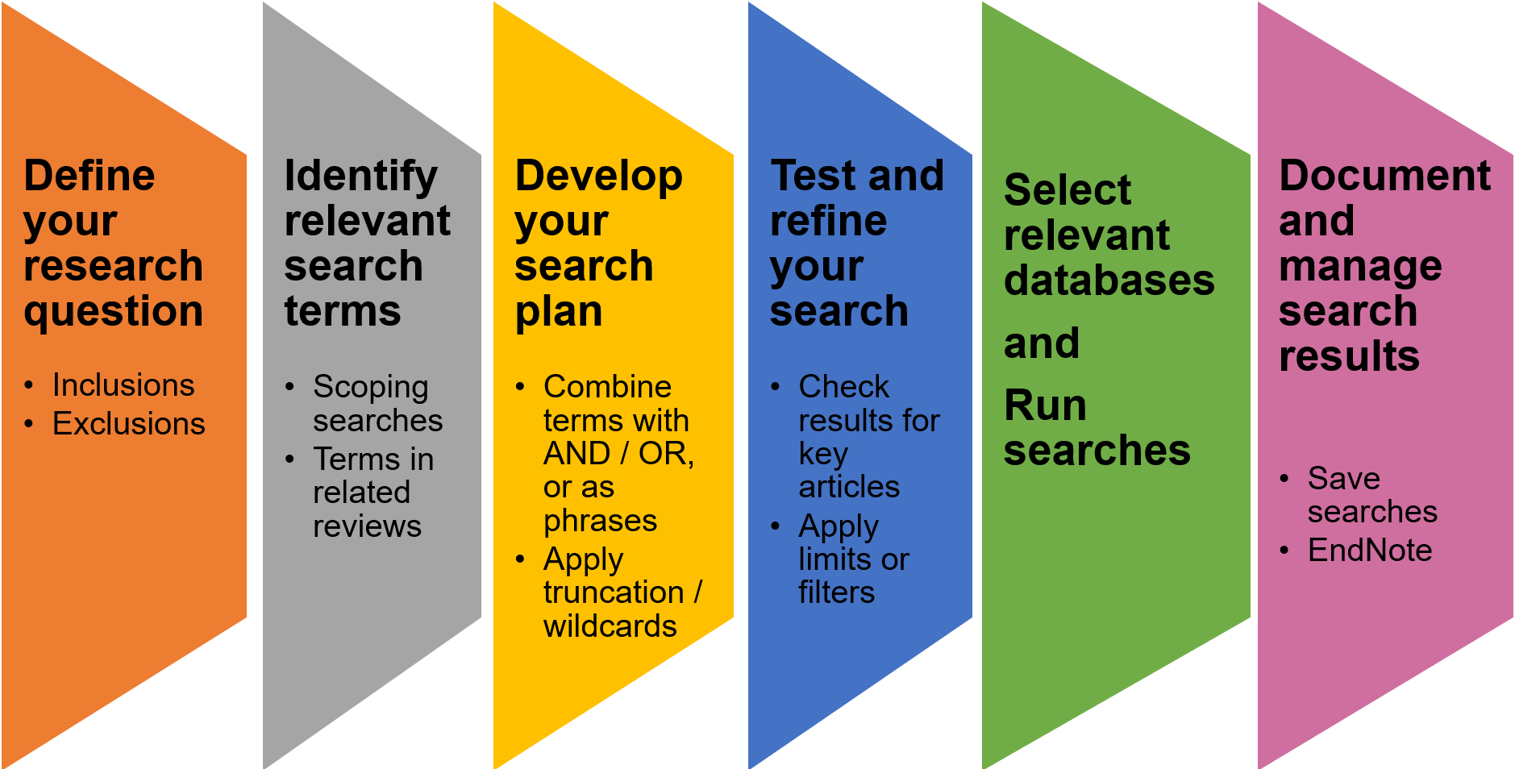
HISS 2022/2023
Literature Search Process
For comprehensive literature searching it is important to be systematic in your approach. This includes developing a plan for your search (including the search terms you will use and the resources you will search), and keeping records of the searches you carry out. The process is listed in steps below, but much of it is iterative rather than linear.

Slide 4
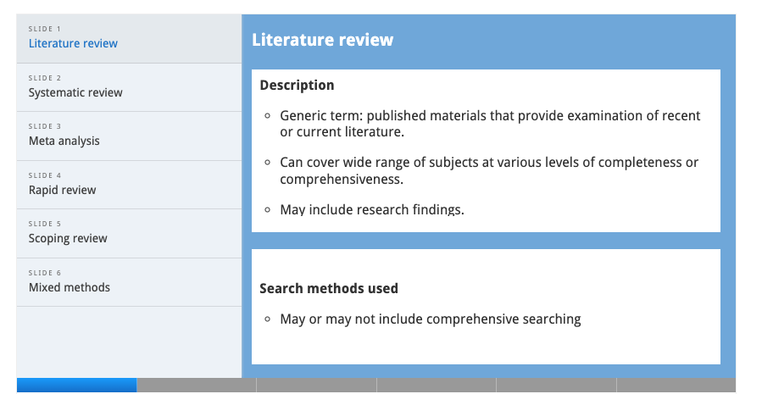
HISS 2022/2023
Literature Search Process

Slide 5
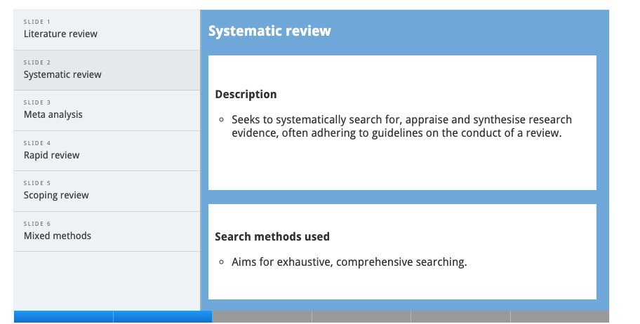
HISS 2022/2023
Literature Search Process

Slide 6
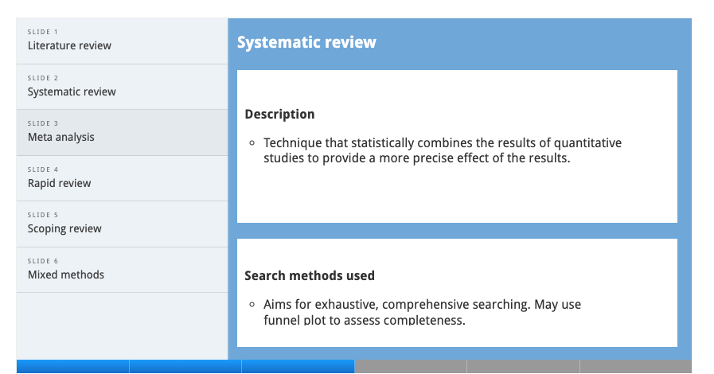
HISS 2022/2023
Literature Search Process

Slide 7
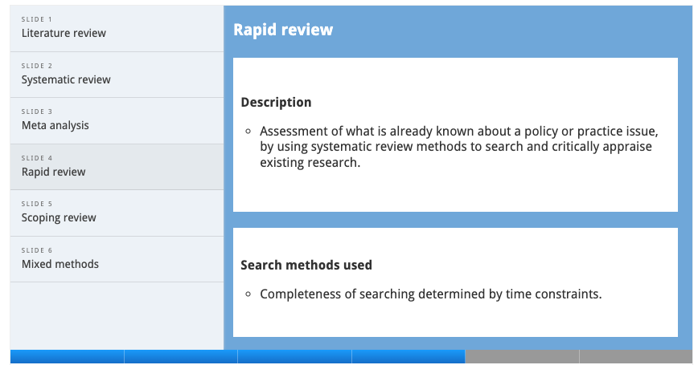
HISS 2022/2023
Literature Search Process

Slide 8
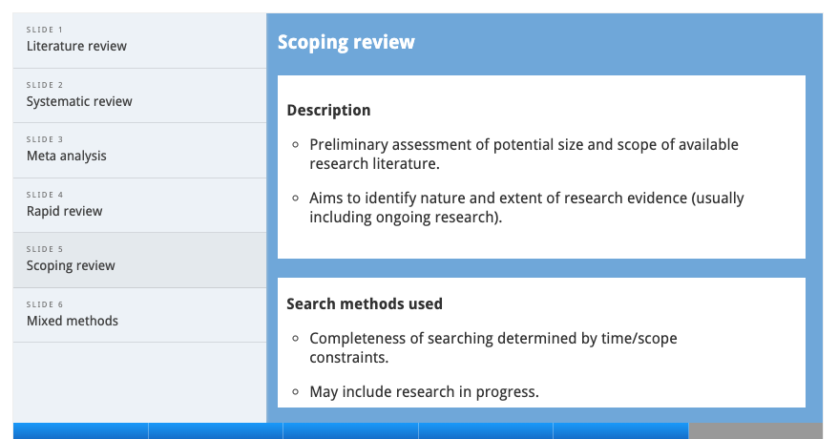
HISS 2022/2023
Literature Search Process

Slide 9
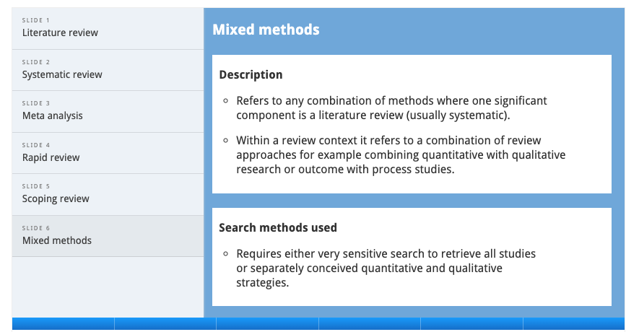
HISS 2022/2023
Literature Search Process

Slide 10
HISS 2022/2023
Scholarly Databases
A good quality literature review involves searching a number of databases individually.
The Library databases are an excellent resource for finding peer-reviewed journal articles and also book chapters, conference papers and more. Databases may be multidisciplinary or discipline-specific.

Slide 11
HISS 2022/2023
Aim of the Review
Literature reviews may be part of a thesis, or may contribute to a larger work such as the introduction in a journal article.
A literature review for publication often seeks to answer a single research question, whereas a literature review for a thesis may seek to answer several questions.
Searching the literature is more effective when you are clear on what you need to find, your research topic is clearly understood and the various concepts within your topic are clearly delineated.

Slide 12
HISS 2022/2023
The first step - preliminary scoping searches
It is important to do background research to make sure your research question has not already been answered in a recent review, and to extend your understanding of the research area and the terminology used in its discussion.
Doing some broad preliminary searching is an essential step to help you understand the quantity of existing literature in your area of interest, and establish a basis for your later more complex searching when you have developed your search strategy. This type of searching usually involves a series of very targeted searches, perhaps looking for your main keywords in the article title.
Google Scholar is what we will use to do a preliminary search.

Slide 13
HISS 2022/2023
The research question
The research question will determine the method of the review and the types of studies included. One way to develop your research question is to put your topic into the format of a question or questions to be answered by the literature.

Slide 14
HISS 2022/2023
Developing a research question
It is likely that at some point during your degree you will be required to create your own research question. The research question states the specific issue or problem that your assignment will focus on. It also outlines the task that you will need to complete.

Slide 15
HISS 2022/2023
Developing a research question
Clear and focused. In other words, the question should clearly state what the writer needs to do.
Not too broad and not too narrow. The question should have an appropriate scope. If the question is too broad it will not be possible to answer it thoroughly within the word limit. If it is too narrow you will not have enough to write about and you will struggle to develop a strong argument (see the activity below for examples).
Not too easy to answer. For example, the question should require more than a simple yes or no answer.
Not too difficult to answer. You must be able to answer the question thoroughly within the given timeframe and word limit.
Researchable. You must have access to a suitable amount of quality research materials, such as academic books and refereed journal articles.
Analytical rather than descriptive. In other words, your research question should allow you to produce an analysis of an issue or problem rather than a simple description of it (more on this below).

Slide 16
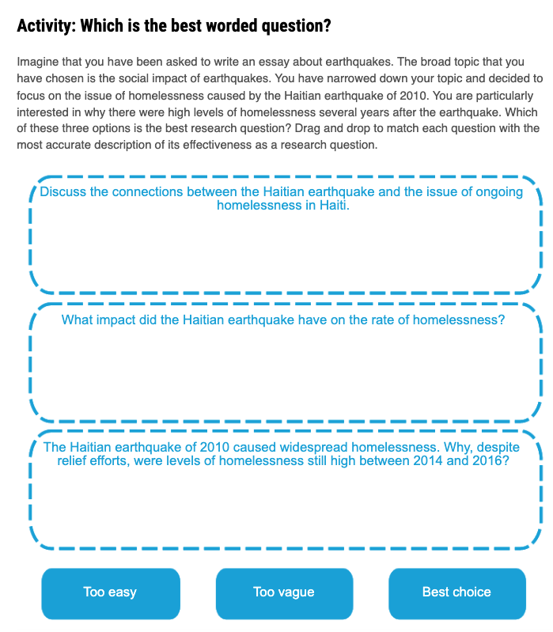
HISS 2022/2023

Slide 17
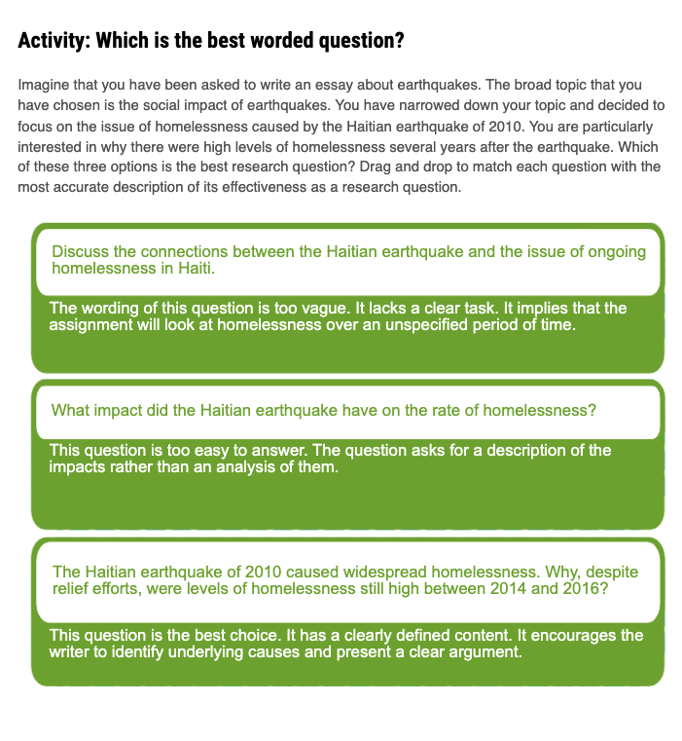
HISS 2022/2023

Slide 18
HISS 2022/2023
Identify key words and concepts
Start developing a search strategy by identifying the key words and concepts within your research question. The aim is to identify the words likely to have been used in the published literature on this topic.
For example: What are the key infection control strategies for preventing the transmission of Methicillin-resistant Staphylococcus aureus (MRSA) in aged care homes.
Treat each component as a separate concept (there are usually between 2-4 concepts).

Slide 19
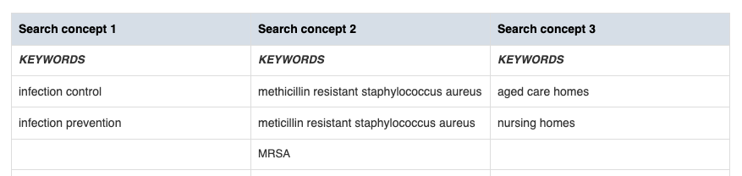
HISS 2022/2023
Identify key words and concepts
For example: What are the key infection control strategies for preventing the transmission of Methicillin-resistant Staphylococcus aureus (MRSA) in aged care homes.
Treat each component as a separate concept (there are usually between 2-4 concepts).

Slide 20
HISS 2022/2023
Combine search terms and concepts
Boolean operators are used to combine the different concepts in your topic to form a search strategy. The main operators used to connect your terms are AND and OR. See an explanation below:
OR
Link keywords related to a single concept with OR
Linking with OR broadens a search (increases the number of results) by searching for any of the alternative keywords
Example: nursing home OR aged care home
AND
Link different concepts with AND
Linking with AND narrows a search (reduces the number of results) by retrieving only those records that include all of your specified keywords
Example: nursing home AND infection control
NOT
using NOT narrows a search by excluding results that contain certain search terms
Most searches do not require the use of the NOT operator
Example: aged care homes NOT residential homes will retrieve all the results that include the words aged care homes but don't include the words residential homes. So if an article discussed both concepts this article would not be retrieved as it would be excluded on the basis of the words residential homes.

Slide 21
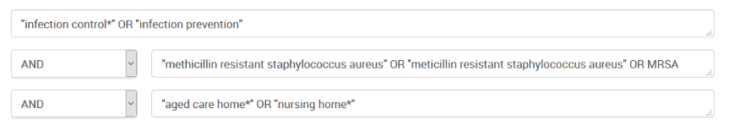
HISS 2022/2023
Example search strategy
An example of a search strategy incorporating all three concepts, that could be applied to different databases is shown below:
The above search strategy in a nested format (for use in a single search box) would look like:
("infection control*" OR "infection prevention") AND ("methicillin resistant staphylococcus aureus" OR "meticillin resistant staphylococcus aureus" OR MRSA) AND ( "aged care home*" OR "nursing home*")

Slide 22
Thank you!

