Slide 1




Monash Healthcare Innovation Summer Scholarships 2020/2021
Professionalism and Personal Branding
Julie Dao

Slide 2
HISS 2020/2021
Professionalism
Professionalism is the conduct, aims, or qualities that characterise or mark a profession or a professional person

Slide 3

HISS 2020/2021
Professionalism
Write down 10 words you would use to describe yourself.
Which 10 words would you use?

Slide 4

HISS 2020/2021
Professionalism
Write down 10 words you would use to describe yourself.
Which 10 words would you use?
Now I want you to think about 3 people you admire - your mum, your manager, a friend?
Which 10 words would you use to describe them?

Slide 5
HISS 2020/2021
Professionalism
We will revisit this at the end of the program (so keep these handy)**
We will ask you at the end of the program to describe your fellow scholars in 10 words
The point of this is to determine if the brand you think you have is actually the brand is what other people see in you

Slide 6
HISS 2020/2021
Personal Branding
Personal branding is a way of establishing and consistently reinforcing who you are and what you stand for in your career and life
*What you think of yourself has less to do with what your brand is*

Slide 7
HISS 2020/2021
3 Tips for Personal Branding
Set up
  Email signature
  Twitter
  LinkedIn

Slide 8
HISS 2020/2021
Why are email signatures so important?
  Legitimacy and Professionalism
Creating a cohesive image displayed through Monash and MYMI shows that you are well established
  Branding
Opportunity to brand every message you send
  Digital Business Card
Conveys your openness to communication

Slide 9
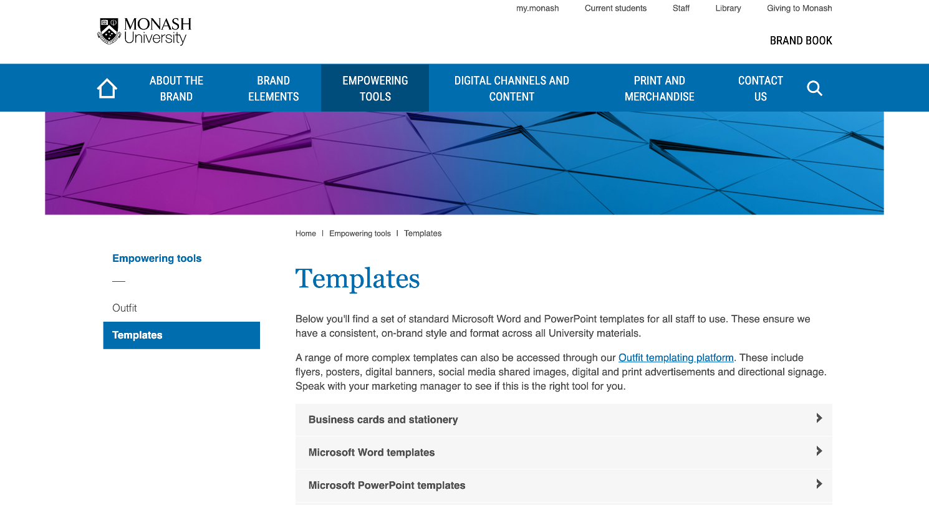

Slide 10
Demo!

Slide 11
Thank you!

