Slide 1
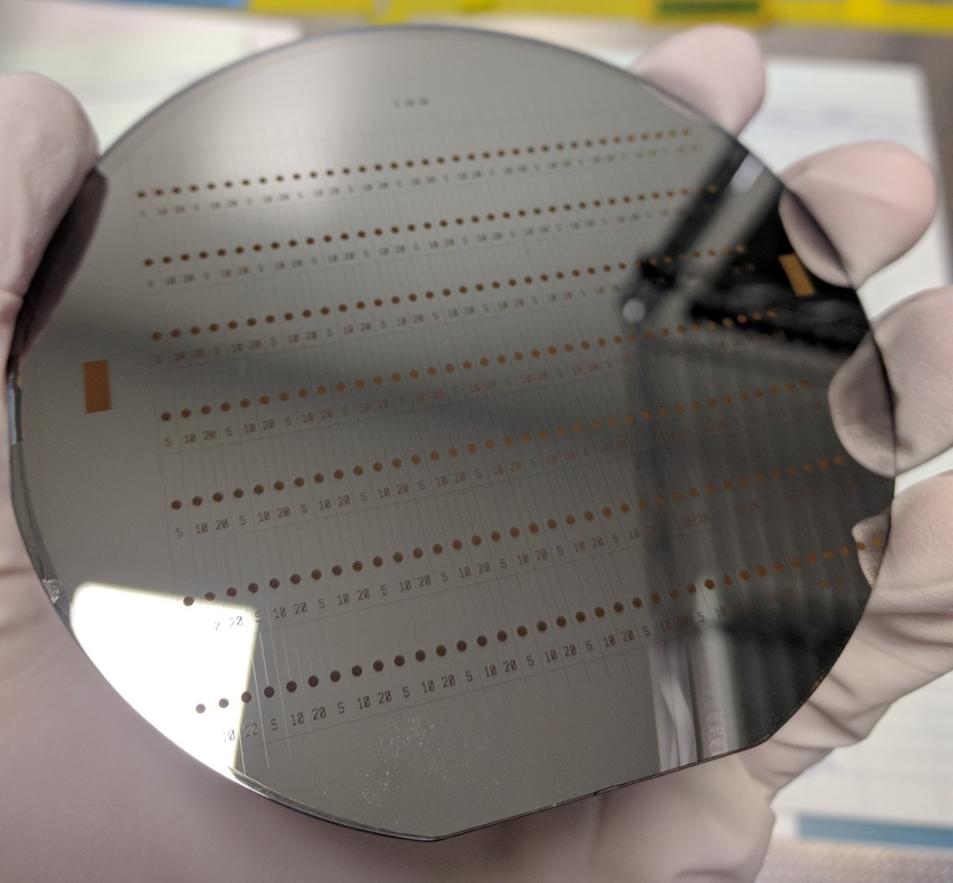

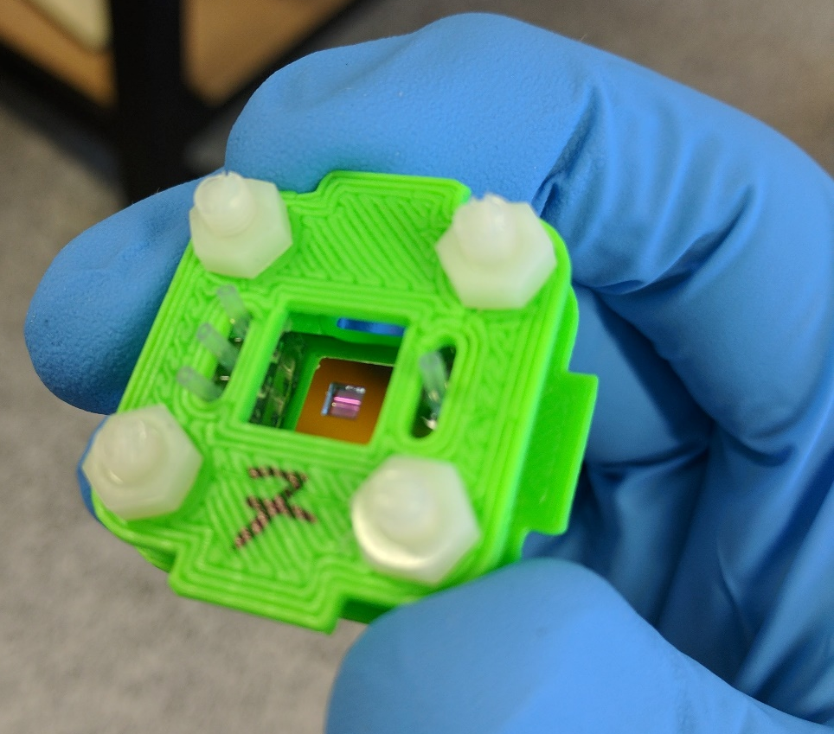
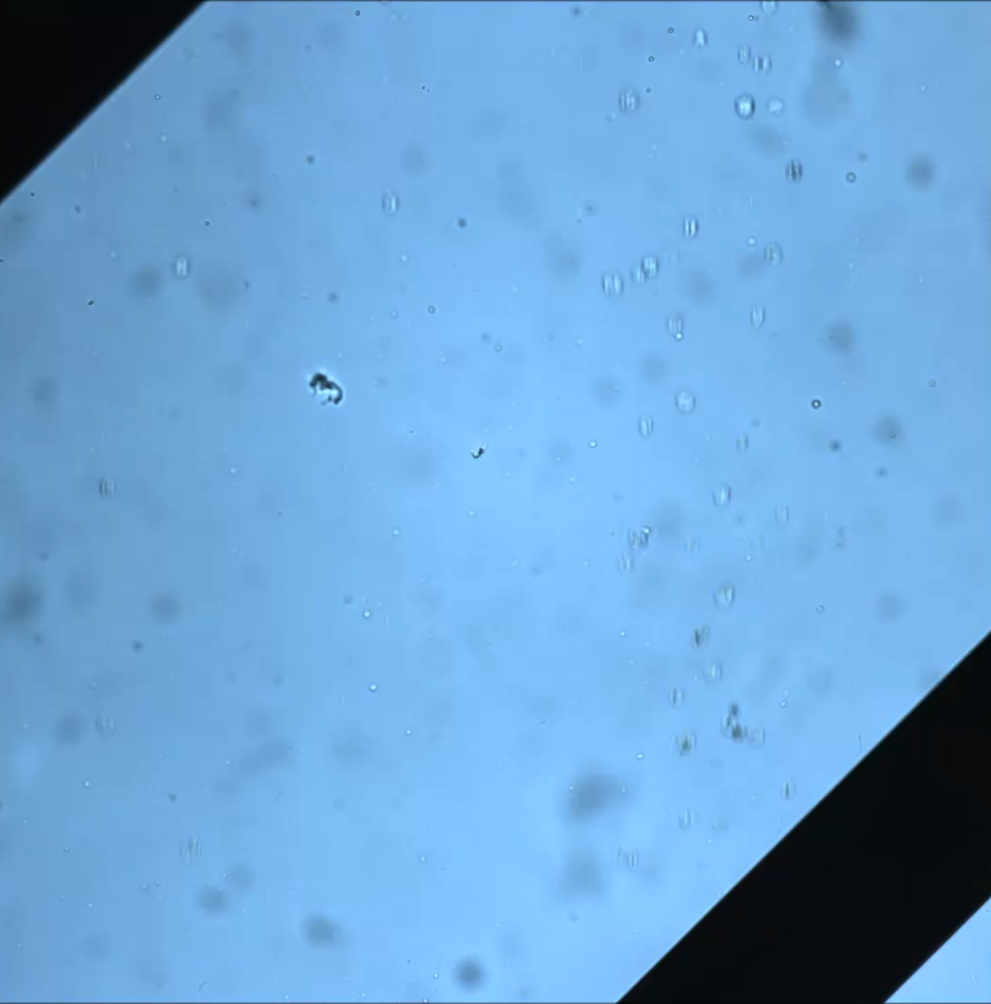
Microfluidic Methods for In Situ Chemical Studies:
On Demand Droplet Generation and X-ray Compatible Devices
MICRO
FLUIDICS

Slide 2
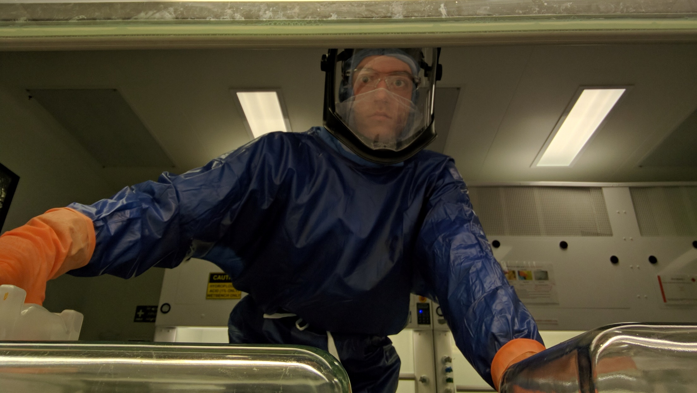
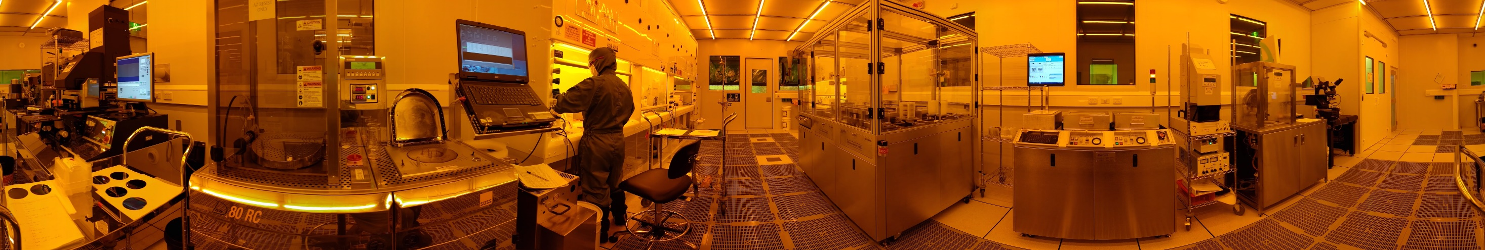

Slide 3
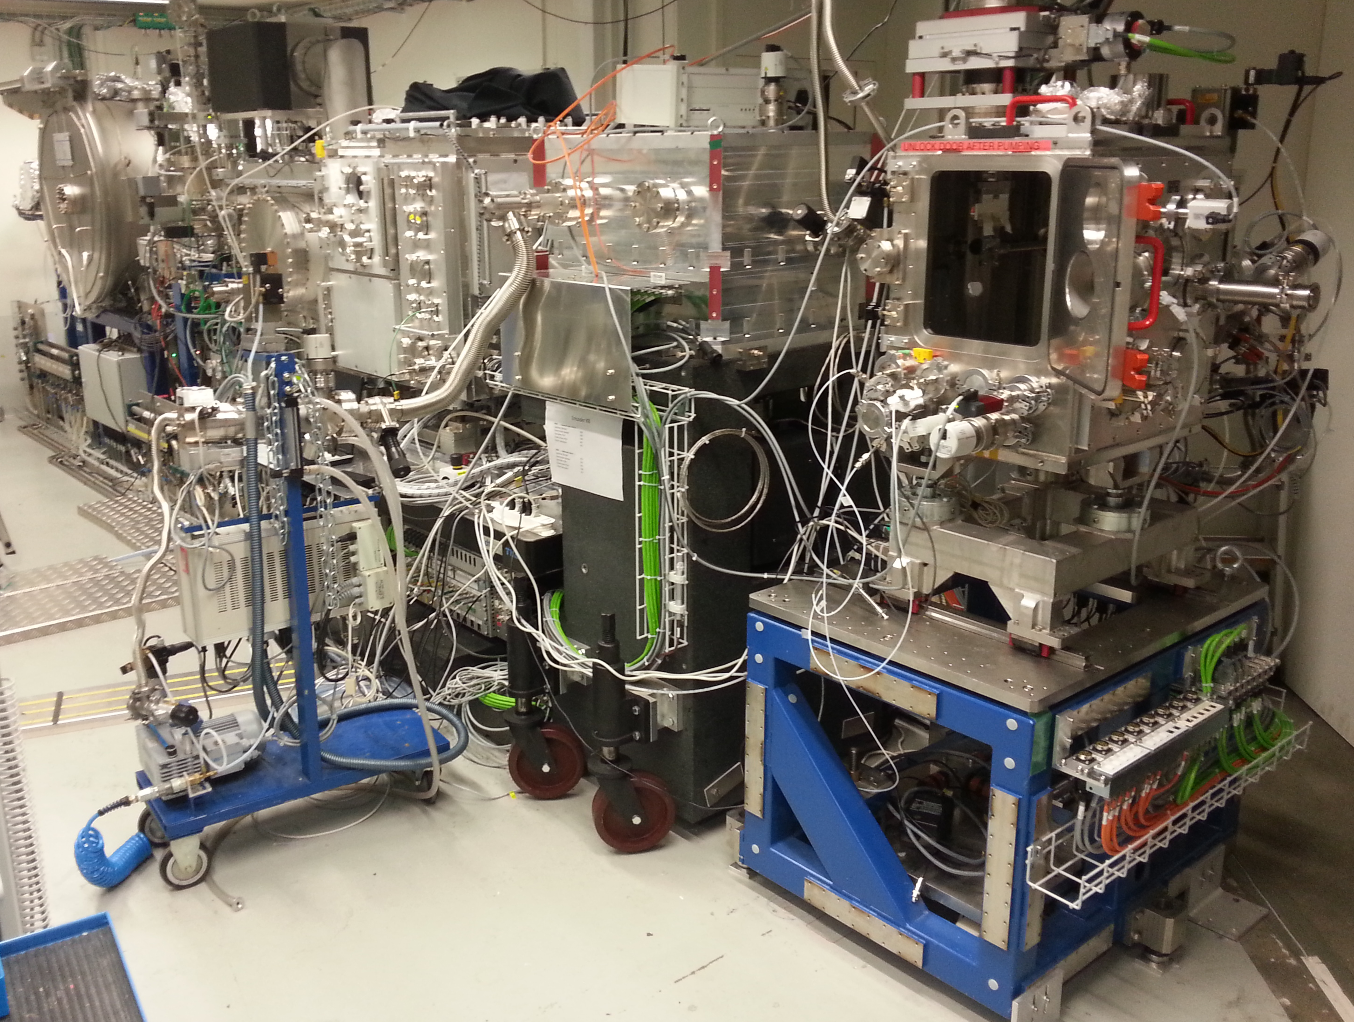
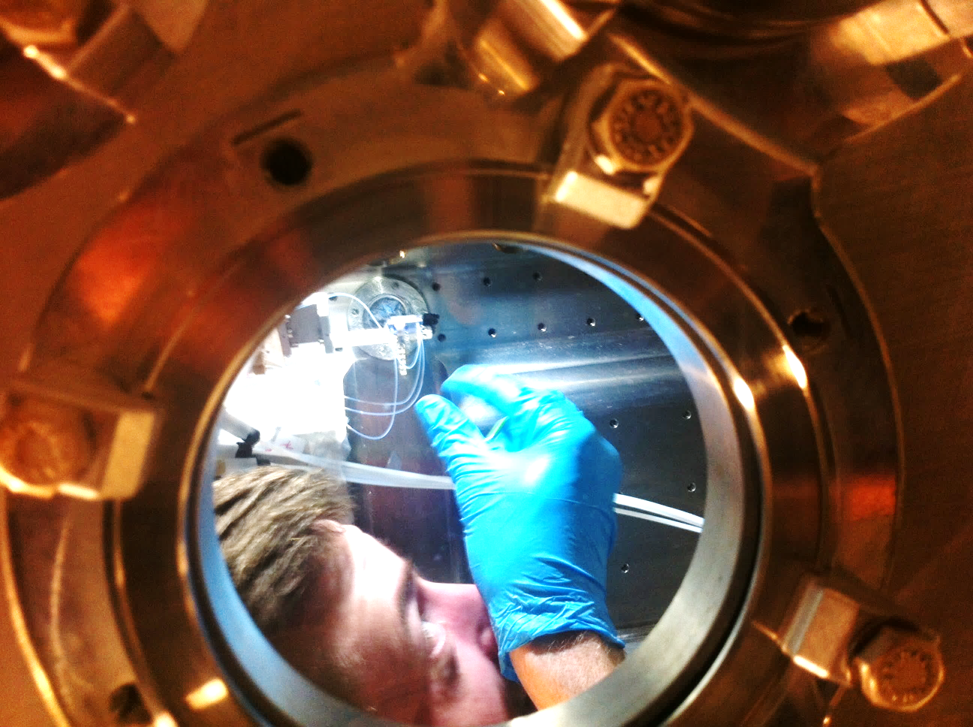
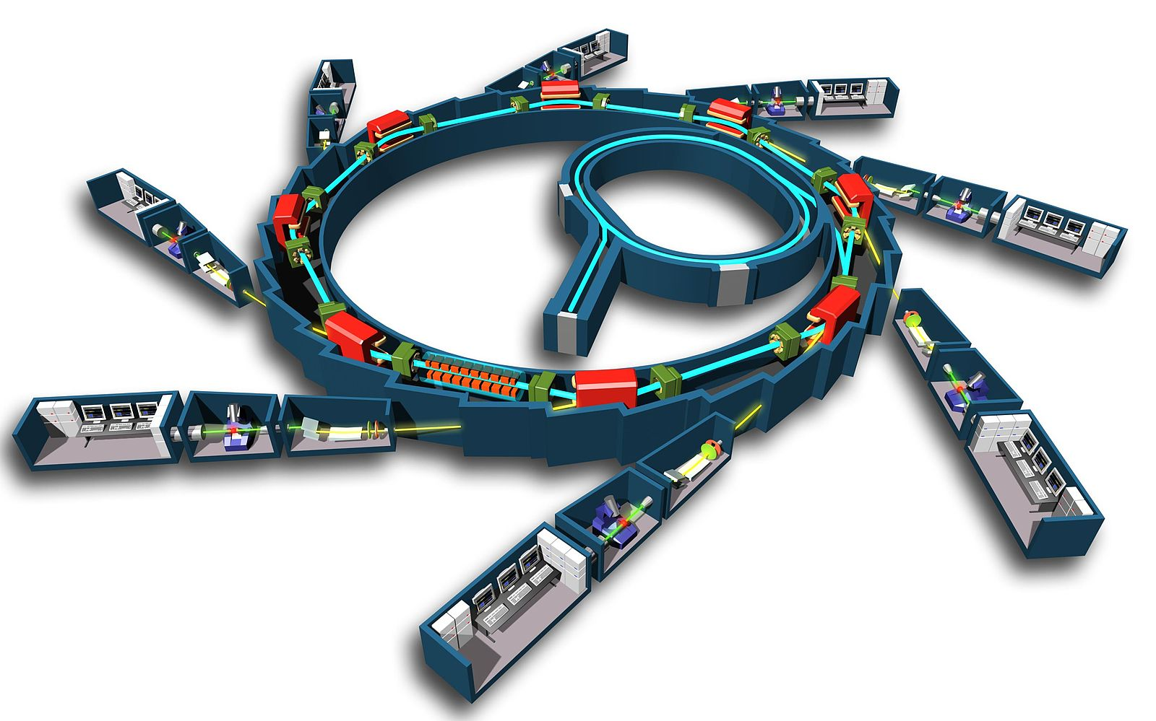

Slide 4
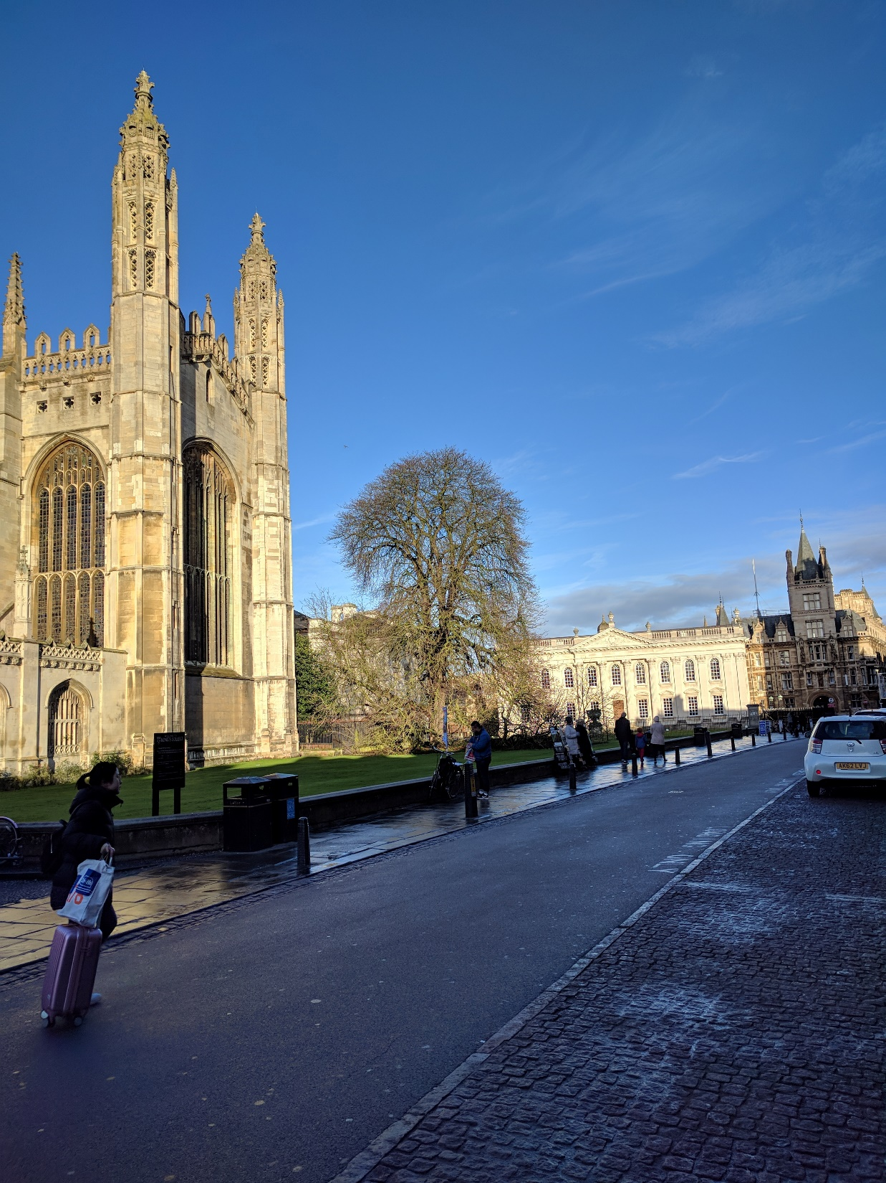
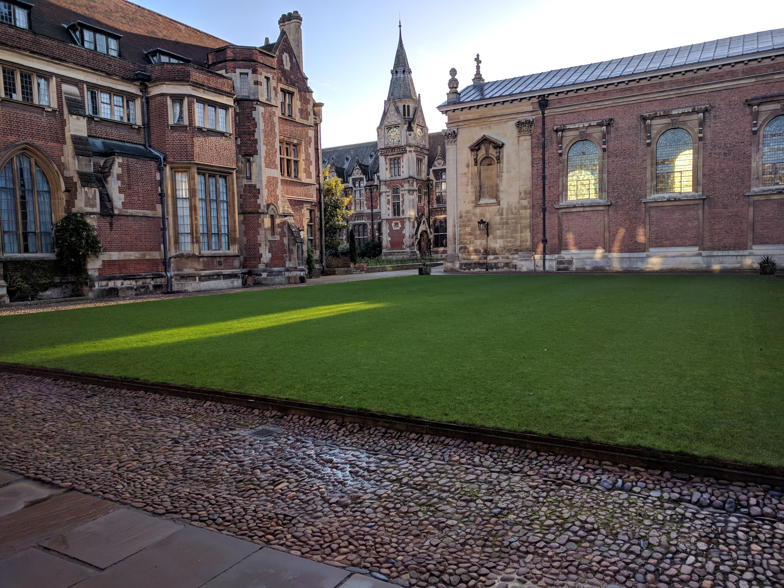


Slide 5
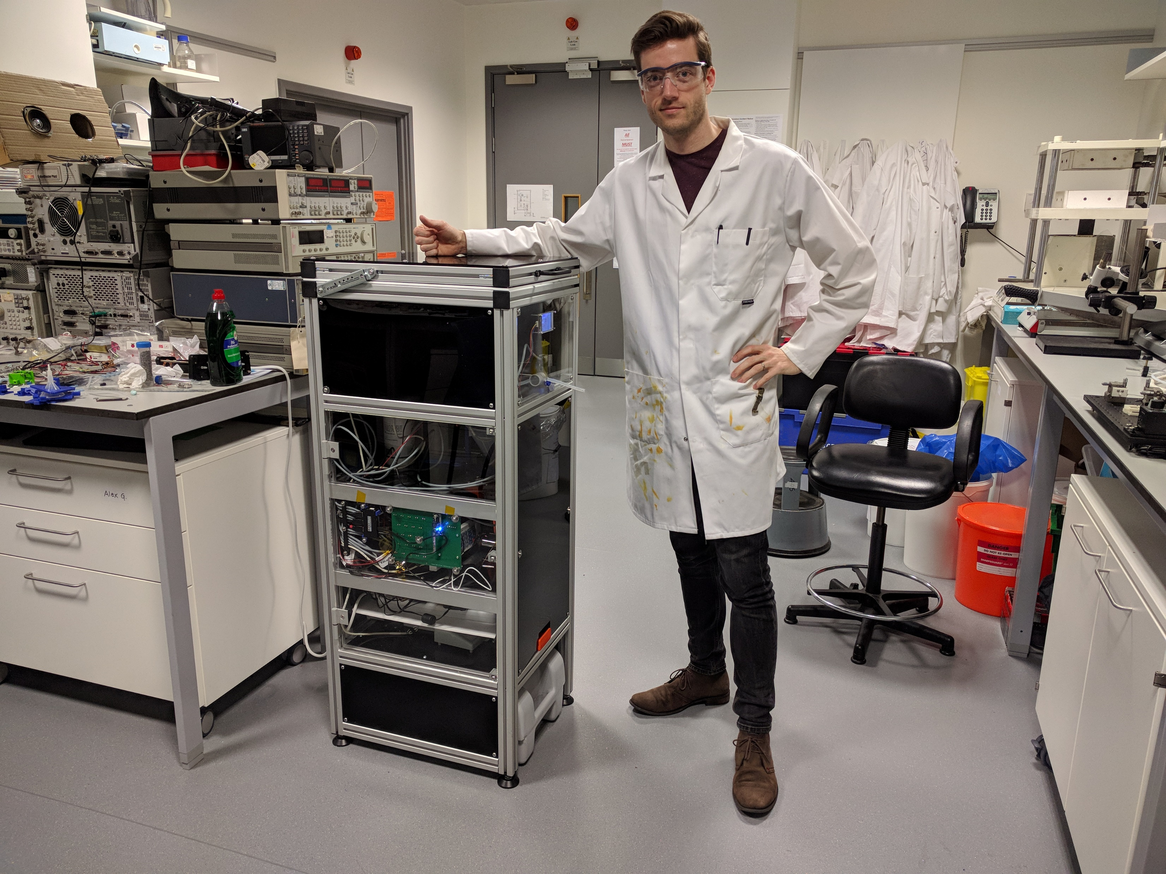

Slide 6
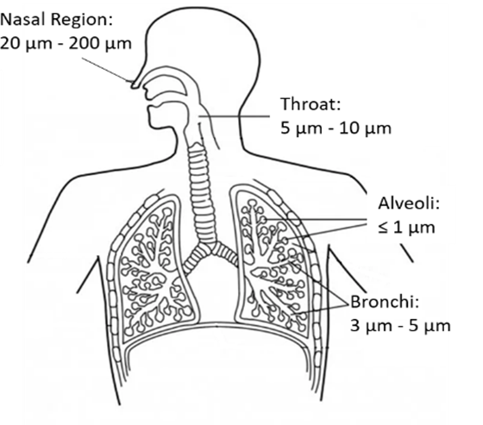
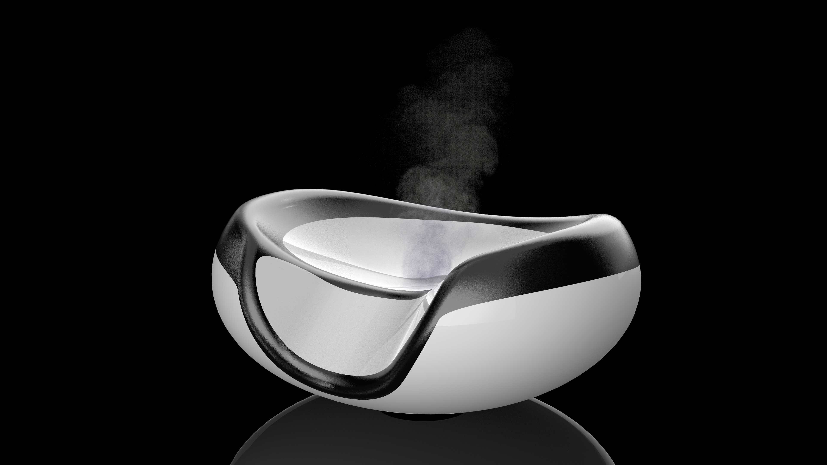
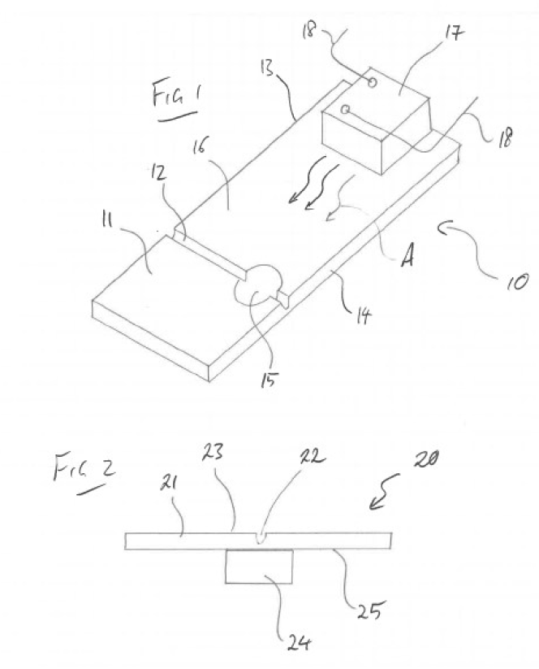
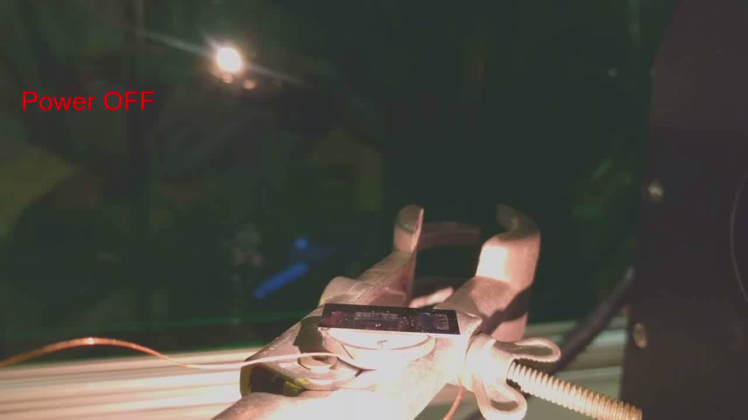
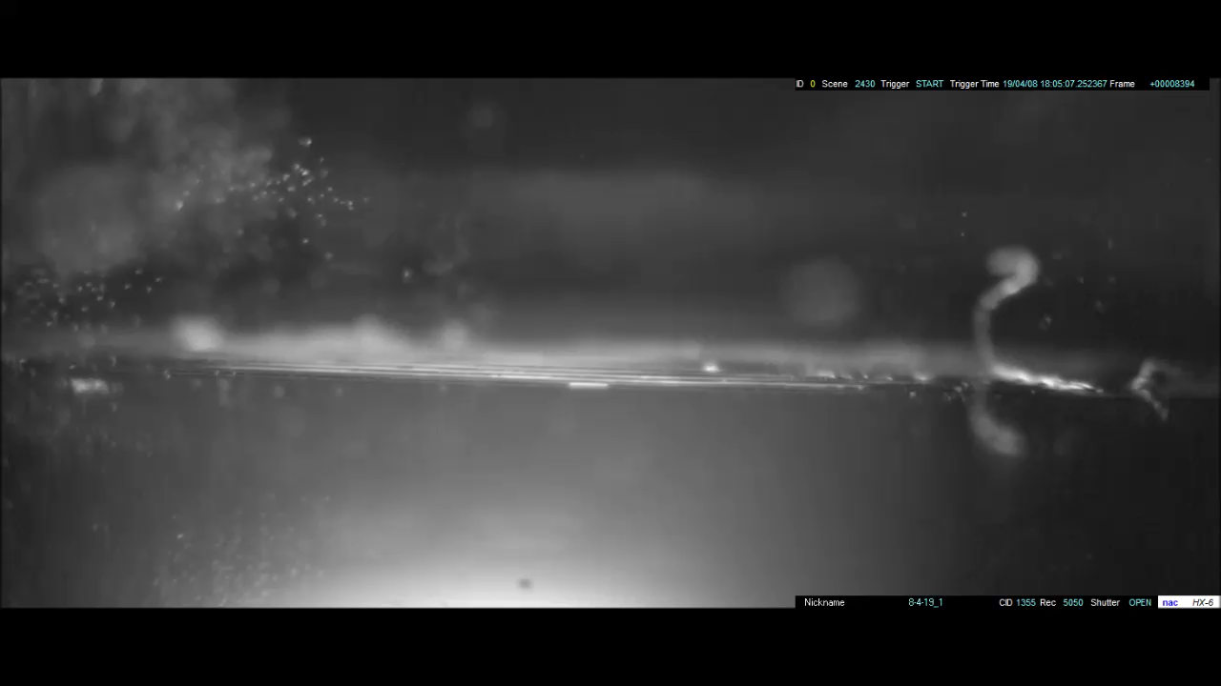
What am I working on now? Pulmonary Drug Delivery
Nebulizer: PCT/AU2019/050778
Monash ref: WS 2018-010-02
Real Time
1/168 Speed

Slide 7
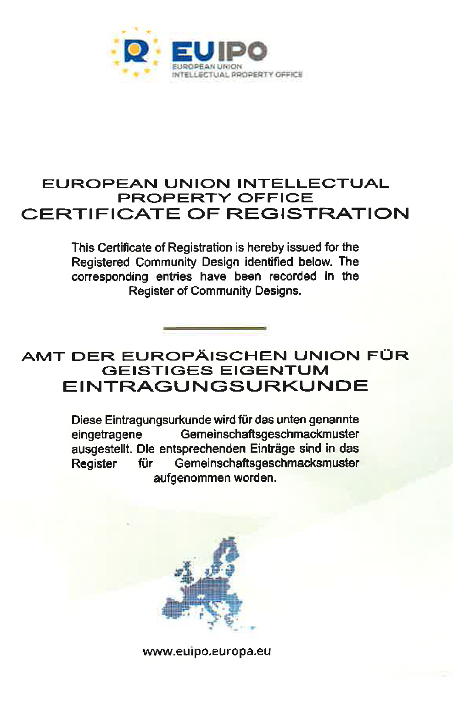
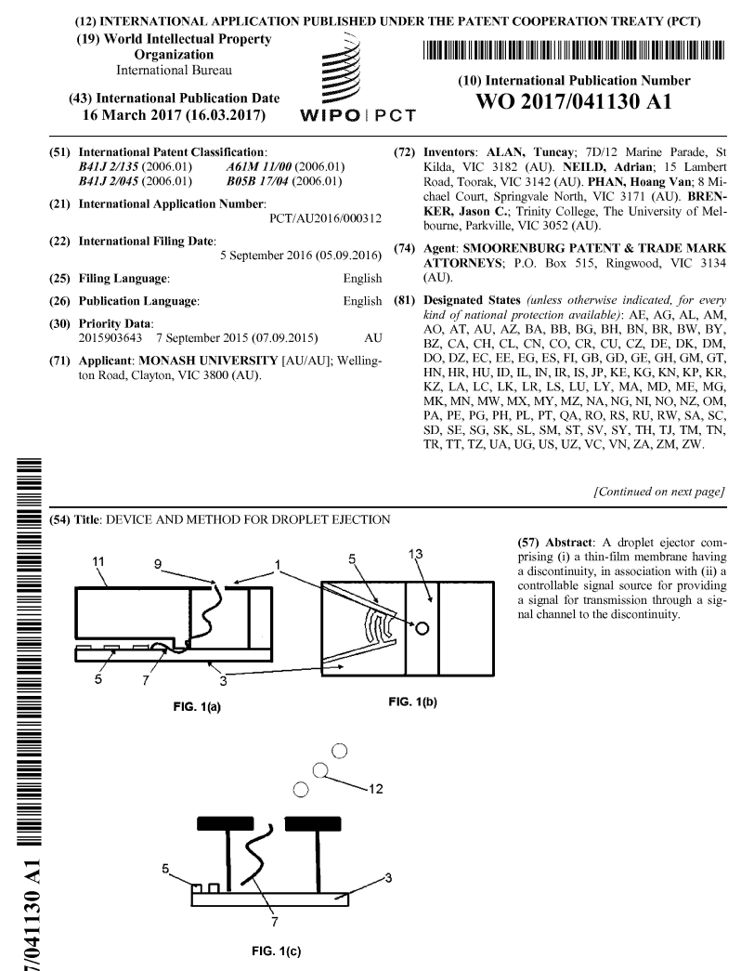
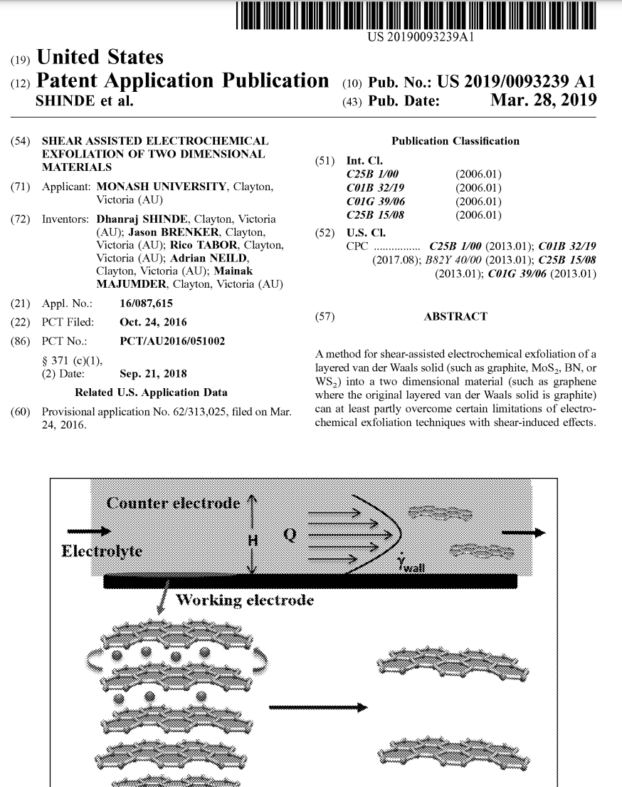
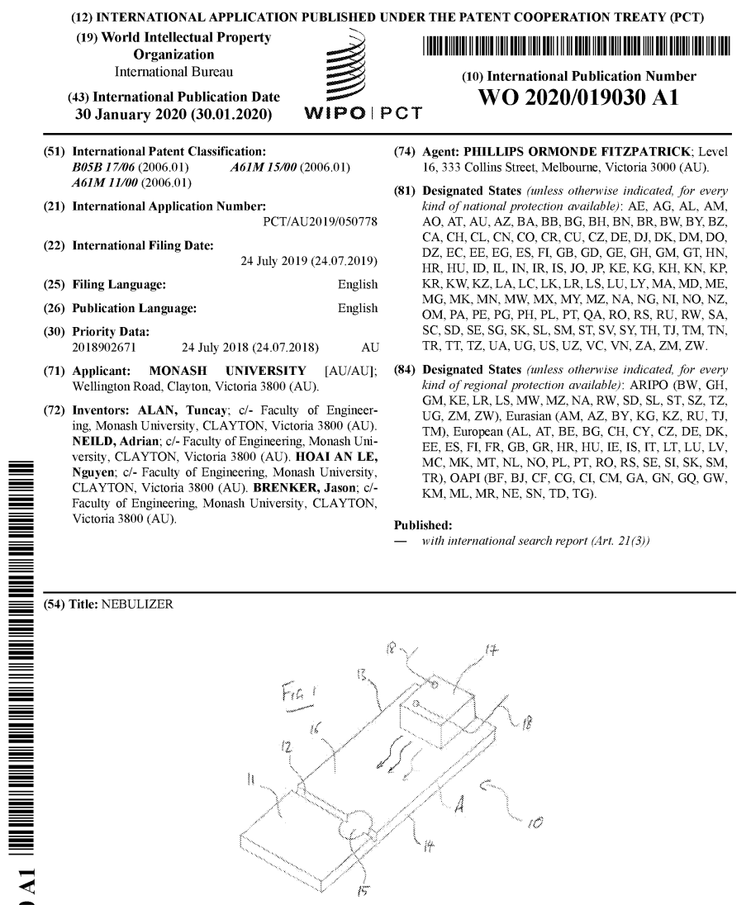
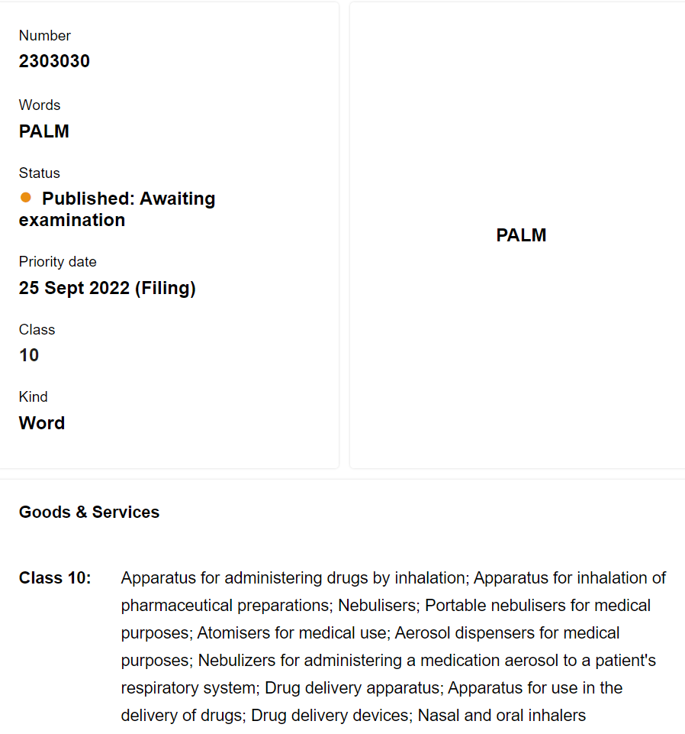
IP Experience
Design Registrations
Patents
Trade Mark

Slide 8
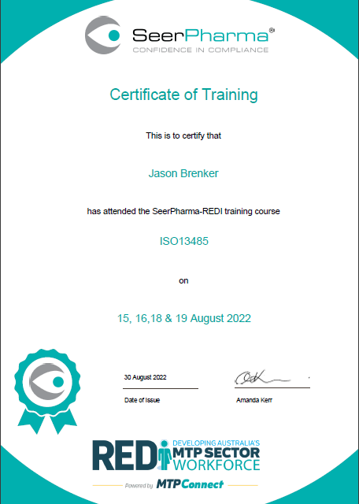
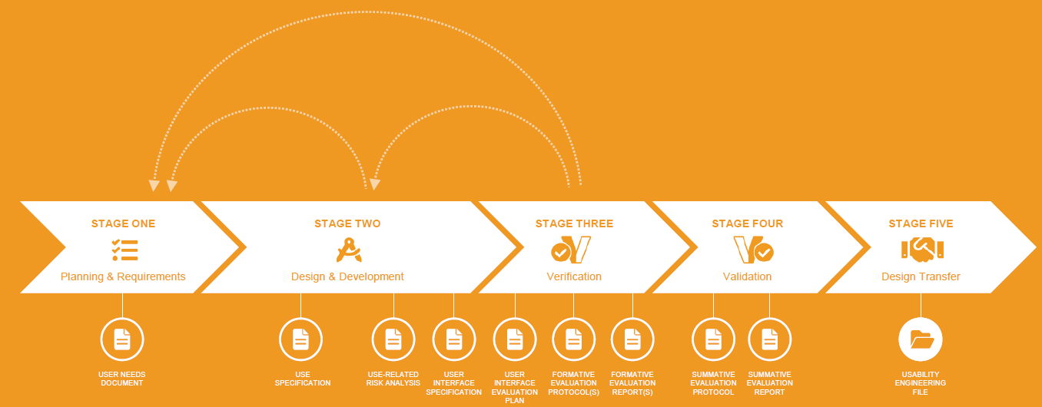
Regulatory Training
ISO 13485
Human Centred Design

Slide 9


Accelerators
CSIRO ON Prime
Monash Generator Accelerator
Funding
Over $1M raised over 4 years so far
$725k through NHMRC Development Grant
Also small grants and research contracts

Slide 10
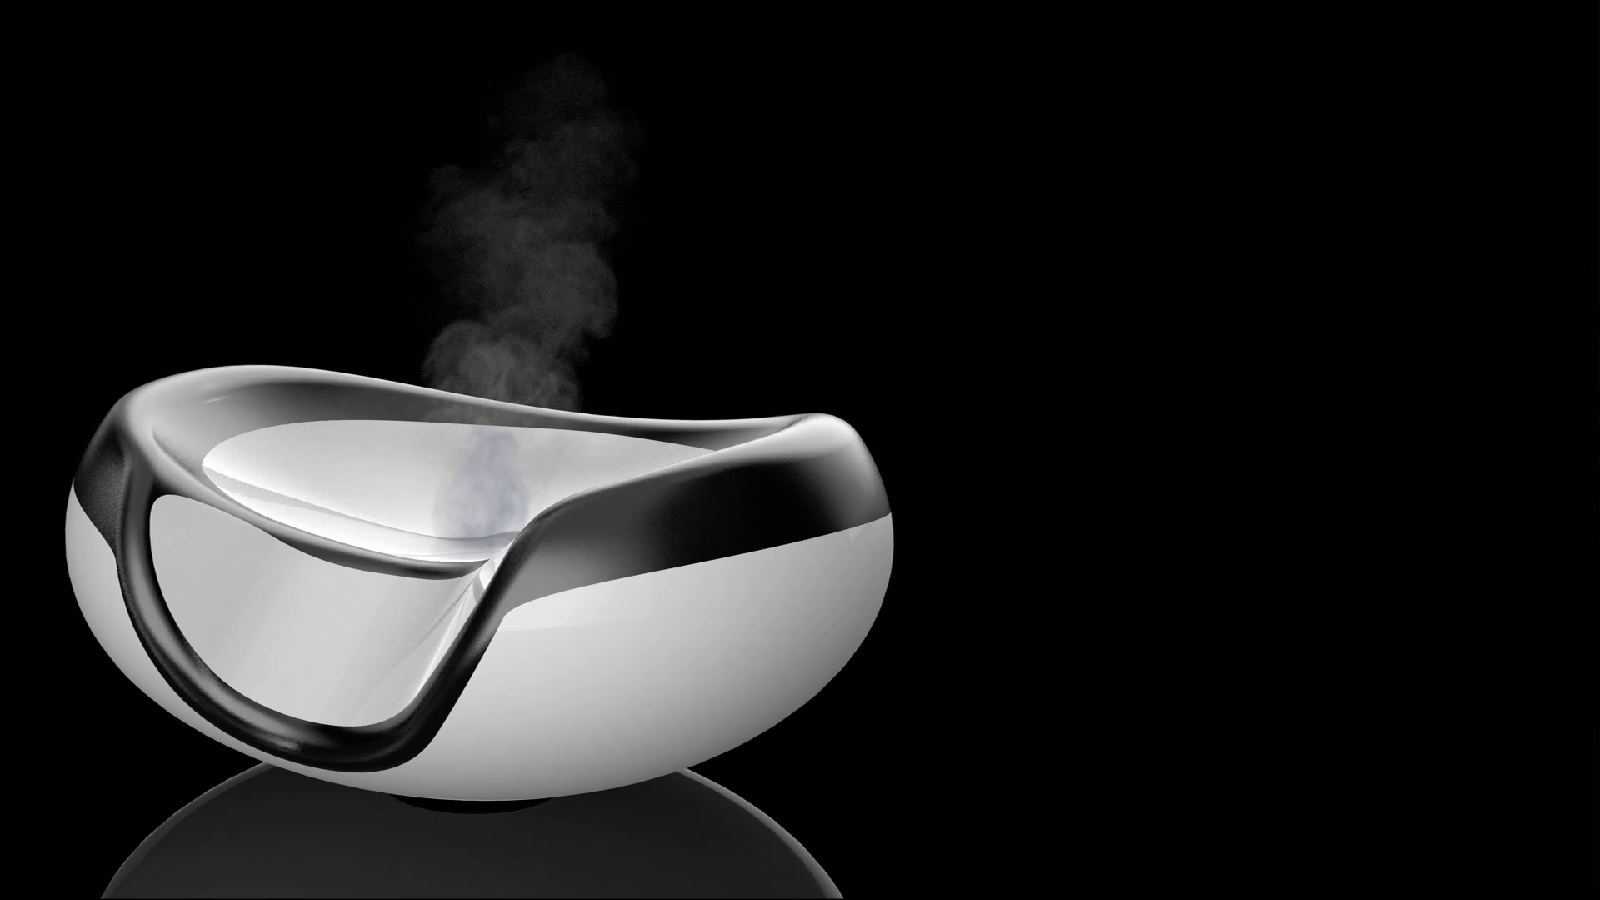

Slide 11
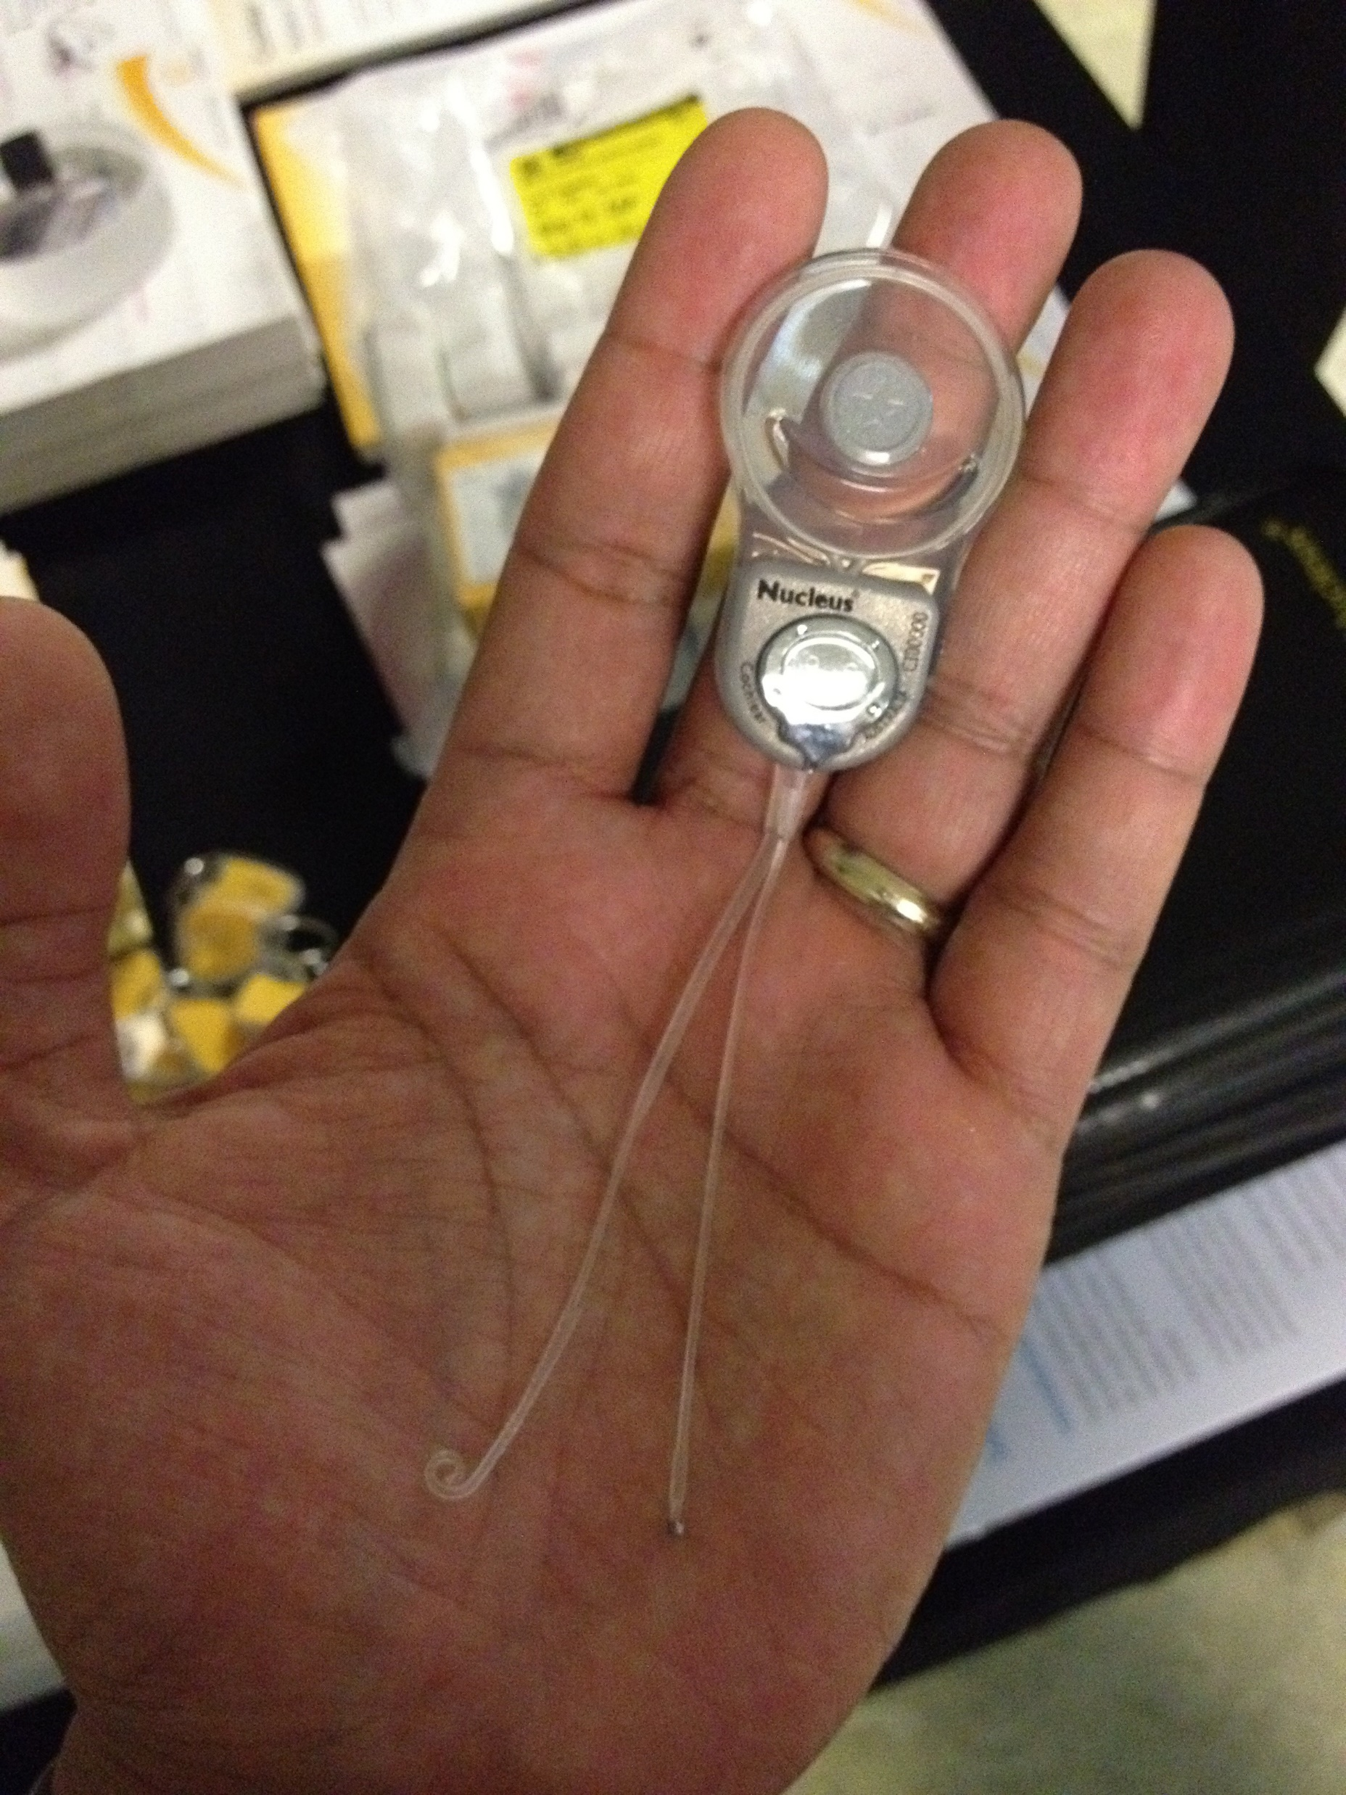


What is Healthcare Innovation
Unmet clinical need
Novel solution
Proof
  new device
  new way of using or analysing data
Cochlear implant, invented in 1978 Clark and his small team made the major break-through and the first patient heard speech
Queensland startup valued at $127 million by Pfizer
  improved processes
Founded in 2012, now Australia's largest and most trusted patient engagement platform
Notes:
https://smallcaps.com.au/resapp-health-takeover-bid-pfizer-shaved-after-disappointing-study-results/

Slide 12





Healthcare Innovation in Australia
Notes:
Connect with Australian companies and view their profile:
4D Medical
Anatomics
ANDHealth
Artrya
AusBiotech
Australian Cardiovascular Alliance (AcVa)
BARD1 Life Sciences Ltd
Cyban
Design and Industry
Envision IT
Genesys Electronics Design
IDE
Inventia Life Sciences
LBT Innovations
Medical Technology Association of Australia
Noisy Guts
Perx Health
Planet Innovation
Seer Medical
SpeedX
WearOptimo

Slide 13

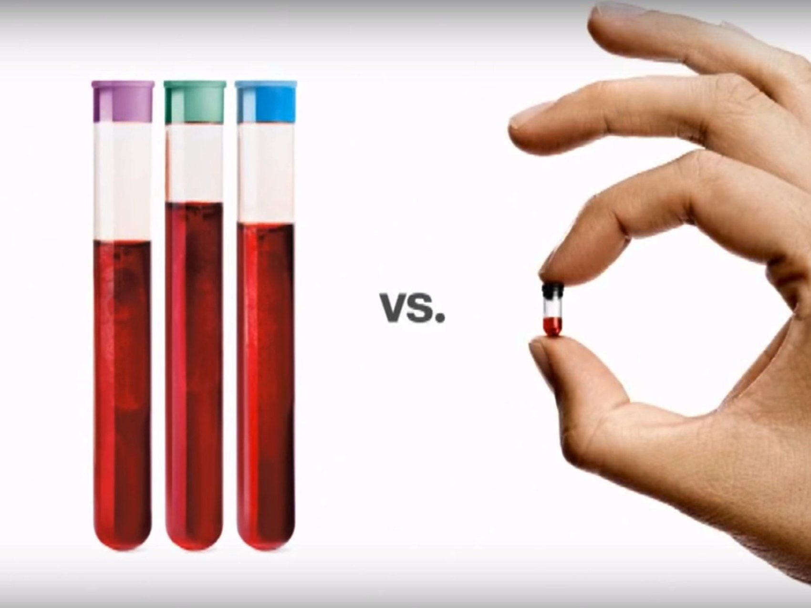
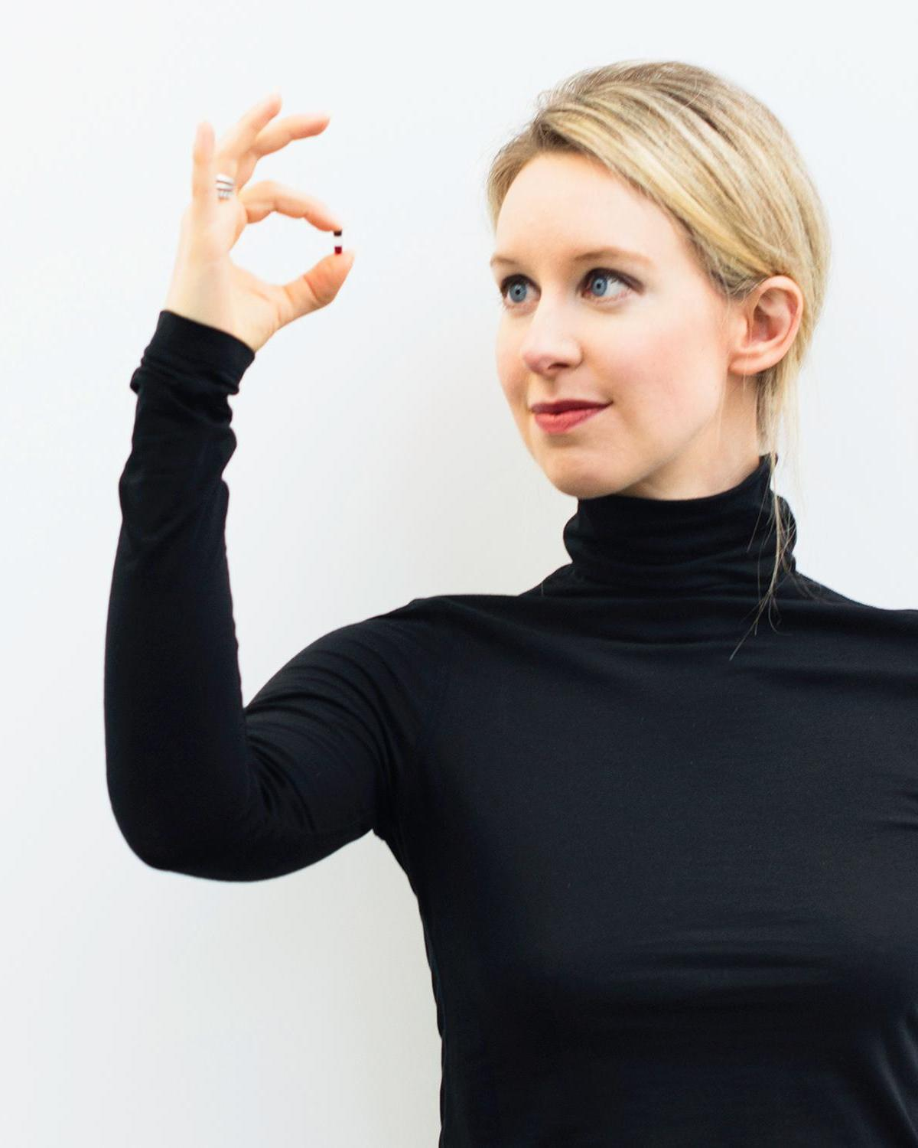
Notes:
Stanford dropout,
Founded 2003
Theranos has raised a total of $1.4B in funding over 10 rounds

Slide 14


Slide 15

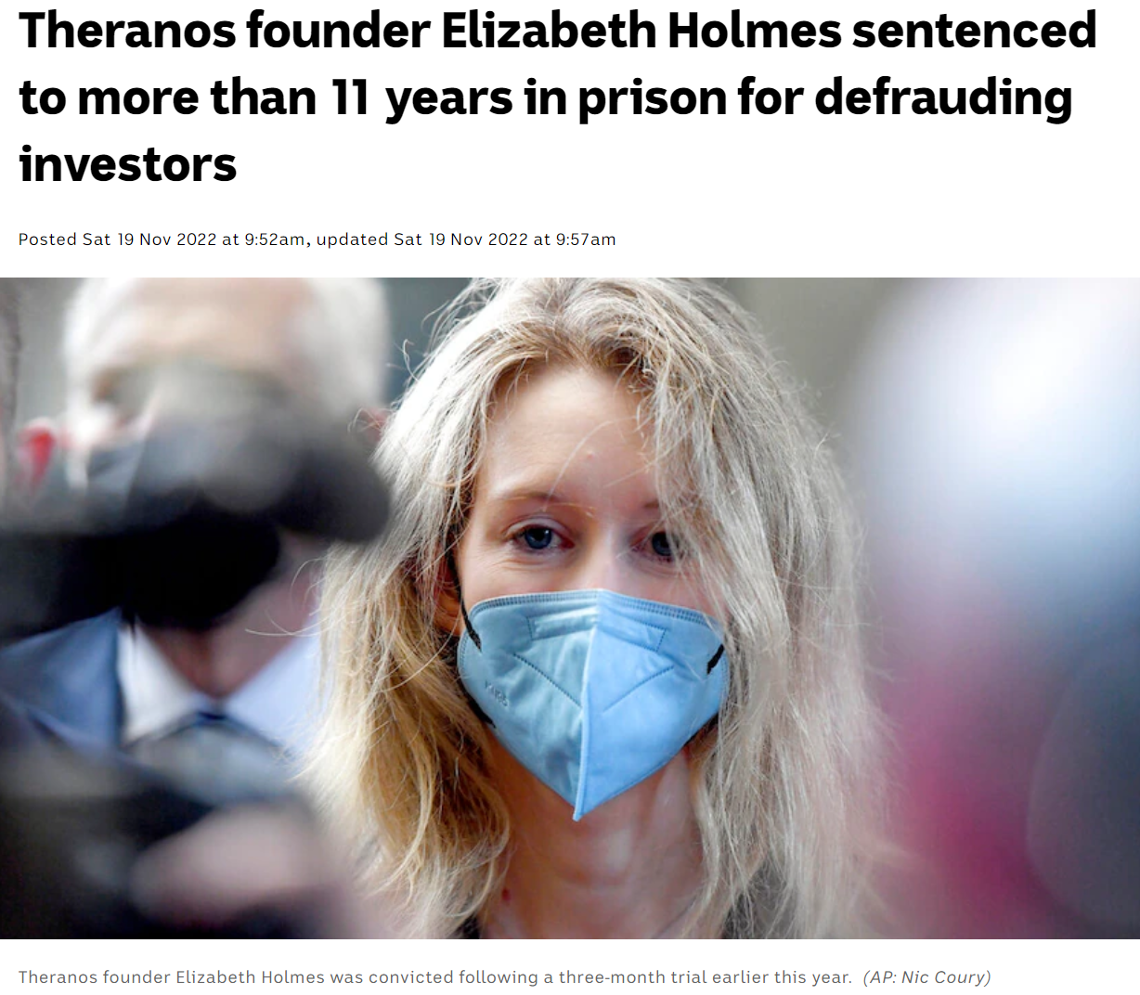
Notes:
Convicted of wire fraud, jailed for 11.5 years

Slide 16

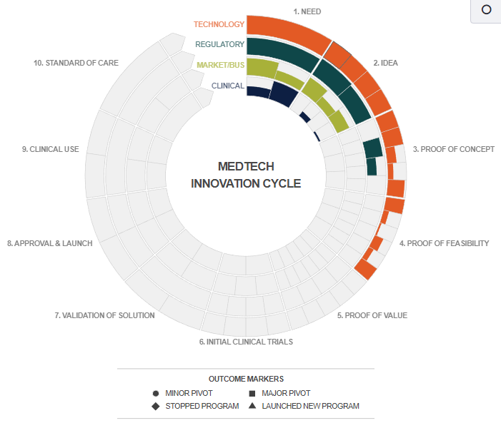

Slide 17
Hospital Networks
Northern Health
  The Northern Hospital
  Broadmeadows Hospital
  Bundoora Extended Care Centre
  Craigieburn Health Service
Peninsula Health
  Frankston Hospital
  Golf Links Road Rehabilitation Centre
  Mornington Centre
  Rosebud Hospital
Alfred Health
  The Alfred
  Caulfield Hospital
  Sandringham Hospital
Eastern Health
  Angliss Hospital
  Box Hill Hospital
  Healesville and District Hospital
  Maroondah Hospital
  Peter James Centre
  Wantirna Health
  Yarra Ranges Health
Austin Health
  Austin Hospital
  Heidelberg Repatriation Hospital
  Olivia Newton-John Cancer Wellness and Research Centre
  Royal Talbot Rehabilitation Centre
Monash Health
  Casey Hospital
  Cranbourne Integrated Care Centre
  Dandenong Hospital
  Kingston Centre
  Monash Medical Centre (Clayton Campus) and Monash Children’s Hospital
  Monash Medical Centre (Moorabbin Campus)
Western Health
  Western Hospital Footscray
  Sunbury Hospital
  Sunshine Hospital and Joan Kirner Women’s and Children’s
  Williamstown Hospital
  Bacchus Marsh and Melton Hospital
Notes:
https://www.health.vic.gov.au/hospitals-and-health-services/public-hospitals-in-victoria

