Slide 1
Interview Etiquette
MYMI

Slide 2
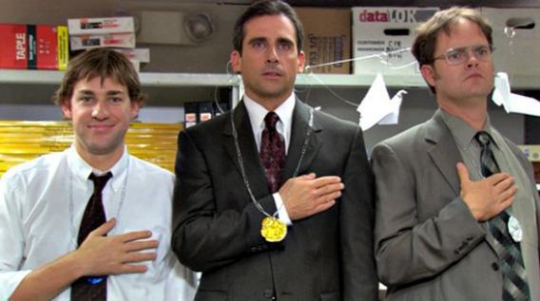
Purpose and Aims
Preparing for conducting interviews
  How to conduct interviews
    The role of the interviewer
  Drafting the questions
    What to ask
    What information is needed
  Emailing/Contact with stakeholders

Slide 3
Table of Contents
01
02
Our role
Emailing
03
Questions

Slide 4

Short video on informational interview basics

Slide 5
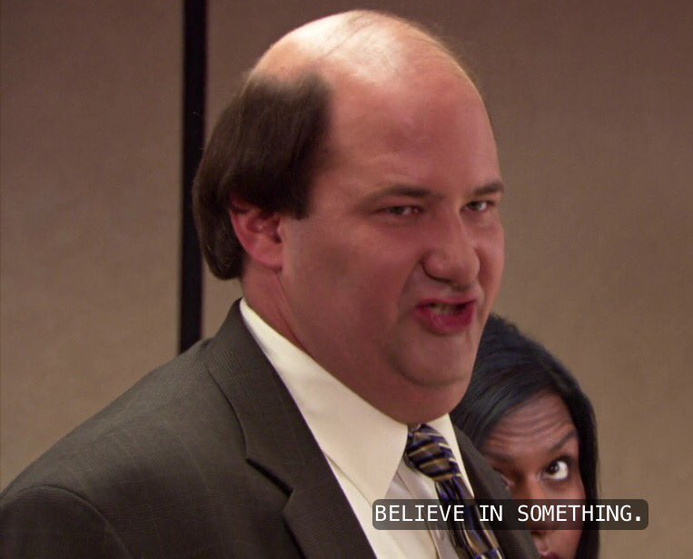
Importance of Informational Interviews
Essential in building a connection/network in the professional field
Gather information about industry, expectations, companies, roles
Can test assumptions
Gives exposure

Slide 6
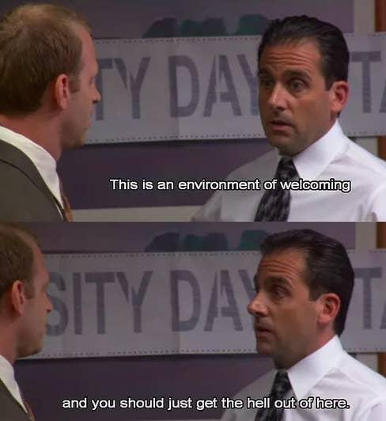
Our role
PURPOSE: To ask open ended questions
Responsibilities:
  Creating a professional and open environment
  Confidentiality
  Good etiquette and preparation
  Protecting IP

Slide 7
Part 1
Contacting stakeholders

Slide 8

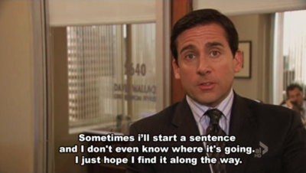
Emailing Clinicians/Professionals:
Background/Affiliation 🡪 personal introduction, degree
Project description
Specific information about clinician/professional
Spend 10 minutes drafting an email for your project

Slide 9
Email template:
Dear ____
I hope this email finds you well.
I'm Shireen Parsamanesh, an Engineering and Biomedical Science student at Monash University, and am reaching out to you as part of the 'Healthcare Innovation Summer Scholarship' program run by MYMI (Monash Young MedTech Innovators), MIME (Monash Institute of Medical Engineering) and Monash Partners. Together with __clinician__, I am aiming to develop a device that accurately produces aerosols modelled on the pattern generated by a human cough to aid in research of airborne disease transmission .
As part of our research, we would find it highly beneficial to gain insight into how a cough simulator could be relevant to your field of work. Could we please meet with you for a 15 minute chat to gain some insight and perspective from someone who ______.
This meeting can be on the Zoom platform or in a real-life setting, whichever is easiest for you.
We look forward to hearing from you.
Kind regards,
Shireen and ____

Slide 10
Part 2
Asking the questions

Slide 11
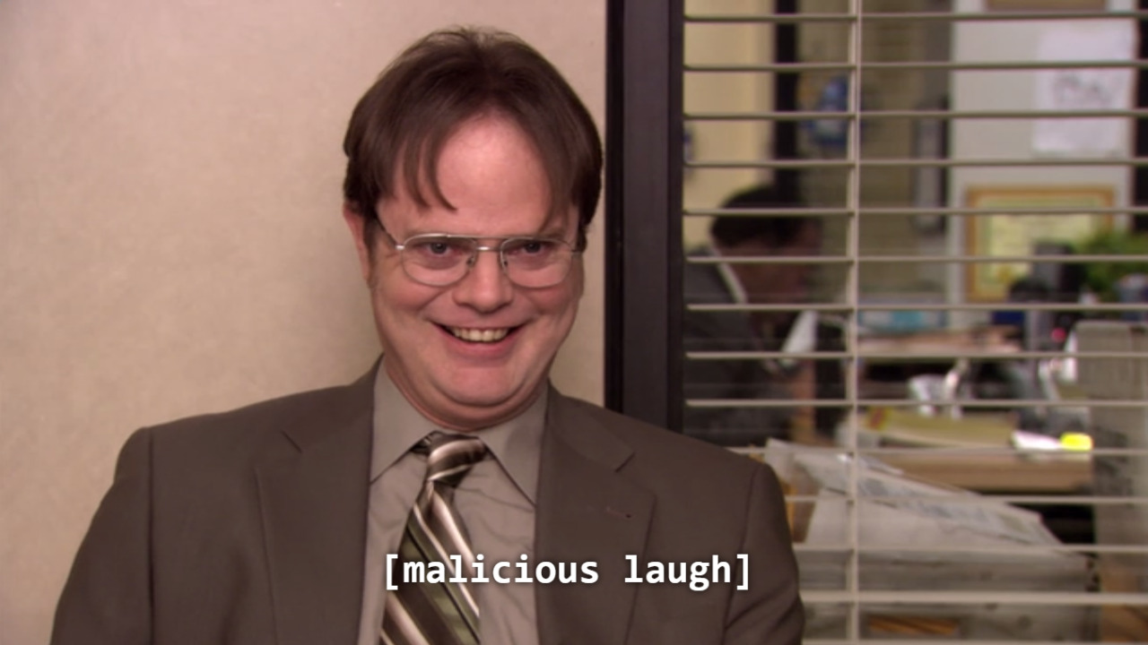
Atmosphere
Key Points:
Breaking the ice
Explain intentions
confidentiality

Slide 12
Style of Questions
Open ended
Scenario based
Questions prompting explanations
Descriptions
Feelings
Ask about situations
Day in the life

Slide 13
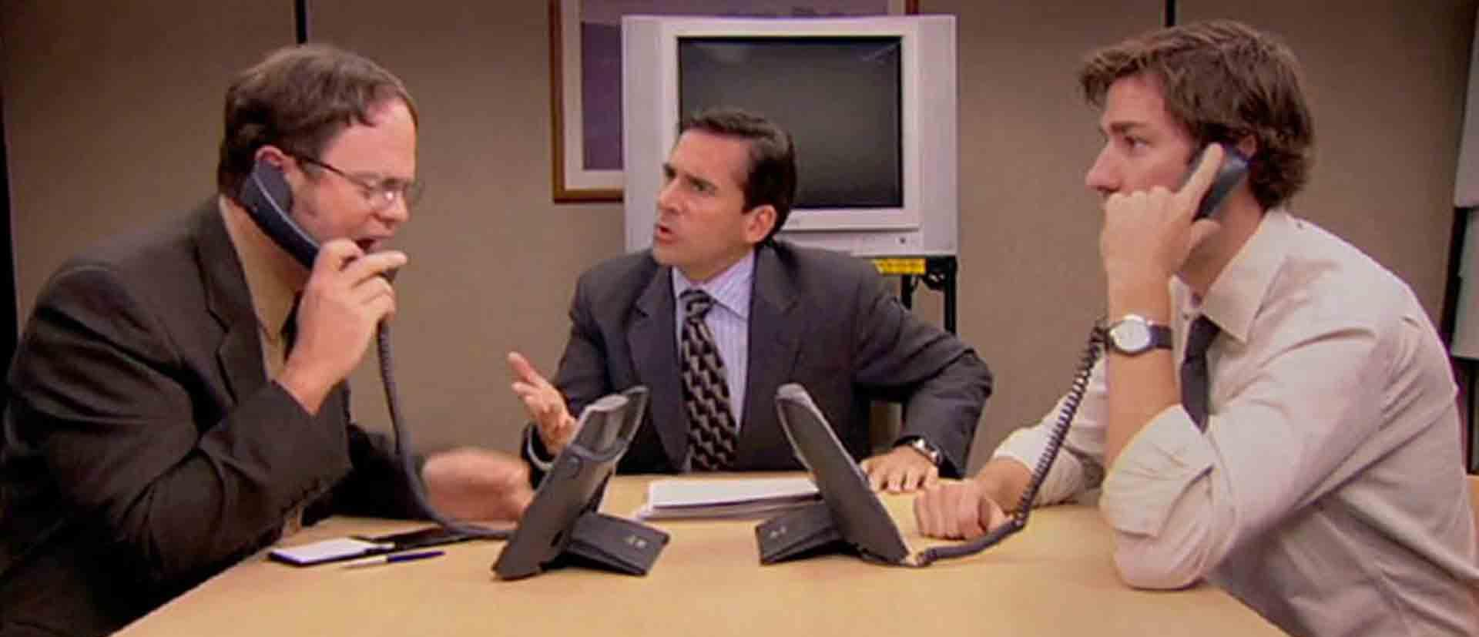
Script

Slide 14
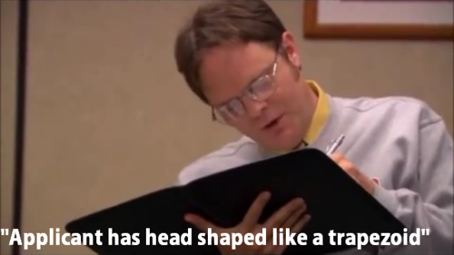
Interview script
Goal of interview
Target population
Building rapport
Current context
Future aspirations
Closing remarks
Taking turns taking notes with partner
Refer to question list

Slide 15
Tips
Ask why/probe
“Tell me more about that”
Never say “usually” when asking a question. 🡪 ask about specifics
Encourage stories
Look for inconsistencies
Pay attention to nonverbal cues
Don’t be afraid of silence
Do not suggest answers to questions
Avoid binary questions
It’s okay to go off script
Be prepared to document.
Always interview in pairs or use a voice recorder.

Slide 16
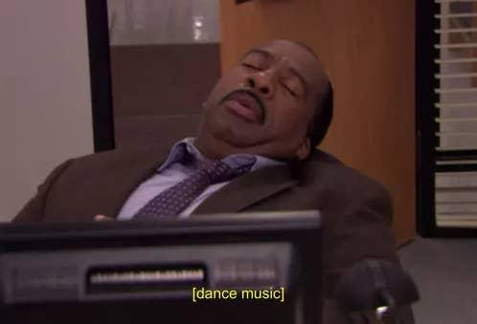
Spend 30 minutes drafting your interview script 🡪 questions to ask, targets

Slide 17
Testing your questions
10 – 15 minutes

