Slide 1




Monash Healthcare Innovation Summer Scholarships 2022/2023

Slide 2
HISS 2022/2023
Acknowledgement of Country
We wish to acknowledge the Traditional Owners of the land whose Monash University campuses share, the Wurundjeri People of the Kulin Nation and pay respects to Elders past and present

Slide 3
HISS 2022/2023
Deliverables
  Develop Mission Statement
  Initial Acceptance Criteria
  Needs Statement
  PICO
  Disease State Fundamentals
Notes:
Basically what is in the textbooks. Students who did well are the ones who followed the textbook well. There are other programs who utilise this book like melb uni and stanford. There will be a lot of individual work so use the book when you get stuck.

Slide 4
HISS 2022/2023
1.1A Define Mission
A mission is a broad direction of what you want to achieve
This will have been established in meetings with your clinical champions and in the briefs given
E.g. For this program the mission is to create an interdisciplinary collaboration in health to work on real world problems
This forms the basis for what decisions you make in the future
Notes:
When you talk to CC or stakeholders throughout the program, you mission will change and its depending on these conversations and the insights you gain that you can define what you are trying to achieve.

Slide 5
HISS 2022/2023
1.1B Define Strength & Weaknesses
You should talk to your partner and reflect on your own skills in the scope of the projects, identification of weaknesses is the most important
Having met with your clinicians, you should be able to get a sense of their strengths and weaknesses in their understanding of the space
Notes:
Never innovate by yourself. Identify your own weaknesses and strengths. Later on when you get paired up, being aware of your skills can help defining what your role will be. Be really honest with yourself. If there is something you want to learn, this is where u can start. When speaking with clinician be honest about capabilities and set outcomes you can meet.

Slide 6
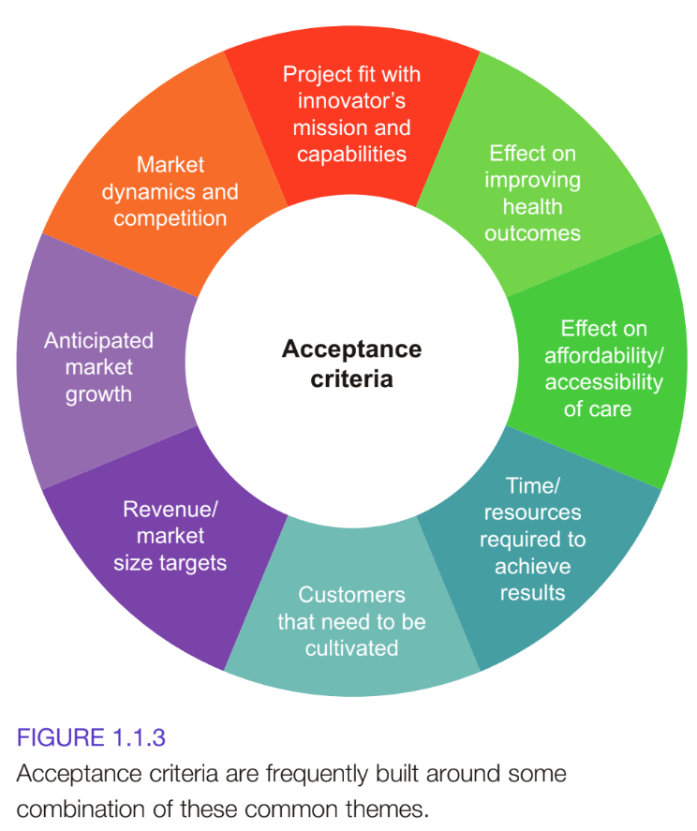
HISS 2022/2023
1.1C Develop Acceptance Criteria
Notes:
Acceptance criteria combines all the facets of the problems. It needs to account for all these things. A true acceptance criteria statement ensures all these are met and ticked off. Does your solution save time for clinicians when finding medical information? Is your solution affordable? You criteria should meet the needs of all these things.

Slide 7
HISS 2022/2023
1.1C Develop Acceptance Criteria
This example has a mission to improve important outcomes for patients on a major scale, the acceptance criteria might require a project that defines acceptance criteria around the magnitude of the impact its solution can have on people’s lives
Eg.
Has a total potential market of $1 billion or more
Will be cost-neutral or cost-reducing (so it gets adopted)
Will be attractive to investors (so it gets adequate financial support)
Results in an innovation that has a significant impact on patient’s quality of life (as opposed to an innovation that makes a device cheaper, faster or easier to use)
All acceptance criteria should be cheaper, faster or easier to use *starting point*
Notes:
Think broadly. I understand the problem but how do i make people want this solution.
Cheaper, faster easier
If your product doesn’t meet these requirements then it wont work. Why would you work on that

Slide 8
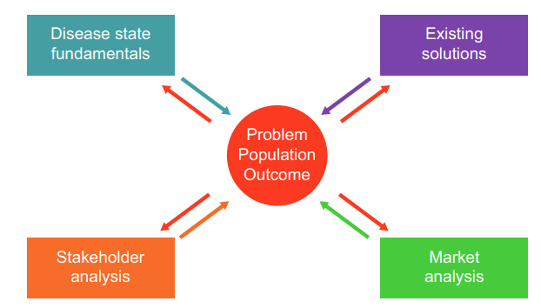
HISS 2022/2023
Developing Needs Statement
Assess how external factors influence goals
External factors can make or break a project.
Good to consider them before starting the process in a general sense to reduce the risks related to the project
Notes:
Disease state fundamentals is doing research on your research and what the symptoms are and understanding the disease you are trying to solve.

Slide 9
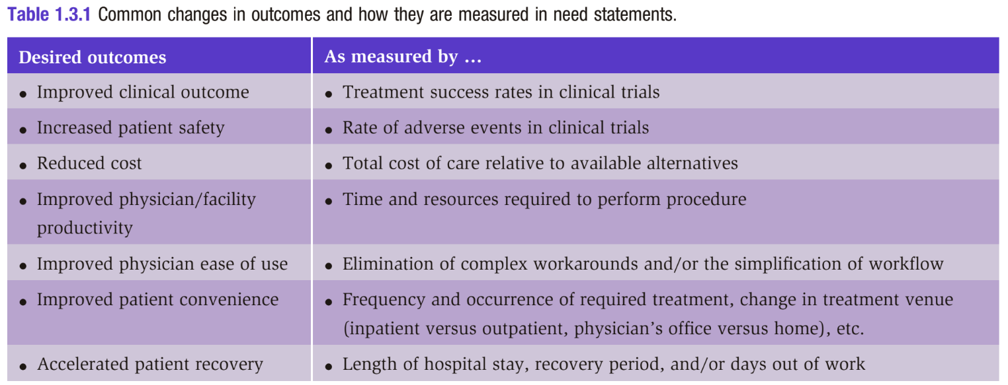
HISS 2022/2023
Developing Needs Statement

Slide 10
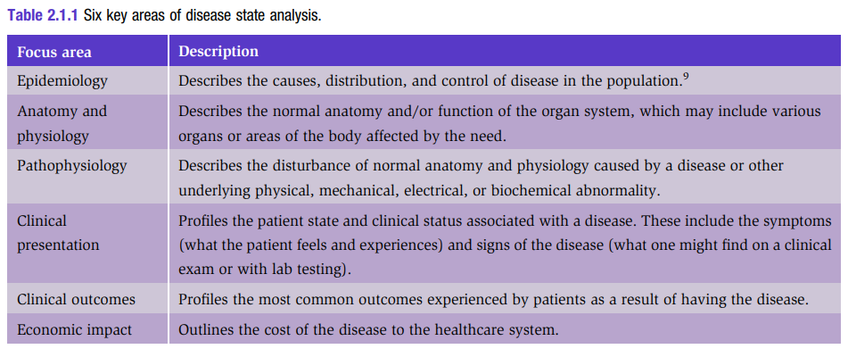
HISS 2022/2023
1.4.A Disease State Fundamentals
This is not relevant to all, but for those doing diseases, this is important to consider. Some of these things you will have looked into already but this is the formalisation of it.
Notes:
pg 114-124
summary and application example on 126

Slide 11
HISS 2022/2023
Deliverables
Mission Statement:
A statement/small paragraph
Acceptance Criteria and Needs Exploration:
Dot point addressing each criteria with brief sentences describing each
Needs Statement: PICO Statement – sentence/small paragraph
Disease State Fundamentals: Dot points addressing each criteria with brief sentences describing each
Due by: 5pm on Thursday with a presentation to team on Friday at 9am

