Slide 1

JANUARY 2023
MONASH HEALTHCARE INNOVATION SUMMER SCHOLARSHIPS
Project Blooming
Jacinta Patel
Dr Rita Upreti
Monash Health, HISS, Monash University, MYMI

Slide 2
Executive Summary
The focus for this project is an all-in-all an app for empowerment in people who are transitioning, providing them with the best evidence based care through a health and wellness app, by measuring breast development in transwomen.
Mission: Statement: To develop a solution for transgender women and gender diverse individuals on feminising hormone therapy to provide:
1. a validated tool for research into treatment options for breast size and shape
2. patient self-monitoring of breast development (i.e., breast size and shape) to improve satisfaction with gender affirming hormone therapy (GAHT).
Needs Statement: An accessible and accurate tool is needed to assess breast development, including shape and size determination, for individuals on feminising gender affirming hormone therapy. This tool would address a clinical and research need and will be developed specifically addressing differences in breast development in cis and trans populations
Unmet clinical need: Breast development is a key feature of feminisation and thus, important to transwomen. The current self-reported Tanner Scale is unreliable. Transwomen seek their health professionals on reassurance and guidance on their bodily development on GAHT and accurate assessment is not available. The only possible competitor Breast-V has not been validated in trans women and this app has not been updated since 2017. Other tools for measurement such as MRI and water displacement is for cosmetic purpose used in breast reconstruction and usually don’t take account both shape and size of the breasts. These tools have a accessibility problems such as price and time efficiency.
Acceptance Criteria
Measures both shape and size accurately and able to give a novel output
100% secure as data should be confidential. Thus, need security restrictions.
Should be accessible geographically and financially.
EXECUTIVE SUMMARY
PAGE 1
Notes:
Breast development is a key feature of feminisation and thus, important to transwomen. - https://academic.oup.com/jcem/article/103/2/532/4642966
Limitation: https://ec.bioscientifica.com/view/journals/ec/11/5/EC-22-0170.xml
https://www.theguardian.com/education/2012/oct/29/research-child-pornography-tanner-scales – origin
Muted - https://link.springer.com/article/10.1007/s40134-018-0260-1
https://appadvice.com/app/breast-v/581963350 – Breast V
https://pubmed.ncbi.nlm.nih.gov/23806950/

Slide 3
Gaps analysis
At the moment, endocrinologist do not have a gold standard to measure breast development in transwomen and gender diverse population as it is not an essential clinical feature used to gauge progress on gender affirming hormone therapy (GAHT) but rather satisfaction of the process. Higher quality of life (QOL) scores are associated with breast development among transgender women (Silva et al., 2021) and scores improve with gender affirming hormone therapy (GAHT) (Feil et al., 2022).
There are about nine main ways to measure breast volume which were 3D modelling, water displacement, cast, MRI, computed tomography (CT), ultrasound, Gorssman-Rouder measuring device, leaner measurement (tape measure) and x-ray (Xi et al., 2014). Tape measure, 3D modelling, and MRI used in this specific population to measure breast development and changes in general under GAHT with 3D imaging and MRI being the most accurate and tape measure being more easy and accessible (de Blok et al., 2020). The most used breast volume measurements were also looked at in cis-women who had breast cancer undergoing breast reconstruction surgery by plastic surgeons. In this population, the gold standard measurements were MRI scans produced by radiologists or water displacement (stakeholder interview).
As none of these above tools were used by transwomen and gender diverse people in real life settings, I have picked bra sizes as the most common way to measure breasts development population. Usually, transwomen gauge their own breast development and is done visually and/or through bra sizes. It is important to keep in mind that bras are not an accurate measure for development as the “how to” varies in cis-women and the anatomy features differ between cis and trans women (Emma Cadence, heart & crossbones 2020). The issue with bras is that it doesn’t consider broader chests, larger frames, tallness, nipple that is more lateral or lower, breast tissue and glands sizes, fat distribution, thicker chest muscles and larger pectoral muscles (Wilhelmus Timmermans et al., 2021).
There is no novel specific tool made to address the problem for this population in clinical or research. The closest competitor is a free app called Breast-V which is based on a algorithm to calculate breast volume in cis-women and has not been updated since 2017 (Apple app store, Breast-V App). The Breast-V app and the authors of a research paper validating this tool are all the same people and method does not include trans women undergone GAHT (Longo et al., 2013). This app uses only three anthropomorphic measurements (sternal notch-to-nipple distance, inframammary fold-to-nipple distance, and inframammary fold-to-fold projection distance) (Apple app store, Breast-V App) in centimetres which is inputted into a calculator to calculate breast volume in (cc/gr).
The current self-reported Tanner Scale (5 stages) usually used during puberty is resorted in literature when comparing breast development in transwomen over 1-3 years under GAHT (Fisher et al., 2017). The following are the staging which are referred to with illustrations (UpToDate, Tanner staging of breast development in females 2023) :
Stage 1: Prepubertal.
Stage 2: Breast bud stage with elevation of breast and papilla; enlargement of areola.
Stage 3: Further enlargement of breast and areola; no separation of their contour.
Stage 4: Areola and papilla form a secondary mound above level of breast.
Stage 5: Mature stage with projection of papilla only, related to recession of areola.
Tanner staging is limited by sensitivity to quantify changes in breast volume and has no external validation (Nolan et al., 2022) , have only been “validated” in cisgender women and was initially made to pinpoint age (Statpearls, Tanner stages).
GAPS ANALYSIS
PAGE 2

Slide 4
The top 3 existing solutions are linear (tape/camera), Grossman-Rounder
Solution | Overview | Clinical and Utilisation Profile | Economic Profile and Gaps
3D Modelling | Cis women for reconstructive and cosmetic breast surgery procedures + after breast cancer Has been tested on Transwomen in literature Natural Shape Methods Considers volume, shape, and surface area | Done through a 3D device such as a laser scanning machine measuring the distance between target pints on the breasts to the scanner, and stereo camera using several synchronised cameras places at different angles. Done standing and can produce a colour-coded map The breast boundary is defined, and the breast area of the 3D model is selected. A chest all is then simulated by software. The selected breast area and simulated chest wall are superimposed to achieve a closed object in which the volume is calculable. | 3D devices can cost $20-100K per piece to buy online Accurate in determining the true boundary of the breast To increase reliability images taken at different times must be standardised/
MRI | Cis women for reconstructive and cosmetic breast surgery procedures Has been tested on Transwomen in literature Stereological/Cavalieri’s method Considers only volume Used in a research setting | The patient is placed in prone (facing down) position and wears a breast coiled to avoid compression of the breasts. This is done in a hospital setting. Researchers manually define breasts and then calculate volume using summed layers. Can also assess breasts implant Can take 30 mins to an hour | Accurate in determining the true boundary of the breast Costs $700 AUD for breast MRI and not covered by Medicare unless you’re in risk of breast cancer
linear measurement | Cis women for reconstructive and cosmetic breast surgery procedures Geometrical methods Considers shape and volume Has been tested on trans women in literature | Using a tape measurer done standing and but can additional Camera + software analysis in 3D measurement done which would cost more, done standing and can take about a minute The investigator measures linear distance between anatomical landmarks on the patient’s body and then uses formula to calculate volume. Formulas can be based on a calculation of the geometry volume of a come or based on polynomial regression of a large data sample such as Breast V | Tape can be $1 High reproducibly but less accuracy Cheaper and requires less time Accessible in almost any local stores
GAPS ANALYSIS
PAGE 3

Slide 5
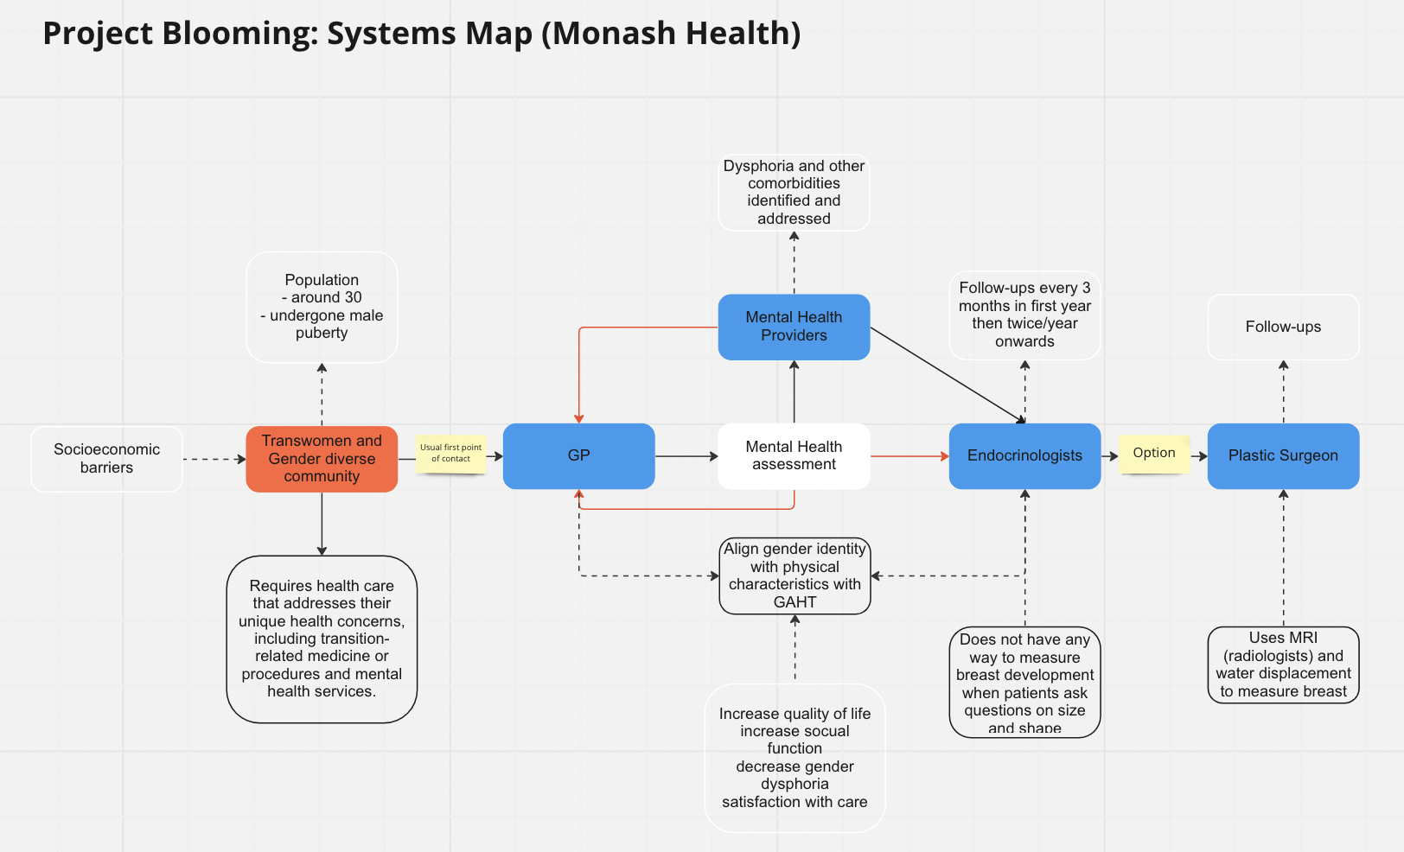
Systems Map
Present here a clear picture of the systems map
Figure 1: Project Blooming's system map
This patient diagram maps the progression of a person seeking gender affirming hormone therapy (GAHT) at the Monash health gender clinic. Usually a person will seek a general practitioner (GP) who then refers them to psychologist for a mental health assessment and then referred to endocrinologists for hormone therapy. People have an option of different health professionals and after GAHT some seek plastic surgeons for breast augmentation.
Link for miro board: https://miro.com/app/board/uXjVP5xwpLk=/
SYSTEMS MAP
PAGE 4
Notes:
https://www.ohtn.on.ca/rapid-response-barriers-to-accessing-health-care-among-transgender-individuals/

Slide 6
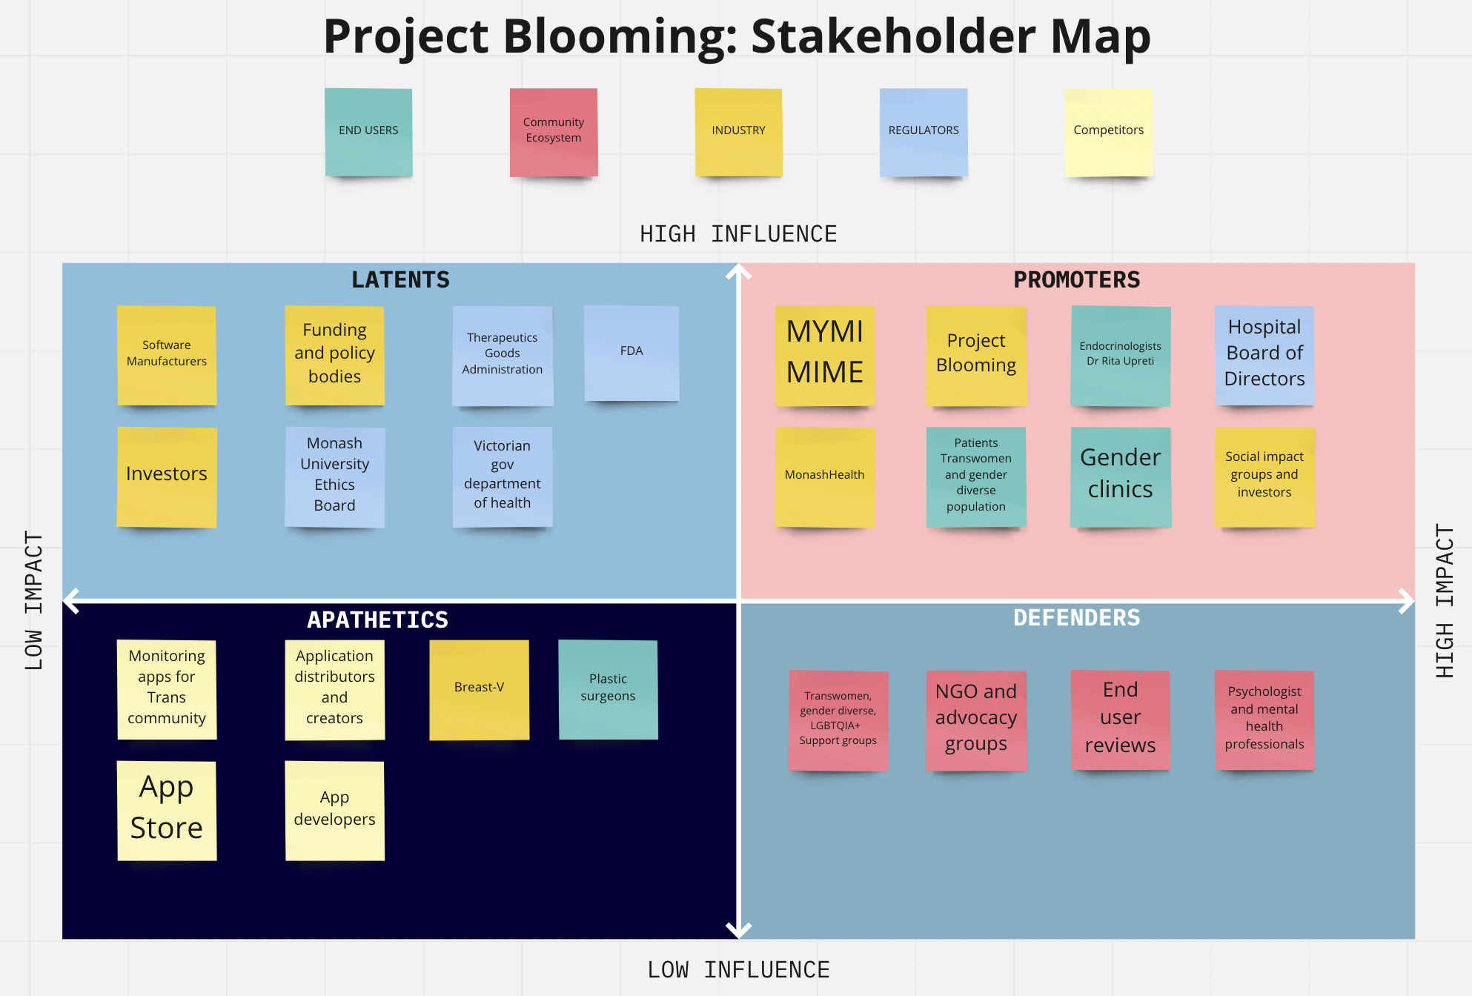
Stakeholder Map
Present here a clear picture of the stakeholder map
Figure 2. Stakeholder Map
Depicts the range of stakeholders and the position they hold in terms of the direct influence they have on Project Booming, and the impact the project will have on them. There are four majors stakeholder categories: stakeholders who are involved in the research of the problem and development of the solution, beneficiaries of the solution, HISS program contacts, and competitors – Breast-V. Promotes and defenders will have high impact in the research and development phase.
Link for miro board: https://miro.com/app/board/uXjVP5xwpLk=/
STAKEHOLDER MAP
PAGE 5

Slide 7
Qualitative/Quantitative Research
It has been difficult finding quantitative data on this population alone (Australian bureau of statistics, 2016). There were many limitations this census highlighted statistics being an inaccurate number. Some 1,260 people were considered to have provided a valid and intentional sex/gender diverse response giving 100 of them were trans female. Limitations were that most households complete the Census without contact with an interviewer or any interaction with ABS staff, in most households, it is common for one person to complete responses on behalf of other household member, and census forms have limited space. Thus, community and organisational surveys have been greatly relied on referring to gender diverse or LGBTQIA+. Globally, 80,000,000 (1%) identify themselves as transgender, non-binary, non-conforming, gender-fluid (World Economic Forum, 2021). About ~2,055,200 are gender diverse in Australia (8%) (ANMF, 2021). Dr Rita Upreti specified that the transgender population of Australia is 1% thus, trans women population is roughly 128,450 (0.5%).
Hormonal therapy is effective procedure at aligning physical characteristics with gender identity and when it is done as a respectful care, it may even improve mental health symptoms (Cheung et al., 2019). Feminising hormone therapy options include transdermal or oral oestradiol. There are additional anti‐androgen therapy with cyproterone acetate or spironolactone usually required. Gender‐affirming hormone therapy is effective and relatively safe with appropriate monitoring (Cheung et al., 2019).
In the United States this population has a shorter life expectancy and increase rates of suicide valance cardiovascular disease in about one and three transgender individuals have reported prejudice when visiting a doctor health clinic. Research on LGBTQ+ health is limited, and these individuals are often grouped into a single category despite diverse experiences. Come and live when research is done the limitation includes studies assessment based on identity (such as gay, lesbian) while some assistance just behaviour (who they interact with). In patient and critical care of transgender in LGBTQ+ patience have unique physio social considerations and hospital care such as the transgender-affirming hospital policies are to be considered. Socio economic disparity is limited access to outpatient care in for this population there is a higher rate of unemployment giving this group low socio-economic status (Splete, 2021).
Most people present to health professionals in adulthood or late adolescence (Tangpricha & Safer, 2021). It is very common for individuals to see primary care providers while some present to mental health providers, some present directly to endocrinologists. Transgender adults report gender incongruence throughout their lives, starting well before puberty. Many transgender adults will be straightforward in their presentation, others will have the diagnosis confounded by mental health concerns. Now, as society is becoming for accepting, many are presenting at a younger age. The approach to home and therapy is an initial assessment, consultation before treatment, individualise approach and hormone therapy goals. The diagnostic current criteria for gender incongruence includes persistent incongruence between gender identity and external sexual anatomy at birth and the absence of a confounding mental disorder or other abnormality. Patients also may be diagnosed with gender dysphoria (discomfort arising in some individuals from the incongruence between their gender identities and their external sexual anatomy at birth.) Mental health professionals use the Diagnostic and Statistical Manual of Mental Disorders, Fifth Edition (DSM-5) to make a diagnosis and used in heath assessment (Tangpricha & Safer, 2021).
QUALITATIVE AND QUANTITATIVE RESEARCH
PAGE 6

Slide 8
Qualitative/Quantitative Research
I have spoken to 5 stakeholders' majority through zoom interviews including my clinical champion. There are three more people for possible interviews in the future plus a consumer panel at Monash Health. This project will be greatly supported from population surveys and consumer interviews as this app would be patient centred.
All these interviews had emphasised that this population is vulnerable and that security measures for this tool is not optional.
4 out of 5 for greatly supportive of this project
2 out of the 5 are endocrinologist, 2 are psychologist and 1 is a plastic surgeon.
All stakeholders are associated with Monash health
All of the stakeholders have interacted with the population but for different reasons specific to their occupation.
The endocrinologists and psychologists talk about expectations regarding hormone therapy
3 out of 5 has talked about the positive impact of breast development during hormone therapy and Halle able to view change has positively impacted their patience.
1 out of the 5 actually measured breast volume which was the plastic surgeon, and this was only used for breast reconstruction surgery. They themselves not measure but obtained an MRI from a radiologist.
The following are some quotes taken during these interviews:
“It is a common thing to come across (for trans women seeking reassurance on their bodily changes). For trans-women, any women, breast are a feature of femineity, classically associated with being female” - Monash Health Endocrinologist
“Absolutely many trans women value breast development as it can help with presentation.” – A clinical psychologist, “People can buy into the process (of measuring breast development) and some patients will see it useful to do in clinical settings.”
”I would use the data from this tool to assess (breast) volume growth anticipation.“ – Private plastic surgeon
“This is a cool idea as it gives objective measure on body changes. People (patients) who had documented transition photos found it really rewarding how much their body changed.“ – A clinical psychologists
QUALITATIVE AND QUANTITATIVE RESEARCH
PAGE 7

Slide 9

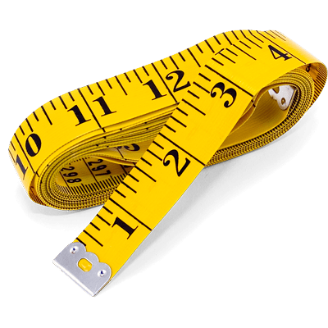
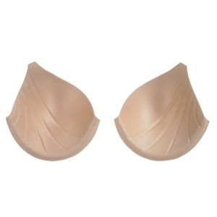
Solution Concept Discussion
During solution ideation these 10 main criteria were considered which were easy to use of fordable timer fission able to be done independently accessibility could be expanded upon easily integrated into personalise of patients confidentiality appropriate and comfortability and add in tracking progress of breast development were used against the standard of bra sizes.
According to the Pugh matrix, the most favourable solution is Augmented Reality technology mobile apps. It is a more time efficient, easy to use, affordable as many already have phones, appropriate/comfortable, can be easily integrated into personal lives of patients and aids in tracking breast development. A solution like this that uses phones has been suggested numerous times from clinicians, stakeholders, peers, and professors from Masterclasses. Furthermore with this reports important acceptance criteria this app would be able to measure both shape and size accurately and calculated in the app giving an output to users. Of course this app would have security considerations because confidentiality is important. We would be able to put security restrictions. Mini rule and urban population have phones and could just download this app and use it then and there.
Another one that was considered was just using a tape measure. This is easy to use affordable so accessible intend to be found in many corner stores. There are different ways to measure breast but this would differ between cis and trans women it would be time consuming. Tape measures are relatively cheap and because of its simplicity security does not have to be considered. Though when measuring features it would take time and it’s hard to calculate what is the appropriate output.
Lastly, bra stencils and bra making foam used in clothing factories were considered during solution ideation. The solution has the same expectations as the tape measure but is is less accessible. Also, bras are made for support and not easement.
Top 3 Solutions
PAGE 8

Slide 10
Final Concept
Similar to an AR ruler app that uses augmented reality technology (AR) to tape measure the real world we will be developing and AR app to measure breast development with only your smartphone’s camera.
The following are the technical considerations when making the app:
Estimate measurement in both horizontal and vertical dimensions with guidelines
Estimate area, volume, breast-to-chest circumference and what shape breasts fall under
Considers anatomical differences and fat distribution i.e. thoracic bone
Output a novel summary scale for size and one for shape.
Restrictions on how many times it can be used per fortnight.
Age restriction
Serial measurements data storage
Security includes password restrictions
App is free to download but you pay in app ($1 for now)
There is a possibility of the novel output scale that can be patented or the app itself. We will seek approval from TGA first under software medical devices. The app of course will have information on where they can seek mental health professionals if they are feeling in insecurity, or to seek endocrinologist if they have any questions about home on therapy and expectations on bodily changes.
The app first be marketed towards clinicians and then the population. In the endocrinologist workflow patients tend to visit every few months accounting for about three times a year and during these sessions the app can be used. Clinicians do care about their patience and to get a better gauge of satisfaction on hormone therapy and consultations this be a good tool.
The advantage of this app is the inclusivity in health care in regards to the population and it’ll to address clinical and research gaps. It is going to be affordable with plans on making the in app charges cheaper.
CHOSEN FINAL CONCEPT
PAGE 9

Slide 11
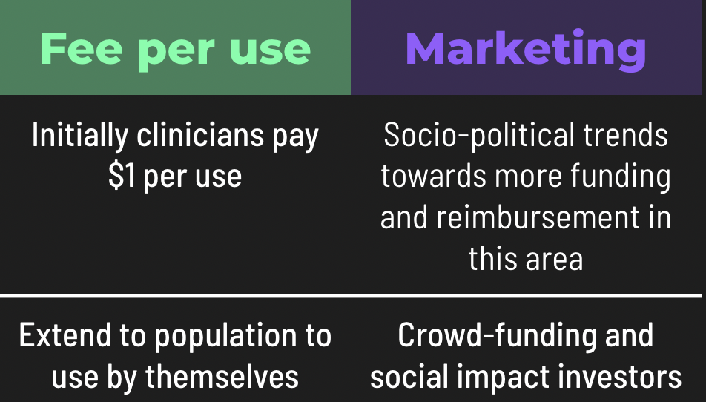
Business Model
Currently, reimbursement for MMAs is not available in Australia through universal or private insurance. The MBS does not have any items that cover MMAs or reimburse GPs, specialists or healthcare workers for utilising MMA capabilities or data. But they are now socio-political trans towards more funding and reimbursement in this area. In 2021, the Greens called for $15 million to be spent annually to cover out-of-pocket costs for trans and gender diverse Australians seeking gender-affirming healthcare.
The only comparable Medicare code is TN.8.150 Correction of development breast abnormality (item 45060) under category 3 therapeutic procedures. Where volumetric measurements of the breast should be performed using a technique which has been reported in a publish study. As mentioned in Analysis answers to health kilometre profile is the improvement of patient experience in regards to quality of life.
Based on the app development calculator Clavax, the AR app is estimated to cost minimally >$5000 for a full measuring-based AR app. This considers integrated payment pathway, email sign-up, idea stage, simple interface, availability on IOS & Android . This price does not consider if the app would need an integrated website or multilingual application. App development cost may increase with the added security level to the mobile app and the complexity of the features. Thus it is expected to develop a custom Android or iOS app in 160 to 190 hours for a cost of $10,000 - $15,000 in general. Maintenance will take $250-$500 a month. Marketing, regulatory, clinical trials and IP will increase this price.
The clinicians will pay one dollar per use of the app and market to the population. Plus there’s a possibility of crowdfunding and social impact investors. The aim of this app is to help this population that tends to have a low socio-economic status and so it is envisioned that the price will be lowered.
BUSINESS MODEL
PAGE 10

Slide 12
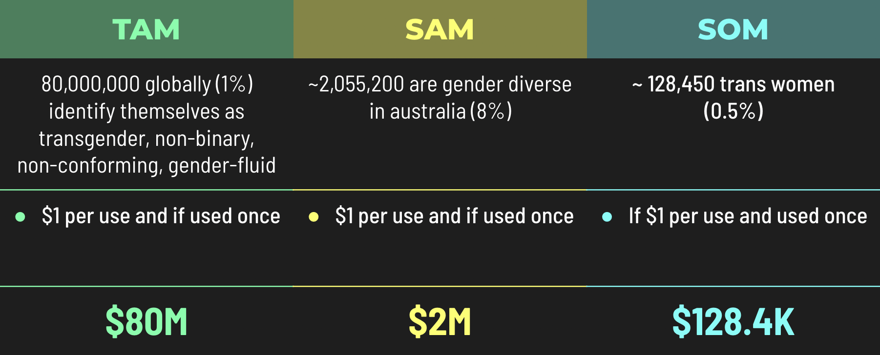
Market Analysis
Statistics regarding sex and identify is not always accurate as it depends on counties and their freedom of expression and how vigorous the census are. The are also socioeconomic reasons transgender people will not publicly state their status. This TAM, SAM and SOM is an underestimate.
Total Addressable Market
8000000000 * 0.01 = 80,000,000 globally identify themselves as transgender, non-binary, non-conforming, gender-fluid
Serviceable Available Market
8% of people living in Australia are gender diverse. That is 25690000 * 0.08 = 205,5200
Serviceable Obtainable Market)
As it hard to find data on how many people are taking estrogen hormones in Australia, general statistics have been used.
~1% of Australia are identify as transgender
~0.5% are transgender women
25690000 * 0.005 = 128,450 trans women
There are no direct competitors. Possibly Breast-V app.
Segmentation within the market:
- Adult trans women undergoing GAHT before breast augmentation
- Adult and adolescent trans women undergoing GAHT before breast augmentation
- Adult trans women undergoing GAHT after breast augmentation
- Adult and adolescent trans women undergoing GAHT after breast augmentation
- In Melbourne
- In Australia
- Worldwide
Expansion of market:
Could also expand measurement app for cis women so the app includes cis and trans women.
Could give plastic surgeons access
Could integrate other measurements important to trans women such as voice changes
Major market forces:
1. Speculation and expectation – people may expect more for this app a and be disappointed.
2. Demand – how many people actually want this app.
MARKET ANALYSIS
PAGE 11
Notes:
TAM = https://www.weforum.org/agenda/2021/06/lgbt-gender-identity-ipsos-2021-survey/
SAM - https://www.anmf.org.au/media/nlhnzb4m/ps_sexuality_sex_and_gender_diversity.pdf
SOM=
https://www.theguardian.com/australia-news/2022/sep/03/please-lean-in-with-a-bit-of-empathy-its-not-easy-being-trans-in-rural-Australia

Slide 13
Proposed KPIs
A summary of avenues for impact and plan for 2023.
This solution fits into Monash Health’s the equity and inclusion strategy
Monash Health has devised a equity (clinical performance) and inclusion strategy for years 2018 – 2023 with LGBTI (lesbian, gay, bisexual, transgender and intersex) being one of their key areas of focus. Their vision in this area includes listening to our community so that they can better understand their needs and ensure everyone feels safe and included. They have also stated they will continue creating actions in future to enhance care for our people and support the implementation of the strategy.
The great part of this project will be listening to our community and their inclusion in research.
Monash Health Annual report indicated Key performance priorities for 2021-23
Their report of operation focuses on high quality and safe care in regards of patient experience (clinical performance) with their target being >=85-95 which is not being met.
This app could possibly increase patient satisfaction with GAHT and this, clinical performance
Monash Gender clinics Role
Gender Endocrinology Clinic KPIs document stated that this project, alongside research studies, is to support ongoing development in clinical care
The gender clinic’s core role is to support the gender transition process and aim to provide individualised, client-centred care for all trans, gender diverse and non-binary people.
This app provides and answers aims of the gender clinic
Social impact groups
- We plan to reach out to these groups to campaign for crowdfunding.
KEY PRIORITY AND PERFORMANCE INDICATOR PAGE 12
Notes:
Monash health - https://monashhealth.org/wp-content/uploads/2022/02/MH_EquityAndInclusionStrategy-2018-23_A4_v4.2.pdf
Monash health E&I - https://monashhealth.org/wp-content/uploads/2022/02/MH_EquityAndInclusionStrategy-2018-23_A4_v4.2.pdf
Annual report - https://monashhealth.org/wp-content/uploads/2022/09/MH-2021-22-Annual-Report_Digital-Accessible.pdf
Gender clinic - https://monashhealth.org/services/gender-clinic/

Slide 14


Ask and Next Steps
Dr Rita Upreti
Monash Health Gender Clinic Endocrinologist
She has worked with transgender women at her clinic and have encountered many calls for more validated transgender-based research and this app is one of them.
Jacinta Patel
Bachelor of Biomedical Science
Advocates for social rights and is interested in social issues. She marketing experiences such as science-based marketing internship at Illumina and google marketing certificate.
THE TEAM
PAGE 13

Slide 15
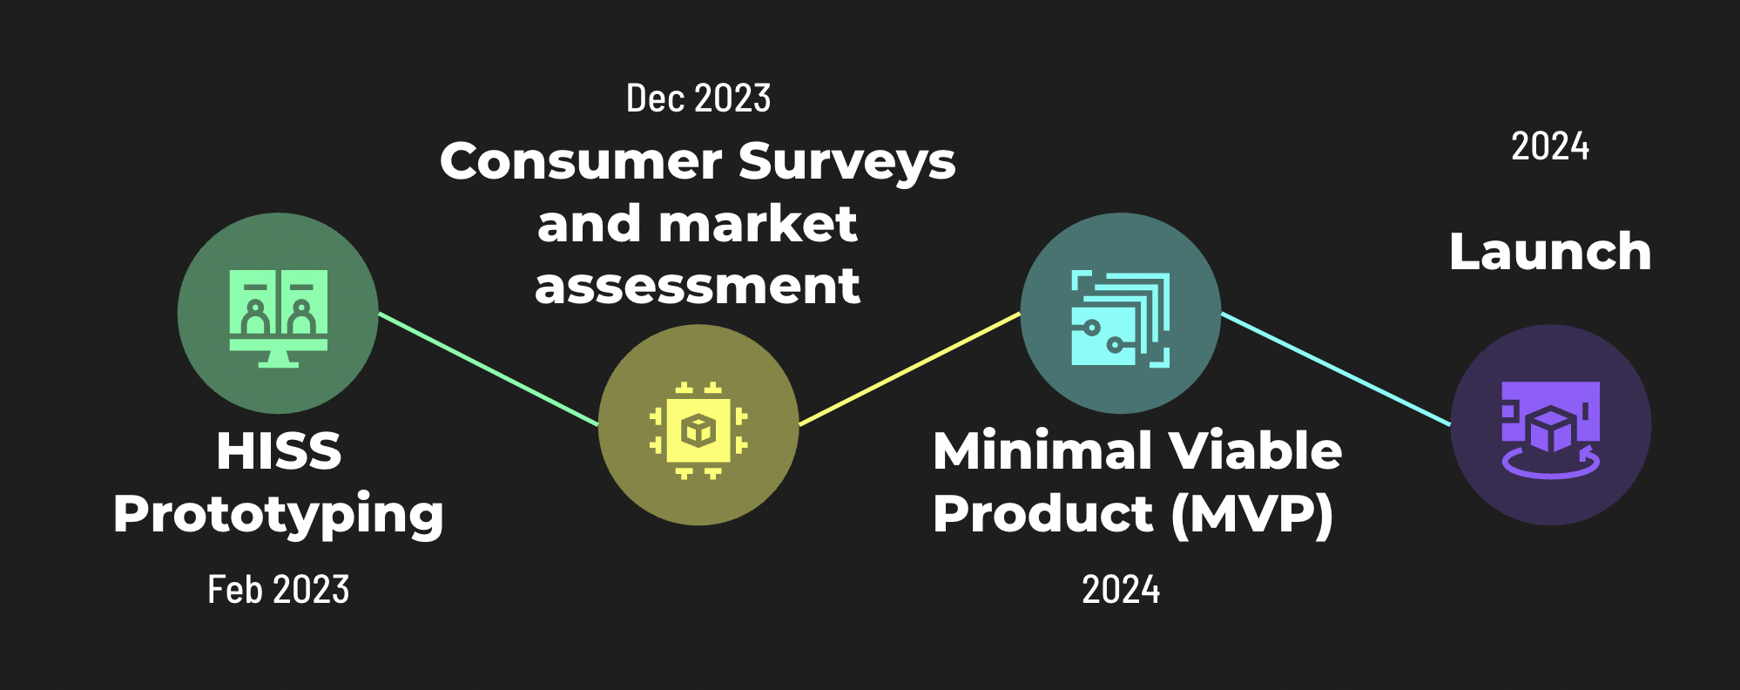
HISS Timeline
STEP 1
We plan to have finished our prototype by February 2023. This does not initially have to be an app as it is just a prototype but something that is able to measure and create an output.
STEP 2
The consumer survey in market assessment is the most important part of this project as it is a patient centered app. Set the mood surveys in this population are already very limited so we aim for better surveys.
STEP 3
Will you believe that our minimal viable product will be accessible by 2024. Of course, depends on if you’re able to recruit the right team members. As we want a possible novel output, there may be a possibility for clinical trials which will lengthen the timeline.
STEP 4
We want to be able to launch this app by lit 2024 in Australia.
TIMELINE PAGE 14

Slide 16
References
Silva ED, Fighera TM, Allgayer RM, Lobato MI, Spritzer PM. Physical and sociodemographic features associated with quality of life among transgender women and men using gender-affirming hormone therapy. Frontiers in Psychiatry. 2021;12.
Feil K, Riedl D, Gschwentner L, Vomstein K, Wegscheider J, arnold emanuela, et al. Development of a quality of life questionnaire for transgender individuals during hormone therapy (itransqol). 2022;
Xi W, Perdanasari AT, Ong Y, Han S, Min P, Su W, et al. Objective breast volume, shape and surface area assessment: A systematic review of breast measurement methods. Aesthetic Plastic Surgery. 2014;38(6):1116–30.
de Blok CJ, Dijkman BA, Wiepjes CM, Staphorsius AS, Timmermans FW, Smit JM, et al. Sustained breast development and breast anthropometric changes in 3 years of gender-affirming hormone treatment. The Journal of Clinical Endocrinology & Metabolism. 2020;106(2).
Web analysis for Emmacadence - Emmacadence.com [Internet]. Emmacadence. [cited 2023Jan14]. Available from: https://emmacadence.com.cutestat.com/
Wilhelmus Timmermans F, Elisabeth Mokken S, Scheffers B, Bouman M-B, Mullender M, van de Grift T. An anthropometric evaluation of the augmented breast: Differences between cis-and transgender women and possible clinical implications. European Journal of Plastic Surgery. 2021;44(5):631–9.
Longo B, Farcomeni A, Ferri G, Campanale A, Sorotos M, Santanelli F. The breast-V. Plastic and Reconstructive Surgery. 2013;132(1).
Fisher AD, Castellini G, Ristori J, Casale H, Cassioli E, Sensi C, et al. P-01-008 cross-sex hormone treatment and psychobiological changes in transsexual persons: Two-year follow-up data. The Journal of Sexual Medicine. 2017;14(4).
UpToDate. [cited 2023Jan14]. Available from: https://www.uptodate.com/contents/image?imageKey=ENDO%2F67072
Nolan BJ, Frydman AS, Leemaqz SY, Carroll M, Grossmann M, Zajac JD, et al. Effects of low-dose oral micronised progesterone on sleep, psychological distress, and breast development in transgender individuals undergoing feminising hormone therapy: A prospective controlled study. Endocrine Connections. 2022;11(5).
Tanner stages - statpearls - NCBI bookshelf [Internet]. [cited 2023Jan14]. Available from: https://www.ncbi.nlm.nih.gov/books/NBK470280/
Sex and gender diversity in the 2016 census [Internet]. Census of Population and Housing: Reflecting Australia - Stories from the Census, 2016. Australian Bureau of Statistics; 2016 [cited 2022Nov25]. Available from: https://www.abs.gov.au/ausstats/abs@.nsf/Lookup/by%20Subject/2071.0~2016~Main%20Features~Sex%20and%20Gender%20Diversity%20in%20the%202016%20Census~100
6 charts that reveal global attitudes to LGBT+ and gender identities in 2021. World Economic Forum; [cited 2023Jan3]. Available from: https://www.weforum.org/agenda/2021/06/lgbt-gender-identity-ipsos-2021-survey/
Australian nursing and midwifery Federation. Sexuality, sex and gender diversity. ANMF Position Statement – Sexuality, sex and gender diversity. 2021;
REFERENCE PAGE 15

Slide 17
References
Cheung AS, Wynne K, Erasmus J, Murray S, Zajac JD. Position statement on the hormonal management of adult transgender and gender diverse individuals. Medical Journal of Australia. 2019;211(3):127–33.
Splete H. Avoid presumptions with LGBTQ patients [Internet]. Conference News. Medscape; 2021 [cited 2023Jan4]. Available from: https://www.medscape.com/viewarticle/950890
Tangpricha V, Safer J. Transgender women: Evaluation and management [Internet]. UpToDate. Wolters Kluwer; 2021 [cited 2022Dec5]. Available from: https://www.uptodate.com/contents/transgender-women-evaluation-and-management
REFERENCE PAGE 16

