Slide 1

JANUARY 2023
MONASH HEALTHCARE INNOVATION SUMMER SCHOLARSHIPS
Project THEIA

Slide 2
Executive Summary
Across the globe, point-of-care medical self-tests (e.g. COVID-19 rapid antigen tests, pregnancy tests) are not designed for the population of blind and low-vision (BLV) individuals (1). Whilst conducting their tests, individuals are typically required to depend upon the assistance of carers and live agents; having someone else read their critical and sensitive medical information. This reduces an individual's independence, autonomy and privacy afforded to sighted users: impacting an individual’s quality of life, and perpetuating inequitable healthcare. The inaccessibility of medical self-tests for BLV individuals has been exacerbated by the COVID-19 pandemic from March in 2020, with the BLV communities across countries including Australia, the United States and the United Kingdom typically having been ‘abandoned’ by public health strategies to shift towards rapid-antigen testing as the predominant method for COVID-19 testing and surveillance (2).
Within Australia alone, the blind and low-vision population consists of 407,811 individuals (3). Independence and privacy are essential to a blind and low-vision individual’s sense of wellbeing and quality of life (4), and blind and low-vision individuals have the right to conduct medical tests with the same standards of autonomy, self-sufficiency and privacy afforded to sighted individuals, in alignment with the principles of equitable healthcare. It is thus a prerogative of equitable healthcare to increase the inclusivity and accessibility of both present and emerging medical self-tests towards the blind and low-vision population, by enabling individuals to conduct the tests both independently and privately, and to be the first to access their sensitive test results.
Acceptance Criteria
The solution enables users to conduct and interpret medical self-tests independently and without live human assistance.
The solution enables users to interpret medical user’s privacy when interpreting the results of medical self-tests.
The solution is cost-reducing, n comparison to current standards of practice.
EXECUTIVE SUMMARY / PAGE 1

Slide 3
Gaps Analysis
The Problem
Worldwide, medical self-tests (i.e. pregnancy tests, COVID-19 rapid antigen tests and HIV tests) are not designed inclusively for the blind and low-vision population. This results in barriers in accessibility for blind and low-vision required to self-test for altered states of health: individuals are unable to learn how to conduct the test independently, due to the visual nature of the instruction manuals, and thus are unable to conduct them; and secondly, users are unable to interpret the results privately (5).
A review of the existing literature indicates strongly-voiced concerns from the blind and low-vision community surrounding the inaccessibility of both existing and future medical self-tests. On 29th April 2022, a Vision Australia submission to the Royal Commission indicated that the inaccessible design of rapid-antigen-tests acted as a “barrier of being unable to self-administer RATs… for many people in the blind and low-vision community,” and that “... there is little if any consideration being given to how the unique needs of the blind and low-vision community can be met both now and into the future evolution of the COVID-19 pandemic, as well as in pandemics yet to come” (5). Chief among the concerns of the blind and low-vision community was the lack of an “imminent solution to the inaccessibility of RATs”, and the fear that this neglect would carry over into future medical self-testing events (“carry over into future waves and pandemics.” (5)). As such, the concern regarding the inaccessibility of tests pertain not only to COVID-19 Rapid Antigen Tests, but towards all current and future medical self-tests.
The Solution Landscape
For Australian blind and low-vision users, the solution landscape is currently dependent on synchronous assistance through a live agent. Besides at-home testing services available in Victoria (6), there are no centralised or scalable solutions that support Australian users in independently conducting and interpreting point-of-care, over-the-counter medical devices or tests (e.g. RAT tests, pregnancy tests) without live assistance. The lack of existing solutions for users to conduct medical tests diminishes the user’s sense of privacy typically afforded to non-blind users during oftentimes critical and sensitive periods of result interpretation; resulting in an exposure of medically sensitive data, and further serving to diminish the user’s dignity, agency, and thus quality of life.
The Existing ‘Gold-Standard’ Solution: AIRA
The landscape of existing “gold-standard” solutions in Australia for blind and low-vision users to conduct and interpret point-of-care, over-the-counter medical tests, predominantly revolve around two mobile applications: AIRA and BeMyEyes (7, 8). Such applications provide synchronous assistance through video-call from live agents towards end-users, and as such, do not enable Australian blind and low-vision users to conduct medical tests independently, or to interpret results privately. The availability, quality and cost-effectiveness of existing solutions vary between application models, and depend upon whether existing government funding bodies (e.g. National Disability Insurance Scheme) provide a limited subsidy for these services. The application AIRA utilises trained agents based in the U.S., thus providing assistance of standardised quality, at a per-hour rate (9); whereas BeMyEyes provides non-standardised quality of assistance from global, untrained volunteers, at a cost-free rate (8).
GAPS ANALYSIS / PAGE 2

Slide 4
Gaps Analysis
The top three existing solutions on the market are as follows:
Synchronous Assistance Mobile Applications (the ‘Gold-Standard’ Solution):
  Overview: These mobile applications (e.g. AIRA, BeMyEyes), available on Apple and Android devices, provide synchronous assistance to blind and low-vision users by connecting users to human agents (7, 8) via video conferencing. These human agents can range from specially-trained agents, volunteers, the support departments of existing companies (e.g. Google, Spotify, LinkedIn, ClearBlue), depending on the app. BeMyEyes provides specialised help in liaison with ClearBlue support agents to provide synchronous assistance towards blind and low-vision users (10).
  Economic Profile: The economic profile depends on the mobile application, and whether or not existing government funding bodies (e.g. the National Disability Insurance Scheme) provide a limited subsidy for users to access these services. Whilst AIRA charges users between $65 = $2900 USD for 15 - 800 minutes (9), BeMyEyes is a free application providing users with the option to subscribe for additional member benefits. There is a high level of dissatisfaction amongst the BLV community surrounding the high costs of AIRA (11).
  Solutions Gap & Alignment: While the synchronous assistance model provides a scalable solution for both present and emerging medical self-tests, these models do not provide users with privacy or independence whilst conducting the tests. This solution functions as the ‘gold-standard’:
Smart Tests (e.g. Ellume):
  Overview: Designed by private manufacturers, Ellume is a smart-test that can connect via BlueTooth to a mobile app on an Apple or Android smartphone device, in order to read out the results to users (12). In the U.K., an emerging pregnancy test intended to provide tactile feedback indicative of results. Critically, this solution has not yet entered the market. There are no other smart tests existing on the market (13).
  Economic Profile: In the U.S., an Ellume test is $35, with 12 free tests subsidised by the U.S (12) government for blind and low-vision users. The tactile pregnancy test has not yet entered the market. These tests are critically more expensive than the current ‘gold-standard’ solution.
  Solutions Gap & Alignment: Whilst these tests are able to be conducted by the user independently, this solution is not scalable towards other present and emerging medical self-tests: requiring development and regulatory approval, for each medical test, and resulting in high entry barriers to development and market. These tests are also limited by supply chain and geographical availability.
Government Programs:
  Overview: For COVID-19 testing, government-funded programs in different regions in Australia (i.e. Victoria) offer at-home PCR tests run by trained nurses. This is not a solution specifically designed for BLV users. This is only available for COVID-19 PCR testing, and not for other use cases including pregnancy, influenza and HIV.
  Economic Profile: The costs of PCR tests are estimated to be $82 (AUD) per test, which may be inclusive of both equipment for testing and labour costs for testers (14). There are no solutions for other medical uses (e.g. pregnancy, influenza and HIV).
  Solutions Gap & Alignment: Whilst these programs provide the option for users to be tested easily and to receive results privately, they are currently available only for COVID-19 tests, and limited by geographic availability, with the continuity of these programs being dependent upon policy-making. It is estimated that these programs would have high-costs due to the labour costs for in-person testers. As such, these programs are not necessarily guaranteed to be accessible.
GAPS ANALYSIS / PAGE 2

Slide 5
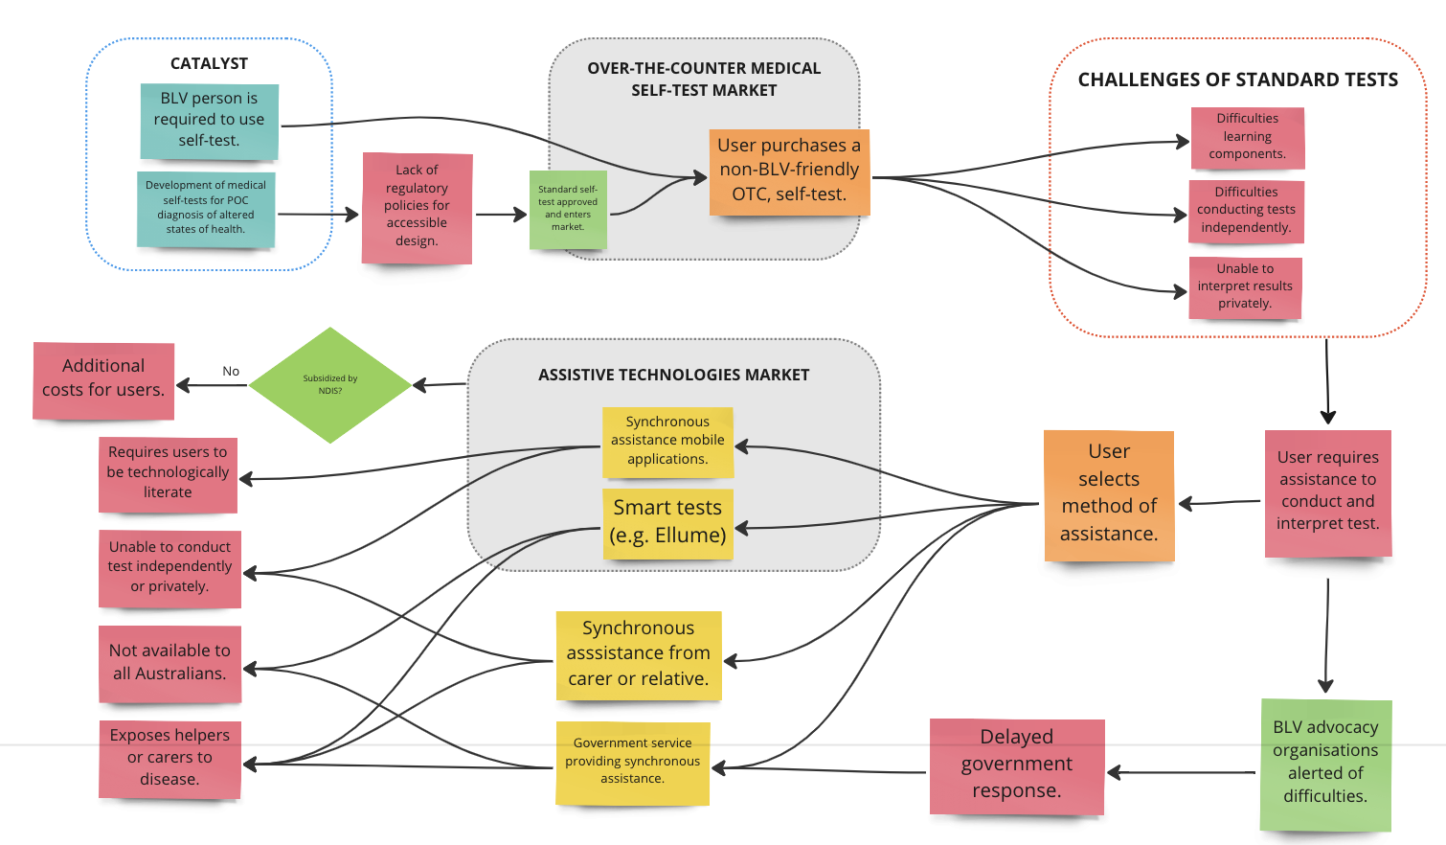
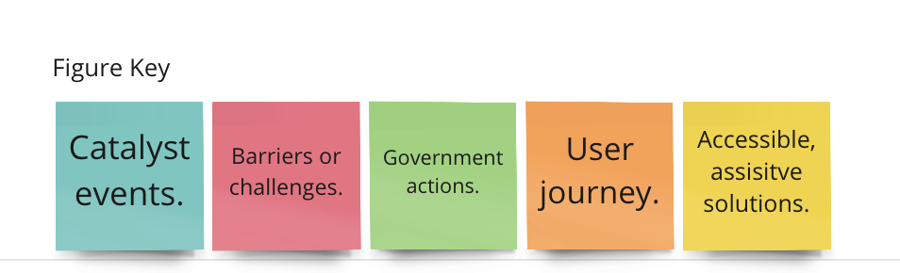
Systems Map
Figure 1. This user diagram maps the progression of how blind & low-vision individuals navigate the market of medical self-tests and the network of government support services, from the point of requiring to do a self-test. Due to the lack of regulatory policies requiring accessible design for self-tests to enter the market, this cycle is perpetuated with the emergence of health conditions or diseases that require point-of-care self-tests. The market of assistive technologies solutions typically arises after the market for standard devices has been introduced, with government responses typically being delayed or not available to all users.
Miro Link: https://miro.com/app/board/uXjVP6krBzI=/
SYSTEMS / STAKEHOLDER MAP / PAGE 3

Slide 6
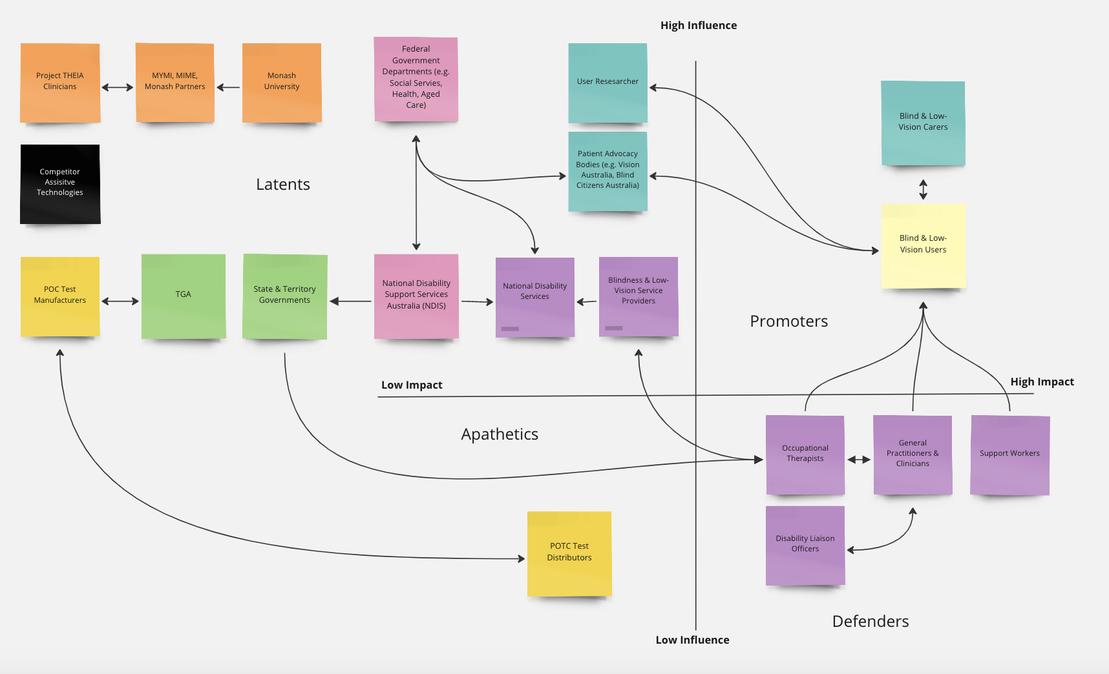
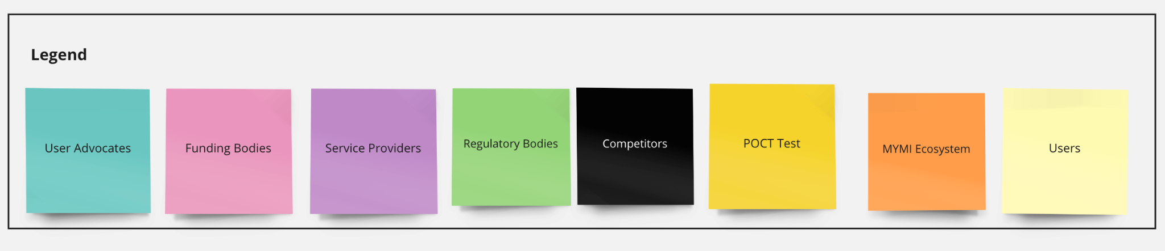
Stakeholder Map
Figure 2. Stakeholder Map
Depicts the range of stakeholders and the position they hold in terms of the direct influence they have on the project, and the impact the project will have on them. There are four majors stakeholder categories: stakeholders who have the highest impact and influence, and refer to end-users and their carers; stakeholders who have a high degree of influence but low degree of impact, and refer to government peak bodies, advocacy groups, service providers, regulatory bodies, and funding bodies, as well as the MIME ecosystem; stakeholders who have a high impact but low influence, including support workers and general physicians; and finally, stakeholders who have low impact and low influence, and refer to the self-test manufacturers.
Miro Link: https://miro.com/app/board/uXjVP7sGSAo=/?share_link_id=559497330734
Link for miro board:
SYSTEMS / STAKEHOLDER MAP / PAGE 4

Slide 7
Outcomes of Qualitative and Quantitative Research
Trends within the Blind & Low-Vision Population
Across the globe, there are 285 million blind and low-vision individuals; and of these, 89% (246 million) individuals have low-vision, whereas the remaining 39 million individuals are blind (16). The population of blind and low-vision individuals is predominantly an elderly one, with 65% of the population over 50 years of age, and 90% of all blind individuals living in low-income countries. As of 2022, there were approximately 407,811 blind and low-vision individuals ¹ in Australia (3); with approximately 70% over the age of 65, and approximately 66,000 people who are blind (17).
Patterns of Smartphone Usage Amongst Blind & Low-Vision Users
As of 2020, a study by Vision Australia involving 845 Australian blind and low-vision individuals found that 79% were smartphone users, resulting in a 365% growth from 2015, and reflecting an increased market penetration of the usage of smartphones amongst the blind and low-vision community (11). Critically, the adoption of smartphones amongst the blind and low-vision community was influenced by age: with 100% of users between 18 - 24 years owning smartphones, 78% of users between ages 65 - 74 years old, and a statistically significant decrease within users older than 75 years old (11). Factors such as level of vision, and the duration of blindness, furthermore influenced the adoption of smartphones. Of individuals who did not use smartphones, 83% were over 65 years of age, and had cited insufficient vision, the perceived limited usefulness of smartphones, lack of familiarity, and costs being cited as the reasons for non-adoption (11).
Critically, the breadth of app usage and awareness of accessibility apps and capabilities was substantially lower, with 50% of participants being aware of the full extent of inclusive application capabilities. This indicates two significant barriers facing the usage of mobile phone applications: firstly, the lack of awareness of the existence of these apps; and secondly, the lack of training available for users to learn how to use these apps. Once these barrier were overcome, however, there was extensive usage of the mobile application. The report summarises it as such:
“(There is) a strong desire for more information, education and assistance in using smartphones in BLV community… When participants did attempt to learn new function or app, the process was often difficult and exacerbated by inaccessibility, yet once mastered, the new app was appreciated and embraced.” (11).
Of the users who were aware of inclusive apps and their availabilities, most users (53%) indicated a higher utility of AI-powered computer vision applications, such as Envision and SeeingAI; whereas only 28% of these users used apps offering synchronous assistance, such as AIRA and BeMyEyes (11). Because both types of technologies occupy a wide range across the cost spectrum, the higher utility for AI-powered applications over live assistance applications is potentially due to a higher awareness of AI-powered apps over live assistance apps, or a preference for asynchronous assistance over synchronous assistance. It was further noted that the predominant platforms through which users were made aware of these applications, were service providers such as Vision Australia, family or friends, and other blind and low-vision users; demonstrating that these platforms are high-value marketing avenues for the promotion of assistive technologies (11).
QUALITATIVE AND QUANTITATIVE RESEARCH / PAGE 5

Slide 8
Outcomes of Qualitative and Quantitative Research
made aware of these applications, were service providers such as Vision Australia, family or friends, and other blind and low-vision users; demonstrating that these platforms are high-value marketing avenues for the promotion of assistive technologies (11).
Inaccessibility of Medical Self-Tests & Implications:
The barriers to medical self-testing have been voiced by a series of other advocacy bodies. Women with Disabilities Australia condemned the ableist response of the government towards the COVID-19 pandemic, with the barriers being manifold, and caused by other factors including the fact that not all individuals had access to family members, nor to smartphones and assistive mobile applications; and the limited ability for the blind and low-vision to travel to PCR testing sites, without exposing others (2). Critically, WWDA indicated that these factors resulted in a decreased number of blind and low-vision individuals being tested, and lowered COVID-19 surveillance amongst the blind and low-vision.
User interviews have further indicated an initial response of fear, and reluctance to conduct self-tests (“... dead scared… no point in getting them.”), a reluctance to have their results interpreted by others (“... Do I really want them to know I’m positive?”), and a general helplessness (“... a mix of frustration and just feeling a bit helpless”); indicating a lack of control and independence when conducting self-tests. Critically, blind and low-vision individuals have attributed more significance to values of control, independence, self-care, dignity, and safety towards their quality-of-life, than sighted individuals; with the blind and low-vision attributing more significance to these values, than other health-related values (e.g. vision, hearing, physical mobility) (4). As such, it is critically important for such interventions to empower users in the domains of control, independence and self-care, in order to be fully reflective of the quality of life preferences for people with disabilities.
QUALITATIVE AND QUANTITATIVE RESEARCH / PAGE 5

Slide 9
Solution Concept Discussion
- top 3
Top 3 Solutions:
Modify existing regulatory policies to require manufacturers to include accessible design with medical self-tests.
The most favourable solution is implementing a set of regulatory guidelines within the medical regulatory bodies that mandates inclusive and accessible design in medical devices (i.e. tactile feedback, talking devices, etc.). Chiefly, this is an ideal solution would ensure that all over-the-counter medical self-tests available in the global market would be accessible to low-vision and blind users, as well as other users with disabilities (e.g. auditory disabilities, motor disabilities, cognitive disabilities) for present and emerging health scenarios, although this is projected to result in higher per-test costs due to high manufacturing costs. The major drawbacks include infeasibility within a short-term scale, and would likely have whole-system collaboration from multiple government and private sectors, as well as disability peak bodies.
Develop an application that enables users to take deidentified photos of their results and have them interpreted either by a community of annotators, an AI model, or friends and family.
The second most favourable solution refers to the development of a mobile application that provides asynchronous assistance to users in order to both conduct tests, and interpret test results. The strengths of this mobile application include its provision of users with an asynchronous alternative to AIRA, enabling users to conduct and interpret medical tests privately and independently; and its ability to scale to accommodate all existing medical-device products within the global self-testing market. Chiefly, it is a cost-reducing solution, with the costs occurring using a low-rate subscription model in comparison to AIRA’s fee-per-minute model; and thus, it is expected to provide a competitive solution in comparison to AIRA. The drawbacks of this solution predominantly revolve around the fact that the ease-of-use of a test will be restricted by the standard test designs for blind and low-vision individuals; and thus, is less competitive than solutions (e.g. a self-test) which implement design for a user’s ease-of-use, or government programs which provide testing by health-care practitioners.
Develop a universal, ‘smart’ medical self-test that is BLV friendly.
The third most favourable solution refers to the development of a universal, ‘smart’ medical self-test that provides accessible results interpretation (i.e. audio or tactile feedback) for the blind and low-vision population. The medical self-test would enable users to conduct and interpret tests privately and independently. Critically, the universal self-tests would result in a higher retail costs per-person due to an estimated increase in manufacturing and regulatory costs. The scalability of the medical self-test would be dependent upon the LFIA testing technology can be implemented within a reusable cassette, with the test-strip being sold separately. Critically, the availability of the tests globally would be limited by global supply chain and geographical availability.
Top 3 Solutions / PAGE 6

Slide 10
Final Concept
Final Solution
The final solution is the development of a mobile application that provides asynchronous assistance to users. Chiefly, the application would assist users through a two-part process: (1) the provision of test instructions using software within an accessible format (e.g. audio and tactile feedback); and (2) sending deidentified images of the test instructions towards end-user interpreters, or an AI model, for interpretation. The results are to be sent back to the user within a certain period of time (an estimated 1 hour - 36 hours for group annotation; immediately, for AI interpretation). Additional lateral-flow-assay tests can be published on the app in 30 minutes due to a pipeline for integrating test instructions (the most time-heavy part of integration). Chiefly, this solution aligns well with all three acceptance criteria: it enables end-users to conduct their tests privately and independently via asynchronous assistance, and is critically functions as a global ‘accessibility’ extension towards antigen tests on the market by its ability to scale towards both existing and future tests.
Regulatory Considerations & Strategy
As a mobile application that chiefly utilises algorithmic models to convert test instructions into accessible formats, and a pipeline to send images between devices, there is a limited degree by which the application can be patented. At the time of writing, the regulatory category of the device is pending confirmation from medical regulatory bodies including the TGA (15). However, due to the fact that the solution provides a similar model of results interpretation to other applications such as AIRA, whose model of synchronous assistance in results interpretation is not regulated by regulatory bodies, it is unlikely for this mobile application to be regulated by medical bodies.
Clinical Considerations
Not applicable.
Technical Risks
There are limited technical risks associated with the development of the mobile application. The technical milestones for the application include:
Development of an AI model for image analysis.
Development of a database and pipeline to store and transfer product and user data.
Creation of the user-side app for blind and low-vision users.
Creation of the agent-side app for interpreters and software developers.
The feature roadmap includes the following:
Development of learning features for users to learn how to use different test brands.
Development of features for users to conduct tests.
Development of features providing users options to send test results.
Development of introductory learning features for users to use the mobile app.
Competitive Advantages
The competitive advantages of this application primarily include its ability to provide users with an asynchronous mode of assistance to conduct tests both independently and privately: unlike the current gold-standard of practice with AIRA, whereby results interpretation are provided through asynchronous assistance, users will not have third-parties read their results before them within a setting whereby information about their identity is exposed. It is furthermore a more cost-reducing service for individuals to conduct medical self-tests than AIRA, and it is a scalability towards a large number of both existing and emerging tests. As such, the device is intended to function as a global accessibility extension.
CHOSEN FINAL CONCEPT / PAGE 7

Slide 11
Business Model
Business Model
The proposed business model implements a direct-to-customer, hybrid fee-for-service and subscription model whereby mobile users are required to subscribe to the application for $2/month for access to accessible test instructions and step-by-step guides. For results interpretation, a small fee of approximately $0.80 per request is proposed for jobs that are sent towards the anonymous group of annotators. The total costs of subscription and interpretation is expected to be competitive with respect to the costs for a user to conduct a test with AIRA, which is estimated to be $36 - $43 per test (see Appendix). A percentage of the payment (e.g. 50%) will be distributed to cover the costs of interpretation, with the remaining margin (e.g. 50%) intended to support software maintenance as well as scalability towards an increased number of medical self-tests brands on the market. The costs of scaling to rapid antigen tests within international markets (e.g. the U.S., U.K., China) can be funded by several sources: donations and crowd-funding; and social impact investors.
Market Penetration Strategy
The market penetration strategy involves a multi-stakeholder advocacy and awareness campaign utilising a partnership with both peak body and government groups. One branch involves liaising with Australian blindness and low-vision advocacy bodies (e.g. Vision Australia, Blind Citizens Australia) for endorsement of the solution amongst their respective BLV client base through support workers, and the utilisation of grant-funding to provide users with a limited number of free tests upon sign-up, and to refer a limited number of free tests to other users. Strategically partnering with peak advocacy bodies (e.g. Blind Citizens Australia) to advocate to federal government departments, can furthermore open up opportunities for grant-funding from with various departments (e.g. Department of Health, Department of Social Services), and government endorsements of the solution on federal support platforms (e.g. Disability Gateway Platform), and call-to-test support lines. An additional branch involves liaising with medical disability liaison officers in order to raise awareness to users regarding the existence of the application.
Acquirers
The potential acquirers of such a model include BeMyEyes, a software application with a large base of both volunteers, blind and low-vision users, and large companies. BeMyEyes can potentially acquire this asynchronous model of assistance as an additional mode within their specialised feature for ‘Personal Health’, such that images are sent to their user-base of volunteers. Critically, this would increase the competitiveness of BeMyEyes against their predominant competitors: AIRA. Other acquirers include the Monash Inclusive Technology Laboratory, which would acquire this application as a research project.
Return on Investment
The social return on investment is calculated as the amount of funds saved by the Australian Government as a result of the absence of subsidising users to conduct tests through applications such as AIRA. This amounts to $1,433,635 AUD per year.
Risks
The most significant risks within this project involve medical liabilities for incorrect test results, and the creation of BLV-friendly instructions which do not relay test manufacturers’ instructions word-for-word. De-risking strategies include the provision of an end-user licence agreement, which advises that should users wish to accept the interpretations of the interpreters, and to conduct the tests using the BLV-friendly version of instructions, the mobile app is not liable for the misinterpretation of test instructions. A lack of an interpreter base is a risk that can be mitigated by channelling annotations towards blind and low-vision support companies (e.g. BeMyEyes), or third-party annotation companies (e.g. Scale).
QUALITATIVE AND QUANTITATIVE RESEARCH / PAGE 8

Slide 12
Market Analysis
TAM
The total addressable market amounts to $5.4bn and reflects the global number of blind and low-vision smartphone users, who have the potential to utilise this mobile application. (See Appendix).
SAM
The serviceable addressable market amounts to $8.99 million and reflects the total number of COVID-19 tests per year conducted by blind and low-vision smartphone users in Australia, assuming that users remain subscribed to the mobile application for one year. (See Appendix).
SOM
The serviceable addressable market amounts to $3.9 million, and reflects the number of COVID-19 tests that are likely to be conducted by blind and low-vision smartphone users in Australia, given the rate of subscription for the Australian population for more popular mobile apps (e.g. Spotify). This assumes that users remain subscribed to the mobile application for one year. (See Appendix).
Competition
The competitors in the Australian market include AIRA and BeMyEyes (7, 8); whereas within the U.S. market, this is expanded to include Ellume, a smart-test manufacturing company (9).
Market Segmentation
Segments of the market relevant to the application include the proportion of blind and low-vision smartphone users who are aware of assistive mobile apps and the smartphone’s capabilities as an assistive device (approximately 50% of users) (11). Within this segment, the population can be further divided into two streams: those who prefer asynchronous assistance to conduct medical self-tests, and those who prefer synchronous assistance to conduct medical self-tests. Critically, this application targets the segment of users who prefer asynchronous assistance to conduct self-tests.
Market Expansion
The market can be expanded to include the general range of retail and commercial products on the consumer market, and within the range, the subset of products which include procedural instructions (e.g. all-in-one baking goods, and component assembly instructions).
QUALITATIVE AND QUANTITATIVE RESEARCH / PAGE 9

Slide 13
Proposed KPIs
There are three predominant areas for which key performance indicators have been proposed: firstly, the engagement of the BLV community with the mobile application, as an indicator for both awareness of the application amongst the population, as well as user’s needs and satisfaction with the app; secondly, the value for money that this mobile app would generate for the Australian Government; and finally, the risks associated with government investment into the mobile app.
Engagement & Utility
  Number of Downloads Per Year: This indicator refers to the number of people with disabilities who have downloaded the application, per year. It reflects both the initial interest amongst the blind and low-vision community for an application such as this, as well as the effectiveness of promotional campaigns.
  Average Time of Retaining App: This indicator refers to the average amount of time a user has the app retained on their phones, per year. It indicates overall satisfaction with the mobile app and the user’s perceived utility of the app.
  Average Time Using the App: This indicator refers to the average amount of a time a user spends on the app, per year. It reflects the utility of the app for each user.
Value for Money
  Government Savings (18) This indicator refers to the financial savings to the Australian Government from preventing the use of AIRA, per year, due to the uptake of THEIA.
Risk
  Payment to Cost Ratio (18): This indicator refers to the ratio of payments from clients to costs of maintenance per year. This indicator refers to the financial risk of investment within THEIA
QUALITATIVE AND QUANTITATIVE RESEARCH / PAGE 10

Slide 14
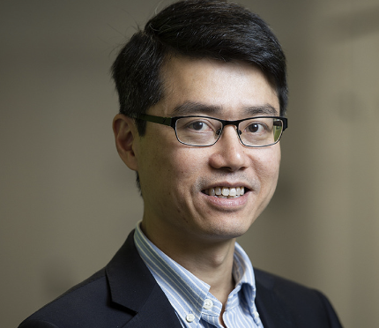
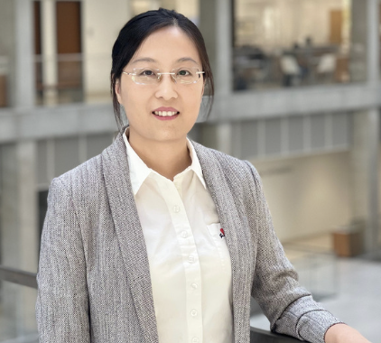
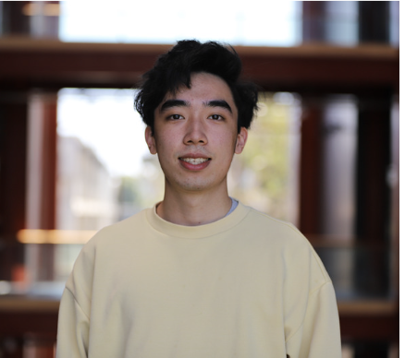

Ask and Next Steps
Meet the Team
Dr. Patrick Kwan: Dr. Kwan is a Professor of Neurology in the Department of Neuroscience in the Central Clinical School, and the Clinical Co-Director of MIME (Monash Institute of Medical Engineering). An international authority in epilepsy management, he supervises multidisciplinary, integrated research teams spanning across genomics, artificial intelligence, and bioengineering, and furthermore has extensive international collaborations in academia, hospitals and the MedTech industry (19).
Dr. YaoYao Jia: Dr. Jia is a research adjunct professor in the Kwan Group at Monash University. With more than five years of research experience in wearable devices for neural interface applications, Dr. Jia’s research focuses on circuit design, embedded hardware design, and neural signal processing for a wide range of clinical applications (20).
William Chen: William Chen is a fourth-year Bachelor of Computer Science (Advanced) student, and is a research assistant in the Monash Inclusive Technologies Lab. With his expertise in software engineering and inclusive mobile app development, William is committed to the development of innovative mobile technologies to empower blind and low-vision users with inclusive and assistive experiences.
Erika Lay: Erika Lay has a Bachelor of Biomedical Science, and is second-year Master’s of Artificial Intelligence student. Her interests focus on the development and integration of AI technologies within the medical industry in order to advance equitable healthcare. With her background in the health-sciences and interests in the applications of deep learning within the medical industry, she is committed to developing solutions that meet unmet clinical needs.
Call to Action
With the technical and economic costs of prototype development being covered by our team’s technical expertise, we are poised to achieve the next steps of launching the solution to market: prototype validation, and the promotion of the application as we prepare to launch the solution to the Australian market. As such, we are seeking a grant of approximately $20,000: with 20% of the funds covering the costs of user-testing and user-experience focus groups; 50% of the funds being used to assist the promotional costs associated with our market penetration strategy. These span from the provision of sign-up and referral bonuses for first-time users, as well as the promotional costs of endorsement on blind and low-vision platforms, including radios such as Talking Vision. 30% of the costs would be allocated to scaling. We furthermore seek to partner with blind and low-vision advocates and users, in order to ensure that the development of our solution remains closely informed by the lived experiences and needs of the blind and low-vision population.
QUALITATIVE AND QUANTITATIVE RESEARCH / PAGE 4

Slide 15
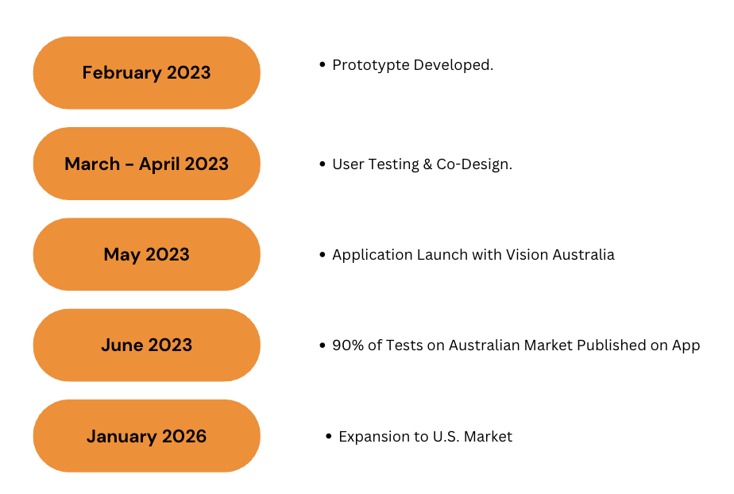
Timeline
The proposed timeline for prototype development, testing, launching and scaling the mobile application is as follows:
QUALITATIVE AND QUANTITATIVE RESEARCH / PAGE 4

Slide 16
Appendix
Costs to Conduct Test with AIRA:
Costs per Minute with AIRA | Average Time to Do a Test | Total Costs to do Test with AIRA
$3.7 - $4.3 | 10 minutes (from User Interview) | $37 - $43
Total Addressable Market:
Blind & Low-Vision Population Globally | Proportion of Smartphone Users | Number of Blind & Low-Vision Smartphone Users | Revenue
285,000,000 (16) | 79% (11) | 225,150,000 | $5,403,600,000
Blind & Low-Vision Smartphone Users in Australia:
Blind & Low-Vision Population in Australia | Proportion of Smartphone Users | Blind & Low-Vision Smartphone Users
407,811 (3) | 79% (11) | 322,171
Number of COVID-19 RAT Tests from Blind & Low-Vision Users in Australia:
Rate of COVID-19 RAT Tests per User per Year (2022) | Number of COVID-19 Tests from BLV Smartphone Users
4.9 Tests/Year (22) | 4.9 Tests/Year * 322,171 Users =1,578,638 Tests
Serviceable Available Market:
Annual Subscription Revenue | Revenue from Interpretation Fees | Serviceable Available Market
322,171 Users x $2 x 12 Months = $7,732,104 | 1,578,638 * $0.80 = $1,262,910.4 | $8,995,014.4
Serviceable Obtainable Market:
Spotify Subscription Rate | Number of Users | Annual Subscription Revenue: | Revenue from Interpretation Fees | Serviceable Obtainable Market:
43.4% of Users (22) | 139822 | 139,822 * $2 * 12 Months = $3,467,585 | 139,822 * 4.9 Tests * $0.80 = $548,102 | $4,015,687
QUALITATIVE AND QUANTITATIVE RESEARCH / PAGE 4

Slide 17
References
Morris A. At-home coronavirus tests are inaccessible to blind people [Internet]. The New York Times. The New York Times; 2022 [cited 2023Jan14]. Available from: https://www.nytimes.com/2022/01/10/health/covid-tests-blind-people.html
Blind and vision impaired community left behind by Covid testing [Internet]. Women With Disabilities Australia. [cited 2023Jan14]. Available from: https://wwda.org.au/blog/blind-and-vision-impaired-community-left-behind-by-covid-testing/
Blindness and vision loss [Internet]. Blindness and vision loss | Vision Australia. Blindness and low vision services. [cited 2023Jan14]. Available from: https://www.visionaustralia.org/information/newly-diagnosed/blindness-and-vision-loss
Crocker M, Hutchinson C, Mpundu-Kaambwa C, Walker R, Chen G, Ratcliffe J. Assessing the relative importance of key quality of life dimensions for people with and without a disability: An empirical ranking comparison study. 2021;
Royal Commission into violence, abuse, neglect and exploitation of people with disability [Internet]. Vision Australia. Vision Australia; 2022. Available from: https://www.visionaustralia.org/sites/default/files/2022-12/Vision%20Australia%20Submission%20on%20Disability%20Royal%20Commission%20-%20Impact%20of%20Omicron%202022.docx
Talking vision preview: Help with at-home covid tests [Internet]. Talking Vision preview: Help with at-home COVID tests | Vision Australia. Blindness and low vision services. [cited 2023Jan14]. Available from: https://www.visionaustralia.org/news/2022-02-10/talking-vision-preview-help-home-covid-tests
Visual interpreting – get live, on-demand access to visual information [Internet]. Aira. [cited 2023Jan14]. Available from: https://aira.io/
Be my eyes - see the world together [Internet]. Be My Eyes - See the world together. [cited 2023Jan14]. Available from: https://www.bemyeyes.com/
Introducing the 2023 retail plans [Internet]. Aira. 2023 [cited 2023Jan14]. Available from: https://aira.io/plans-and-prices/
Clearblue now offers support with pregnancy and fertility tests through be my eyes [Internet]. Be My Eyes - See the world together. [cited 2023Jan14]. Available from: https://www.bemyeyes.com/blog/clearblue-bemyeyes
Locke K, Ellis K, Lemt M, McRae L, Peaty G. [Internet]. Smartphones and equal access for people who are blind or have low vision. Vision Australia; 2020 Aug. Available from: https://ccat.curtin.edu.au/wp-content/uploads/sites/33/2021/01/VisionAustraliaSmartphoneReportACC.pdf
Download the App now [Internet]. Accessibility | Ellume COVID-19 Home Test. [cited 2023Jan14]. Available from: https://www.ellumecovidtest.com/accessibility
Dean G. This is the UK's first pregnancy test specifically for visually impaired women. users feel their results, rather than seeing them. [Internet]. Business Insider. Business Insider; [cited 2023Jan14]. Available from: https://www.businessinsider.com/rnib-uk-accessible-pregnancy-test-for-blind-visually-impaired-women-2020-10
Karnon J, Afzali HH, Bonevski B. An economic evaluation of government-funded COVID-19 testing in Australia. Applied Health Economics and Health Policy. 2022;20(5):681–91.
QUALITATIVE AND QUANTITATIVE RESEARCH / PAGE 4

Slide 18
References
Department of Health. . 1.2 ed. Software for use with COVID-19 rapid antigen self-tests Woden, ACT: Therapeutic Goods Administration; 2022.
Global facts on blindness and low vision [Internet]. Global facts on blindness and low vision | Vision Australia. Blindness and low vision services. [cited 2023Jan14]. Available from: https://visionaustralia.org/news/2019-08-23/global-facts-blindness-and-low-vision
A snapshot of blindness and low Vision Services in Australia [Internet]. Vision 2020 Australia. 2019 [cited 2023Jan14]. Available from: https://www.vision2020australia.org.au/resources/a-snapshot-of-blindness-and-low-vision-services-in-australia/
Media Unit. Social Impact Investing Discussion Paper Parkes, ACT: Commonwealth of Australia; 2017.
Patrick Kwan [Internet]. Monash University. [cited 2023Jan14]. Available from: https://research.monash.edu/en/persons/patrick-kwan
Yaoyao Jia - Assistant professor - The University of Texas ... - linkedin [Internet]. LinkedIn; [cited 2023Jan14]. Available from: https://www.linkedin.com/in/yaoyao-jia-32863590
Mathieu E, Ritchie H, Rodés-Guirao L, Appel C, Giattino C, Hasell J, et al. Coronavirus (COVID-19) testing [Internet]. Our World in Data. 2020 [cited 2023Jan14]. Available from: https://ourworldindata.org/coronavirus-testing
Hughes C. Australia: Leading music apps by downloads 2022 [Internet]. Statista. 2023 [cited 2023Jan14]. Available from: https://www.statista.com/statistics/1220219/australia-leading-music-apps-by-downloads/#:~:text=According%20to%20AppMagic%2C%20Spotify%20was,and%207.6%20million%20downloads%2C%20respectively
QUALITATIVE AND QUANTITATIVE RESEARCH / PAGE 4

