Slide 1

JANUARY 2023
MONASH HEALTHCARE INNOVATION SUMMER SCHOLARSHIPS
Project SeeSaw

Slide 2
Executive Summary
People in the older ages (generally above the age 60 years) have a tendency to fall subconsciously and it is concerning due to the fact the that at their age its nearly impossible to recover from the injuries and might cause the death of an individual if the injury is serious. To overcome this problem Dr. Melanie launched a rating scale[1] for people above the age of 50 years to get a check on how well they can balance to avoid these problems in later stages. Th scale helps them to know about their current status, what to exercise and for how long.
I have been allocated to this project to make this method more effect and regulatory in terms of data storage and handling. Thus, Digitising the BIS so it is easily accessible to people and easy to use. Additional, to process the data and maker an exercise guide to provide suggestion for different exercises on the basis of quantitative analysis of scores for different exercises.
The Viable solution to cater all this I came up with a Web App designed similar to a fitness app to show progress and save appropriate data for research.
Acceptance Criteria
No cap in Storage of user data
50% decrease in the no. of people required to perform the test
New option for personal progress tracking
Digitally stored information and easily processable for Exercise Guide preparation
EXECUTIVE SUMMARY / PAGE 1

Slide 3
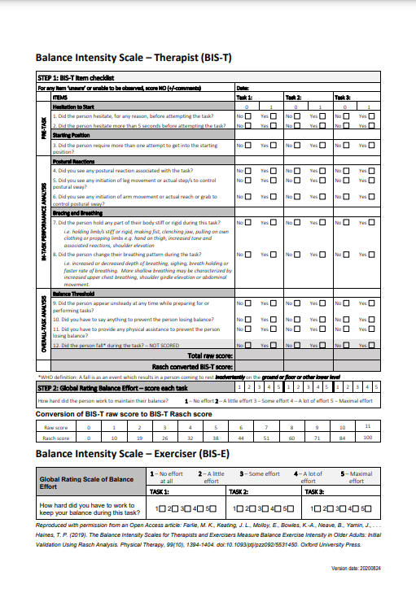
Gaps analysis
Dr. Melanie’s solution is a complete tool to find out,which exercise should a person do and for how long using the Rasch score analysis for a particular Balance exercise and individual.
This being a Gold Standard still needs the improvements of digitally storing data, showcasing the daily progress of an individual, and making it easier for you to take the test on your own.
Reason for this being:
This is a pen and paper form which makes you store each form you take test on.
There is a handwritten data and no way to directly compare progress
The Handwritten Information is not integrable to some other medical data and cannot be easily used for the research purposes.
Figure 1. BIS Form
Depicts the BIS form made by Dr. Melanie. [2]
GAPS ANALYSIS / PAGE 2

Slide 4
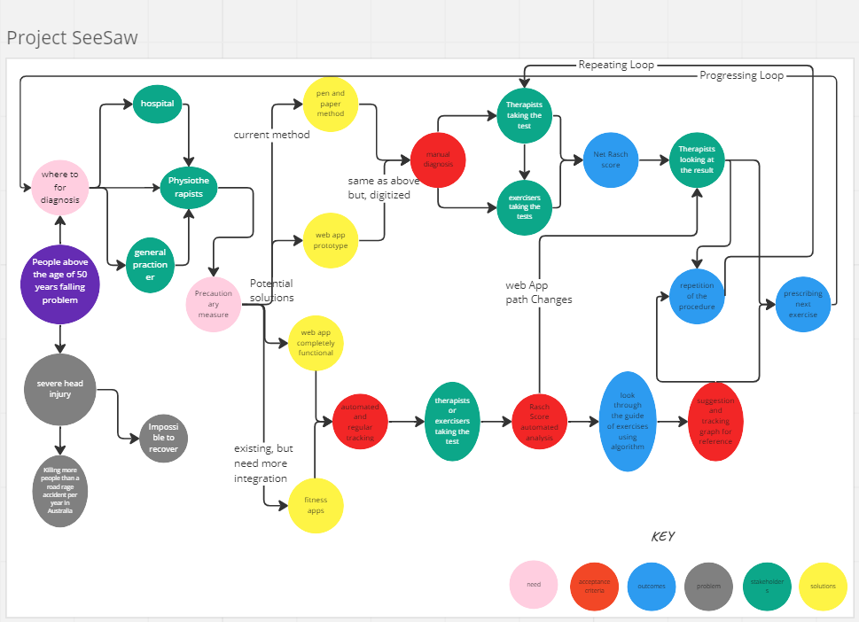
Systems Map
Present here a clear picture of the systems map (process flowchart)
Make sure to include an appropriate figure legend.
Figure 1: This patient diagram maps
the progression from going to a Physiotherapist or a hospital to how they take the balance intensity scale test on their own with the help of the Web App to record their progress and
Link for miro board:
https://miro.com/app/board/uXjVP6krBzI=/
SYSTEMS / STAKEHOLDER MAP / PAGE 3

Slide 5
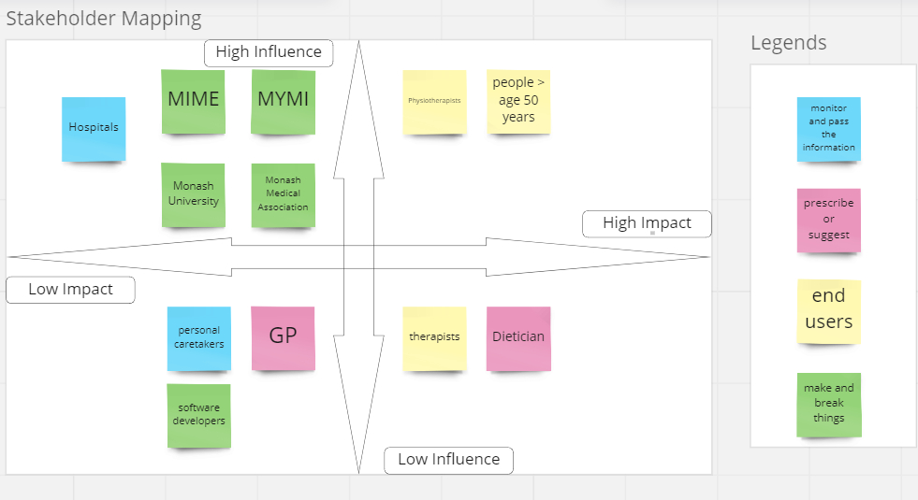
Stakeholder Map
Present here a clear picture of the stakeholder map (with relevant key)
Make sure to include an appropriate figure legend for the map
Figure 2. Stakeholder Map
Depicts the range of stakeholders and the position they hold in terms of the direct influence they have on the project, and the impact the project will have on them. There are four majors stakeholder categories: stakeholders who are involved in the research of the problem and development of the solution, beneficiaries of the solution, HISS program contacts, and competitors - existing solutions. With People above the age of 50 years being the largest stakeholder as they are not only involved in the research and development phase, but they will also benefit from the solution, allowing them to take tests on their own and keep a track of their personal progress on daily basis.
Link for miro board:
https://miro.com/app/board/uXjVP5Nbq7Y=/
SYSTEMS / STAKEHOLDER MAP / PAGE 4

Slide 6
Outcomes of Qualitative and Quantitative Research
The Problem:
    People after falling tend to suffer from injuries in heads and other parts of body that are sometimes beyond recovery at their age.
    Then there are people dying due to those severe injuries from falling and rate of this happening is actually more than the people of dying because of road accidents in Melbourne alone
The problem of falling in older people is not very hard to solve it just needs a little more attention to it
The Current Solution
Dr. Melanie produced a tool to make people do balance exercises with the knowledge of what they are doing and what is it improving quantitatively.
BIS became the first and only tool to address this problem with the help of physiotherapy.
Around 800 people use this BIS per Annum
QUALITATIVE AND QUANTITATIVE RESEARCH / PAGE 5

Slide 7
Solution Concept Discussion
- top 3
#1 - Google forms that are connected to an HTML based form links the data to a spreadsheet
                The Solution will create a huge database to study and Improve the Scale(BIS-T)
                The Solution will allow the clinicians and trainers to gain an insight about the progress of the exerciser - Progress and score tracking
                Financially viable as free to use and no subscription cost is required
                Not designed to store medical information and uses a google worksheet to store data in the back-end
#2 - A Gyroscopic weighing machine, measures the real time weight, height and balance
The Solution will also Minimize the need for 2 or more people to complete the test for the individual - Exerciser will be able to take the test on its own
The Solution will ease the process of taking tests with an interactive UI/UX - visual aids and images with questions for better demonstration(BIS-E);\
Requires a lot of funding, not economically viable for everyone in the category of 50 years and above.
Will take a lot of time to research and prototype.
#3 - App on to help therapists see the calculated score from BIS.
The Solution will also Minimize the need for 2 or more people to complete the test for the individual - Exerciser will be able to take the test on its own
The solution will solely be licensed for research and health purposes so no share custody of data
Will require an initial investment but, will be economically viable for everyone in the category of 50 years and above.
Will not take a lot of time to research and prototype.
Will generate revenue to keep the project running.
Top 3 Solutions / PAGE 6

Slide 8
Final Concept
In conclusion the Web App clearly is the best solution to choose from. Google form is the 2nd best but both limits the adaptability to make the process Do it Yourself and still requires at least 2 people to take the test. On the other hand, the Gyroscopic machine being far from ideal is a quite accurate and easy to use tool for people.
The app will have a Dashboard featuring a Graph of your daily and weekly progress with name of exercises.
The User data will be available for the user to look and ask for a progress report from their physiotherapist.
Additionally, the relevant data of the exercises will be used anonymously for the improvement of the scale and to suggest guide of exercises for individuals
CHOSEN FINAL CONCEPT / PAGE 7

Slide 9
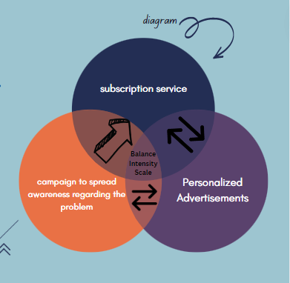
Business Model
A over the desk business model is suitable for sensitizing people about the App. The customers, which in this case are patients, pay a subscription fee in exchange for access to the tool without advertisements. The other perpetual source of income will be the personalized advertisements generating revenue on per click basis.
This business model can ensure a regular stream of income to cope up with running and maintenance costs if there is a strong customer base. Customer subscribing to this service will also receive a personal tracking assistance on how to and what to exercise and for how long.
Cost will depend on how complex the web application is, and This tool should cost approximately $120,000-150,000 to make[3] and market.
The Subscription cost to remove the advertisements will be approximately $3 a month.
QUALITATIVE AND QUANTITATIVE RESEARCH / PAGE 8

Slide 10
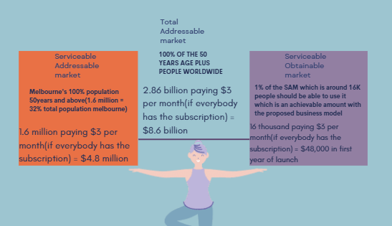
Market Analysis
Addressable Market will consist of the largest stakeholder the people above the age of 50years and even if they won’t buy the subscription we will still be getting around 2 dollars per user per month if they are using it everyday.
Which will land us to exactly a 2/3rd share of what we are planning to achieve with subscription but we can expect better reach of users with advertising as it will be free for the users.
QUALITATIVE AND QUANTITATIVE RESEARCH / PAGE 9

Slide 11
KPIs
The solution is mostly irrelevant to the hospital’s KPI.
The most relevant KPI is that it could improve client experience.
    The tool will improve healthcare provider experience in managing patient care as there is less time lost in coordinating patient treatment schedule.
    The tool can also improve balancing among patients and enhance the experience.
QUALITATIVE AND QUANTITATIVE RESEARCH / PAGE 10

Slide 12
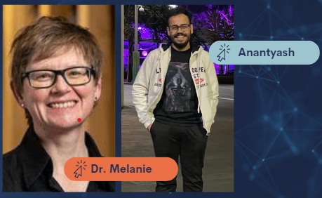
Team
Dr. Melanie designed the Balance Intensity Scale in 2018 after analyzing the need to reduce the injuries caused to adults due to falling unconsciously. The BIS is a clinical measurement of balance exercise intensity used to rate exercises performed by adults and I am helping her with making the tool more user friendly and that can store data online
QUALITATIVE AND QUANTITATIVE RESEARCH / PAGE 4

Slide 13
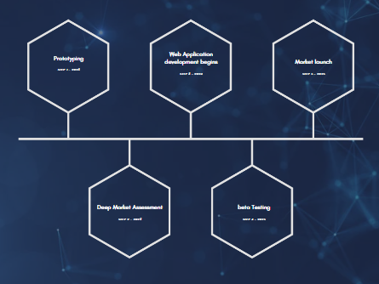
Timeline
2023
Prototyping
Parallelly analysis of market
2024
Development of the web application begins
Simultaneous Marketing
2025
Beta Testing
Market launch
QUALITATIVE AND QUANTITATIVE RESEARCH / PAGE 4

Slide 14
References
[1] Farlie, M. K., Keating, J. L., Molloy, E., Bowles, K.-A., Neave, B., Yamin, J., . . . Haines, T. P. (2019). The Balance Intensity Scales for Therapists and Exercisers Measure Balance Exercise Intensity in Older Adults: Initial Validation Using Rasch Analysis. Physical Therapy, 99(10), 1394-1404. https://doi.org/10.1093/ptj/pzz092
[2] https://www.monash.edu/medicine/balance-intensity-scale
[3] https://ideausher.com/services/mobile-app-development/
QUALITATIVE AND QUANTITATIVE RESEARCH / PAGE 4

