Slide 1

JANUARY 2023
MONASH HEALTHCARE INNOVATION SUMMER SCHOLARSHIPS
Project Dolphin
Maya Wilmshurst
Dr Lucy Gately

Slide 2
Executive Summary
Project Dolphin’s mission is to improve patient adherence to orally administered cancer medications.
Chemotherapy is increasingly being administered orally rather than intravenously, with more than a quarter of antineoplastic drugs being consumed by the patient in their home rather than intravenously administered in-hospital [1]. Responsibility for medication management and symptom management is being shifted away from the oncology treating team and to the patient, introducing issues concerning adherence [2]. While numerous studies have highlighted low adherence amongst oral chemotherapy patients - with a mean adherence of 85% [3] - this data has not been applied to systematic changes within the clinical setting. There are currently no formalised mechanisms in place to monitor medication adherence or to suggest medication management tools to help patients manage complex treatment regimens. The onus is on the patient to reach out for help, source tools online and self-report issues. The clinician is left in the dark, making clinical decisions based on the assumption of 100% adherence.
Project Dolphin is developing a patient adherence dashboard to give clinicians data regarding their patient’s adherence and a database of existing medication management solutions. Rather than adding to the over-saturation of the medication management market, this focuses on the unmet information needs of clinicians so that they can make well-informed decisions and support their patients in better adhering to their treatment regimen.
Empowering patients with the tools and knowledge to manage their medications, and clinicians with an accurate understanding of their patient’s adherence, will improve the efficacy of oral anticancer treatment, improving resultant cancer prognosis and reducing reliance on healthcare resources.
Acceptance Criteria
Have a net neutral short-term impact on the patient’s quality of life (QoL)
Increase in patient adherence to oral chemotherapy treatment regimen
Increase clinician knowledge of patient’s adherence
Improve cancer prognosis: reduce number of cancer deaths due to cancer or treatment-related factors and rate of cancer recurrence
EXECUTIVE SUMMARY / PAGE 1

Slide 3
Gaps analysis
In contrast with intravenous chemotherapy which is administered in-hospital, oral antineoplastic drugs are typically self-administered outside of the hospital setting, transferring the medication management responsibilities onto the patient and away from their treating team [1,4]. After the patient is diagnosed with cancer, they will be prescribed with oral chemotherapy medication(s) and told key information regarding their treatment – adherence is rarely discussed here, perhaps contributing to unmet patient needs for 43-49% of patient education processes [5]. The patient collects their medication from an in-hospital or community pharmacist. For periods between 3 weeks to 3 months (in between follow-up consultations with their oncologist), the patient manages their medication regimen from home, communicating with Symptom and Urgent Review Clinic (SURC) or external services such as Cancer Council as needed. There is no bidirectional communication here, the onus is on patients to reach out. Patients may source medication management tools of their own volition (such as pill reminder applications or paper pill diaries). Throughout the treatment, there is no standardized or formalised mechanism in place to monitor the patient’s adherence or check on their treatment [6]. The onus is on the patient to self-report any issues they are having with side effects or non-adherence (some clinicians may informally enquire if they have missed any doses).
The market is over-saturated with patient-focused solutions that aim to help patients track their medications, remember them or understand them better. What is currently lacking are clinician-focused solutions that facilitate their understanding of their patients’ adherence and allow them to identify (and help the patient overcome) barriers to effective medication management.
Solution 1: Medisafe Pill Reminder App
The Medisafe Pill Reminder App helps patients remember to take their medications, track adherence and monitor symptoms. The application is used by the patient (those managing ongoing medication regimens), with data able to be shared to healthcare practitioners, carers or family members. The patient receives alerts to remind them to take their medications and can input when they take their medications and what symptoms they experience. It has been ranked #1 by pharmacists for helping patients remember to take their medications [7] and increases patient adherence by 7% [8]. It is not exclusively used by oncology patients but offers some oral chemotherapies. The application is free for the user with the option to upgrade to premium for additional non-essential features. The company generates revenue from pharmaceutical companies who receive anonymized data to improve their understanding of patient behaviour.
Solution Alignment | Gaps in Solution
Increases patient adherence by tackling forgetfulness Potentially increases clinician knowledge of patient’s adherence | Relies on patient sourcing the application and entering accurate data May decrease patient QoL Lack of specificity to oncology
GAPS ANALYSIS / PAGE 2

Slide 4
Gaps analysis
Solution 2: GlowCap
GlowCap is a pharmacy-connected pill bottle cap. Patients taking oral medications (not specifically chemotherapy) upload their medication schedule to the connected system and attach the bottle cap to their pill bottle. The electronic cap records when medication has been taken and reminds users to take their pill(s) through visual cues, auditory prompts or through phone call. It generates compliance reports for clinicians and/or families/carers. Randomised clinical trials have demonstrated >25% adherence improvement [9]. While the product is no longer on the market, its cost was covered by the user at $US10/cap and $US15/month.
Solution 3: Physical pill diaries (ie. Dana-Faber Cancer Institute drug diary)
Physical pill diaries provide a template for patients to track their medication adherence. Users can fill in (online or in paper form) when they take the medication as well as any symptoms they experience due to the dose. This allows patients to keep track of their adherence, remember whether they have taken their pills for the day and link symptoms to certain treatments. This tool may be used to communicate with clinicians during follow-up appointments. This is particularly catered towards patients who do not feel comfortable using a smart phone (such as elderly populations). Various physical pill diary templates are available for free online.
This is allowed to be 2 pages
Solution Alignment | Gaps in Solution
Increases patient adherence by tackling forgetfulness Potentially increases clinician knowledge of patient’s adherence | Lack of specificity to oncology No longer available on the market Only directly tackles forgetfulness as factor contributing to low adherence Requires patient initiative to source and pay for the product
Solution Alignment | Gaps in Solution
Helps patient track their adherence Somewhat tackles forgetfulness Potentially increases clinician knowledge of patient’s adherence Links symptoms to treatment-related factors | Lack of specificity to oncology Requires patient initiative to source the template and fill it in consistently and accurately Lacks ability to improve clinician understanding of patient’s adherence - does not offer a usable adherence summary for clinicians
GAPS ANALYSIS / PAGE 2

Slide 5
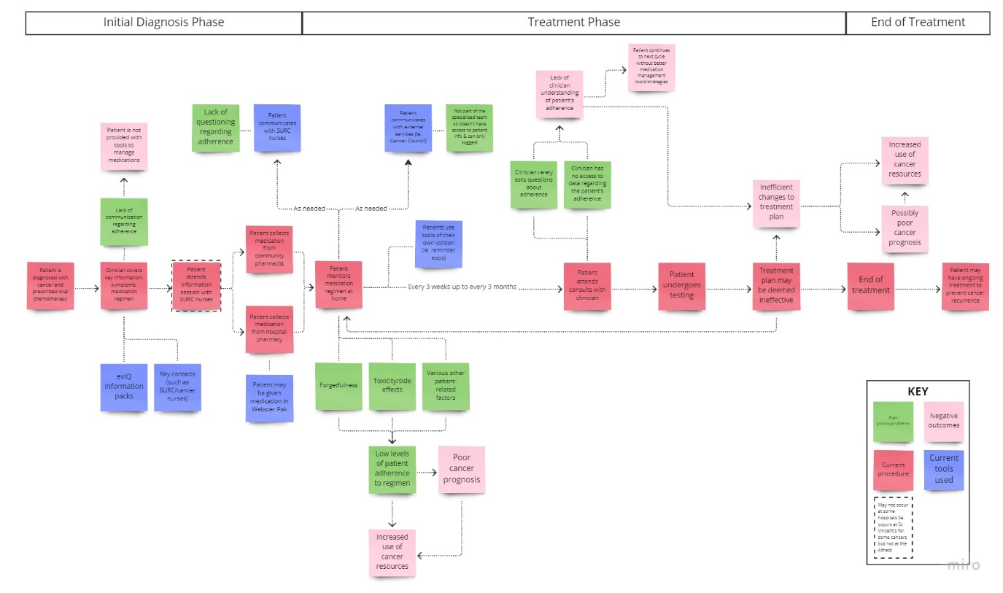
Systems Map
Figure 1: This diagram maps the patient journey from cancer diagnosis to end of treatment. There are few formalised systems in place to monitor, follow-up on or improve patient adherence. Throughout the Treatment Phase, the onus is on the patient to source medication management tools and self-report adherence issues during consultations or to the Symptom and Urgent Review Clinic team.
Link for miro board: https://miro.com/app/board/uXjVP7s99Tk=/
SYSTEMS / STAKEHOLDER MAP / PAGE 3

Slide 6
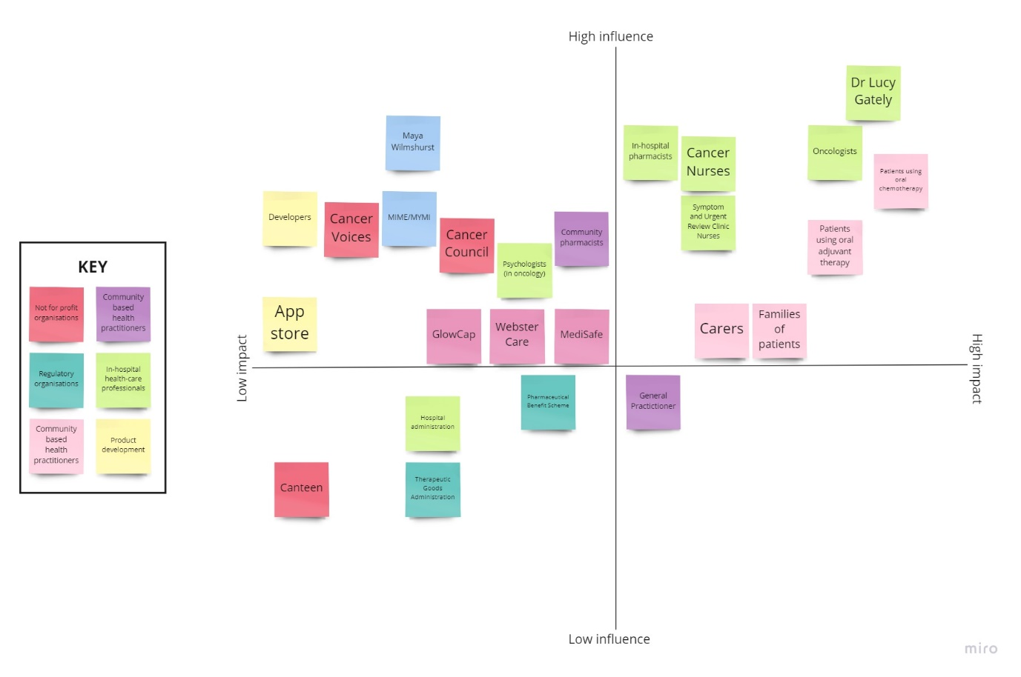
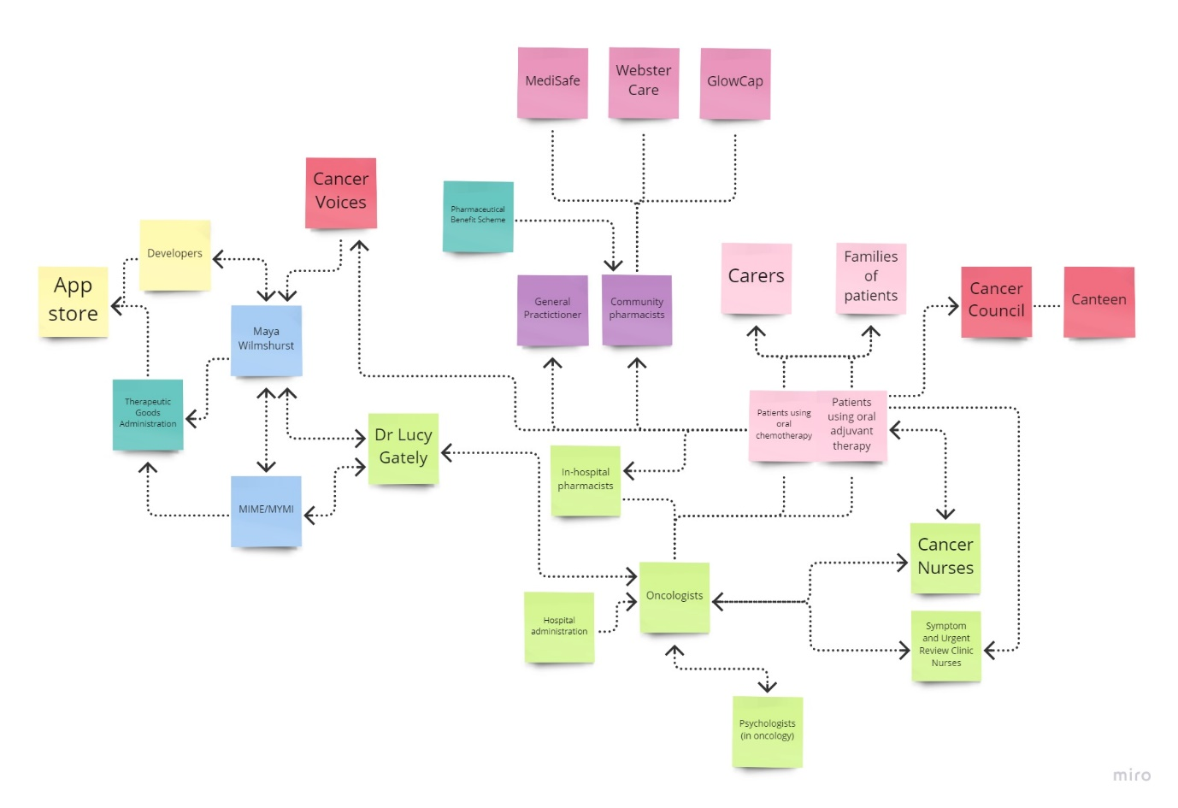
Stakeholder Map
Figure 2. Stakeholder Map
This diagram depicts the stakeholders involved in the project. Their position is determined by the influence they have on the project, and the impact the project has/will have on them.
Figure 3. Connected Stakeholder Map
This diagram depicts the connections between the various stakeholders involved in the project. The direction of the arrows connote the direction of communication between the two connected parties. (Same key as Figure 2)
Link for miro board: https://miro.com/app/board/uXjVP7s99Tk=/
SYSTEMS / STAKEHOLDER MAP / PAGE 4

Slide 7
Outcomes of Qualitative and Quantitative Research
    Chemotherapy is used as a curative or palliative treatment for a variety of cancers and can be administered orally or parenterally. The majority of patients prefer oral chemotherapy over intravenous administration (77-89%) [10, 11, 12] due to convenience, ease of administration (including fear of needles), sense of autonomy and improved quality of life [10, 12, 13], resulting in a trend towards increased oral administration of antineoplastic therapies. In 2008, it was anticipated that a large proportion (>25%) of anticancer drugs being developed would be orally administered [1].
    Oral chemotherapies are typically self-administered outside of the hospital setting, transferring the medication management responsibilities onto the patient and away from their treating team [2]. This results in lower levels of adherence (compared to in-hospital intravenous administration), with patients taking on average 85.57% of their oral therapy [3].
    In a study on patients taking imatinib, 26.4% of patients had adherence <= 90% [14]
    Another study highlighted non-adherence as well as over-adherence with trial participants’ adherence ranging from 29% to 202% (only 14.2% took 100% of their prescribed doses) [15].
    Overall, approximately one-quarter to one-third of patients are classified as non-adherent [16]
    The reasons for non-adherence include: treatment related factors (ie. side effects, drug interactions), patient-related barriers (ie. forgetting, difficulties taking pills), social factors and health-care system related factors (ie. fragmentation in oncology care, poor clinician-patient communication) [13, 15, 17, 80, 19, 20]. Over-compliance may result from strong belief in the importance of their treatment [21].
    Non-adherence to chemotherapy treatment results in poor treatment outcomes and cancer prognosis (including increased risk of recurrence and lower survival rate) [13, 15, 17, 22] - for leukemia patients, the 6-year probability of a major molecular response (3-log reduction, meaning that 0.1% of cells have the BCR-ABL1 gene) decreases by 66.1% for non-adherent patients (<90% adherence) [14]. Clinicians may inefficiently change the treatment plan due to perceived inefficacy [4]. It also results in increased use of healthcare resources and thus, higher healthcare costs. In a US study, a 10% point decrease in adherence correlated to a 14% increase in healthcare costs (excluding medication costs) [24]. Over-compliance may result in detrimental drug toxicity and/or dose modification that may come at a cost of worsened treatment outcomes [21].
    From interviews:
“Perhaps we don’t ask patients enough about adherence…”
“I’m not sure we actually know” if patient adherence to oral chemotherapy is an issue, “we need to audit it.”
Symptom and Urgent Review Clinic (SURC) Nurses
Oncologists (The Alfred)
Two case studies (from clinicians interviewed):
Patient was meant to be taking chemotherapy treatment for 2 weeks and then take 1 week off. They didn’t take the 1 week off.
Recently discovered a patient was taking 1 pill when they were meant to be taking 2 daily. The information was on the prescription and the medication but the patient did not realise.
QUALITATIVE AND QUANTITATIVE RESEARCH / PAGE 5

Slide 8
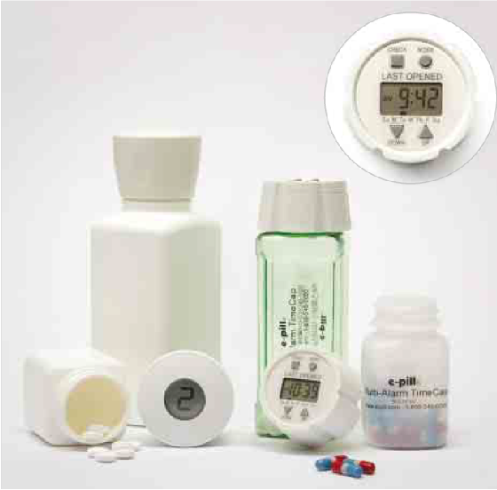
Solution Concept Discussion
- top 3
Solution | Cost | Acceptance Criteria
Medication Event Monitoring System Electronically connected pill bottle cap (or other pill packing) that registers when it has been opened. Generates adherence reports that can be sent to the clinician. It is currently used in some clinical trials to monitor medication intake. | $99.80 USD/patient (for the technology used in clinical trials) [25] | (+) Accurate granular adherence monitoring [26] (+) Allows for clinician understanding of patient’s adherence (+) Prevents uninformed clinical decisions (such as treatment changes) (+) Allows for patient understanding of their own adherence (+) Easily integrates into the patient and clinician’s workflow (-) Requires additional intervention to improve patient adherence (clinician needs to understand reasons for non-adherence and suggest solutions) (-) Very expensive (“This system is also expensive and therefore may not be a feasible option within the community setting” [17]) (-) Patient is constantly aware they are being monitored
Adherence Tools Education Pack List of medication management tools (hardware and software) available that can be provided to patient during the initial consultation (or during a follow-up appointment). | Free tool but may include paid medication management options. Option for companies to pay to be included on the list (with ethics considerations). | (+) Improves patient’s adherence by empowering them to manage their medication (+) Easily integrated into the clinician’s workflow (-) Does not allow for clinician understanding of patient’s adherence (-) Does not allow for patient’s understanding of their adherence (-) Relies on patient’s self-understanding to determine which solution is best
Pharmacy-Generated Adherence Reports Use community and in-hospital pharmacy data on when patient is dispensed medication(s) to generate an approximate adherence report. Create a dashboard for clinicians to access and navigate this data. | Likely free tool to create based on a partnership with the hospital. | (+) Allows for sufficient clinician understanding of patient’s adherence (+) Prevents uninformed clinical decisions (such as treatment changes) (+) Relatively easily integrates into the clinician’s workflow (+) No change in QoL for the patient (+) Patient does not know their adherence is being surveyed (-) Requires additional intervention to improve patient adherence (clinician needs to understand reasons for non-adherence and suggest solutions) (-) Does not allow for patient understanding of their adherence
Top 3 Solutions / PAGE 6

Slide 9
Final Concept
As identified through clinician interviews, there is a lack of knowledge amongst healthcare practitioners regarding their patients’ adherence. This may lead to uninformed clinical decisions (as they assume 100% adherence unless issues are self-reported by the patient) and lack of individualised patient support. It is thus important that the final concept gives the clinician an accurate understanding of their patient’s medication management as well as a way to improve their adherence. The final concept is a web-based adherence management dashboard which comprises two elements:
Patient adherence reports generated from existing pharmacy dispensing records to give clinicians an understanding of their patient’s adherence.
Adherence Tools Education Pack to give clinicians and patients the tools to effectively manage their medication.
The Pharmacy-generated adherence report is an online dashboard for clinicians to use to access their patients’ adherence data. The data is collected from pharmacy dispensing reports (both in-hospital and community) regarding when patients fill prescriptions and used to calculate monthly medication possession ratio (MPR) statistics. MPR is typically calculated by dividing the total days' supply of drug acquired in a year divided by 365. [27] For more granular adherence understanding, this will be calculated monthly (the most common time period for prescriptions to be filled).
While this is a less granular and robust method of monitoring patient compliance to their treatment regimen than medication event monitoring systems (MEMS) – it equates drugs dispensed to drugs consumed by the patient and does not offer an understanding of day-by-day adherence – this is significantly cheaper and offers a satisfactory level of granularity to be useful in the clinical setting. It allows clinicians to understanding the overall adherence of their patients, identify misunderstandings (such as if the patient has mis-interpreted the treatment plan) and open a dialogue to identify barriers to adherence and overcome them in the case that MPR < 100%.
This solution is similar to what is currently used to monitor and manage patients’ intake of addictive drugs: Safescript. This software similarly provides clinician with access to their patient’s prescription records (from pharmacists) as a way of guiding clinical decisions.
Clinical considerations
The solution is easily integrated into clinician workflow as it does not require additional time or training to use. The only burden is the requirement that they access an alternative online website/dashboard. The clinician is supplied with an easily digestible adherence report to aid in their clinical decision making. The solution will thus likely be easily adopted by clinicians as it has a net positive effect on their workflow: it does not increase their work burden and simply offers them additional knowledge to better understand and support their patient. The data from the adherence reports should be used to open a bidirectional dialogue with a non-adherent patient during consultations to understand why they are not adhering to their treatment plan. Once a barrier or barriers have been identified, the clinician can suggest medication management strategies for the patient.
Technical considerations
The greatest technical risks are associated with the data collection mechanisms. There is room for potential inaccuracies in the data given that it extrapolates rather than directly tracking medication consumption patterns. Furthermore, given the fragmentation of medication dispensing, there may be discrepancies in the quality and consistency of patient data between community pharmacies which may compromise the comprehensiveness of the adherence report. The cost associated with these technical risks is not high, as the adherence reporting is intended as a guide for clinicians rather than a definitive gauge of adherence. Patients whose data is likely to be compromised by issues with community pharmacies’ dispensing records will be flagged so that clinicians are aware of potential inaccuracies.
CHOSEN FINAL CONCEPT / PAGE 7

Slide 10
Business Model
Health Economic Profile
Compared to the Standard Operating Procedure (SOP), the initial costs of this solution for hospitals is higher given that there is currently no medication monitoring system in place. Ultimately, the system would lower the cost for hospitals as improving patient adherence has been shown to significantly lower total healthcare costs per patient [24] due to les outpatient visits, lower chance of hospitalisation and shorter hospital stays.
Business Structure
The proposed business model is Business to Business (B2B) whereby the product will be purchased by the hospital for their oncology department. The payment model operates on a subscription service with the hospital paying a monthly fee to use the online patient adherence dashboard. This also grants them access to the Adherence Tools Pack which is also housed on the dashboard to help guide their support of patient medication management.
Market Penetration Strategy
The exit strategy is to sell the online platform to the Alfred or to integrate it into existing patient medical records through My Health Record.
Risks
Offer the service for free (3 months) to clinicians within the Alfred’s oncology department
Test the efficacy and ease of use for clinicians
Create data to highlight the importance of monitoring adherence to improve it
Sell the system on a subscription plan to the Alfred oncology department.
Sell the system to other oncology departments: Monash Partners followed by Victorian hospitals, Australian hospitals, global hospitals potentially
Adapt the system to cater to other medications (disease states) to broaden the market scope.
Risk | De-risking Strategy
Low-uptake amongst clinicians | Use initial free trial amongst The Alfred oncologists to highlight (currently unknown) low adherence rates and hence, the necessity for the system. This will also facilitate broader adoption by highlighting its usefulness to clinicians.
Privacy and Data Storage | The same data is already stored within the hospital network. Relevant hospital technical support/consultants will be consulted to ensure sufficient privacy system is used. Software system will use strong security measures to ensure only relevant clinicians have access to their patients’ data.
Inaccurate Data The data is being collated and presented digestibly by the system rather than collected. | Include disclaimer that the data is based on pharmacy dispensing records from sources X, Y and Z and will reflect any biases or inaccuracies within these data sources.
Funding | Create low fidelity prototypes initially Acquire funding through external investors
QUALITATIVE AND QUANTITATIVE RESEARCH / PAGE 8

Slide 11
Market Analysis
Total Addressable Market (TAM):
Global Medication Adherence Market (CAGR of 10-15%) *
$3.9 B
Serviceable Addressable Market (SAM):
Australian Oral Chemotherapy Adherence Market*
$1.13 M
Serviceable Obtainable Market (SOM):
Monash Partners Oral Chemotherapy Adherence Market*
$170 K
*This is based off the following assumptions
The solution is aimed at oncology departments that offer oral chemotherapy as a treatment option for their patients. Given that patients on intravenous (IV) and oral chemotherapy are able to be better monitored and more frequently followed-up on, the solution will likely offer the most valuable insight into patients who are only taking oral chemotherapy.
Once the solution is established within the oncology sector, the market can be expanded to include other disease states that are also treated using oral medications.
Key competitors on the market are other solutions that allow for medication monitoring. For example: pill counting techniques (not a product/company specifically), Medication Event Monitoring Systems (such as from AARDEX group), physical pill diaries etc. Software and hardware solutions that facilitate medication management are complementary services to the online adherence management dashboard rather than being direct competitors.
[28] | Global Medication Adherence Market is worth $3.9 B (2021)
[29, 30] | Australia’s pharmaceutical market is worth 1.77% of the world’s pharmaceutical market (Australia’s market/Global market = $25.2 B/1.42 T)
 | Australia’s Medication Adherence market is worth $69 M (1.77% of 3.9B)
[31] | 1.64% of PBS listed prescription drugs are antineoplastic (this does not include non-subsidised drugs). Australia’s oncology medication adherence market is worth $1.13 M (1.64% of $69M).
[32] | Monash Partners service 15% of Australia’s population. Size of Monash Partners oncology medication adherence market = $169,500.
QUALITATIVE AND QUANTITATIVE RESEARCH / PAGE 9

Slide 12
Proposed KPIs
The Alfred Key Performance Indicators [32]:
While the solution does not directly fit with The Alfred’s KPIs, its successful implementation would have an effect on the hospital’s ability to achieve certain indicators, particularly relating to comprehensive care. Given that increasing adherence reduces chance of hospitalisation, number of outpatient visits and length of hospital stays [24], integrating this solution into The Alfred would improve the hospital’s ability to focus its resources on improving (access to) comprehensive care for other patients. This includes: increasing emergency department (ED) response times for non-oncology patients, improving care within the ED to decrease patients’ length of stay and seeing Specialist Clinic Routine referrals more quickly, all of which fall under The Alfred’s KPIs for comprehensive care.
Hospital KPIs [33]:
With a view towards expanding the service into other Australian hospitals, the KPIs of other hospitals are considered here more broadly. The key sets of indicators are:
MIME’s Key Performance Indicators (KPIs):
This project fits into MIME’s focus on improving clinician workflow and cancer care.
Indicator Domain | How improved adherence helps hospitals attain outcomes
1. Safety and Effectiveness | Reduces in-hospital mortality rates by improving cancer prognosis Reduces risk of unplanned hospital re-admission Decreases number of cancer deaths
2. Equity and Access | Decreases ED wait length time by diverting resources away from unplanned cancer hospitalisations Improves specialist care by reducing number of outpatient visits for cancer patients
3. Efficiency/Value for money | Decreases average length of hospital stay Reduces healthcare expenditure per capita by potential life years lost by decreasing reliance on healthcare resources and improving cancer outcomes
4. Patient Centered /Experience | Improves responsiveness to in-patient needs by reducing hospitalisation of cancer patients and thus, their use of hospital resources and time Improves out-patient experience by reducing number of cancer out-patient visits
QUALITATIVE AND QUANTITATIVE RESEARCH / PAGE 10

Slide 13


Ask and Next Steps
Dr Lucy Gately
PhD FRACP MBBS BSci Clin Dip Pall Med
Head of Neuro-Oncology and Clinical Innovation
Medical Oncologist | Alfred Health
Cabrini Family Cancer Clinic | Cabrini Health
Clinical Research Fellow | Personalised Oncology Division | Walter and Eliza Hall Institute of Medical Research
Insight into current oral chemotherapy clinical practice
Knowledge of how new innovations can integrate into clinician workflow
Maya Wilmshurst
Third Year Bachelor of Mechanical Engineering (Honours) and Bachelor of Arts
Some software development experience
Happy to further develop software skills and data analysis skills
Our Ask
Software expertise in web development
UI/UX design
Legal expertise to aid in developing process to access patients’ dispensing records
QUALITATIVE AND QUANTITATIVE RESEARCH / PAGE 4

Slide 14
Timeline
End of HISS:
- Figma prototype
- Understanding of process for accessing pharmacy dispensing records
December 2023:
Creation of Minimum Viable Product (MVP)
Preliminary testing
January 2024:
- Free trial at The Alfred
May 2024:
- Data collection and analysis (feedback from free trial)
July 2024:
- Software development complete (changes based on feedback have been implemented)
- Launch subscription model in Monash Partners’ oncology departments
2025 +
- Expansion to other hospitals in Australia
- Develop application for other disease states with oral medication
QUALITATIVE AND QUANTITATIVE RESEARCH / PAGE 4

Slide 15
References
Weingart SN, Brown E, Bach PB, Eng K, Johnson SA, Kuzel TM, et al. NCCN Task Force Report: Oral chemotherapy [Internet]. JNCCN. National Comprehensive Cancer Network; 2008 [cited 2023Jan14]. Available from: https://jnccn.org/configurable/content/journals$002fjnccn$002f6$002fS3$002farticle-pS-1.xml?t%3Aac=journals%24002fjnccn%24002f6%24002fS3%24002farticle-pS-1.xml
Richmond JP, Kelly MG, Johnston A, Hynes L, Murphy PJ, Murphy AW. Current management of adults receiving oral anti-cancer medications: A scoping review protocol [Internet]. HRB open research. U.S. National Library of Medicine; 2022 [cited 2023Jan14]. Available from: https://www.ncbi.nlm.nih.gov/pmc/articles/PMC8802151/
Jacobs JM;Ream ME;Pensak N;Nisotel LE;Fishbein JN;MacDonald JJ;Buzaglo J;Lennes IT;Safren SA;Pirl WF;Temel JS;Greer JA; Patient experiences with oral chemotherapy: Adherence, symptoms, and quality of life [Internet]. Journal of the National Comprehensive Cancer Network : JNCCN. U.S. National Library of Medicine; [cited 2023Jan14]. Available from: https://pubmed.ncbi.nlm.nih.gov/30865917/
Betcher J, Dow E, Khera N. Oral chemotherapy in patients with hematological malignancies-care process, pharmacoeconomic and policy implications - current hematologic malignancy reports [Internet]. SpringerLink. Springer US; 2016 [cited 2023Jan14]. Available from: https://link.springer.com/article/10.1007/s11899-016-0325-2
Zerillo JA;Pham TH;Kadlubek P;Severson JA;Mackler E;Jacobson JO;Blayney DW; Administration of oral chemotherapy: Results from three rounds of the Quality Oncology Practice initiative [Internet]. Journal of oncology practice. U.S. National Library of Medicine; [cited 2023Jan14]. Available from: https://pubmed.ncbi.nlm.nih.gov/25784581/
Annual report to the nation on the status of cancer, part 1: National ... [Internet]. [cited 2023Jan14]. Available from: https://acsjournals.onlinelibrary.wiley.com/doi/full/10.1002/cncr.34479
Inc. MS. Medisafe Pill Reminder [Internet]. App Store. 2012 [cited 2023Jan14]. Available from: https://apps.apple.com/au/app/medisafe-pill-reminder/id573916946
Komodo health study: Medisafe digital companion increases adherence and persistence [Internet]. Medisafe. 2022 [cited 2023Jan14]. Available from: https://www.medisafe.com/education-resources/komodo-health-study-medisafe-digital-companion-increases-adherence-and-persistence/
Helping people stay healthy and independent - GSMA [Internet]. [cited 2023Jan14]. Available from: https://www.gsma.com/iot/wp-content/uploads/2012/03/embattvitalityglowcapshires0611.pdf
Fitch MI, Liu G, Franssen E. Patient preferences for oral versus intravenous palliative chemotherapy. [Internet]. Journal of Clinical Oncology. [cited 2023Jan14]. Available from: https://ascopubs.org/doi/pdf/10.1200/JCO.1997.15.1.110?role=tab
J.Wojtacki, R.Wiraszka, G.Rolka-Stempniewicz, M.Grzegorczyk. Breast cancer patients preferences for oral versus intravenous second-line anticancer therapy [Internet]. European Journal of Cancer Supplements. Elsevier; 2006 [cited 2023Jan14]. Available from: https://www.sciencedirect.com/science/article/pii/S1359634906804015
Díaz MN, Ciruelos EM, Isla MD, López R, Bernabé R, González E, et al. Patient preference for oral chemotherapy in the treatment of metastatic breast and lung cancer [Internet]. [cited 2023Jan14]. Available from: https://onlinelibrary.wiley.com/doi/10.1111/ecc.13164
Lin C;Clark R;Tu P;Bosworth HB;Zullig LL; Breast cancer oral anti-cancer medication adherence: A systematic review of psychosocial motivators and barriers [Internet]. Breast cancer research and treatment. U.S. National Library of Medicine; [cited 2023Jan14]. Available from: https://pubmed.ncbi.nlm.nih.gov/28573448
Marin D, Bazeos A, Mahon F-X, Eliasson L, Milojkovic D, Bua M, et al. Adherence is the critical factor for achieving molecular responses in patients with chronic myeloid leukemia who achieve complete cytogenetic responses on Imatinib [Internet]. Journal of clinical oncology : official journal of the American Society of Clinical Oncology. U.S. National Library of Medicine; 2010 [cited 2023Jan14]. Available from: https://www.ncbi.nlm.nih.gov/pmc/articles/PMC6366340/
Noens L;van Lierde MA;De Bock R;Verhoef G;Zachée P;Berneman Z;Martiat P;Mineur P;Van Eygen K;MacDonald K;De Geest S;Albrecht T;Abraham I; Prevalence, determinants, and outcomes of nonadherence to imatinib therapy in patients with chronic myeloid leukemia: The adagio study [Internet]. Blood. U.S. National Library of Medicine; [cited 2023Jan14]. Available from: https://pubmed.ncbi.nlm.nih.gov/19349618/
Huang W-C, Chen C-Y, Lin S-J, Chang C-S. Medication adherence to oral anticancer drugs: Systematic Review [Internet]. Taylor & Francis. [cited 2023Jan14]. Available from: https://www.tandfonline.com/doi/full/10.1586/14737140.2016.1159515
McCue D, Lohr L, Pick A. Improving adherence to oral cancer therapy in clinical practice [Internet]. [cited 2023Jan14]. Available from: https://accpjournals.onlinelibrary.wiley.com/doi/10.1002/phar.1399
QUALITATIVE AND QUANTITATIVE RESEARCH / PAGE 4

Slide 16
References
    Krikorian S;Pories S;Tataronis G;Caughey T;Chervinsky K;Lotz M;Shen AH;Weissmann L; Adherence to oral chemotherapy: Challenges and opportunities [Internet]. Journal of oncology pharmacy practice : official publication of the International Society of Oncology Pharmacy Practitioners. U.S. National Library of Medicine; [cited 2023Jan14]. Available from: https://pubmed.ncbi.nlm.nih.gov/30253725/
    S; PRJGTMA. Identifying adherence barriers to oral endocrine therapy among breast cancer survivors [Internet]. Breast cancer research and treatment. U.S. National Library of Medicine; [cited 2023Jan14]. Available from: https://pubmed.ncbi.nlm.nih.gov/30523459/
    Khandelwal N, Duncan I, Ahmed T, Rubinstein E, Pegus C. Oral chemotherapy program improves adherence and reduces medication wastage and hospital admissions [Internet]. JNCCN. Harborside Press, LLC; 2012 [cited 2023Jan14]. Available from: https://jnccn.org/view/journals/jnccn/10/5/article-p618.xml
    Allen J, Williamson S. Over compliance with Capecitabine Oral Chemotherapy - International Journal of Clinical Pharmacy [Internet]. SpringerLink. Springer Netherlands; 2014 [cited 2023Jan14]. Available from: https://link.springer.com/article/10.1007/s11096-014-9921-1
    Ganesan P, Sagar TG, Dubashi B, Rajendranath R, Kannan K, Cyriac S, et al. Nonadherence to imatinib adversely affects event free survival in ... [Internet]. [cited 2023Jan14]. Available from: https://onlinelibrary.wiley.com/doi/10.1002/ajh.22019
    Betcher J, Dow E, Khera N. Oral chemotherapy in patients with hematological malignancies-care process, pharmacoeconomic and policy implications - current hematologic malignancy reports [Internet]. SpringerLink. Springer US; 2016 [cited 2023Jan14]. Available from: https://link.springer.com/article/10.1007/s11899-016-0325-2
    Darkow T, Henk HJ, Thomas SK, Feng W, Baladi J-F, Goldberg GA, et al. Treatment interruptions and non-adherence with imatinib and associated healthcare costs - pharmacoeconomics [Internet]. SpringerLink. Springer International Publishing; 2012 [cited 2023Jan14]. Available from: https://link.springer.com/article/10.2165/00019053-200725060-00004
    Yang J, Kim H-Y, Park S, Sentissi I, Green N, Oh BK, et al. Cost-effectiveness of a medication event monitoring system for tuberculosis management in Morocco [Internet]. PLOS ONE. Public Library of Science; [cited 2023Jan14]. Available from: https://journals.plos.org/plosone/article?id=10.1371%2Fjournal.pone.0267292
    El Alili M, Vrijens B, Demonceau J, Evers SM, Hiligsmann M. A scoping review of studies comparing the medication event monitoring system (MEMS) with alternative methods for measuring medication adherence [Internet]. British journal of clinical pharmacology. U.S. National Library of Medicine; 2016 [cited 2023Jan14]. Available from: https://www.ncbi.nlm.nih.gov/pmc/articles/PMC4917812/
    McCue D, Lohr L, Pick A. Improving adherence to oral cancer therapy in clinical practice [Internet]. [cited 2023Jan14]. Available from: https://accpjournals.onlinelibrary.wiley.com/doi/10.1002/phar.1399
    BlueWeave Consulting and Research Pvt Ltd. Medication adherence market to surpass USD 5.5 billion mark, with a CAGR of 11.1% by 2028: BlueWeave consulting [Internet]. GlobeNewswire News Room. BlueWeave Consulting and Research Pvt Ltd; 2022 [cited 2023Jan14]. Available from: https://www.globenewswire.com/news-release/2022/08/12/2497732/0/en/Medication-Adherence-Market-to-Surpass-USD-5-5-Billion-Mark-With-a-CAGR-of-11-1-by-2028-BlueWeave-Consulting.html#:~:text=The%20global%20Medication%20Adherence%20market,%2D2028%20(forecast%20period)
    Admin. Australian pharmaceutical market to surpass $25 billion [Internet]. Drug Development and Delivery. 2016 [cited 2023Jan14]. Available from: https://drug-dev.com/australian-pharmaceutical-market-to-surpass-25-billion/
    Mikulic M. Topic: Global Pharmaceutical Industry [Internet]. Statista. [cited 2023Jan14]. Available from: https://www.statista.com/topics/1764/global-pharmaceutical-industry/#topicHeader__wrapper
    Australian statistics on medicines 2015 [Internet]. Pharmaceutical Benefits Scheme (PBS) | Australian Statistics on Medicines 2015. [cited 2023Jan14]. Available from: https://www.pbs.gov.au/pbs/statistics/asm/asm-2015
    Improving the lives of our patients [Internet]. Alfred Health. 2023 [cited 2023Jan14]. Available from: https://www.alfredhealth.org.au/
    Key performance indicators for hospital reporting executive summary [Internet]. [cited 2023Jan14]. Available from: https://monashhealth.org/wp-content/uploads/2019/03/Indicators-of-Hospital-Performance-FINAL-Aug-2016_sop.pdf
QUALITATIVE AND QUANTITATIVE RESEARCH / PAGE 4

