Slide 1

JANUARY 2023
MONASH HEALTHCARE INNOVATION SUMMER SCHOLARSHIPS
Project Relay
Current Team: Maria Zarco-Vera
Clinical Champion: Mark Voskoboynik
Affiliations: The Alfred Hospital

Slide 2
Executive Summary
Oncology clinical trials are defined as complex due to the nature of the designs, conduction, analyses and reporting. A key element on these trials is the appointment system. At The Alfred Hospital, there are two types of appointments each with their own systems. Doctor appointments are displayed on the Patient Portal, whereas the trial related appointments are handwritten on a yellow card, due to the quantity of them and needing to reschedule them often. The problem arises when a patient misses an appointment and the subsequent ones get canceled. Trial coordinators will spend at least 10 hours a fortnight rescheduling them and almost half a million dollars will be lost a year in Victoria due to inefficiencies in clinical trials in Victoria. The 25% of healthcare budget in Australia, can be better spent. Therefore, project Relay aims to improve communication between patients, carers and trial coordinators in complex oncology clinical trials.
Acceptance Criteria
50% decrease in amount of oncology clinical trial appointments missed
Integration in at least 1 of the following systems: CERNER, patient portal, EMR
30% increase in productivity of clinical trial coordinators
EXECUTIVE SUMMARY / PAGE 1

Slide 3
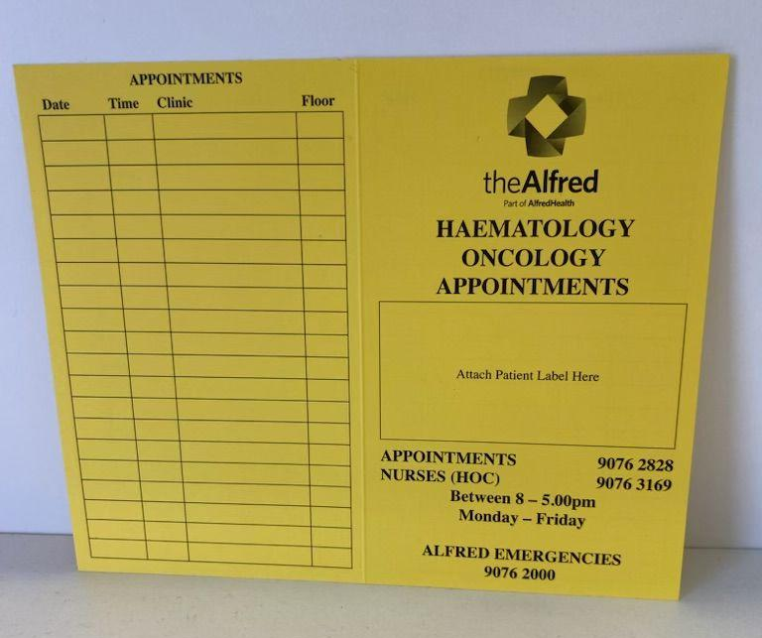
Gaps analysis
At the Department of Medical Oncology at The Alfred, complex oncology clinical trials have two types of appointments with their respective systems. There are doctor appointments and “trial related” appointments. Doctor appointments are booked by coordinators through Cerner and then these automatically appear on the Patient Portal. On the other hand, trial related appointments (for a couple of months) are handwritten on a yellow card, as shown below. It is very hard to reschedule appointments through Cerner and described as “archaic”, hence coordinators opted for the hard copy card. The benefits of this system is that if one appointment is missed and subsequently the others get cancelled, then the patient can get a new yellow card rather than manually rescheduling all appointments through Cerner. However, this systems raises issues if the patient is forgetful and forgets which card to follow, or if they lose the card. Additionally, the card does not have an automatic notification system like the patient portal does, thus it relies on the coordinators keeping track of the patients coming and of the reminders.
Other hospitals like The Royal Melbourne Hospital, The Peter McCallum Cancer Centre and The Royal Women’s Hospital use an app called HealthHub which allows for appointments to be rescheduled in an easier way. However, this app falls under Epic which is a competitor of Cerner so it would not be possible to implement it at The Alfred.
Figure 1. Yellow card
Depicts the yellow card used for trial related appointments in complex oncology clinical trials.
GAPS ANALYSIS / PAGE 2

Slide 4
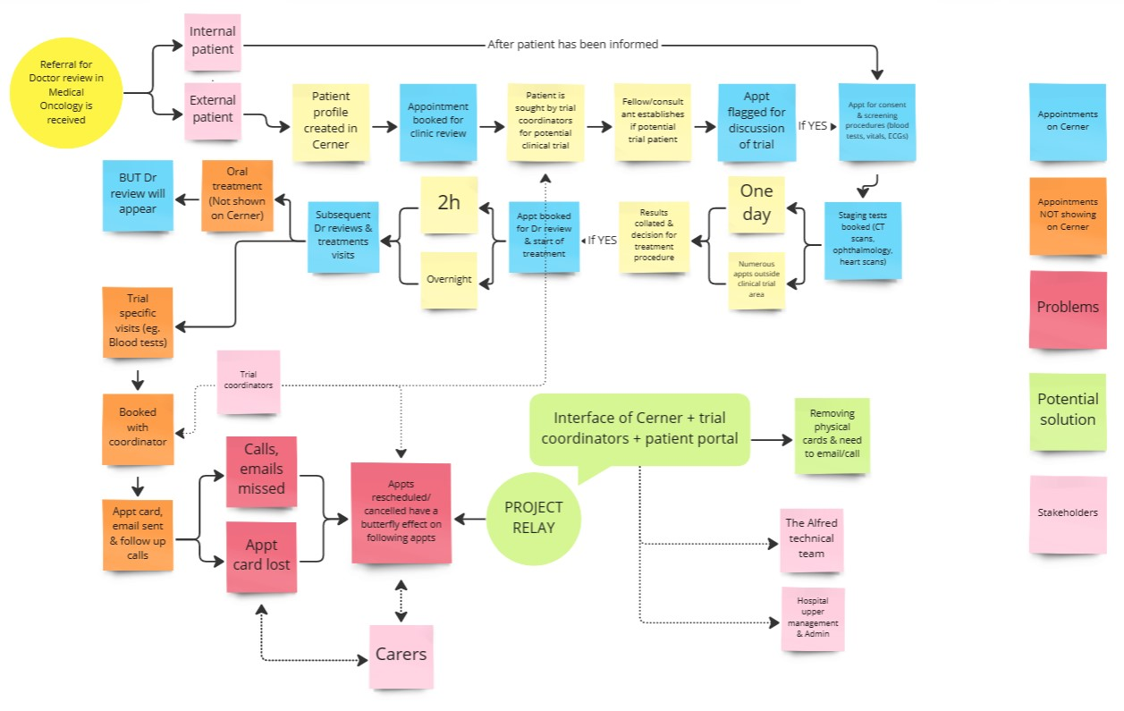
Systems Map
Figure 1: Systems Map
This patient diagram maps the progression from admission into The Alfred for chemotherapy and choosing to participate in a complex oncology clinical trial, through to the different appointments they must attend and how/where each is scheduled. It finalises with Project Relay highlighting where this project is relevant and what stages it helps with. Additionally, the legend specifies the problems, as well as the solution, stakeholders and more importantly the root of this: whether appointments are being scheduled on CERNER or not.
Link for miro board: https://miro.com/app/board/uXjVP6krBzI=/
SYSTEMS / STAKEHOLDER MAP / PAGE 3

Slide 5
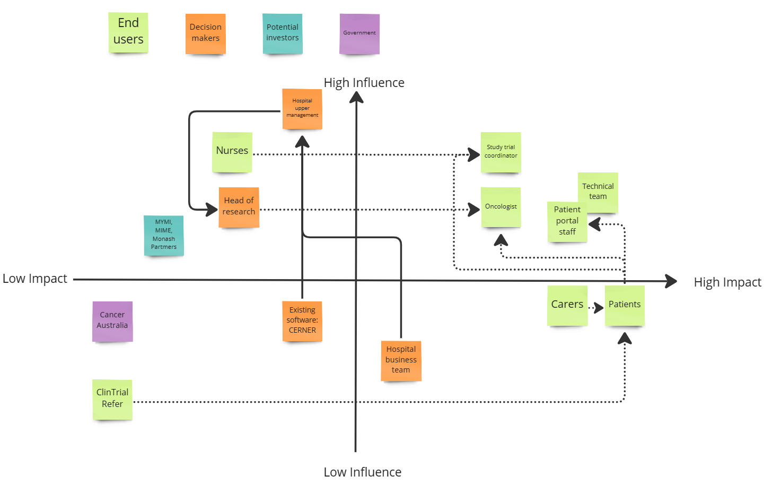
Stakeholder Map
Figure 2. Stakeholder Map
Depicts the range of stakeholders and the position they hold in terms of the direct influence they have on the project, and the impact the project will have on them. There are four majors stakeholder categories: the end users,, the decision makers, the professional investors and the government. Additionally, arrows highlight the relationship between them and the direction in which communication flows.
Link for miro board: https://miro.com/app/board/uXjVP6krBzI=/
SYSTEMS / STAKEHOLDER MAP / PAGE 4

Slide 6
Outcomes of Qualitative and Quantitative Research
The current situation at The Alfred affects the workflow and patient experience, clinicians describing it as “archaic”, but it also has an economic impact. 10% of patients will miss trial related appointments and it takes 10 hours a fortnight for coordinators to reschedule the appointments. Given the salary is $45/h, this results in $450 lost in a fortnight by one coordinator. Additionally, there are 20 coordinators in Medical Oncology and 50 active clinical trials in Victoria [1]. When accounting for all these factors, Victoria can lose up to half a million dollars due to the inefficiency of this system. A fact worth noting is that 25% of the heath care budget is allocated to clinical trials [1], thus there is a need to improve this system so that the budget can be allocated more efficiently.
Moreover, in 2018 it was stated by The Checkley Group that 90% of Australian Public Hospitals use Cerner [2]. This is worth noting as it means that if a solution was created by Cerner, then it could be widely implemented.
QUALITATIVE AND QUANTITATIVE RESEARCH / PAGE 5

Slide 7
Solution Concept Discussion - top 3
The initial concept design involved the creation of an API. As explained previously, the patient portal shows the doctor appointments booked through CERNER. On the other hand, the Yellow Card shows the trial related appointments. Additionally, the trial coordinators have a Microsoft Calendar that keeps track of the trial related appointments as a form of communication with the Pharmacy. An API was initially explored, as a way to link the Microsoft Calendar and the Patient Portal. This way, the Portal would centralise the appointments, which would get rid of the yellow cards, thus decreasing the amount of appointments missed. Additionally, it would be integrated with CERNER and it would reduce the workload associated with the inefficiencies of the Yellow Card hence increasing productivity. However, the Patient Portal is a subset of CERNER therefore, it could cost between $15,000 and $20,000 to create and implement this API [3], as well as years of work.
Another concept design that was considered was the creation of an app called YellowCard. This app would digitalise the current hard copy yellow card with the trial related appointments. The cost of a health care app development is $120-250,000 [4] and it would take 5 to 6 months. This app could decrease the appointments missed but it would cost an additional $20,000 for it to be integrated with CERNER. Time is key here and it leads to the third solution concept, CERNER Oncology.
CERNER’s PowerChart Oncology is a comprehensive oncology specific EHR. As it is already part of CERNER, trial related appointments would automatically show on the patient portal, the hard copy yellow card would be dismissed thus decreasing number of appointments missed and additionally the coordinators would share the workload with the Patient Portal in regards to rescheduling appointments.
Top 3 Solutions / PAGE 6

Slide 8
Final Concept
CERNER’s PowerChart Oncology is a comprehensive oncology specific EHR. As it is already part of CERNER, trial related appointments would automatically show on the patient portal, hence fitting in the clinical workflow. Additionally, The Alfred already holds the digital/structural skeleton of CERNER so the clinical adoption strategy would be more in regards to adopting the new features of the Oncology EHR. The hard copy yellow card would be dismissed thus decreasing number of appointments missed. Additionally the coordinators would share the workload with the Patient Portal in regards to rescheduling appointments.
This is a solution created by CERNER Oracle, patent related features will be held and organised by them. Moreover, risks in relation to privacy would be mitigated as CERNER maintains a security incident management process to investigate, mitigate and communicate system security events occurring within a Platform. There exists a risk in regards to how in depth this new feature can be used for complex clinical trials, as well as whether the coordinators will have the skills to use the program. The de-risking strategies, would focus then on active communication from the Department of Medical Oncology and the Patient Portal so as to investigate this area and potentially raise cases for improvement. Additionally, The Alfred has employees who focus on providing training about CERNER. Therefore, the trial coordinators would be advised to take these training courses so that the new system works to its full capacity.
Finally, there exists competitive advantages in that CERNER is an established corporation, therefore adapting to them ensures security, legitimacy and professionalism. As other corporations are trying to create oncology EHRs, CERNER will focus on improving its services and listening to clinicians who have for years shown disdain on the current oncology EHRs. The advantage lies on the fact that CERNER has the funds and resources to keep on improving its services, as opposed to a start-up.
CHOSEN FINAL CONCEPT / PAGE 7

Slide 9
Business Model
Currently, the health economic profile of the SOP (standard operating procedure) shows the following: there is an indirect cost associated to the use of the yellow cards and hence the need to call and email as a result of rescheduling. A clinical trial coordinator is paid $70912 to $81454 per year [5], assuming they spend 10 hours a week dealing with the inefficiencies of the SOP then it results in a $20363 used every year for just one trial coordinator. Moreover, there is the associated cost of a hospital chair that is not being used 100% time, as result of cancellations. On the other hand, the health economic profile for CERNER would aim to significantly reduce the number of hours spent by coordinators rescheduling patients.
The business model proposed in this project is a B2B, whereby the project members act as a consulting body. As a result, project members will not be making money but CERNER will obtain revenue. In 2020, CERNER obtained a revenue of $8.25B [6], so it is expected that over the years CERNER Oncology would contribute to that. Since this is integrated in The Alfred, then patients will not need to pay.
QUALITATIVE AND QUANTITATIVE RESEARCH / PAGE 8

Slide 10
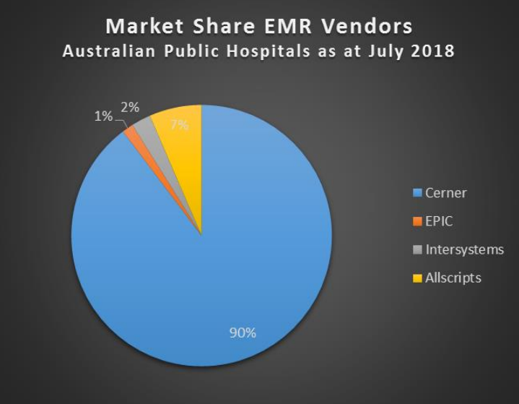
Market Analysis
The TAM (Total Addressable Market) of CERNER is $45B, as stated in Oracle Investor Relations [6]. The SAM (Serviceable Available Market), calculated from the percentage of hospitals that use CERNER in Australia (90%) and those which also have clinical trials (293) is $5B. The SOM (Serviceable Obtainable Market) include the clinical trials at The Alfred, equating 18.8 million dollars. The competition in the market includes EPIC, but as shown in the figure below, a report done by The Checkley Group in 2018 highlighted that the market is dominated by CERNER as key system [2].
Figure 2. Stakeholder Map
Depicts the range of stakeholders and the position they hold in terms of the direct influence they have on the project, and the impact the project will have on them. There are four majors stakeholder categories: the end users, the decision makers, the professional investors and
QUALITATIVE AND QUANTITATIVE RESEARCH / PAGE 9

Slide 11
Proposed KPIs
The clinical trials are paid for by sponsors, therefore The Alfred’s KPIs serve only in regards to the infrastructure where these clinical trials are being carried out. Therefore, this project is not directly affected by KPIs. However, they may improve patient experience. Trial coordinators and the Patient Portal will work together to ensure that all patients attend their appointments yet have flexibility to reschedule if necessary, as well as ensuring there isn’t an overwhelming amount of emails, calls and reminders being sent which can result in confusion. Moreover, it will improve the working experience of trial coordinators.
QUALITATIVE AND QUANTITATIVE RESEARCH / PAGE 10

Slide 12
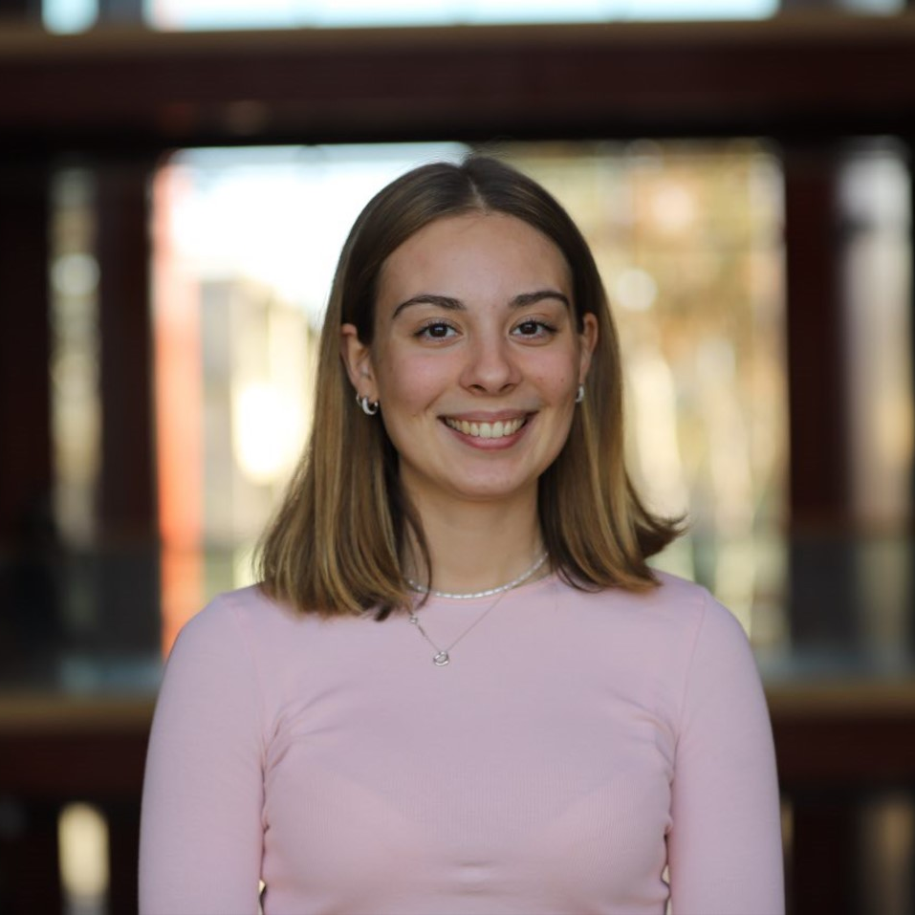
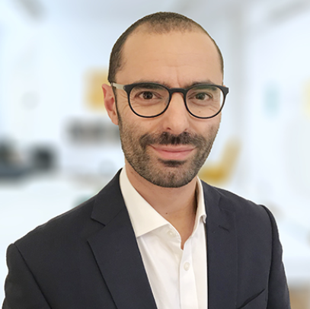
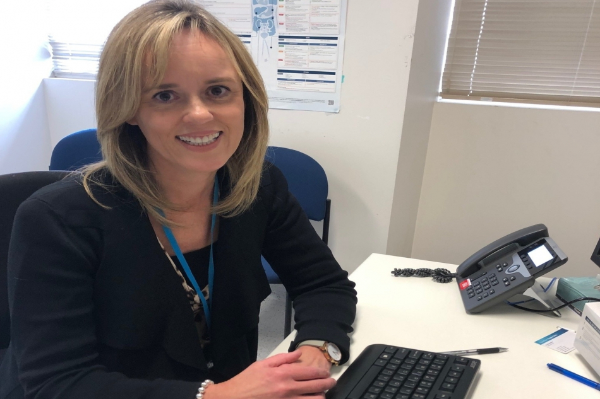
Our Team
Maria Zarco-Vera, second year Biomedical Engineering student. Project lead of Project Relay and Engagement Officer in Monash Young Medtech Innovators (MYMI).
W
Mark Voskoboynik, (Clinical Champion) MBBS (Hons), FRACP Clinical Research Fellowship - Guys Hospital & Sarah Cannon Research Institute, London UK. Works in Phase I oncology clinical trials at Nucleus Network. Submitted Project Relay to HISS and facilitates communication within The Alfred Hospital.
Chris Brooks, Research Manager Medical Oncology at Alfred Health with 25 years of nursing, research and clinical trial experience. Oversees a team of 20 that are in charge of 50 open clinical trails, thus has a thorough understanding of the management behind these trials as well as contacts within the hospital.
When will CERNER Oncology be implemented at The Alfred?
QUALITATIVE AND QUANTITATIVE RESEARCH / PAGE 4

Slide 13
Timeline
Speak with Ellen Heywood. Ellen, is the Ambulatory Cancer Services Manager and is pushing for CERNER Oncology to be implemented at The Alfred.
Once that date is established, the Project Lead will act as a consulting body and keep in contact with Medical Oncology to ensure that this new feature of CERNER meets their needs.
QUALITATIVE AND QUANTITATIVE RESEARCH / PAGE 4

Slide 14
References
MTPConnect. (2021). Australia’s Clinical Trials Sector. mtpconnect.org.au
EMR in Australia – The State of the Nation. hisa.org.au. December 2018. 9/01/2023. https://www.hisa.org.au/slides/hic18/tue/BrucePedersen.pdf
How much does it cost to develop an API? AppMaster. December 2021. 20/12/2022. https://appmaster.io/blog/how-much-does-it-cost-develop-api
How much does it cost to develop an app? DreamWalk. July 2022. 20/12/2022. https://dreamwalk.com.au/app-development-questions/how-much-does-it-cost-to-develop-an-app
Clinical Trial Coordinator – Alfred Health. Alfred Health. N/a. 9/01/2023. https://careers.alfredhealth.org.au/jobs
Cerner: Underwhelming Growth Targets Warrant Investor Caution. Seeking Alpha. March 2020. 08/01/2023. https://seekingalpha.com/article/4334201-cerner-underwhelming-growth-targets-warrant-investor-caution
QUALITATIVE AND QUANTITATIVE RESEARCH / PAGE 4

