Slide 1




Project Sentinel
Week 6 Deliverable Summary
[template, delete]
ENTER OWN IMAGE HERE (e.g. scholar and clinician photo)
Monash Healthcare Innovation Summer Scholarship
2022/2023
Scholars: Calvin Zheng, Diana Kovaleva
Clinicians: Dr Thanh Phan

Slide 2
Project Sentinel - Week 6 Deliverables
HISS 2022/2023
Mission Statement:
To create a solution that is able to monitor the stability of the neuronal activity of patients recovering from ischaemic stroke over time, and is able to provide continuous visual output to nurses and doctors to improve the efficiency and effectiveness of patient monitoring.
Needs Statement:
A method of monitoring patients recovering from ischaemic strokes without the presence of medical staff over a long period of time, that is able to update doctors and nurses of the condition of the patient over the duration of the monitoring session in an easy-to-read format, so that help can be provided in an efficient manner.

Slide 3
Project Sentinel - Week 6 Deliverables
Proposed business model
HISS 2022/2023
Fee per patient business model
Capitated fee model - set fee per patient, regardless of treatment
More beneficial for companies with broad product lines
Increased certainty in costs for customers → less money lost on difficult cases for the hospitals
May be difficult to incentivise customers to pay when fewer equipment is involved → should not be a problem in our case, since stroke is usually a multi-stage treatment program
Needs high IP protection/ barriers to entry to not be challenged by other businesses and other business models

Slide 4
Project Sentinel - Week 6 Deliverables
Business model - cost, revenue/reimbursement
HISS 2022/2023
Business costs:
Low cost business as the product is software
Developer salary of $50/hr
Regulation costs:
Annual registration for class IIa device - $975 per annum to be included in the ARTG
Application fee - $1098 one time payment
Proposed price:
Range of $50 - $150 per patient
Limited by EEG price: $344.25, according to Medicare.

Slide 5
Project Sentinel - Week 6 Deliverables
Business model - risk management
HISS 2022/2023
Exit strategy
Merger and acquisition
Selling our stake to a partner or investor (Clinician)
Industry risk
This market is currently untapped, so getting into the market faster reduces the risk caused by competition.
Protect IP early
Create a brand name to secure a customer base
Have competitive pricing
Management risk
Hire professional administrators with more experience to manage the business.
Technology risk
Acquire patient data and reviews to identify areas of improvement.
Supply chain risk
Make our software compatible with many different brands of EEGs.
Keep up to date with modern hospital equipment.
Customer risk
Maintain continuous communication with existing customers.
Use marketing and networking to expand the customer base.

Slide 6
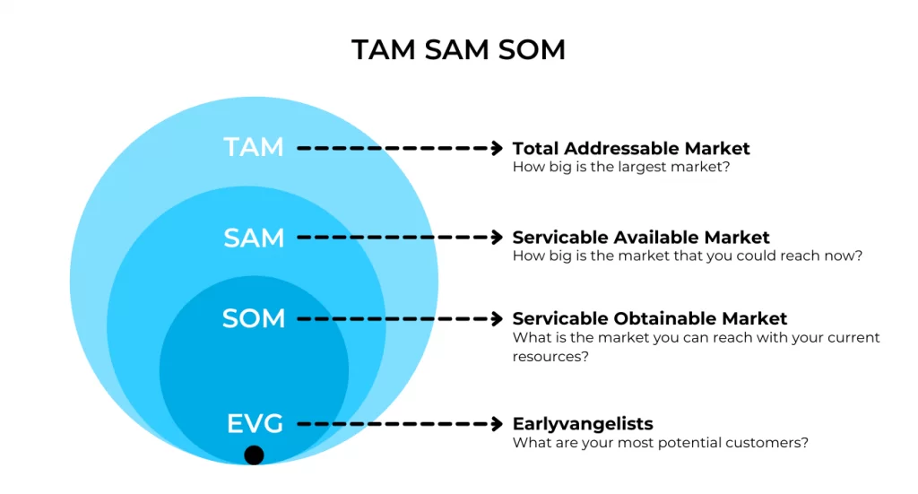
Project Sentinel - Week 6 Deliverables
Market analysis
HISS 2022/2023
TAM:
Global neurology device market for 2022: $12.4 USD billion
$1.06 USD billion annually for the EEG market
Ischaemic strokes:
  7.6 million new cases annually.
  77 million cases living with ischaemic stroke experience annually.
SAM:
50% of patients that were admitted for a stroke require extended hospital stay (more than 2 days). ¼ of stroke admission cases are false alarms. ⅓ of confirmed cases are mild, and do not require extended stay.
Approximately 5 million ischaemic stroke cases annually require extended stay.
SOM:
Approximately 20 000 people annually for the Australian market.

Slide 7
Project Sentinel - Week 6 Deliverables
Project Reflection
HISS 2022/2023
End of week reflections/highlights/learning points:
Importance of selecting the correct business model to ensure company longevity
Insight into economic factors affecting the development of a MedTech product
Final Questions:
Do we have to adhere to a singular business model throughout the entire product development process, or can the strategy be changed later on once the company grows in size, a larger customer base is acquired, etc.?

