Slide 1
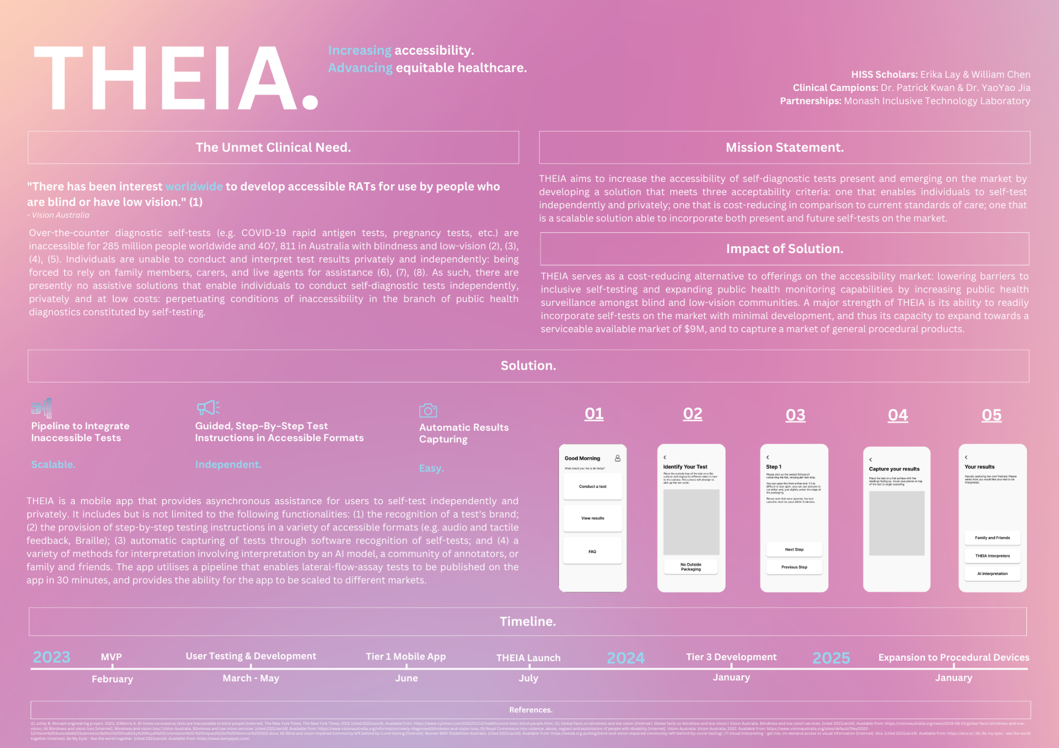
Notes:
https://www.canva.com/design/DAFaZszv--g/_vC-JAtFQZiVedGniG5FLA/view?utm_content=DAFaZszv--g&utm_campaign=designshare&utm_medium=link2&utm_source=sharebutton

